Slide 1
STRINGS
(IN JAVA)

Slide 2
Outline
What is String?
Different Methods to create Strings.
String Pool concept in Java
Some methods for String manipulation in java

Slide 3
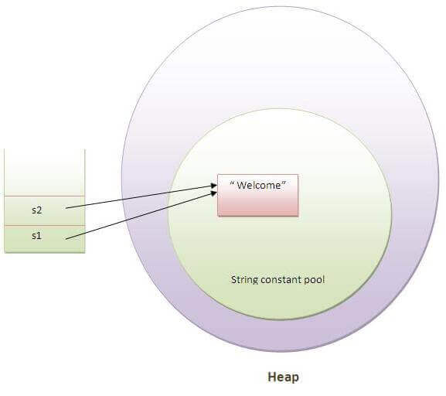
What is String?
String is basically an object that represents sequence of char values
But in Java String is an object that represents a sequence of characters.

Slide 4
Methods to create Strings
1. By string Literal
String s="welcome";
String s1="Welcome";
String s2="Welcome";
2 By new Keyword
String s=new String("Welcome");

Slide 5
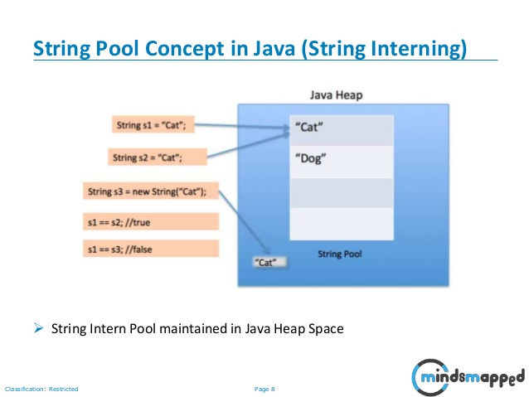
String pool concept in java

Slide 6
Some methods for String manipulation
Char charAt(int index)
Int length()
String Substring(int beginIndex)
String toUpperCase
String toLowerCase

Slide 7
THANK YOU

