Slide 1

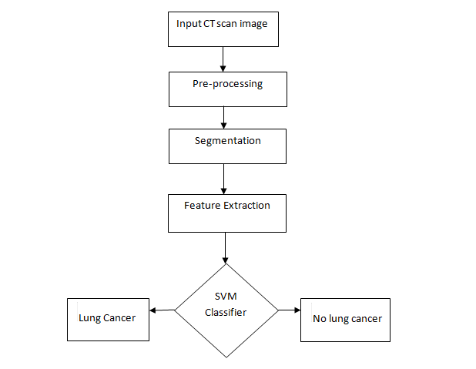

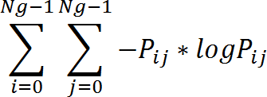
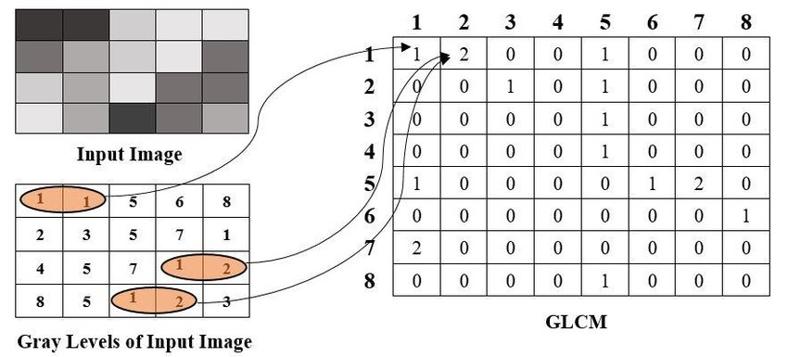
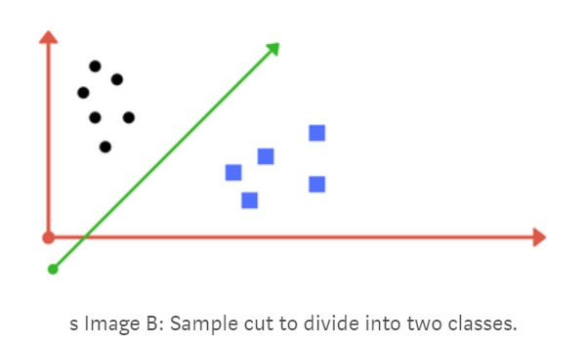
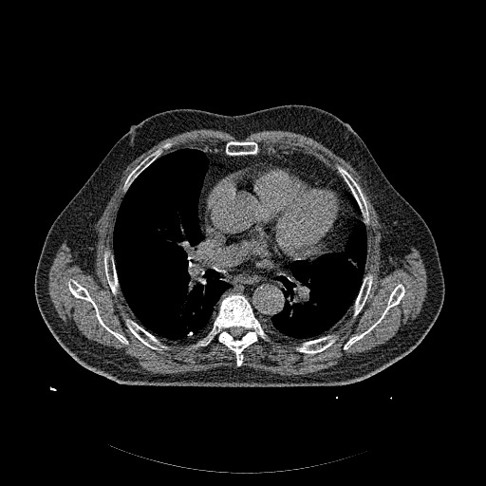

Lung Cancer Detection using Machine Learning
PROJECT GUIDE : Prof . K . S . Kadam
Problem Statement
System Architecture
GLCM Feature Extraction
Early detection of lung cancer using Image processing and Machine Learning.
ASM
Entropy
Overview
There are 2.5 million people who get diagnosed with lung cancer per year.
The disease has different stages whereby it starts from the small tissue and spreads across the lungs
More than 12,200 individuals had lung cancer in 2016-17.
Deaths from lung cancer in 2016-17 were 8839
Scope
Classifier
In this module we are performing early detection of lung cancer
The software is used as a classifier to improve accuracy and sensitivity of the system.
The classification is based on the texture features that are extracted from the input images.
Processing of Image
Input : DICOM image
Output: Segmented Image
Methodology
Application and Future Scope
Modules :
1. Pre – Processing
2. Segmentation
3. Feature Extraction
4. SVM classifier
We can use this to detect lung cancer at an early stage .
In future we can further modify it to detect the size of nodule causing cancer as well as classify cancer into stages.

