Slide 1




Accelerated Stochastic Gradient Descent
Prateek Jain
Microsoft Research, INDIA
Joint work with
Sham M. Kakade, Rahul Kidambi, Praneeth Netrapalli, Aaron Sidford
Univ. of Washington, Seattle
MSR India
Stanford
University

Slide 2



Overview
Question: can SGD be accelerated
Challenge: Acceleration is unstable wrt arbitrary noise in gradients [d’Aspremont 2008, Ghadimi & Lan 2010, Dieuleveut et al.2016]
Setting: linear regression in statistical setting

Slide 3



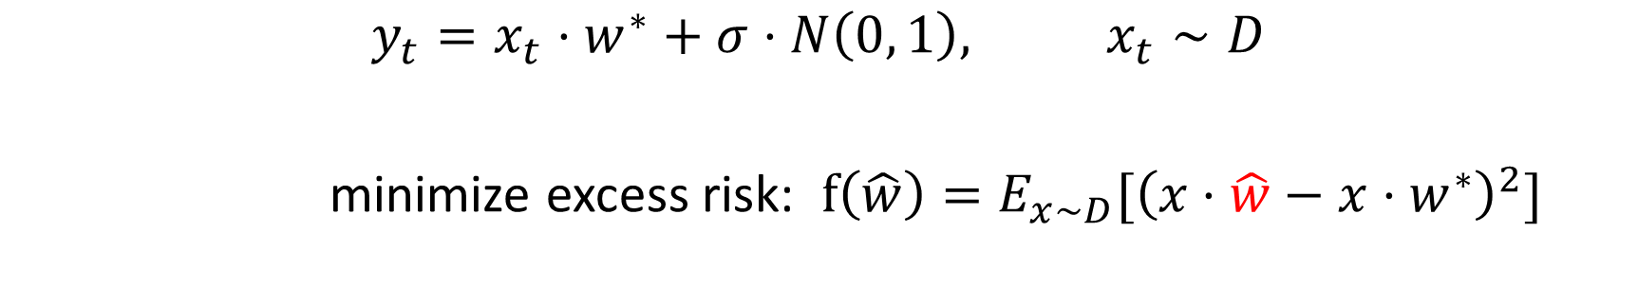




Setting
$$(x_{1},y_{1})$$
$$(x_{2},y_{2})$$
$$(x_{t},y_{t})$$
$$(x_{n},y_{n})$$
$$x_{t}$$
$$y_{t}=x_{t}⋅w^{∗}+σ⋅N\left(0, 1\right), x_{t}∼D$$
minimize excess risk: $f\left(\hat{w}\right)=E_{x∼D}[{\left(x⋅\hat{w}−x⋅w^{∗}\right)}^{2}]$
$$d$$
Consider special case: $y=x⋅w^{∗}$ i.e., no noise

Slide 4
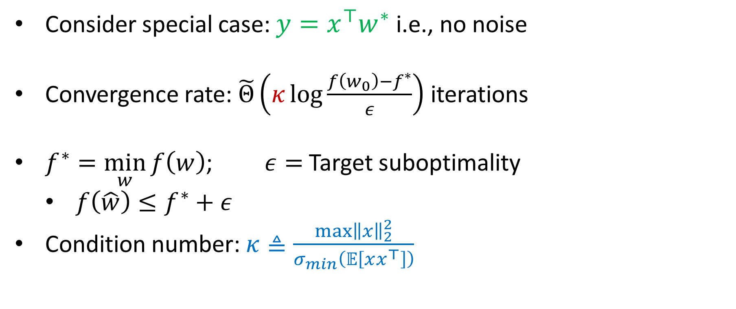
Convergence rate of SGD
Consider special case: $y=x^{⊤}w^{∗}$ i.e., no noise
Convergence rate: $\tilde{Θ}\left(κ\log{\frac{f\left(w_{0}\right)−f^{∗}}{ε}}\right)$ iterations
$f^{∗}=\min_{w}{f\left(w\right)}$; $ε=$ Target suboptimality
$f\left(\hat{w}\right)≤f^{∗}+ε$
Condition number: $κ≜\frac{\max{{\left\|x\right\|}_{2}^{2}}}{σ_{min}\left(𝔼\left[xx^{⊤}\right]\right)}$

Slide 5
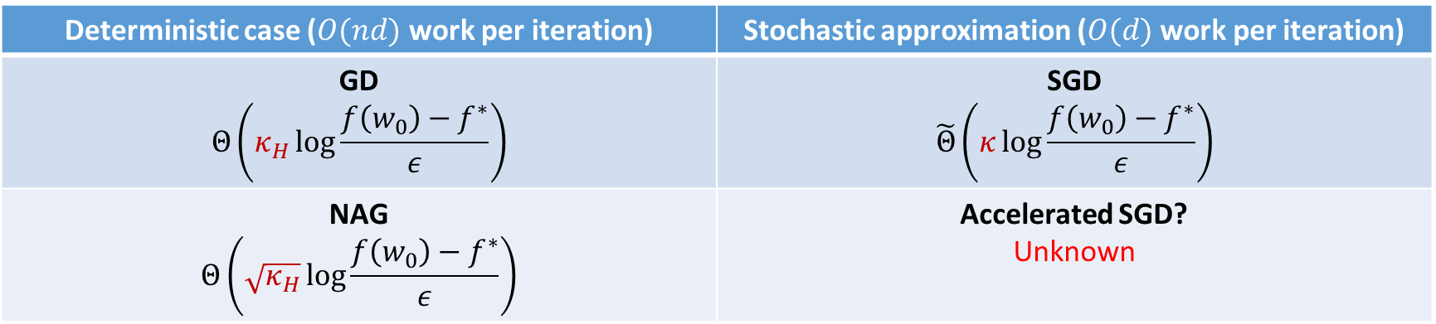

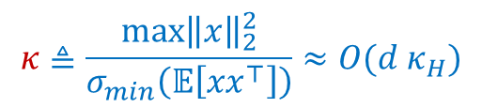
State of the art (# iterations)
$$κ≜\frac{\max{{\left\|x\right\|}_{2}^{2}}}{σ_{min}\left(𝔼\left[xx^{⊤}\right]\right)}≈O(d κ_{H})$$
Deterministic case ($O(nd)$ work per iteration) | Stochastic approximation ($O(d)$ work per iteration)
GD $$Θ\left(κ_{H}\log{\frac{f\left(w_{0}\right)−f^{∗}}{ε}}\right)$$ | SGD $$\tilde{Θ}\left(κ\log{\frac{f\left(w_{0}\right)−f^{∗}}{ε}}\right)$$
NAG $$Θ\left(\sqrt{κ_{H}}\log{\frac{f\left(w_{0}\right)−f^{∗}}{ε}}\right)$$ | Accelerated SGD? Unknown
$$κ_{H}≝\frac{σ_{max}\left(XX^{⊤}\right)}{σ_{min}\left(XX^{⊤}\right)}$$
Main question: Is accelerating SGD possible?
Extremely important in practice
As we saw, acceleration can really give orders of magnitude improvement
Almost all deep learning packages use SGD+momentum
Our earlier work shows acceleration leads to more parallelizability

Slide 6

Outline of our results
Is it always possible to improve $κ$ to $\sqrt{κ}$?
No

Slide 7
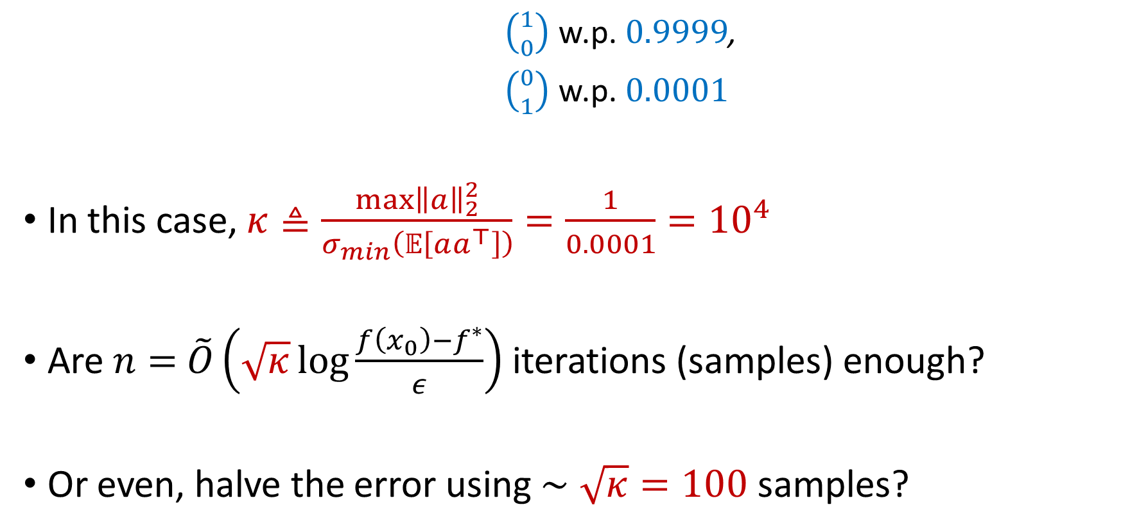
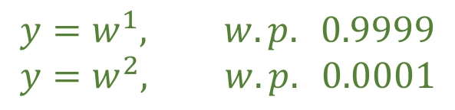


Example I: Discrete distribution
$$y=x^{1}w^{1}+x^{2}w^{2}$$
$\left({1 \atop 0}\right)$ w.p. $0.9999$,
$\left({0 \atop 1}\right)$ w.p. $0.0001$
In this case, $κ≜\frac{\max{{\left\|a\right\|}_{2}^{2}}}{σ_{min}\left(𝔼\left[aa^{⊤}\right]\right)}=\frac{1}{0.0001}={10}^{4}$
Are $n=$ $\tilde{O}\left(\sqrt{κ}\log{\frac{f\left(x_{0}\right)−f^{∗}}{ε}}\right)$ iterations (samples) enough?
Or even, halve the error using $∼\sqrt{κ}=100$ samples?
$$y=w^{1}, w.p. 0.9999 \\ y=w^{2}, w.p. 0.0001$$
$$x=$$

Slide 8

Outline of our results
Is it always possible to improve $κ$ to $\sqrt{κ}$?
No
Is improvement ever possible?
Perhaps, depends on other problem parameters

Slide 9
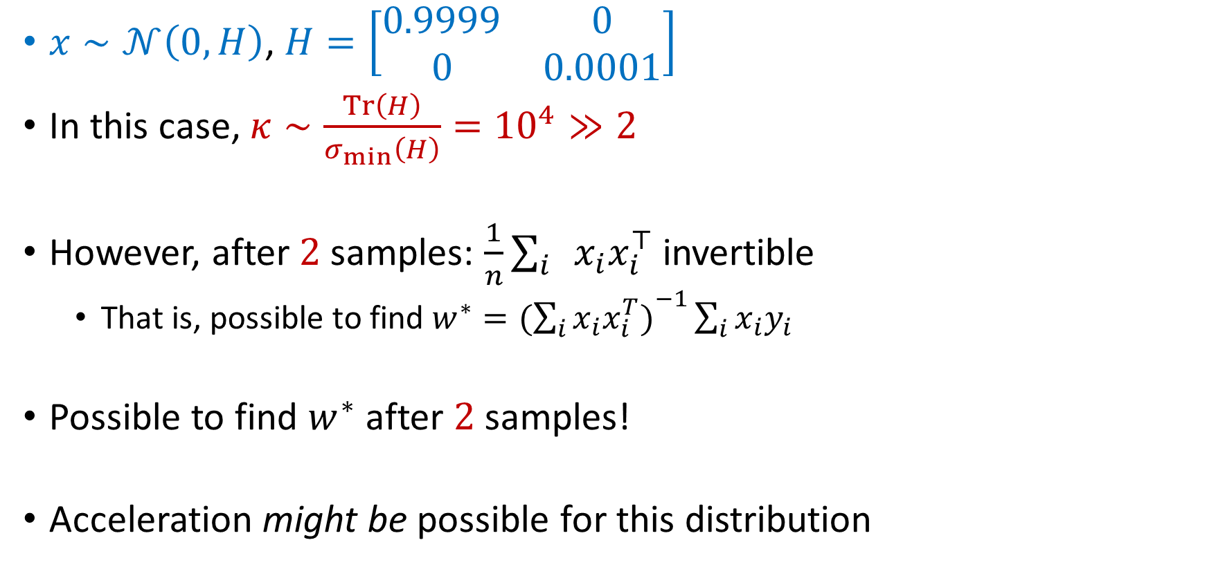
Example II: Gaussian
Question 2
Is acceleration ever possible?
Answer: Perhaps, but depends on other problem parameters
$x∼𝒩\left(0,H\right)$, $H=\left[\begin{matrix}0.9999 & 0 \\ 0 & 0.0001\end{matrix}\right]$
In this case, $κ∼\frac{Tr\left(H\right)}{σ_{min}\left(H\right)}={10}^{4}≫2$
However, after $2$ samples: $\frac{1}{n}\sum_{i}{x_{i}x_{i}^{⊤}}$ invertible
That is, possible to find $w^{∗}=({\sum_{i}{x_{i}x_{i}^{T})}}^{−1}\sum_{i}{x_{i}y_{i}}$
Possible to find $w^{∗}$ after $2$ samples!
Acceleration might be possible for this distribution

Slide 10

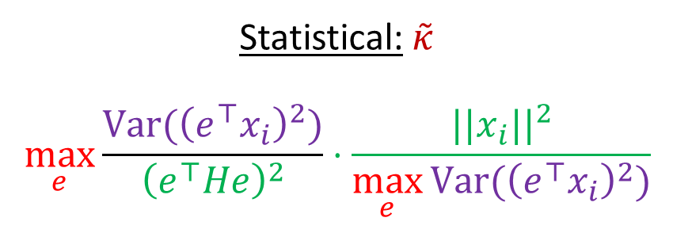

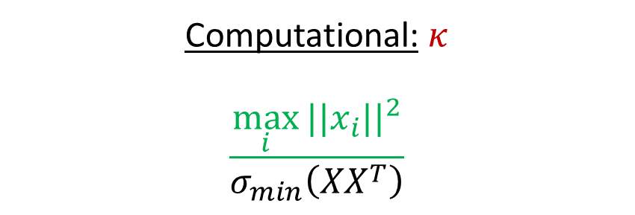




Discrete vs Gaussian
Statistical: $\tilde{κ}$
$$\max_{e}{\frac{Var({\left(e^{⊤}x_{i}\right)}^{2})}{{\left(e^{⊤}He\right)}^{2}}}⋅\frac{||x_{i}||^{2}}{\max_{e}{Var({\left(e^{⊤}x_{i}\right)}^{2})}}$$
Computational: $κ$
$$\frac{\max_{i}{||x_{i}||^{2}}}{σ_{min}\left(XX^{T}\right)}$$
$$≤$$
$$∼$$
Discrete
$${10}^{4}$$
$${10}^{4}$$
$$≪$$
Gaussian
$$2$$
$${10}^{4}$$

Slide 11
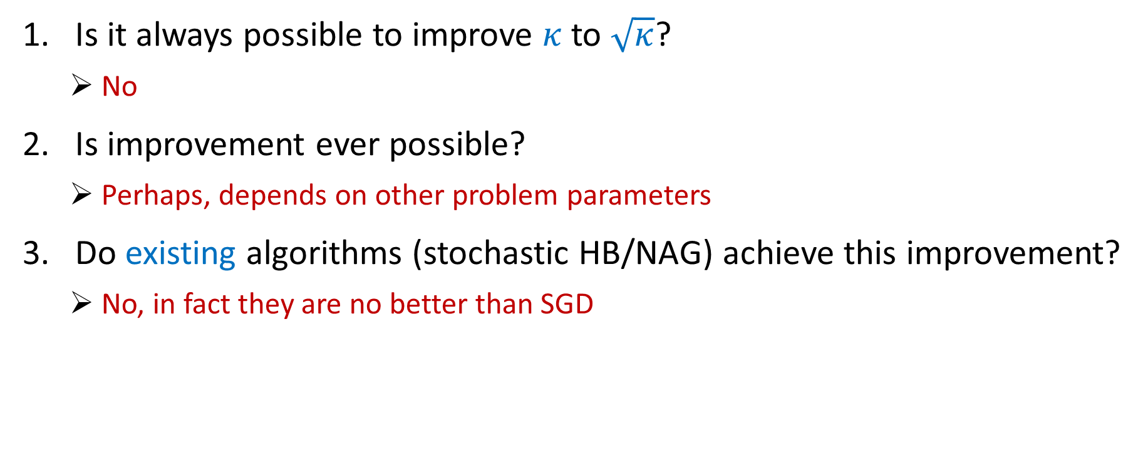
Outline of our results
Is it always possible to improve $κ$ to $\sqrt{κ}$?
No
Is improvement ever possible?
Perhaps, depends on other problem parameters
Do existing algorithms (stochastic HB/NAG) achieve this improvement?
No, in fact they are no better than SGD

Slide 12
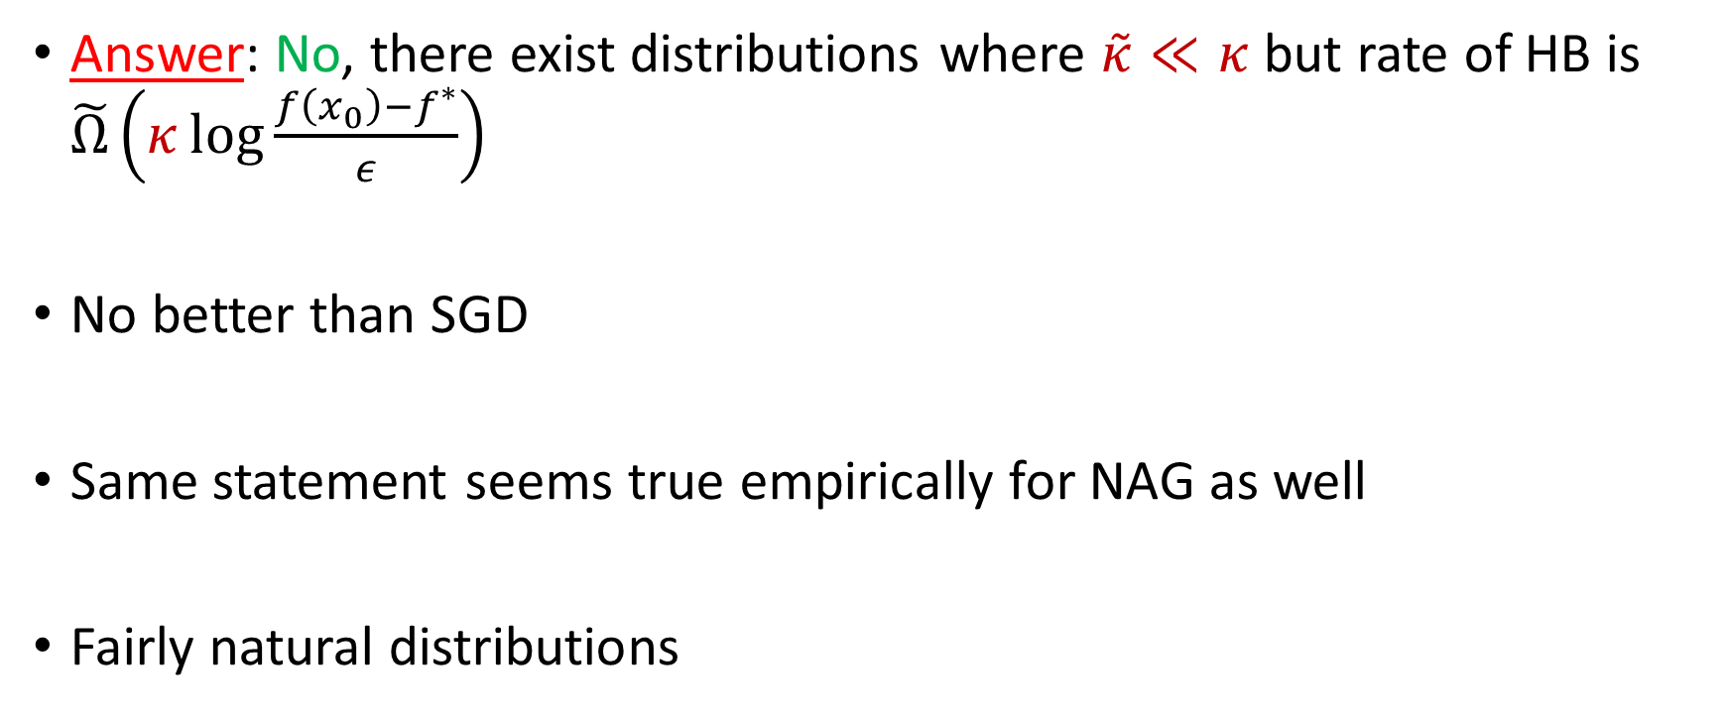
Question 3: Do existing algorithms stochastic HB/NAG achieve this improvement?
Answer: No, there exist distributions where $\tilde{κ}≪κ$ but rate of HB is $\tilde{Ω}\left(κ\log{\frac{f\left(x_{0}\right)−f^{∗}}{ε}}\right)$
No better than SGD
Same statement seems true empirically for NAG as well
Fairly natural distributions

Slide 13
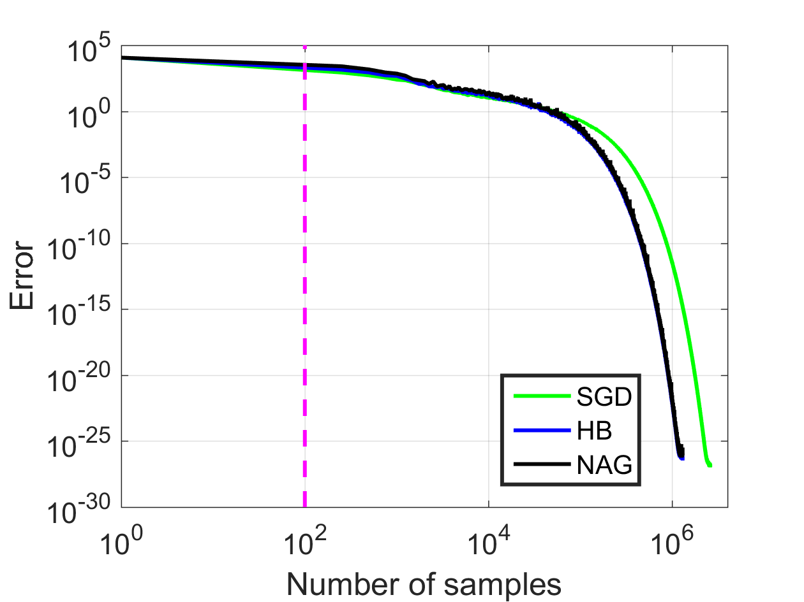
Empirical behavior of stochastic HB/NAG
Gaussian distribution

Slide 14

Outline of our results
Is it always possible to improve $κ$ to $\sqrt{κ}$?
No
Is improvement ever possible?
Perhaps, depends on other problem parameters
Do existing algorithms (stochastic HB/NAG) achieve this improvement?
No, in fact they are no better than SGD
Can we design an algorithm improving over SGD?
Yes, we design such an algorithm (ASGD)

Slide 15

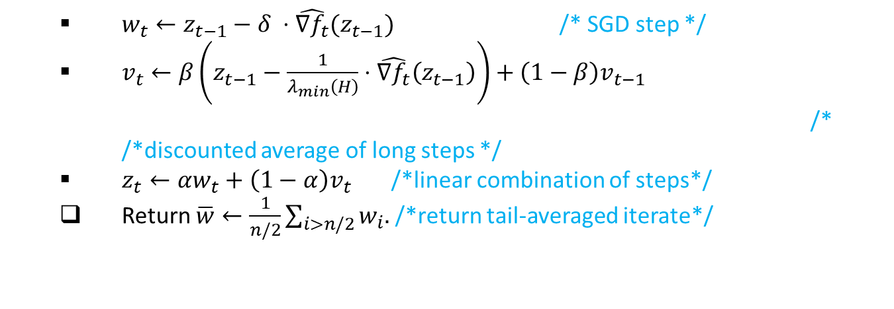
Question 4: Can we design an algorithm improving over SGD?
Yes!
Convergence rate of ASGD: $\tilde{O}\left(\sqrt{κ\tilde{κ}}\log{\frac{f\left(w_{0}\right)−f^{∗}}{ε}}\right)$
Compared to SGD: $\tilde{Θ}\left(κ\log{\frac{f\left(w_{0}\right)−f^{∗}}{ε}}\right)$
Improvement since $\tilde{κ}≤κ$
$w_{t}←z_{t−1}−δ ⋅\hat{{∇f}_{t}}(z_{t−1})$ /* SGD step */
$v_{t}←β\left(z_{t−1}−\frac{1}{λ_{min}\left(H\right)}⋅\hat{{∇f}_{t}}\left(z_{t−1}\right)\right)+\left(1−β\right)v_{t−1}$ /* /*discounted average of long steps */
$z_{t}←αw_{t}+\left(1−α\right)v_{t}$ /*linear combination of steps*/
Return $\overline{w}←\frac{1}{n/2}\sum_{i>n/2}{w_{i}.}$ /*return tail-averaged iterate*/

Slide 16
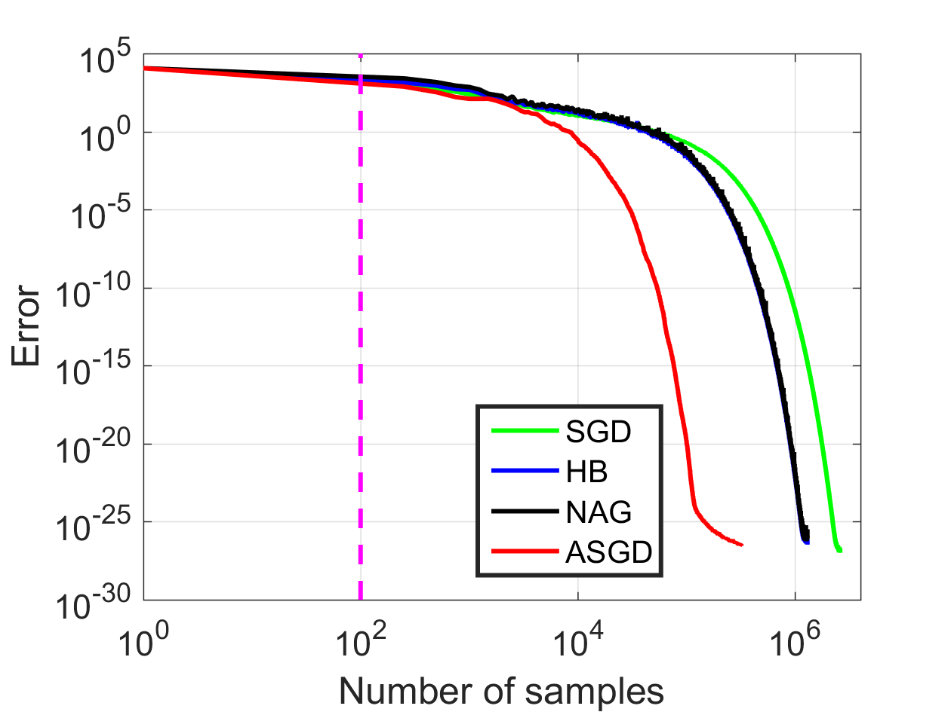
Simulations
Does not achieve lower bound $\tilde{κ}∼100$. We believe not possible.

Slide 17
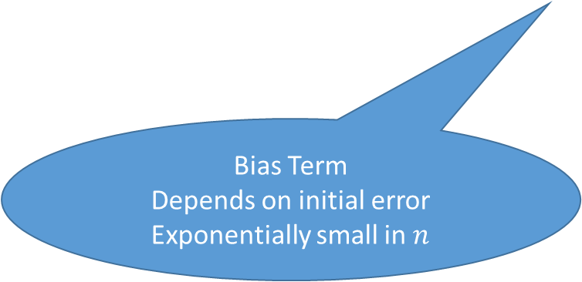

Result for a statistical setting
$y=x^{⊤}w^{∗}+ζ, ζ∼σN(0, 1)$
After $n$ points, ASGD recovers $\hat{w}$ s.t.
$$f\left(\hat{w}\right)=E_{x∼D}\left[{\left(x⋅w^{∗}−x⋅\hat{w}\right)}^{2}\right]≤\exp\left(−\frac{n}{\sqrt{κ\tilde{κ}}}\right)f\left(w_{0}\right) + \frac{σ^{2}d}{n}$$
Bias Term
Depends on initial error
Exponentially small in $n$
Variance Term
Optimal information theoretically

Slide 18
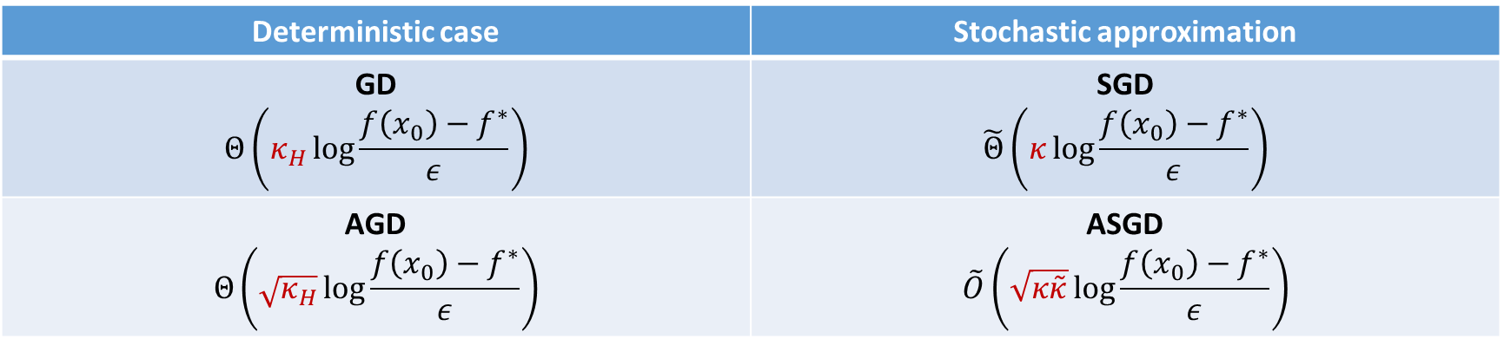
Recap
Deterministic case | Stochastic approximation
GD $$Θ\left(κ_{H}\log{\frac{f\left(x_{0}\right)−f^{∗}}{ε}}\right)$$ | SGD $$\tilde{Θ}\left(κ\log{\frac{f\left(x_{0}\right)−f^{∗}}{ε}}\right)$$
AGD $$Θ\left(\sqrt{κ_{H}}\log{\frac{f\left(x_{0}\right)−f^{∗}}{ε}}\right)$$ | ASGD $$\tilde{O}\left(\sqrt{κ\tilde{κ}}\log{\frac{f\left(x_{0}\right)−f^{∗}}{ε}}\right)$$
Stochastic HB/NAG do not accelerate in stochastic setting
ASGD – acceleration possible in the stochastic setting
Theoretical results for linear regression
Works well for training neural nets (even for small batchsizes)

Slide 19
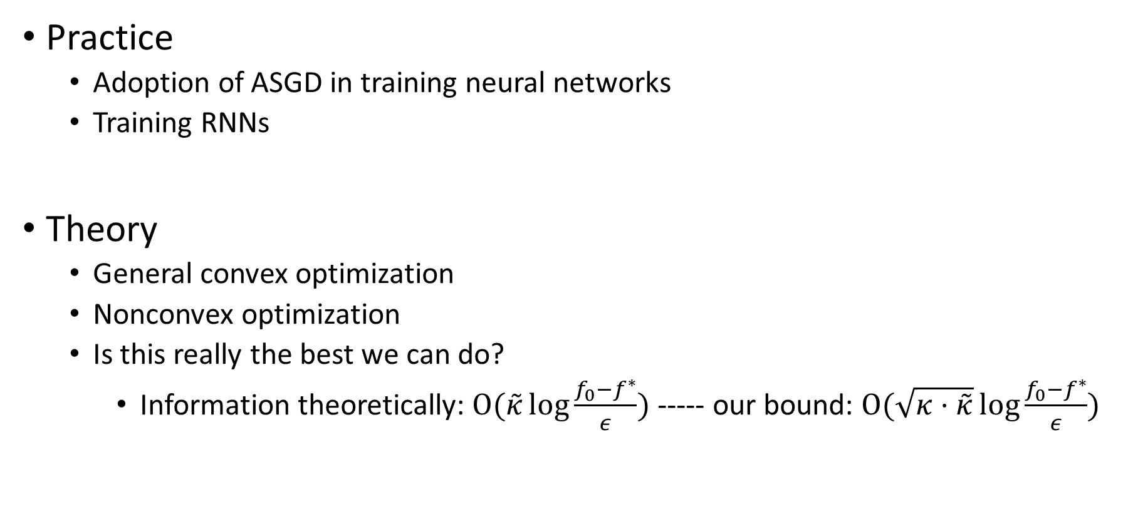
Going forward
Practice
Adoption of ASGD in training neural networks
Training RNNs
Theory
General convex optimization
Nonconvex optimization
Is this really the best we can do?
Information theoretically: $O(\tilde{κ}\log{\frac{f_{0}−f^{∗}}{ε}})$ ----- our bound: $O(\sqrt{κ⋅\tilde{κ}}\log{\frac{f_{0}−f^{∗}}{ε}})$

Slide 20
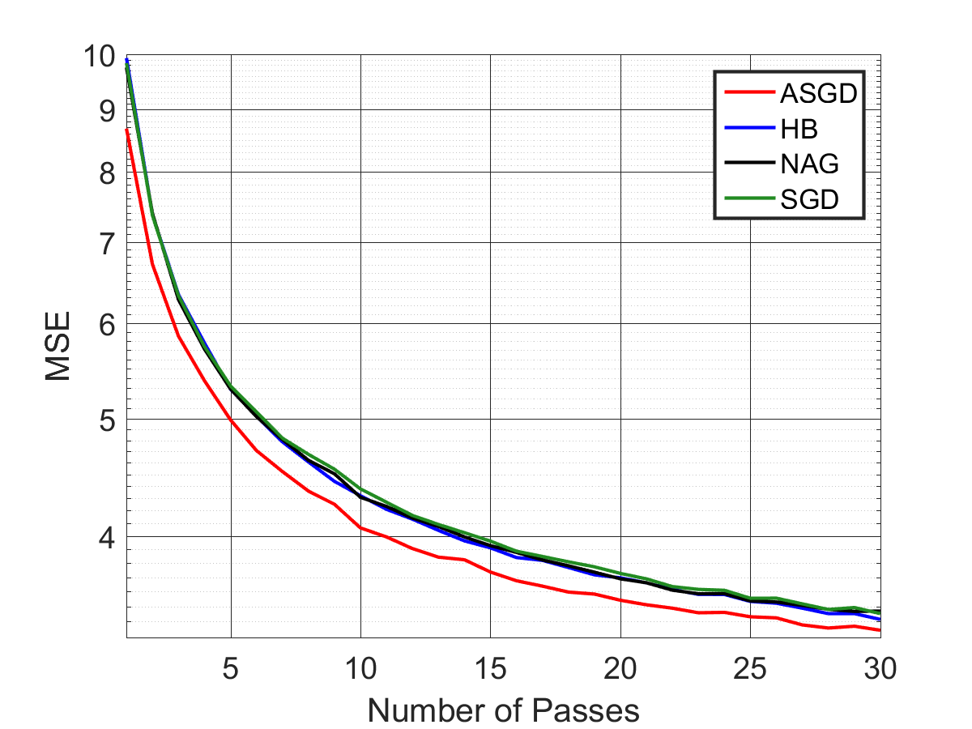
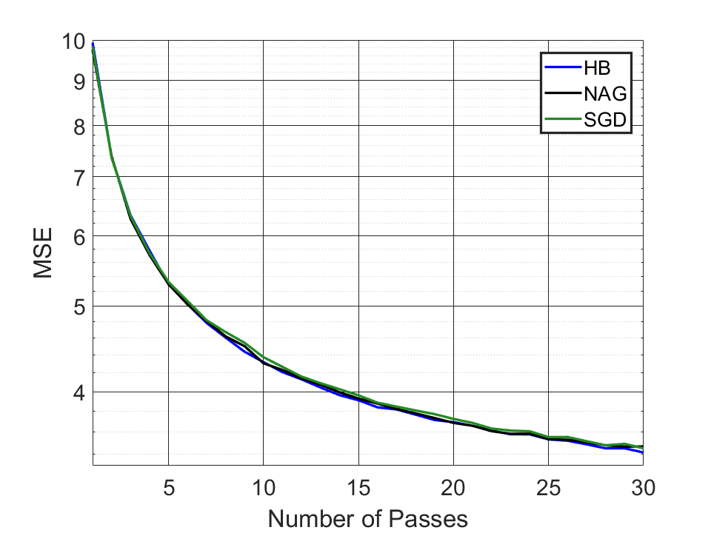
Deep autoencoder for mnist, small batch size (1)
ASGD (our algorithm) vs others

