Slide 1

Kriti ElectroVate Da Vinci Cup
Team Umiam
Abhishek Anand| Rahul Kumar | Shashank Oberoi | Yash Khatri

Slide 2



Le Air Braille
Problem statement
Statement ID: E101
Statement:Design a prototype of a device that can help to assist disabled peoplein fields as diverse as education,the home,leisure,transport and work.
Problem Description
We aimed to resolve the problem of inexistence of affordable Braille script writers.
Thus,we made a prototype of a portable electronic braille script typing interface named “Eazy Type”.

Slide 3


Objective and Motivation
Help Visually challenged
Improve their daily life quality.
To boost educational prospects.
Making them aware of the growing technology.
Provide assistance in other diverse fields of life.
To make them self-reliant.
Motivation
A disability isolates a person from its other normal peers.So,we thought that use of modern technology can help them overcome the barrier of social disparity.Moreover,reading and writing is a powerful weapon to express one’s emotions,so we chose to develop a prototype of a device that types in a script specially designed for them-’Braille’.

Slide 4
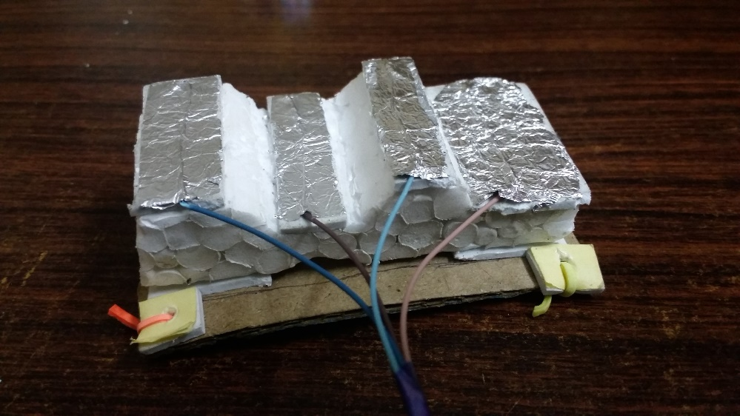
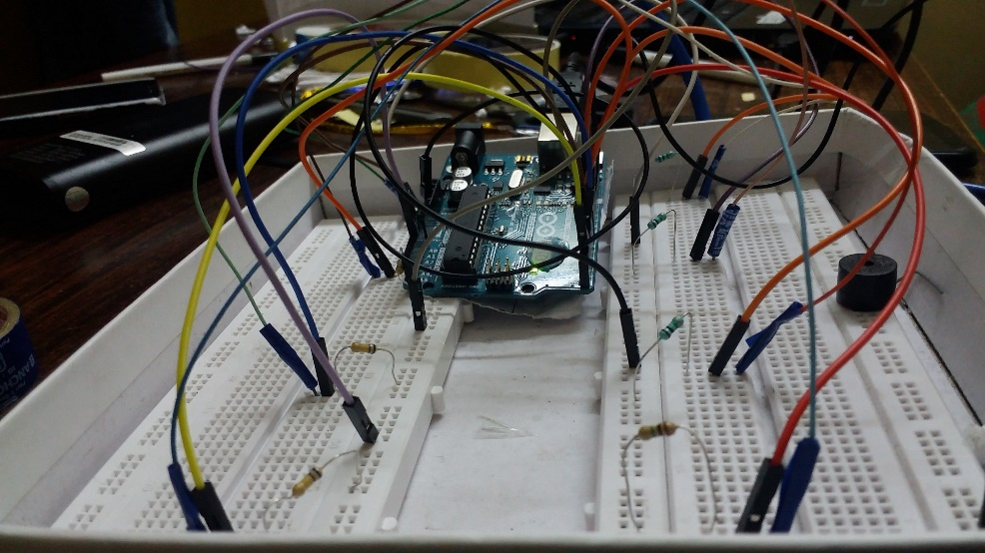
About the prototype-Eazy Type
General Description
Prototype is basically a typing device that produces output in Braille script.
It takes input by touch on capacitor sensor.
Micro-controller used in this device is Arduino ATmega328P.
Capacitive Sensor
Connecting wires
Arduino
Resistors
Breadboard

Slide 5
Working Principles of Eazy Type
Data Input by touch on capacitive sensor
Processing of input data by arduino micro-controller
Displays corresponding alpha-numeric character
Extraction and conversion of these characters to standard Braille by MATLAB

Slide 6
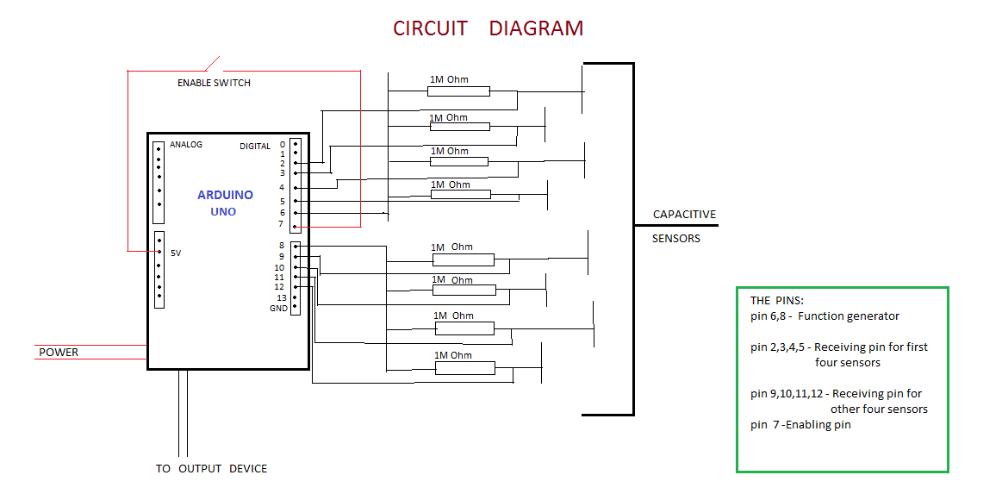
Circuit Analysis
Analysis
Pins 2,34,5,9,10,11,12 are connected to capacitive sensors.
The Arduino receives a signal if the sensors are touched.
Based on touch patterns Arduino decodes the signal and maps it to corresponding asci code and transfers to display device configured.
Then,using MATLAB the character received is converted to Braille Image.

Slide 7
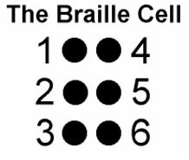
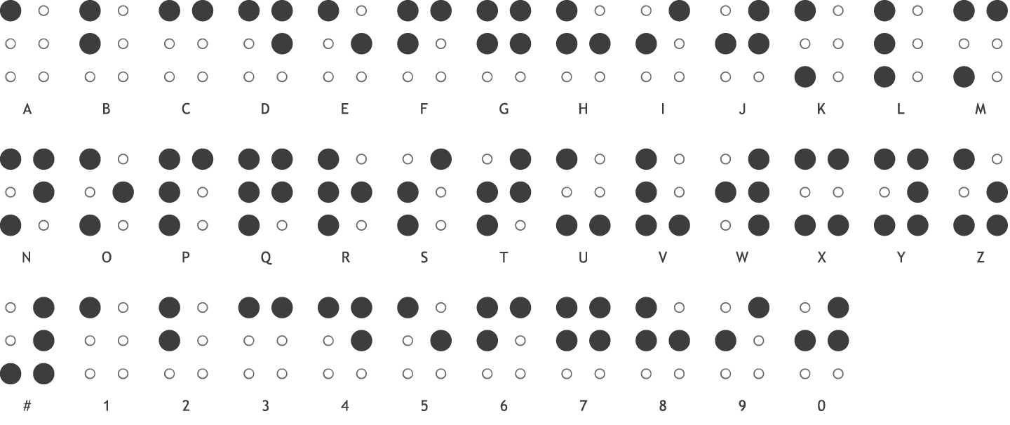
Braille Script
A dark dot in braille cell corresponds to a touch by corresponding finger on capacitive sensor.

Slide 8
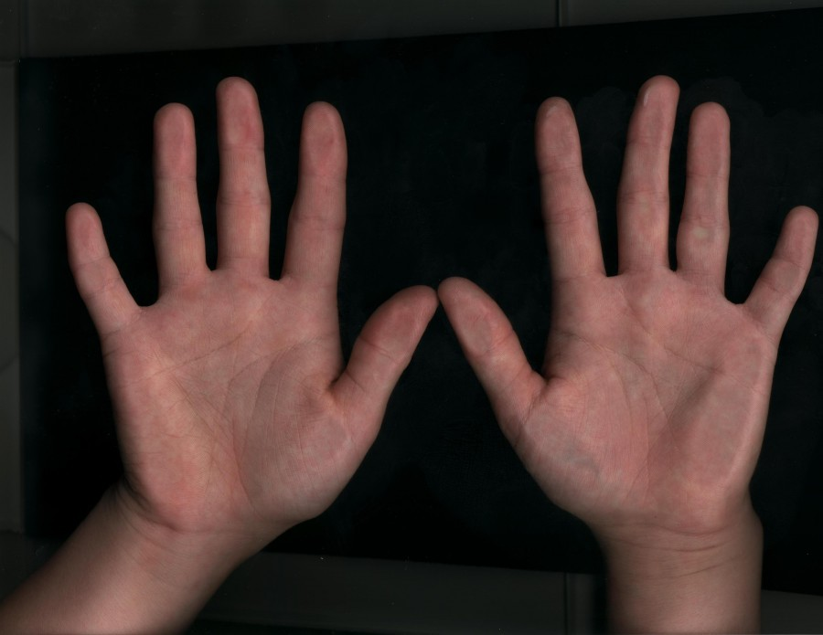
Braille Characters-Input Correspondence
1 | 4
2 | 5
3 | 6
The Braille Cell
Right Hand

Slide 9
Necessity
1-educated;2-uneducated
Necessity
India being home to maximum no. of blinds in world,it is very important to increase their literacy rate for country’s development.
It will increase employment opportunities for the challenged ones.
First-hand experience of growing technology.

Slide 10
Feasibility and Necessity
Easy Implementation
Edge over other products
Components used in the prototype are very usual ones like Arduino is one of the most commonly used micro-controller and capacitive sensors are also used widely nowadays,thus rejecting the scenario of unavailability of components.
Moreover,the correspondence between Braille cell and finger touch is very easy to learn for any person.
adaf

Slide 11
THANK YOU!

Slide 12
QUESTIONS?

Slide 13



Prioritization of Issues
Time frame available for decision
Financial Impact
Strategic factors
Priority order
Re-commissioned drama series
Peak Entertainment period ahead
(Olympics 2016)
#1
1-2 months
Evaluated Loss: 25,000 INR
#2
Fire Accident
3-4 days
Loss of equipment
Product unavailability at peak season
#3
Corporate Advertising Proposal
Potential Profits (per ad): 32,264 INR (5-year)
1-2 weeks
Need for diversification

Slide 14


Evaluation of Options
Scenario I: Re-commissioned drama series
Option 1: SET’s proposal
Option 2:
Option 3:
RFP’s total revenue(Drama-FY 2015)
50,00,000 INR
10%
>5%
SET is paying at reduced level
Margin is secured
Accept offer
Cost savings are ensured
Utilise the savings to develop more creative content
Still making operating profits
5% of profits - DRAMA
Total Operational Profits
2,50,000 INR

Slide 15
Evaluation of Options
Scenario I: Re-commissioned drama series
Option 1: SET’s proposal
Option 2:
Negotiations with SET
Option 3:
Increased fee for re-commissioned programme to pay compensation
Celebrity element associated with Vijender Singh
Increased viewership
Huge fan-following
Compensation to GGG to loop in the leading actor
Time availability to approve the contract

Slide 16
Analysis
Scenario I: Re-commissioned drama series
Option 1: SET’s proposal
Option 2:
Option 3:
76%
24%
21,789
6,821
39% overall growth in revenue
Drama series contribute 85% of the growth
20,620
9% decrease in operational profits
Operating margins maintained at 5%
FY 2014
Source: Ref1, Ref2

Slide 17

Recommendation
Scenario I: Re-commissioned drama series
Option 1: SET’s proposal
Option 2:
Option 3:
Compensation Model
Ask SET to compensate to GGG
Enhanced viewership in upcoming Olympic season
Potential growth for marketing opportunities
Sports Icon will increase the brand value
Proposal to RFP
10% reduced fee is enough to generate operating profits
Savings from compensation can be utilized for better content development
International Sales can expect a boost

Slide 18
Scenario II: Fire accident at studio
Summary
Situation
Fire mishap on set building location
Allegedly cause is lack of concentration & tiredness of workers
Constraints
Lack of flexibility for filming schedule
Mismanaged building of sets
Unavailability of set & lack of time to submit VT
Decision Guidelines
Quality Maintenance
Reputation
Ethical considerations
Optimal Recovery proposal
Case-I : Cash in hand
Internal cash management between production & finance departments
Lack of financial debts will lead to spending cash reserves
Case-II : Low Cash Reserves
Further delay on projects
Lesser funding due to loss of reputation in future
Dilution of Brand’s Image due to excess payments on operating profits
Quality Reduction

Slide 19
Recommendation
Scenario II: Fire accident at studio
How to avoid such mishaps in future?
Mitigation Strategies
Trained set builders to be hired
Vocational Trainings for handling such incidents
Regularly supervised set building
Regulated check in salary payment of set builders
Flexible scheduling to avoid long working hours & delays in projects

Slide 20
Evaluation of Idea
Scenario III: Corporate Advertisements
Market Analysis
Market Size
3,575
Growth Potential
2,750
2,260
Ease of Entry
1,750
1,140
+11.5%
(2014)
+10%
(2013)
43,065
(2014)
38,598
35,074
(2012)
37% of active internet users FMCG Ads
Total Adex (INR Crores)
Source: Ref5, Ref6

Slide 21
Evaluation of Idea
Scenario III: Corporate Advertisements
Market Analysis
Data Insights
Market Size
Tele-advertising in India
Growth Potential
Ease of Entry
5
8
16
Online media is potentially growing for specific content
5
2013
2018 (E)
4
42
34
40
40
Indian Tele-advertising is expected to grow at 16.2% CAGR for 2014-18
Source: Ref3

Slide 22




Evaluation of Idea
Scenario III: Corporate Advertisements
Market Analysis
Why YouTube?
Market Size
Mobile Usage
17 %
(on a daily basis)
27 %
(on weekly basis)
71 % active user’s first video destination
Growth Potential
Ease of Entry
CPV CPC
Models
DEMOGRAPHICS
CONTEXTUAL TARGETING
SIMILAR AUDIENCE
IN-MARKET
CUSTOM AFFINITY SEGMENTS
Youtube Targeting Possibilities

Slide 23
Financial analysis
Scenario III: Corporate Advertisements
Cost Analysis
Revenues & ROI
Worst Case Scenario Analysis
Average
17,000
-700
21,250
6,205
26,563
13,774
33,203
22,333
41,504
32,264
Higher Costs
17,000
-1,500
21,250
5,525
26,563
13,196
33,203
21,842
41,504
31,847
Cost (Skills) level
FY 2015
FY 2016
FY 2017
FY 2018
FY 2019
Revenue Profits
Revenue Profits
417 INR
Total profits (per ad):
1.29% decrease
(as compared to 5 year plan)
Source: Team analysis on case data

Slide 24
Summary
Scenario III: Corporate Advertisements
Revenue vs Cost-Distribution

Slide 25
Summary
Scenario III: Corporate Advertisements
Recommendation
Marketing Strategy for HUL
Reject proposal (as of 1 Nov 2012)
Launch Ads on YouTube as well
CSR Advertising will give sudden boost to the companies noble policies & strategies
Product Line Specific online events can be channelized via Facebook & YouTube
Better controlled consumer insights through the applications of Big-Data in Marketing & Consumer Analytics
Note 1 & Note 2
Sustained Profit Growths
Only 1.29% decrease in profits
RFP should hire more talented actors
Why expand to newer domain?
Highly profitable future returns
Negligible losses in comparison to operating profits

Slide 26

Kriti Case Study
Team Umiam
Questions?

Slide 27
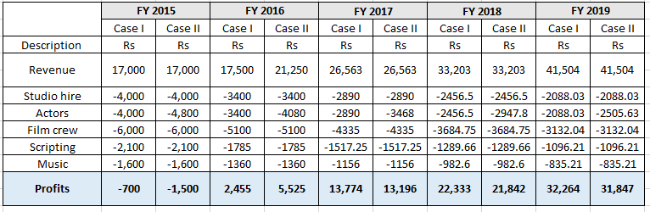
Appendix I

Slide 28
Appendix II
References
Ref1: http://www.afaqs.com/news/story/41820_Online-Ad-Spends-in-India-to-touch-Rs-3575-crore-by-March-2015
Ref2: http://www.on-click.es/limitless/why-flipkart-is-likely-to-succeed-with-its-upcoming-app-only-avatar/
Ref3: http://www.digitalstrategyconsulting.com/india/
Ref4: https://webrepublic.com/en/blog/2015/2/16/infographic-everything-about-youtube-marketing/
Ref5: ➢ http://www.medianama.com/2015/02/223-advertising-in-india/
Ref6: http://www.ambientinsight.com/Resources/Documents/AmbientInsight_SeriousPlay2014_WW_2013_2018_GameBasedLearning_Market.pdf

