Slide 1
Automobile Engine Test Results
Presented By:
Kobbajigari Rahul- 1583

Slide 2
Agenda
Problem Statement
Domain Understanding
Data Understanding
Data Analysis
Data Preprocessing
Data Visualizations
Model Building
Conclusion
Summary

Slide 3
PROBLEM DESCRIPTION
Purpose:-
A leading car manufacturer is designing an automobile engine
Before the production starts they have conducted engine bench test for the extremely accurate results.
Company management has decide to use some previous data on various configurations tested and determine through analytics model if their new design will pass or not.
Every engine has a unique ID where it is taken as primary data.
02

Slide 4
DOMAIN UNDERSTANDING
Aim:-
Car manufacturer has deicide to perform engine bench test on there new designing an automobile engine
Each bench test is expensive, Noise and Time consuming process, To reduce the revenue cost for manufacturer company has decide to use some previous data on various configurations tested and determine through analytics model if their new design will pass or not.
This will help the manufacturer company to reduce down only few configurations for further testing on physical bench test.
Test- A and Test- B are different type of test performed on pervious engine test results.
02

Slide 5
PROJECT WORKFLOW
Write your relevant text here
Problem description
domain understand
Pre-processing
Data Visualisation
Optimisation
Model Building
Features remover
Dealing With N/a’s
26

Slide 6
VARIABLE IDENTIFICATION
Predictor Variables
Total number of attributes are 23 with 1 numerical attributes and rest all are categorial
Target Variable
There is one class attribute about test, “Y” is results of various test results
06

Slide 7
Categorical Attributes
List:-
Material grade
Lubrication
Valve type
Bearing Vendor
Fuel Type
Compression ratio
Cam arrangement
Cylinder arrangement
Turbocharger
Varaible valve timing
11.Cylinder deactivation
12. Direct injection
13. Main bearing type
14. Displacement
15. Piston type
16. Max.torque
17. Peak power
18. Crankshaft Design
19.Linear Design.
02

Slide 8
“Y”- Target variable
Fail | 48.41%
Pass | 51.58%

Slide 9
Preprocessing and Variable Transformation:
Dealing With Missing Values
knn Imputation.
Missing values are Equally distributed among all variables in train and test.
Each row doesn’t contain more 2 NA’s
Merged the Test A and Test B columns to the main train and test data and created new column TestAB .
Removed variables using Chi-square value which are not influencing target variable(Y)

Slide 10
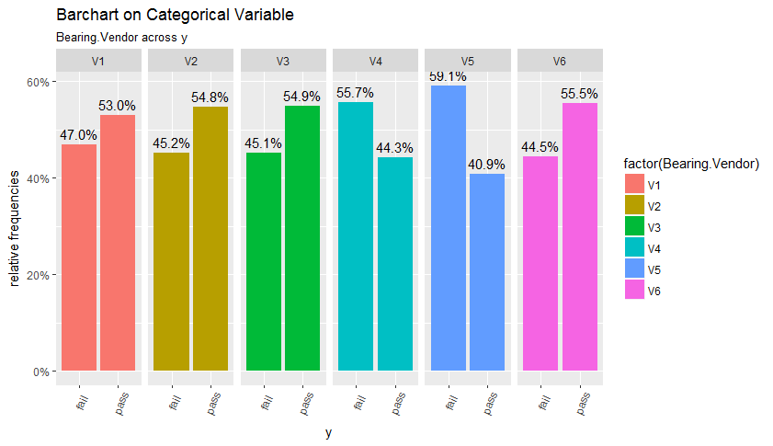

Slide 11
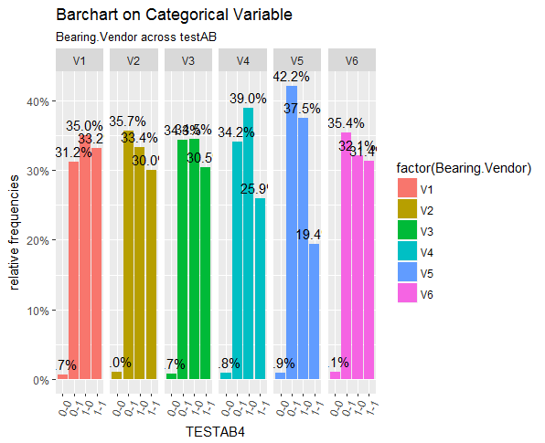

Slide 12
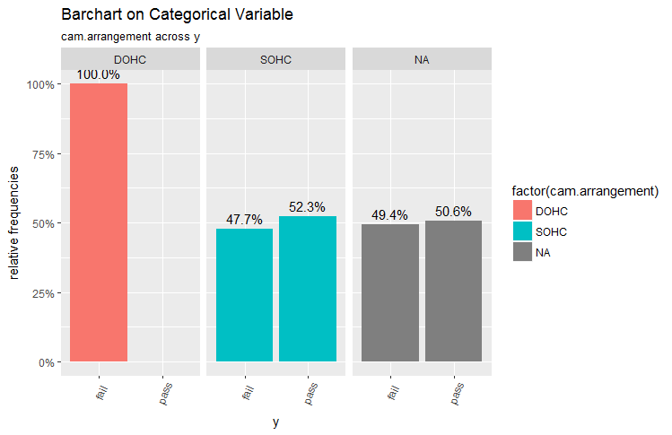

Slide 13
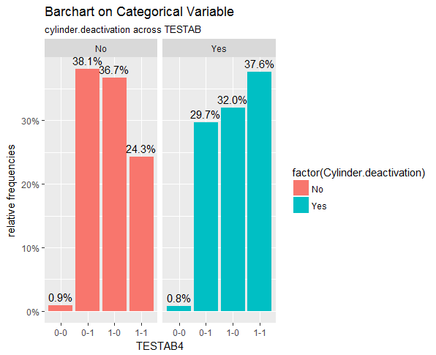

Slide 14
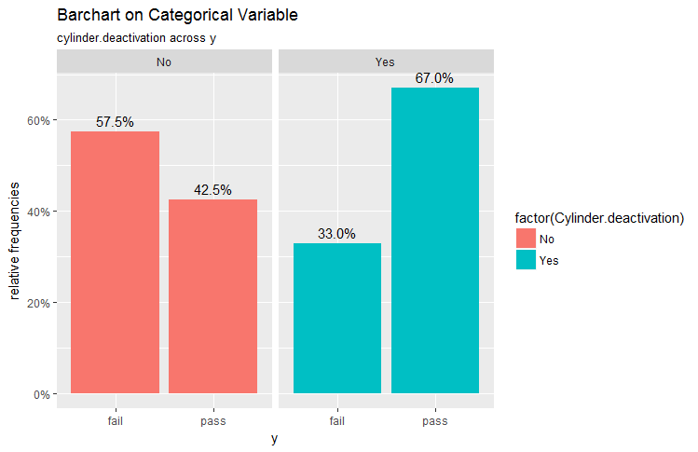

Slide 16
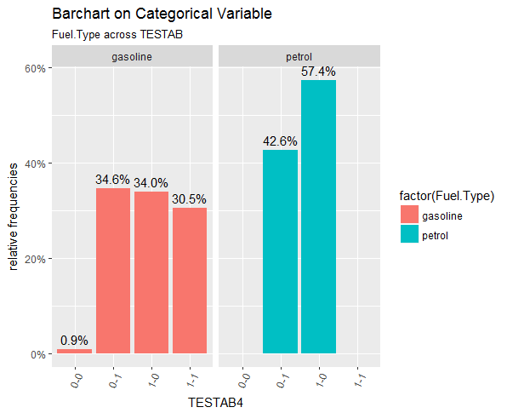

Slide 17
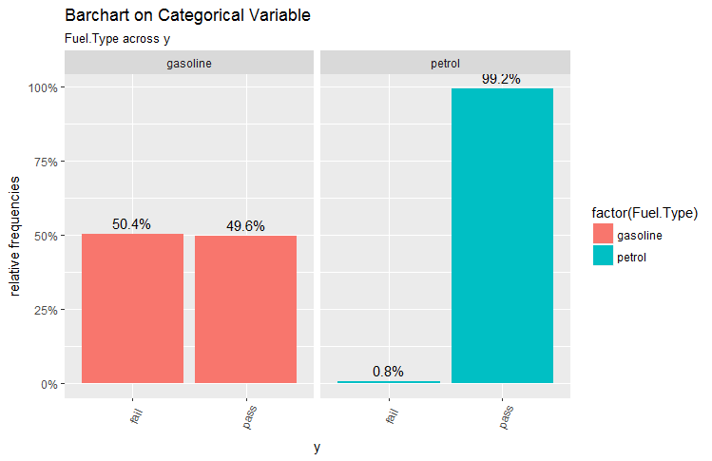

Slide 18
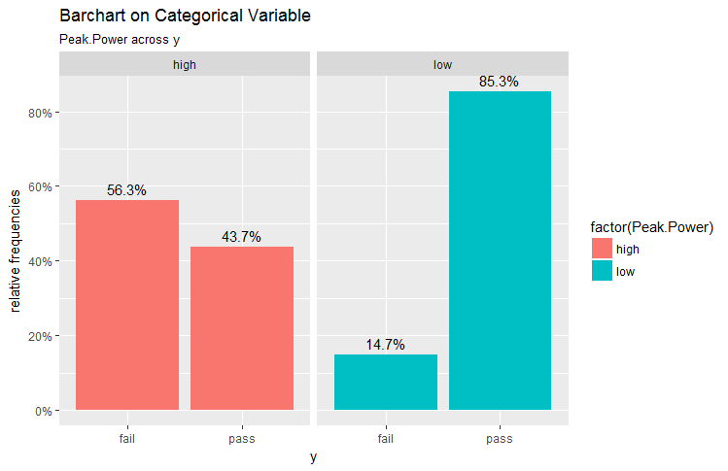

Slide 19
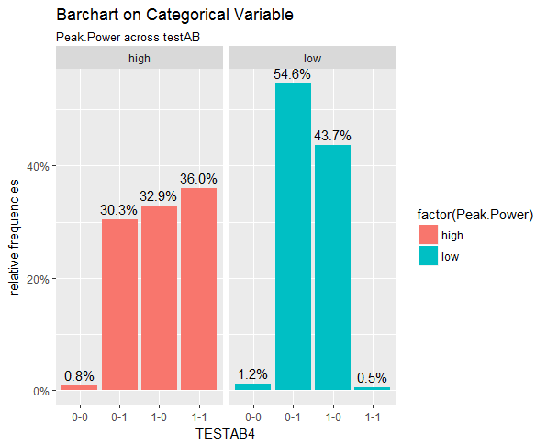

Slide 20
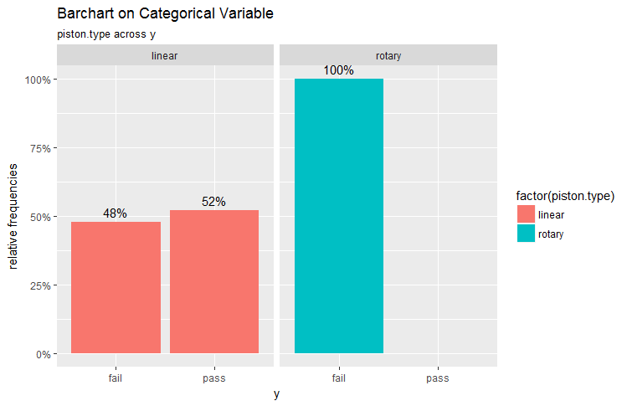

Slide 21
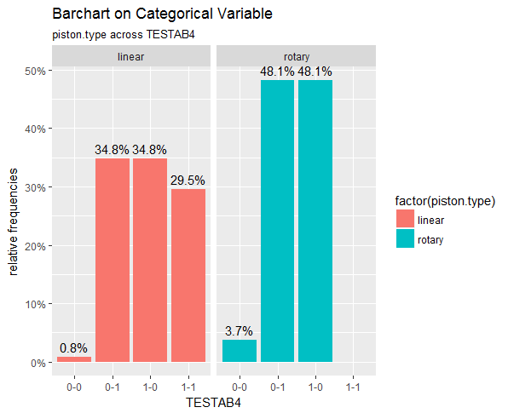

Slide 22
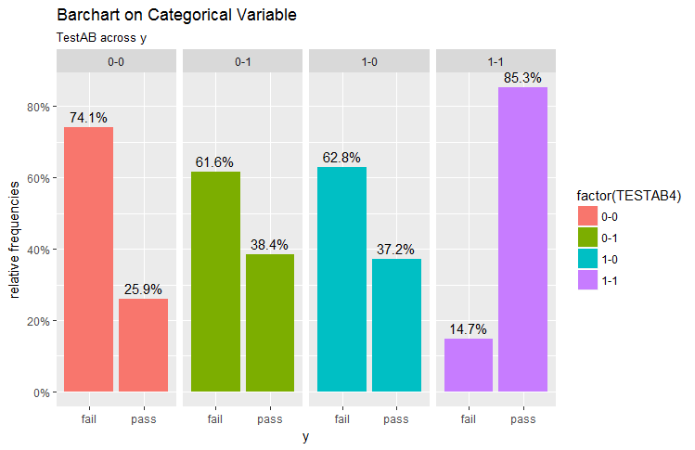

Slide 23
List of Machine Learning Algorithms
Logistic
Regression
Random
Forest
C 5.0
SVM
XG-Boost
R-part
20

Slide 24
Model Improvement
Random forest using cross validation
R- Part
Applied Turng parameters
MONDAY
Tuesday
Wedsday
Feature Selection
Data visualisation
Thursday
Friday
02

Slide 25
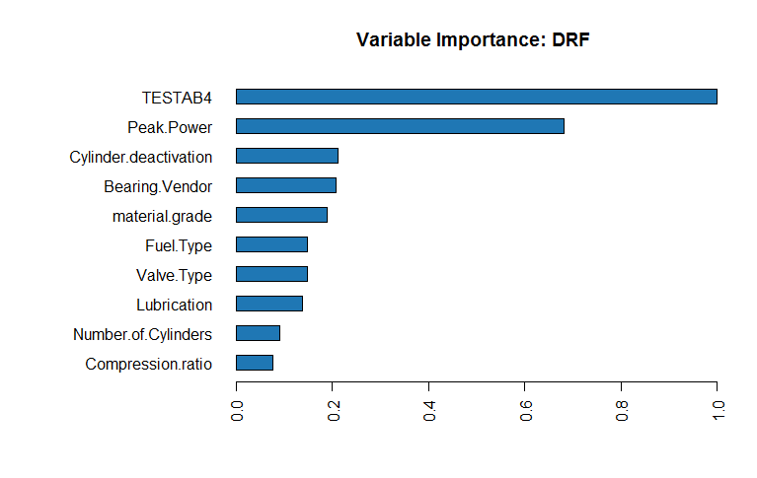

Slide 26
Training models with cross validation
10 fold cross validation with tunelength of 3 gave following results.
Models: GLM, CART, GBM, RF, XGB, svm
Number of resamples: 30
Accuracy table
Min. 1st Qu. Median Mean 3rd Qu. Max.
GLM 0.8222222 0.8615506 0.8734177 0.8689289 0.8829114 0.9047619
CART 0.7594937 0.8164557 0.8401899 0.8395581 0.8691531 0.8860759
GBM 0.8253968 0.8612191 0.8734177 0.8697731 0.8829114 0.9047619
RF 0.8222222 0.8520570 0.8686709 0.8633338 0.8757911 0.8920635
XGB 0.8227848 0.8582756 0.8734177 0.8691402 0.8847406 0.9047619
svm 0.8227848 0.8615506 0.8734177 0.8694574 0.8829114 0.9047619

Slide 27
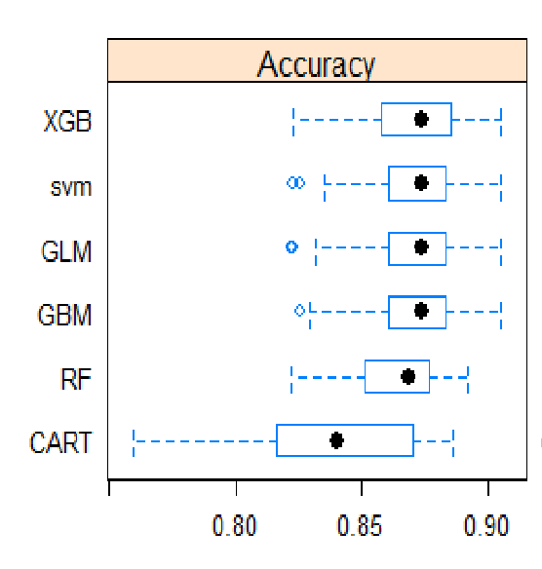

Slide 28
Models | Accuracy(train) | Accuracy(test)
Logistic regression | 86.9 | 87
Random Forest | 86.77 | 87
Rpart | 86.33 | 87
SVM | 86.69 | 87
XGBoost | 86.34 | 86

