Slide 1
Xplore Group
Group 5

Slide 2

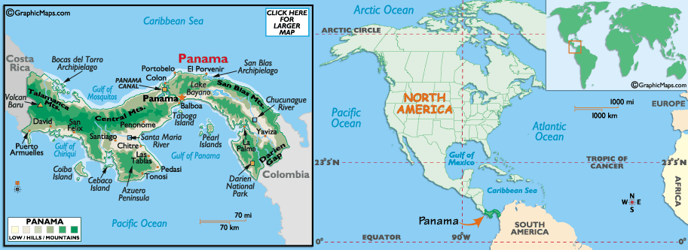
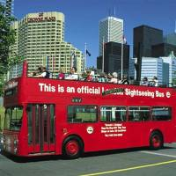
The Company
Mission:
Creating a truly memorable experience for visitors exploring a new destination.
Concept:
First venture is Xplore Panama offering convenient, scenic, bus routes for tourists that wish to explore Panama at their own schedule.

Slide 3
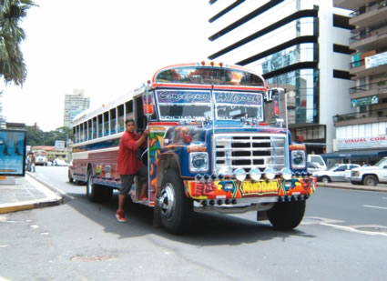
Problem & Need
Public transportation suffers from poor customer service and security.
Guided tours in Panama are expensive and inflexible.
Tourists are required to know where they want to go or must follow a pre-determined schedule.
Notes:
http://www.transitionsabroad.com/publications/magazine/0505/bus_in_panama.jpg

Slide 4
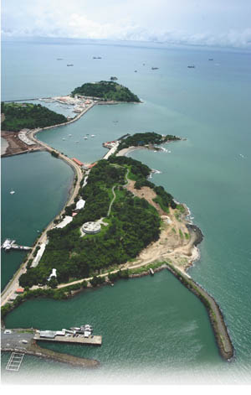
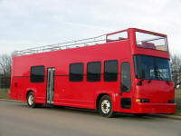
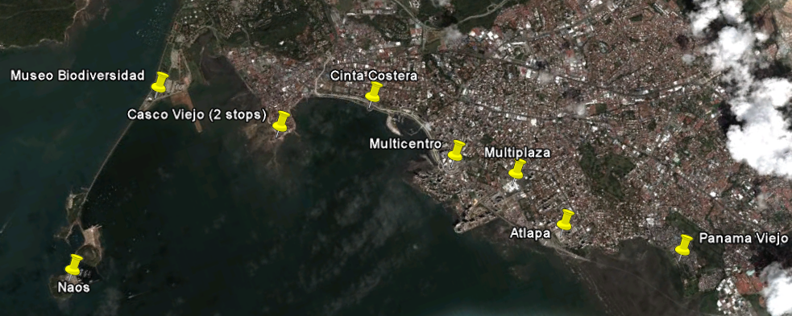
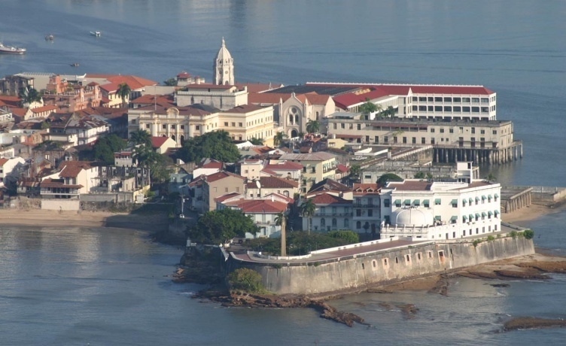
The Service
3 Double Decker Buses
9 Stops
2-Hour Route
Audio Tour
in 11 Languages

Slide 5
The Market
Panama is the fastest growing tourism market in Latin America.
Tourists contributed over $1.3 billion to Panamanian economy during 2009.
Recreational Visitors
Cruise Ship Tourists
Business Visitors
Tourists Visiting Family
and Friends
Notes:
Panama is one the fastest growing tourism markets in Latin America. With over 1.3 million visitors contributing over 1.3 billion dollars in 2009, the Panamanian government has made great strides to not only embrace the tourism market, but help assist future growth for the market.
The world travel and tourism council expects the Panama tourism market to increase by nearly 5.1% every year. This growth has allowed the Panamanian Institute of Tourism to invest 92.5 million dollars just in 2008 to help make the country, tourist friendly. This has included the addition of tourism signs, information kiosks and tourist centers throughout the country to help guide tourists.
I will now turn it over to Roy who will talk about the competition expected in Panama.

Slide 6

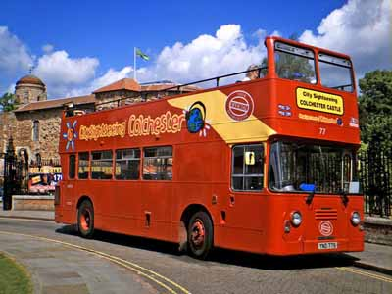

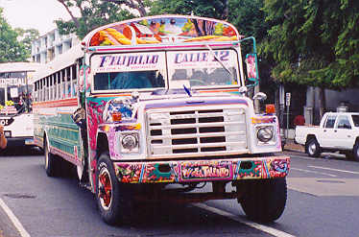
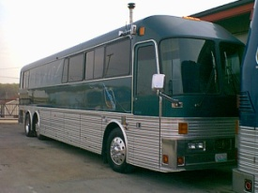
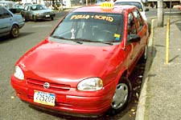

The Competition
 | Xplore | Rental Car | Public Bus | Tour Guides | Taxi
Open Top
Commentary in native language |  |  |  | Limited languages
Hop-on, hop-off
Safe & Comfortable
Online Ticketing
800 & Customer Care
Partnership with agencies, cruise lines
Price | $25 | $160~200/wk | $.5/ride | $75~100 | $3~20
Notes:
May need to work on this slide.
6

Slide 7
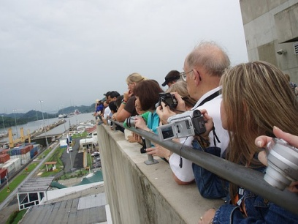
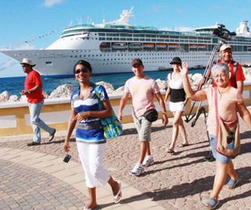
The Customer
69% Visit for Scenery
62% Value a 2-hour Tour at $20; 36% will pay more than $30
55% Utilize Internet; 22% Utilize Travel Agent and 17% Utilize Hotel Bellhop
78% Stay in Panama for 1+ Days
39% Have Cruise Stop in Panama

Slide 8
Marketing Strategy
Internet Marketing
55% Search Tour Information on Internet
www.xplorepanama.com
Online ads on discussion boards
General Tourists
Billboard Ads and handout brochures at customs and borders
Eye-Catching Logos on the Bus and Bus Stop
Partnership
Incentive Program with Hotels, Cruise Lines, and Travel Agencies

Slide 9

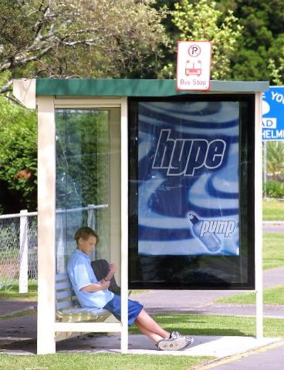


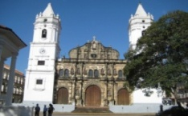



Advertising Strategy
Partners and Referrals
Billboards
Printed Logo on Bus
Bus Stops
Tri-fold Brochures
Time to Xplore Panama!
Xplore

Slide 10
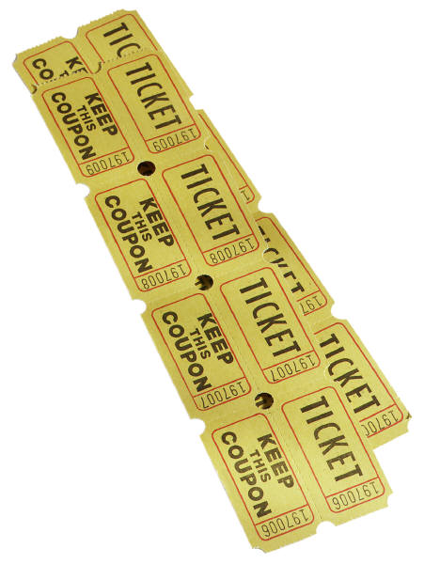
Pricing Strategy
Individual Pricing
62% Willing to Pay $20 or more
Partner and Referral Pricing
Type of Pass | Bus Stop Price
1-Day | $25
2-Day | $35
3-Day | $40
Type of Pass | Direct Sales Price | % of Total Tickets Sold |  | Partner Sales Price | % of Total Tickets Sold |  | Discounted Bellhop Sales Price | % of Total Tickets Sold
1-Day | $25 | 5% |  | $20 | 15% |  | $22 | 2%
2-Day | $35 | 10% |  | $29 | 20% |  | $31 | 3%
3-Day | $40 | 15% |  | $33 | 25% |  | $35 | 5%

Slide 11
Resources and Ops
Buses
Begin with 3 Buses
Add 1 per Year
Audio Commentary
Start with 11 Languages
Gather Customer Feedback
Office Space and Parking
Office Space on Naos Island Serves as Customer Service Center and Bus Parking
Website
Tickets, Information, and Surveys

Slide 12
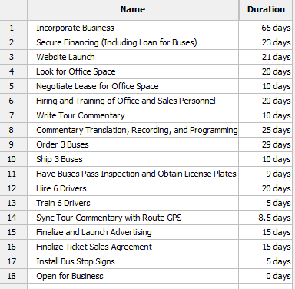
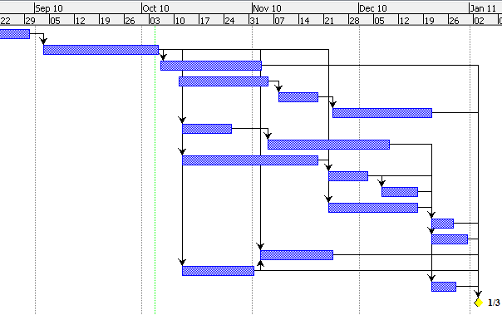
Timeline of Events

Slide 13
Financials
Startup Budget
First Year Sales Forecast
Startup Budget | Cost
Salaries | $ 57,000
Capital Requirements | $ 765,000
Other Operating / Administrative Expenses | $ 271,510
TOTAL | $1,093,510
2011 sales forecast | Jan | Feb | Mar | Apr | May | June
% of all visitors | 0.5% | 0.8% | 1.0% | 1.3% | 1.5% | 1.8%
Tickets sold | 1,053 | 1,593 | 2,087 | 2,150 | 2,369 | 2,751
 | July | Aug | Sep | Oct | Nov | Dec | Total
 | 2.0% | 2.3% | 2.5% | 2.8% | 3.0% | 3.3% | 1.9%
 | 3,488 | 3,858 | 3,672 | 4,909 | 6,308 | 7,457 | 41,696

Slide 14
Financials
Statement of Cash Flows
 | Pre-Open | Year 1 Total | Year 2 total | Year 3 Total
BEG CASH ON HAND | $0 | $54,373 | $611,980 | $1,926,187
MONTHLY NET CHANGE | $54,373 | $557,607 | $1,314,207 | $1,914,580
ENDING CASH ON HAND | $54,373 | $611,980 | $1,926,187 | $3,840,766
Balance Sheet
 | Pre Open | Year 1 | Year 2 | Year 3
TOTAL ASSETS | $819,373 | $1,223,980 | $2,585,187 | $4,496,766
TOTAL LIABILITIES | $525,000 | $441,654 | $495,881 | $508,500
TOTAL EQUITY | $294,373 | $782,326 | $2,089,306 | $3,988,267
Income Statement
 | Pre-Open | Year 1 Total | Year 2 Total | Year Total
SALES |  | $1,289,249 | $2,341,468 | $3,092,269
GROSS PROFIT % | 0% | 87% | 90% | 91%
OPERATING INCOME | ($205,627) | $488,957 | $1,571,843 | $2,217,875
NET INCOME | ($205,627) | $282,326 | $1,306,980 | $1,898,961

Slide 15
Financials
Break Even Analysis
Break Even Point
31,128 Tickets
$962,474 Sales

Slide 16

Funding and Offering
Xplore Panama Requires $1,025,000
Bank: $525,000
Founders: $200,000
Outside Investors: $300,000
Potential ROI for Investors
668% over 3 Years

Slide 17
Xplore Group
Providing a
Truly Memorable Experience
Notes:
http://advertising.blog.com.mt/files/2009/01/supreme-bus-icon.jpg

