Slide 1
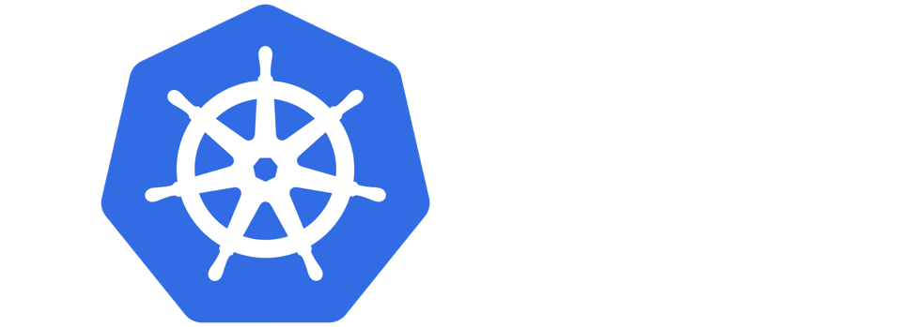
Introduction to Kubernetes
FOSSMeet’21
Rahul Krishnan R A

Slide 2


About Me
> Consultant @ Capgemini
> Gopher
> OpenEBS and Debian Contributor
@rahulkrishnanra
https://uk.linkedin.com/in/rahulkrishnanra

Slide 3
What are containers?
versus
App B
App A
App C
App D
App A
App B
Guest Os
Guest Os
Docker
Hypervisor
Host Operating System
Infrastructure
Infrastructure
Virtual Machine
The hardware is virtualized so multiple operating system can be isolated on the machine
Containers
Virtualized operating system - libraries and applications are isolated

Slide 4
Microservices in containers
Monolithic Application
Microservices Application
Front End
Account Services
Account Services
User
User
Front End
Payment Services
Payment Services
Shipping Services
Shipping Services

Slide 5
Need of container Orchestrator
- Container orchestartion automated the deployment, management,
Scaling, and networking of containers
- Framework for managing containers and microservices architecture at scale

Slide 6
Stepping into Kubernetes
- Open source container orchestartion tool
- Orginally developed and designed by Google
- Google donated the kubernetes project to CNCF
- Builds upon 15 years of running production workloads at Google
- Eliminates many of the manual process involved in deploying and
Scaling containerized applications

Slide 7
UI
Kubernetes Architecture
Worker Node 1
Pod 2
Pod 1
Pod 3
container1
container1
container1
container2
container2
container2
K8s Master
Container Runtime
UI
API Server
kubelet
kube-proxy
Scheduler
Pod 2
Controller-Manager
Pod 1
Pod 3
CLI
container1
etcd
container1
container2
container2
container2
container2
Container Runtime
kubelet
kube-proxy
Worker Node 2

Slide 8
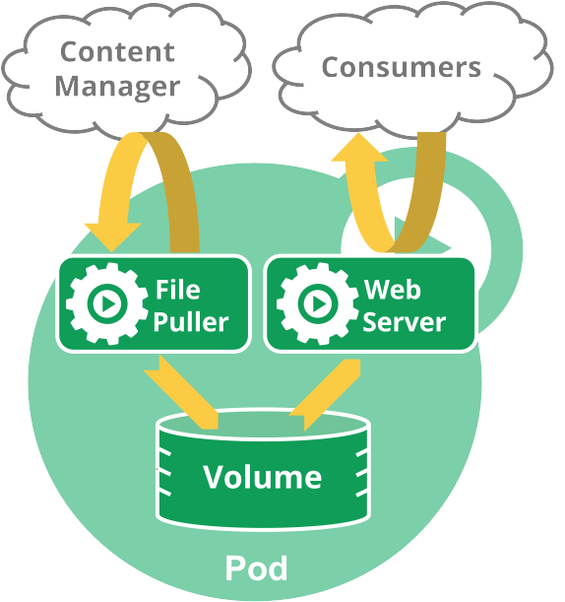
POD in k8s
- Smallest deployable units
- Unit of replication in Kubernetes
- Pod is a group of one or more containers
- Pods are ephemeral
- Primary primitive for running containerized workload
- May contain one or more containers

Slide 9
K8s Deployment
- Pods are usually managed by one more
layer of abstraction
- Declare how many replicas of a pod should be
running at a time
- Declare the desired state of the system
Deployment
Replica Set
Replica Set
Replica Set
Pod
Pod
Pod
Pod
Pod
Pod
NODE
NODE
NODE

Slide 10
Service in k8s
Service A
- Service routes traffic across a set of Pods
- Discovery and routing among dependent Pods
- Services match a set of Pods using Labels and
Selectors
- An abstraction which defines a logical set of Pods and a policy by which to access them
app=A
app=A
app=A

Slide 11
Ingress
Pod
Cluster
Ingress
- Ingress exposes HTTP and HTTPS routes from
Outside the cluster to services within the cluster
- Ingress Controller is responsible for fulfilling the
ingress
Service
Service
Pod
Pod
Pod

Slide 12
{ Demo }

