Slide 1
WordPress on AWS
High-Availability Architecture
Prepared By : Rahul Krishnan P
Terraform ≥ 1.7
AWS Provider ~>5.0
Amazon Linux 2 ARM64
t4g.small Graviton2

Slide 2
01 — OVERVIEW
What Was Built
A fully automated deployment of WordPress stack on AWS — split across two dedicated VPCs (app tier + data tier) connected via VPC Peering. No manual steps except the configuration of WordPress, no hard-coded passwords, no SSH keys.
KEY DESIGN DECISIONS
✓
EC2 in private subnets — no direct public access
✓
t4g.small ARM Graviton2 — ~20% cheaper than x86 equivalent
✓
Secrets Manager for DB creds — zero hard-coded passwords
✓
VPC Peering — DB isolated in its own VPC (VPC2)
✓
SSM Session Manager — no SSH keys, no bastion host
2

Slide 3
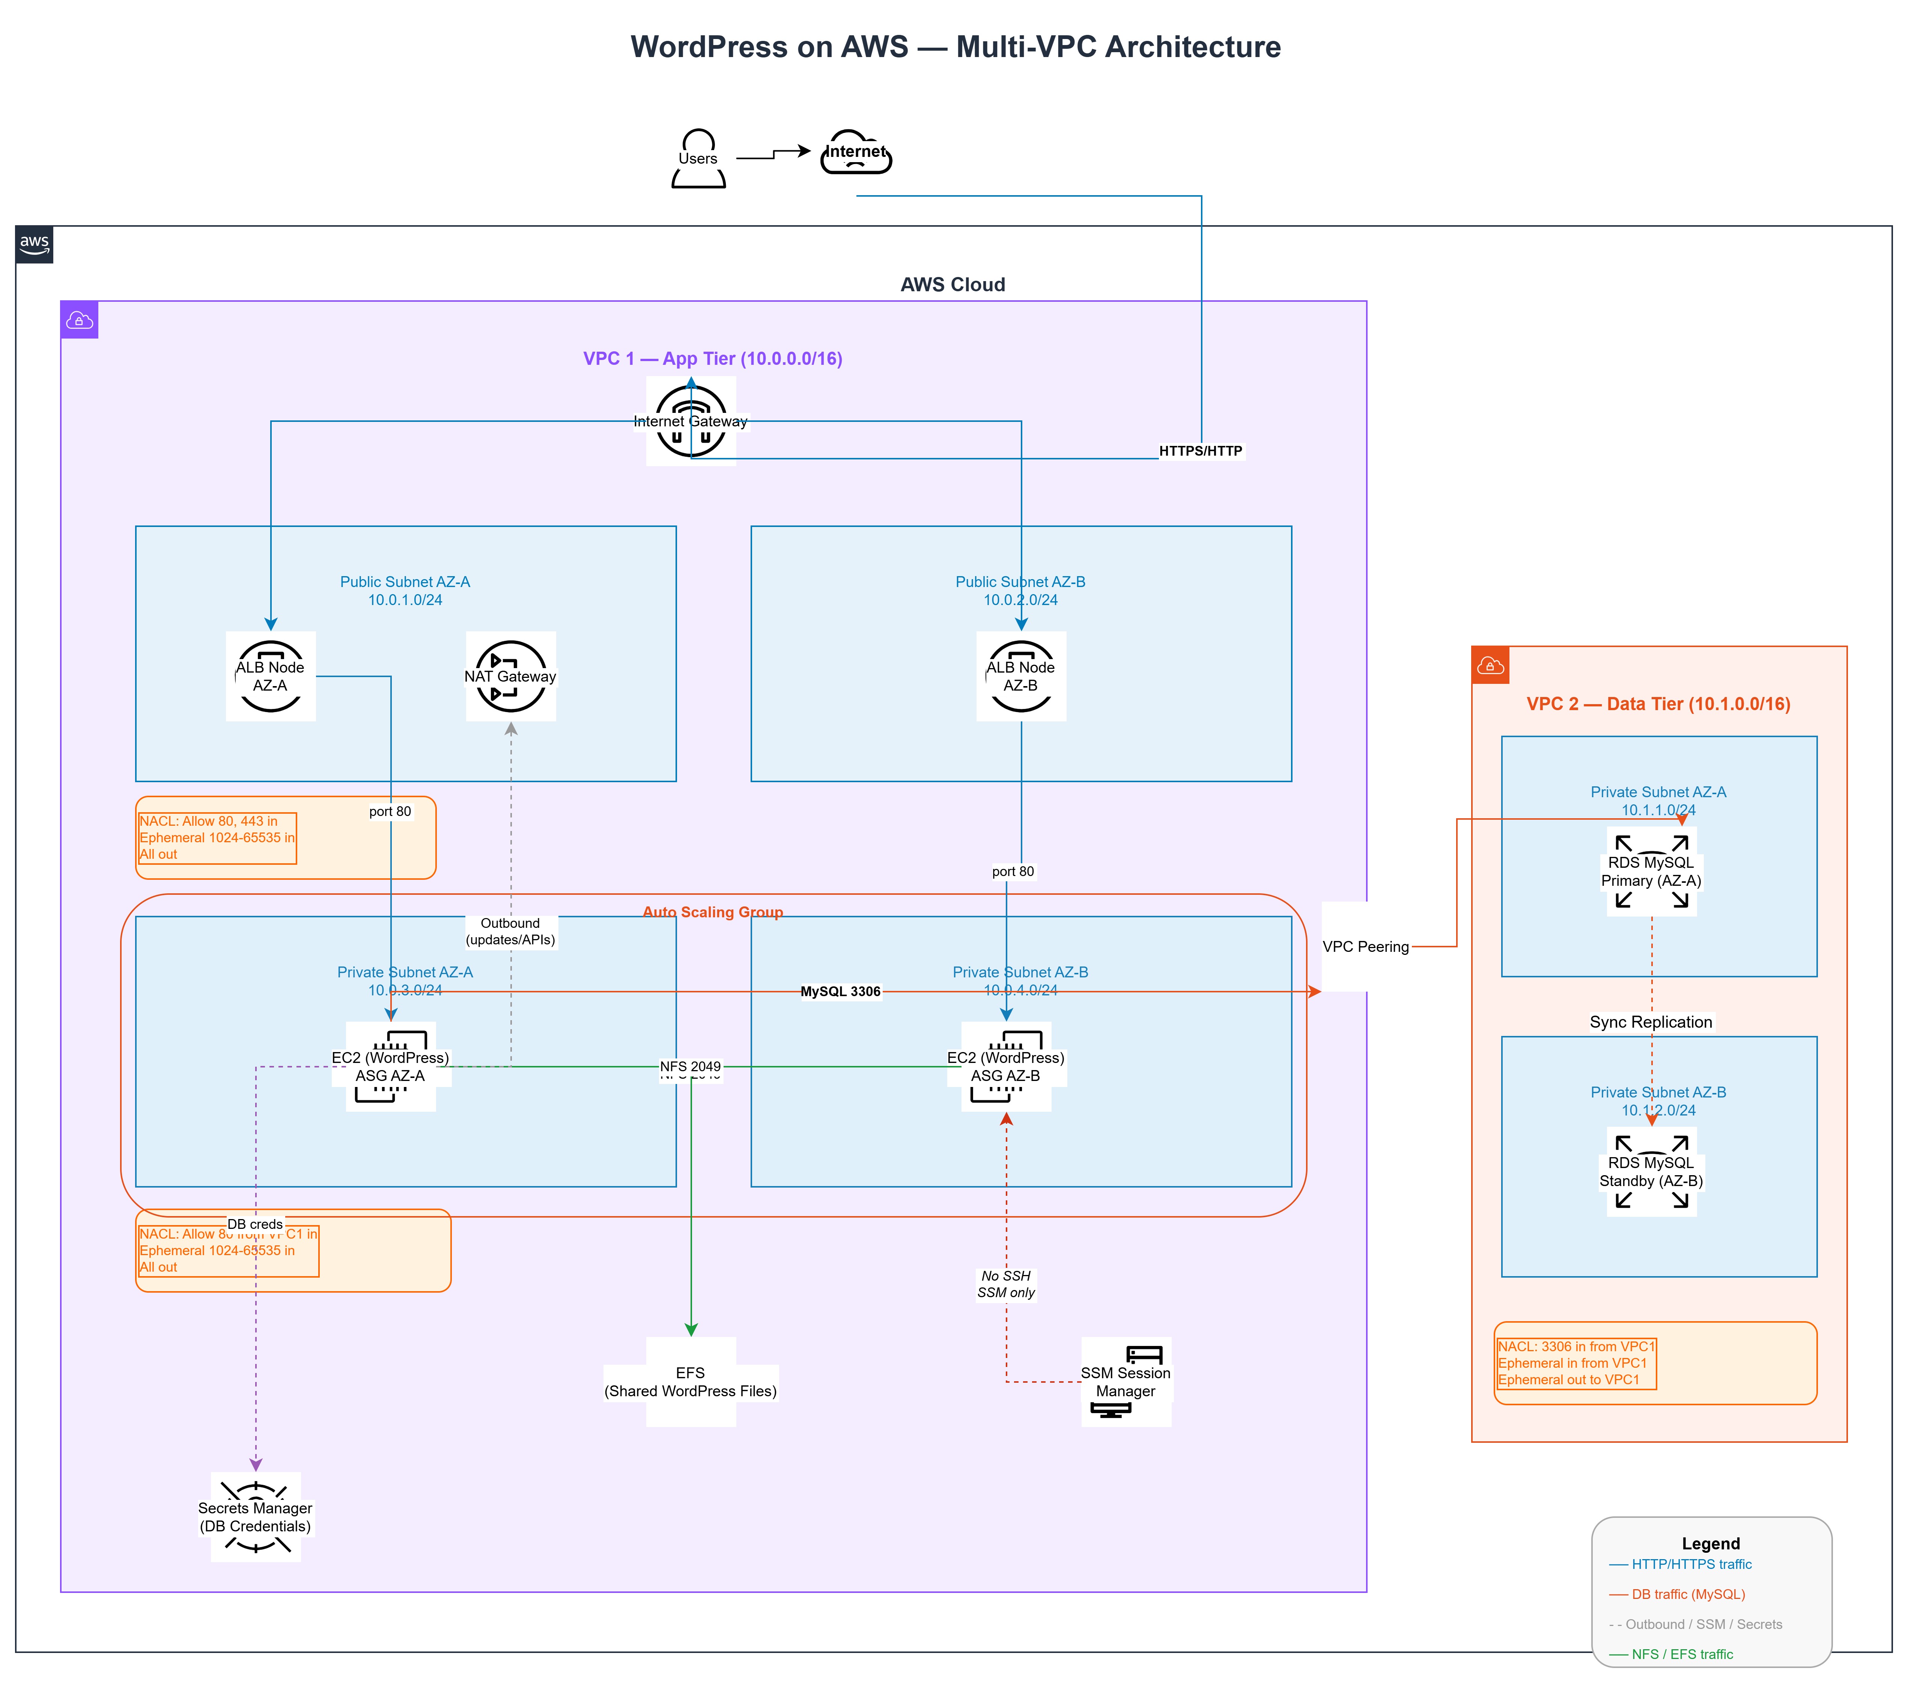
02 — ARCHITECTURE
Dual-VPC Design on AWS
3

Slide 4
03 — TERRAFORM
Terraform Structure — What Each Does
providers.tf
rds.tf
AWS + Random provider versions, default tags (Project / Owner / ManagedBy)
MySQL 8.0 db.t4g.small Multi-AZ, gp3 20 GB encrypted, subnet group across VPC2
variables.tf
efs.tf
All input variables with defaults; name prefix validation ≤20 chars
EFS filesystem (encrypted, bursting), mount targets in both private AZs
networking.tf
asg.tf
VPC 1 & 2, 6 subnets, IGW, NAT GW (EIP), VPC Peering, route tables, NACLs
Launch template + ASG (min 1 / desired 2 / max 4), CPU scaling, CloudWatch alarms
security.tf
alb.tf
4 SGs — ALB (internet), EC2 (ALB SG ref only), EFS (EC2 SG ref), RDS (CIDR)
Internet-facing ALB, lb_cookie sticky TG, /health check, HTTP :80 listener
iam.tf
outputs.tf
EC2 role — SSM + scoped Secrets Manager + EFS mount policies + instance profile
ALB URL, admin URL, secret ARN, EFS ID, ASG name, NAT EIP, peering ID
secrets.tf
userdata.sh
random_password 32-char, random_string username, Secrets Manager secret + IAM read policy
Automatically installs and configures WordPress, Nginx, PHP, and EFS during EC2 instance launch
4

Slide 5
04 — BOOTSTRAP
userdata.sh — EC2 Boot Sequence
1
NAT Check
5
Fetch DB Credentials
Polls aws.amazon.com up to 30× before proceeding — ensures NAT Gateway is routing before package installs
aws secretsmanager get-secret-value via IAM role → parse JSON with jq → inject into wp-config.php
2
Install LEMP Stack
6
Deploy WordPress
yum update → amazon-linux-extras enable nginx1 php8.1 → install Nginx, PHP-FPM, all WordPress PHP extensions
Primary: wget latest.tar.gz → extract to EFS. Secondary instances wait for wp-config.php to appear
3
Mount EFS
7
Configure Nginx
Mounts shared EFS at /var/www/html via TLS + IAM. All ASG instances share the same web root
Writes wordpress.conf with try_files for clean URLs, FastCGI PHP-FPM socket, /health → 200 for ALB checks
4
First-Boot Lock
Flock-based lock on EFS — only the PRIMARY instance downloads WordPress and writes wp-config.php
After apply: open ALB DNS in browser → complete WordPress setup wizard (site title, admin user, password). No SSM needed.
5

Slide 6
05 — DEPLOYMENT
How to Deploy — Step by Step
01
terraform init
Downloads AWS + random providers, initialises lock file
02
terraform plan
Review resources before creating anything
03
terraform apply
Provisions full stack — takes ~10–15 min (RDS Multi-AZ + ASG health checks)
04
terraform output
Note alb_dns_name, asg_name, db_secret_arn
05
Open ALB DNS in browser
Wait ~5 min for instances to boot, mount EFS, and pass ALB health checks
06
Complete WordPress wizard
Set site title, admin username, password, email — one time only
Prerequisites: AWS CLI configured · Terraform ≥ 1.7.0 · Sufficient IAM permissions
6

Slide 7
06 — LIMITATIONS
Known Gaps & Production Fixes
LIMITATION
IMPACT
PRODUCTION FIX
No HTTPS / TLS
HIGH
ACM certificate + port 443 listener + HTTP→HTTPS redirect on ALB
No RDS Backups
HIGH
Set backup_retention_period ≥ 7, enable deletion_protection = true
No WAF
MEDIUM
Attach AWS WAF WebACL with managed rule groups to ALB
No CDN
LOW
CloudFront distribution in front of ALB for edge caching & HTTPS
Local Terraform state
MEDIUM
S3 backend + DynamoDB state locking for team use
No CloudWatch Dashboard
LOW
Add a unified dashboard — CPU, ALB 5xx, RDS connections, EFS throughput
7

Slide 8
Summary
What This Assessment Demonstrates
Dual-VPC Isolation
Zero Hard-Coded Creds
DB unreachable from internet — strong network separation at infrastructure level
Secrets Manager + IAM roles — credentials never in code, state, or shell history
Auto-Scaling Compute
Defence-in-Depth Security
ASG with t4g.small Graviton2 across 2 AZs — scales on CPU, no manual intervention
IMDSv2 + no SSH + SSM + NACLs + SG chaining + all storage encrypted
Shared EFS Web Root
One-Command Deploy
All instances share /var/www/html — uploads consistent, no split-brain
terraform apply provisions everything end-to-end — fully repeatable, version controlled

