Slide 1
MINOR PROJECT 1 | AIML TRACK
LOAN APPROVAL
PREDICTION SYSTEM
LoanWise • Logistic Regression • Streamlit
Presented by: RAHUL KUMAR
Roll No.: 301302224267
CSE Core | Rungta College of Engineering and Technology | 2024–2028
Live demo: https://loan-approval-prediction-system-8dn6o5usdvqfd2y8tvmcjw.streamlit.app/

Slide 2
1. Problem Statement
PROBLEM
Loan application assessment uses applicant and loan attributes. A consistent, accessible way to demonstrate a model-based estimate can help explain a classification workflow.
SOLUTION
A Streamlit web application collects applicant details, requests a Logistic Regression prediction, and displays the outcome and model-estimated probability.
RAHUL KUMAR • 301302224267 • CSE CORE • 2024–2028

Slide 3
2. Objectives
• Build a browser-based loan prediction interface
• Use Logistic Regression as the stated classifier
• Load a persisted model artifact for inference
• Show a predicted outcome and estimated probability
• Provide a separate EMI calculator
• Document and test the application responsibly
RAHUL KUMAR • 301302224267 • CSE CORE • 2024–2028

Slide 4
3. Technology Stack
Python
scikit-learn
Streamlit
Application and ML code
Classification model
Interactive web interface
joblib
Google Colab
GitHub
Persisted model artifact
Notebook environment
Source control and hosting
RAHUL KUMAR • 301302224267 • CSE CORE • 2024–2028

Slide 5
4. Dataset and Features
Complete from the actual Colab notebook before final submission.
Dataset name/source: [exact source]
Dataset size: [verified rows and columns]
Target field and labels: [exact values]
Input feature list: [actual fields]
Preprocessing and train/test split: [actual steps]
RAHUL KUMAR • 301302224267 • CSE CORE • 2024–2028

Slide 6
5. Methodology
01
02
03
04
05
06
Inspect data
→
Preprocess
→
Split data
→
Train Logistic Regression
→
Evaluate
→
Save and deploy
Keep training-time preprocessing and inference-time feature ordering consistent.
RAHUL KUMAR • 301302224267 • CSE CORE • 2024–2028

Slide 7
6. System Architecture
Dataset / Colab notebook
↓
Preprocessing and feature preparation
↓
Logistic Regression model
↓
Evaluation and saved model artifact
↓
Streamlit form → prediction → result display
Separate utility: EMI calculator
RAHUL KUMAR • 301302224267 • CSE CORE • 2024–2028

Slide 8
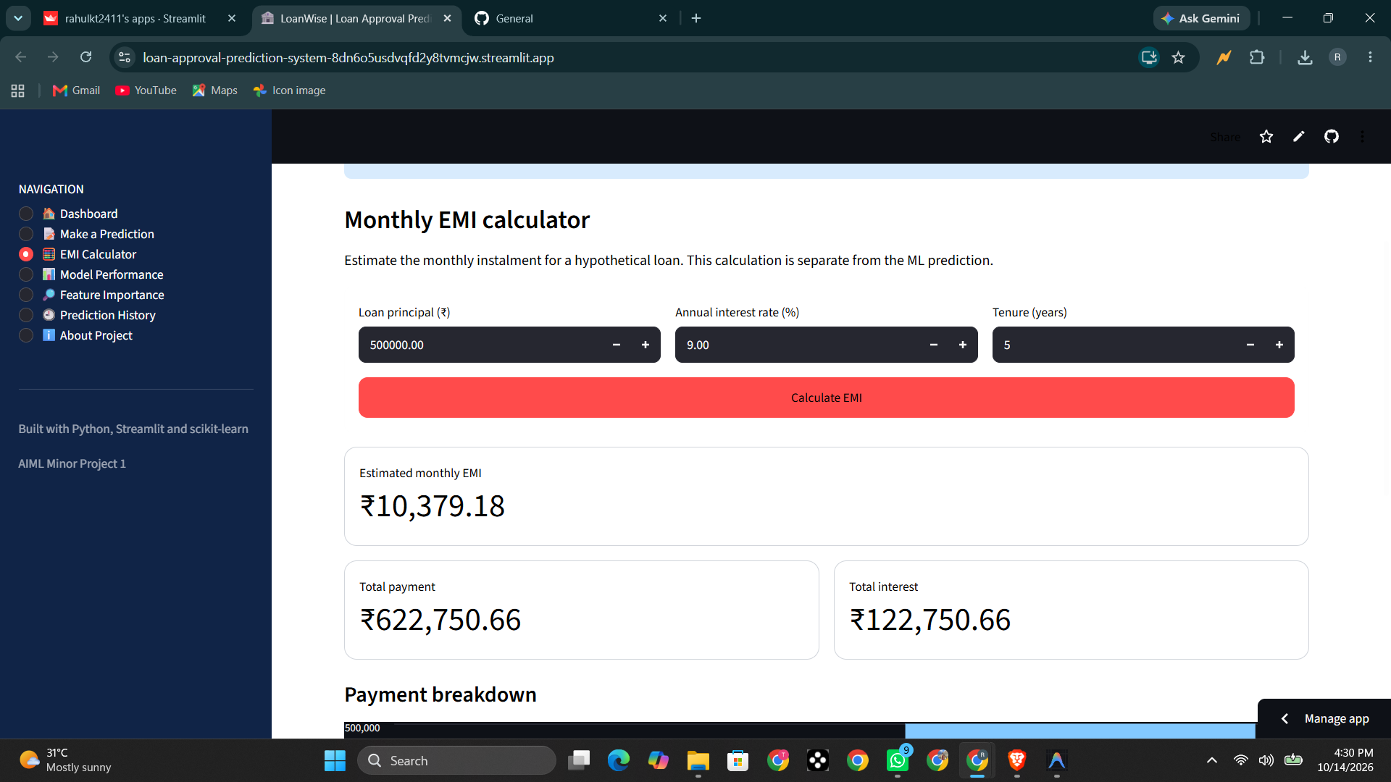
RAHUL KUMAR • 301302224267 • CSE CORE • 2024–2028

Slide 9
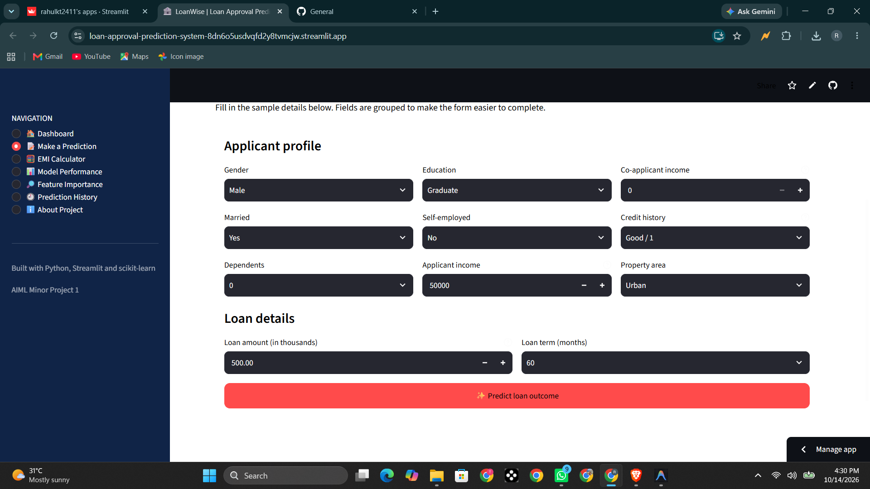
Example shown: model-estimated approval probability 63.3% — this is not model accuracy.
RAHUL KUMAR • 301302224267 • CSE CORE • 2024–2028

Slide 10
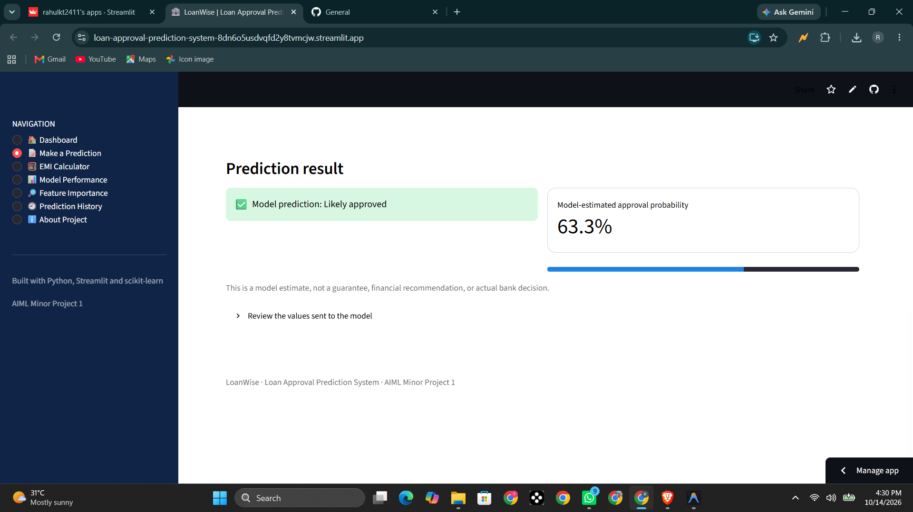
RAHUL KUMAR • 301302224267 • CSE CORE • 2024–2028

Slide 11
10. Model Evaluation
Model: Logistic Regression
Accuracy: [add verified value]
Precision: [add verified value]
Recall: [add verified value]
F1-score / ROC-AUC: [add if actually calculated]
Evaluation method and test-set details: [from notebook]
Do not use the 63.3% example prediction as an accuracy metric.
RAHUL KUMAR • 301302224267 • CSE CORE • 2024–2028

Slide 12
11. Testing and Observations
Observed in supplied screenshots:
• Applicant input form is displayed
• Prediction outcome and 63.3% estimated probability are displayed
• EMI calculator displays monthly EMI and payment breakdown
Still verify: invalid input handling, model loading, model performance page, and feature importance page.
RAHUL KUMAR • 301302224267 • CSE CORE • 2024–2028

Slide 13
12. Limitations and Responsible Use
• Output depends on training data and preprocessing
• Historical lending data may encode bias
• Probability estimates may not be calibrated
• A model prediction is not a bank decision or guarantee
• EMI estimates may omit lender fees and other charges
• Academic prototype only; not for actual credit decisions
RAHUL KUMAR • 301302224267 • CSE CORE • 2024–2028

Slide 14
13. Conclusion and Future Scope
CONCLUSION
LoanWise demonstrates a loan-status classification interface using Logistic Regression and Streamlit, with a separate EMI calculator.
FUTURE SCOPE
• Reproducible evaluation and confusion matrix
• Input validation and error handling
• Explainability and fairness assessment
• Dataset attribution and model versioning
RAHUL KUMAR • 301302224267 • CSE CORE • 2024–2028

Slide 15
14. Project Links
GitHub repository:
https://github.com/rahulkt2411/loan-approval-prediction-system
Colab notebook:
https://colab.research.google.com/drive/1HWvlstT-uvcoJwy5BrhV5cRekh0WQ8lC#scrollTo=P9UzhP-ZUfxz
Live Streamlit application:
https://loan-approval-prediction-system-8dn6o5usdvqfd2y8tvmcjw.streamlit.app/
Documentation: scikit-learn.org/stable/ | docs.streamlit.io/
RAHUL KUMAR • 301302224267 • CSE CORE • 2024–2028

Slide 16
Thank You
Questions?
THANK YOU
Questions and feedback are welcome.
RAHUL KUMAR • 301302224267 • CSE CORE • 2024–2028

