Slide 1

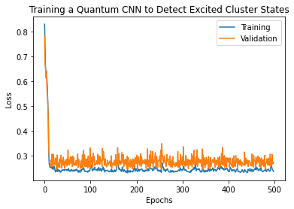
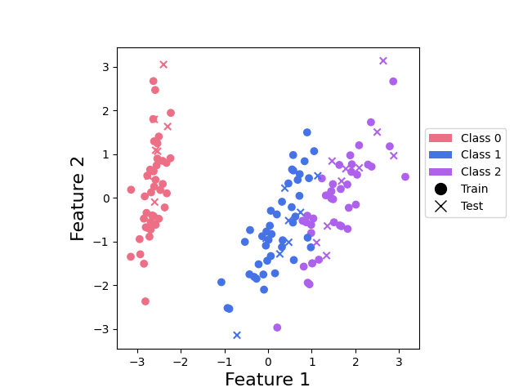
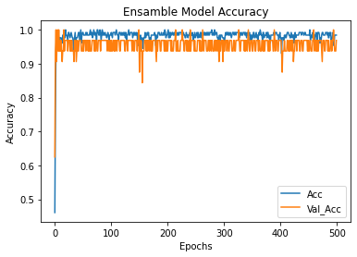
PROJECT TITLE
Department of Computer Science & Engineering
School of Computing
1156CS601 – MINOR PROJECT
WINTER SEMESTER 21-22
ABSTRACT
INTRODUCTION
RESULTS
STANDARDS AND POLICIES
Ensemble learning is the process by which multiple models, such as classifiers or experts, are strategically generated and combined to solve a particular computational intelligence problem. Ensemble learning is primarily used to improve the classification performance. We use the forest.qvm device to simulate one QPU and the qiskit.aer device to simulate another. Each QPU makes an independent prediction, and an ensemble model is formed by choosing the prediction of the most confident QPU. The iris dataset is used in this project, consisting of three classes of iris flower.The TensorFlow quantum package was used to add the outcomes of the quantum circuits to dense layers for efficient classification.
Quantum machine learning is a research area that explores the interplay of ideas from quantum computing and machine learning. Quantum machine learning extends the pool of hardware for machine learning by an entirely new type of computing device — the quantum computer. Information processing with quantum computers relies on substantially different laws of physics known as quantum theory We use the forest.qvm device to simulate one QPU and the qiskit.aer device to simulate another. Each QPU makes an independent prediction, and an ensemble model is formed by choosing the prediction of the most confident QPU. The iris dataset is used in this consisting of three classes of iris flower. Using a pre-trained model and the PyTorch interface, we’ll see that ensembling allows the QPUs to specialize towards different classes.
In the modern viewpoint, quantum computers can be used and trained as like neural networks. We can systematically adapt the physical control parameters, such as an electromagnetic field strength or a laser pulse frequency, to solve a problem. For example, a trained circuit can be used to classify the content of images, and by encoding the image into the physical state of the device and taking measurements
The quantum filters of the proposed HQCNN model were extended to three and it is named HQCNN-3QF in this section.
The quantum filters are extracting features from the output of the AddCircuit layer. And combined using concatenate layer in the model.
Each quantum filter produced 4 qubits of extracted information from the data. The layered architecture of the HQCNN-3QF was illustrated
Anaconda Prompt
Anaconda prompt is a type of command line interface which explicitly deals with the ML( MachineLearning) modules.And navigator is available in all the Windows,Linux and MacOS.The anaconda prompt has many number of IDE’s which make the coding easier. The UI can also be implemented in python. Standard Used: ISO/IEC 10918-1:1994
Jupyter
It’s like an open source web application that allows us to share and create the documents which contains the live code, equations, visualizations and narrative text. It can be used for data cleaning and transformation, numerical simulation, statistical modeling, data visualization, machine learning. Standard Used: ISO/IEC WD TR 24772-4
Table 1. The layered architecture of the HQCNN-1QF model
METHODOLOGIES
Quantum computing is a computing paradigm based on the laws of quantum mechanics, enabling a breakthrough in computing power. By carefully exploiting quantum effects such as interference or entanglement, quantum computers aim to efficiently solve particularly difficult problems that would be unsolvable for classical machines, with quantum advantages such as exponential acceleration. On the other hand, Quantum Machine Learning (QML) brings somewhat different research elements from the intersection with classical Machine Learning (ML) while using the computational advantage of quantum computing. There are many aspects and algorithms of QML, such as solving systems of linear equations, principal component analysis (QPCA) and support vector machines. In this article, we focus specifically on the Support Vector Machine (QSVM) model. Similar to support vector machines, the Quantum SVM algorithm (QSVM) is applied to classification problems that require a mapping of functions implicitly specified by a kernel (i.e., a function that is the inner product in the space of the functions being mapped represents). In particular, some previous papers analyze cases where the kernel computation is not classically efficient since it would scale exponentially with the size of the problem (i.e., large number of functions). In addition to speeding up kernel computation, other potential benefits of QSVM could include improved analysis performance (e.g., higher model accuracy), speedup of model training, and data protection
Figure 2Ensemble classification with Forest and Qiskit devices
CONCLUSIONS
A Deep Convolutional Neural Network is a part of deep neural networks commonly used to classify multimedia data such as images and audios.
A quantum computing technique provides high computing power with low energy consumption; it is the best alternative to traditional computing techniques to perform complex tasks.
The proposed HQCNN combines a quantum filter with the traditional fully connected network for speeding up the training process.
The quantum filter consists of QConv and QPool layers for feature extraction from data. The fully connected neural network was introduced after the quantum filter process
TEAM MEMBER DETAILS
vtu11836(Ayush Raj)
vtu12952(Anshuman Raj)
vtu13664(Rahul kumar Thakur)
<+91 6299552593>
<+91 6204158450>
<+91 9127579584>
vtu11836@veltech.edu.in
vtu12952@veltech.edu.in
vtu13664@veltech.edu.in
ACKNOWLEDGEMENT
Dr. Arun Pandian J , M.E. Ph.D.,/ASSOCIATE PROFESSOR
+91 88078 13091
jarunpandian@veltech.edu.in

