Slide 1

DEPARTMENT OF COMPUTER SCIENCE & ENGINEERING
SCHOOL OF COMPUTING
1156CS601- MINOR PROJECT
WINTER SEMESTER 21-22
SEMESTER END PROJECT VIVA VOCE EXAMINATIONS
“QUANTUM COMPUTING BASED ENSEMBLE CLASSIFICATION”
SUPERVISED BY
Dr. Arun Pandian J
ASSOCIATE PROFESSOR
PRESENTED BY
1. Ayush Raj (11836)(19UECS0083)
2. Anshuman Raj (12952)(19UECS0063)
3. Rahul Kumar Thakur (13664)(19UECS0816)

Slide 2
AGENDA
ABSTRACT
OBJECTIVE
INTRODUCTION
LITERATURE REVIEW (SOFT COPY OF PAPERS TO BE LINKED AS HYPERLINK)
DESIGN AND METHODOLOGIES
STANDARDS & POLICIES USED
IMPLEMENTATION
TESTING
INPUT AND OUTPUT
DEMO SCREENSHOT
CONCLUSION
FUTURE ENHANCEMENTS
REFERENCES
PLAGIARISM REPORT OF PPT
POSTER PRESENTATION

Slide 3
ABSTRACT
Ensemble learning is the process by which multiple models, such as classifiers or experts, are strategically generated and combined to solve a particular computational intelligence problem. Ensemble learning is primarily used to improve the classification performance. We use the forest.qvm device to simulate one QPU and the qiskit.aer device to simulate another. Each QPU makes an independent prediction, and an ensemble model is formed by choosing the prediction of the most confident QPU. The iris dataset is used in this project, consisting of three classes of iris flower.The TensorFlow quantum package was used to add the outcomes of the quantum circuits to dense layers for efficient classification. A different number of quantum filters were used in the HQCNN model and tested. A different number of quantum filters were used in the HQCNN model design. The performance of the HQCNN models with the different number of quantum filters was compared using validation and testing performance.

Slide 4
OBJECTIVES
Aim of the Project:
To implement the ensample learning techniques using quantum computing approach. To enhance the model predictions using ensample learning on multi class classification
Scope of the Project:
Developing a novel ensample learning technique using quantum circuits and machine learning algorithms for image classification on quantum data. Develop multiple QPUs for classification applications

Slide 5
INTRODUCTION
Quantum machine learning is a research area that explores the interplay of ideas from quantum computing and machine learning. Quantum machine learning extends the pool of hardware for machine learning by an entirely new type of computing device — the quantum computer. Information processing with quantum computers relies on substantially different laws of physics known as quantum theory.
We use the forest.qvm device to simulate one QPU and the qiskit.aer device to simulate another. Each QPU makes an independent prediction, and an ensemble model is formed by choosing the prediction of the most confident QPU. The iris dataset is used in this consisting of three classes of iris flower.
Using a pre-trained model and the PyTorch interface, we’ll see that ensembling allows the QPUs to specialize towards different classes.

Slide 6
LITERATURE REVIEW
Gahi, Y., El Alaoui, I. and Guennoun, M., 2020. An End to End Cloud Computing Privacy Framework Using Blind Processing. International Journal of Smart Security Technologies (IJSST), 7(1), pp.1-20.
Gustiani, C. and Bandung, I., 2020. Blind Oracular Quantum Computation: from Concept to Physical Implementation (Doctoral dissertation, Universitatsbibliothek der RWTH Aachen).
Chen, F. Miao, and X. Shen, “Hyperspectral Remote Sensing Image Classification with CNN Based on Quantum Genetic-Optimized Sparse Representation,” IEEE Access, vol. 8, pp. 99900–99909, 2020.

Slide 7
LITERATURE REVIEW
Friis, N., Marty, O., Maier, C., Hempel, C., Holzapfel, M., Jurcevic, P., Plenio, ¨ M.B., Huber, M., Roos, C., Blatt, R. and Lanyon, B., 2018. Observation of entangled states of a fully controlled 20-qubit system. Physical Review X, 8(2), p.021012.
Artificial neural networks are powerful techniques to solve modern decision-making challenges such as classification, time series forecasting and natural language processing.
Advanced neural networks like Convolutional Neural Network (CNN) and Recurrent Neural Networks (RNN) need more powerful computational tools than traditional computing systems to handle complex data.
The combination of recent artificial. Neural networks and quantum computing techniques may extend the decisionmaking capabilities of modern computers.

Slide 8
DESIGN AND METHODOLOGIES
1.Design Quantum SVM Model
Quantum computing is a computing paradigm based on the laws of quantum mechanics, enabling a breakthrough in computing power. By carefully exploiting quantum effects such as interference or entanglement, quantum computers aim to efficiently solve particularly difficult problems that would be unsolvable for classical machines, with quantum advantages such as exponential acceleration. On the other hand, Quantum Machine Learning (QML) brings somewhat different research elements from the intersection with classical Machine Learning (ML) while using the computational advantage of quantum computing. There are many aspects and algorithms of QML, such as solving systems of linear equations, principal component analysis (QPCA) and support vector machines. In this article, we focus specifically on the Support Vector Machine (QSVM) model. Similar to support vector machines, the Quantum SVM algorithm (QSVM) is applied to classification problems that require a mapping of functions implicitly specified by a kernel (i.e., a function that is the inner product in the space of the functions being mapped represents)

Slide 9
2.Design Quantum Neural Network
Machine learning (ML), particularly applied to deep neural networks through the backpropagation algorithm, has enabled a wide range of revolutionary applications, ranging from social to scientific1,2. Achievements include the, which now provides daily handwriting and speech recognition for applications at the frontier of scientific research2-4. Despite rapid theoretical and practical advances, ML training algorithms are computationally intensive, and now that Moore’s law is failing, we must look to a future with a slower progress rate5. However, exciting new possibilities are opening up due to the impending advent of quantum computing devices that directly exploit the laws of quantum mechanics to circumvent the technological and thermodynamic limitations of classical computing.

Slide 10
Standards & Policies
Anaconda Prompt
Anaconda prompt is a type of command line interface which explicitly deals with the ML( MachineLearning) modules.And navigator is available in all the Windows,Linux and MacOS.The anaconda prompt has many number of IDE’s which make the coding easier. The UI can also be implemented in python.
Standard Used: ISO/IEC 10918-1:1994
Jupyter
It’s like an open source web application that allows us to share and create the documents which contains the live code, equations, visualizations and narrative text. It can be used for data cleaning and transformation, numerical simulation, statistical modeling, data visualization, machine learning.
Standard Used: ISO/IEC WD TR 24772-4

Slide 11
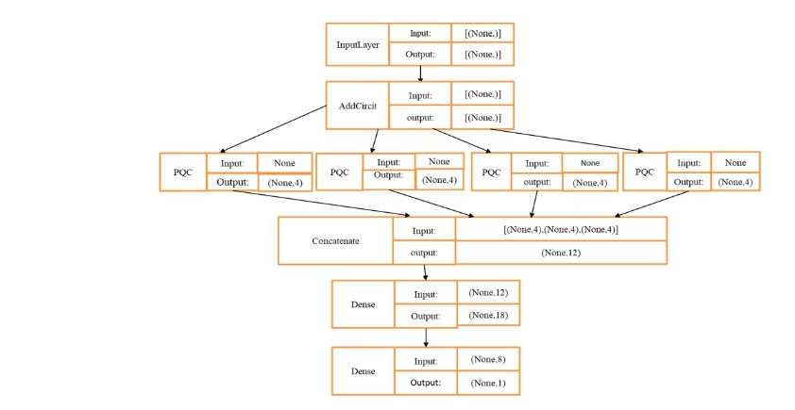
IMPLEMENTATION
ARCHITECTURE DIAGRAM

Slide 12
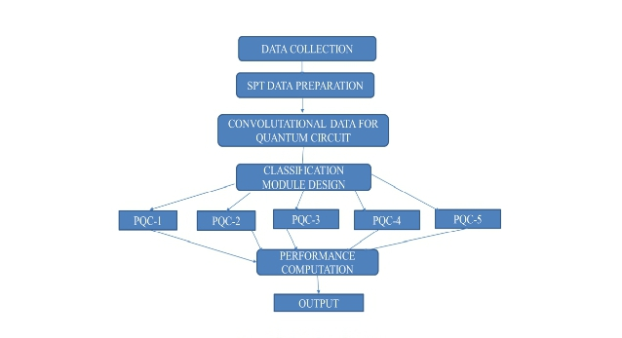
DATA FLOW DIAGRAM

Slide 13
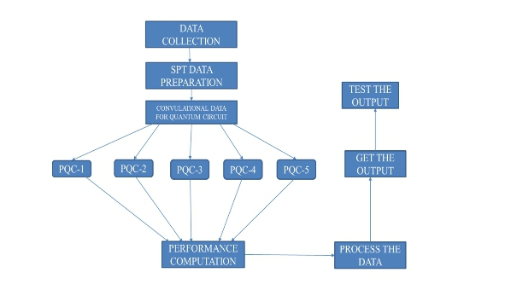
USE CASE DIAGRAM

Slide 14
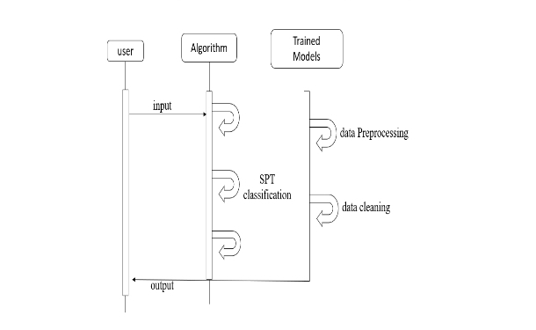
SEQUENCE DIAGRAM

Slide 15
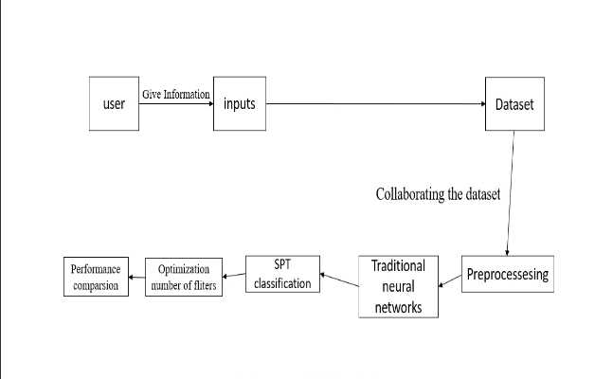
COLLABORATION DIAGRAM

Slide 16
TESTING
UNIT TESTING
It concentrates on the tiniest a aspect of software development it is where we test a single unit or a collection of interconnected units. Using sample input and watching the accompanying outputs is a common method used by programmers.
INTEGRATION TESTING
The goal is to take unit –tested components and use them to create a program structure that is dictated by design. Integration testing occurs when a set of components is combined to achieve a result.
FUNCTIONAL TESTING
Every time a new module is added , the program is altered . This sort of testing ensures that the entire component functions properly even after it has been added to the entire application.

Slide 17
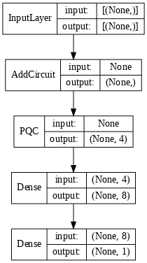
INPUT AND OUTPUT
Input Design
At first, a novel HQCNN model with one quantum filter was proposed for the STP phase data classification. This model combines a quantum filter with the traditional artificial neural network. After the quantum filter operation, the qubits are transferred to the fully connected neural network. The fully connected neural network contains two dense layers. The second dense layer was used to classify the data to respective labels. The layered architecture of the proposed HQCNN1QF was illustrated in fig.5.1.The training and validation set of the dataset was used to train the model. The HQCNN-1QF model was trained to 300 epochs on a GPU environment.

Slide 18
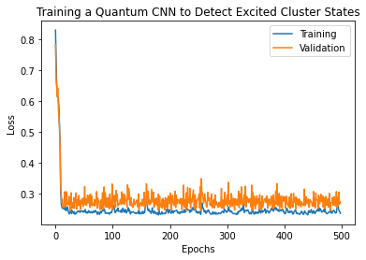
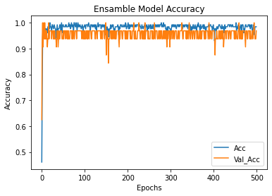
Output Design

Slide 19
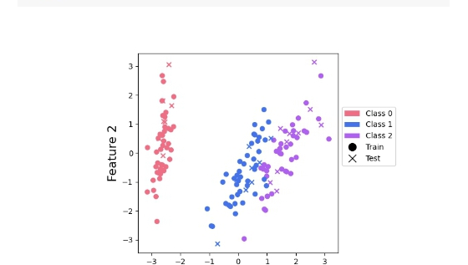
DEMO SCREENSHOT

Slide 20
CONCLUSION
A Deep Convolutional Neural Network is a part of deep neural networks commonly used to classify multimedia data such as images and audios. The CNN requires high computation power to get trained on sample data for classification tasks. In addition, the high computational power requirement consumes more energy. A quantum computing technique provides high computing power with low energy consumption; it is the best alternative to traditional computing techniques to perform complex tasks.The proposed HQCNN combines a quantum filter with the traditional fully connected network for speeding up the training process. The quantum filter consists of QConv and QPool layers for feature extraction from data. The fully connected neural network was introduced after the quantum filter process. The number of quantum filters was optimized using their validation performance. In the future, the research will focus on the optimization of the number of filters and layers in the traditional neural network part of the HQCNN model. Also, the HQCNN model will extend to some other classification datasets

Slide 21
Future Enhancements
To Develop a quantum data using Projected Quantum Kernel features form image dataset.To Design a novel hybrid classification technique using quantum circuits and convolutional neural network for image classification.To Analysis the performance of the hybrid QCNN network and classical CNN networks on image classification.Developing a novel hybrid classification technique using quantum circuits and convolutional neural network for image classification on quantum data.Identify the importance of the quantum filter numbers on classification model design.

Slide 22
REFERENCES(as per IEEE format only)
Friis, N., Marty, O., Maier, C., Hempel, C., Holzapfel, M., Jurcevic, P., Plenio, ¨ M.B., Huber, M., Roos, C., Blatt, R. and Lanyon, B., 2018. Observation of entangled states of a fully controlled 20-qubit system. Physical Review X, 8(2), p.021012.
Gahi, Y., El Alaoui, I. and Guennoun, M., 2020. An End to End Cloud Computing Privacy Framework Using Blind Processing. International Journal of Smart Security Technologies (IJSST), 7(1), pp.1-20
Gustiani, C. and Bandung, I., 2020. Blind Oracular Quantum Computation: from Concept to Physical Implementation (Doctoral dissertation, Universitatsbibliothek der RWTH Aachen)

Slide 23
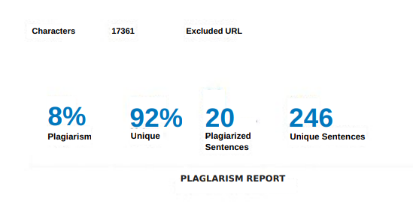
Plaglarism Report of PPT

Slide 24
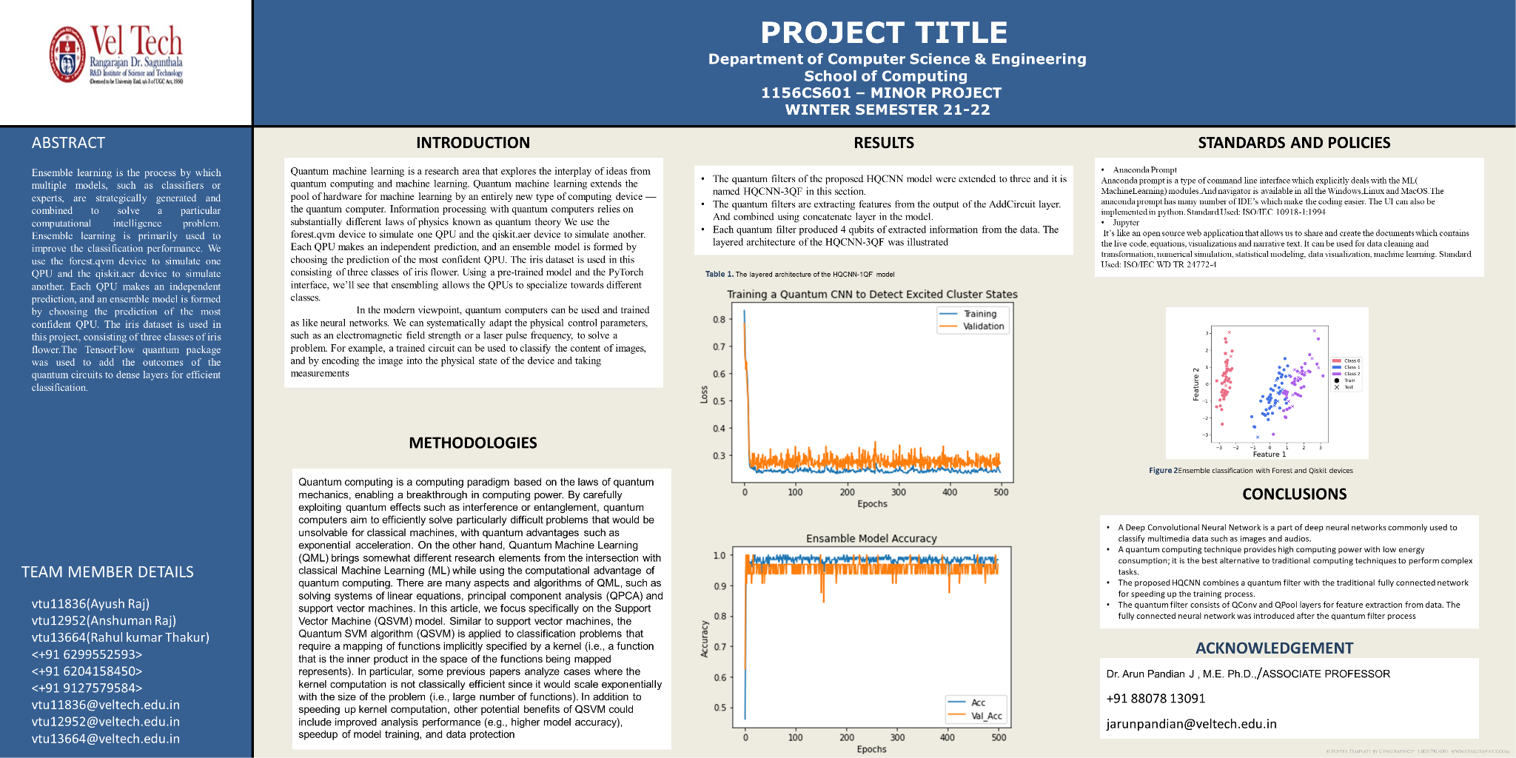
Poster Presentation

Slide 25
THANK YOU

