Slide 1


VS
Traditional Games vs. Mobile Games
A Comparative Study of Play, Culture, and Screens
Paper Code: HU391 Paper Name: Technical Seminar Presentation and Group Discussion
Abhinab Kumar
Nikhil Kumar Chouhan
Rishi Gupta
Roll No. 147
Roll No. 169
Roll No. 168

Slide 2
Content
1
Introduction
8
Screen Time & Addiction Concerns
2
What Are Traditional Games?
9
Cultural Value & Heritage
3
What Are Mobile Games?
10
Survey: Methodology
4
Physical & Health Impact
11
Survey: Findings
5
Social Interaction & Bonding
12
Conclusion
6
Cognitive & Skill Development
13
Bibliography
7
Cost & Accessibility
14
Acknowledgment
Traditional Games vs. Mobile Games
2

Slide 3

Introduction
Games have always been central to human life — a way to build friendships, sharpen skills, and pass down culture across generations.
For decades, children in India and around the world grew up playing kabaddi, kho-kho, marbles, hopscotch, and gilli-danda in open fields and courtyards.
Play has always
followed technology.
The rise of smartphones has introduced a new form of play: mobile games — accessible instantly, playable alone, and often designed to be highly engaging.
From street corners to smartphone screens, the way children and adults play has been reshaped by technology.
This presentation compares the two forms of play across health, social, cognitive, economic, and cultural dimensions, supported by a short primary survey.
Traditional Games vs. Mobile Games
3

Slide 4
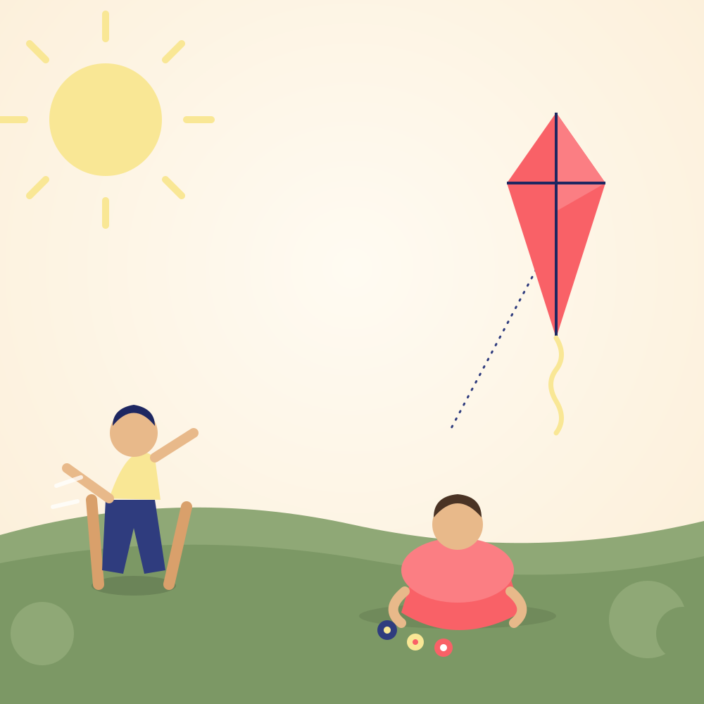


What Are Traditional Games?
Games passed down through generations, usually played outdoors with minimal or no equipment, relying on physical activity and group participation.
Kancha (Marbles)
Kabaddi
Hopscotch
Precision & strategy with simple stones
Team stamina, strength & tactics
Balance & coordination on a chalk grid
Traditional Games vs. Mobile Games
4

Slide 5




What Are Mobile Games?
Digital games played on smartphones or tablets — instantly accessible, often free-to-play, and designed for short or extended solo/online sessions.
Puzzle Games
Battle Royale
Sports Sims
Candy Crush-style logic & matching
BGMI, Free Fire — action
FIFA Mobile, cricket games
Traditional Games vs. Mobile Games
5

Slide 6


Physical & Health Impact
Traditional Games
Mobile Games
High physical exertion — running, jumping, throwing build strength and stamina.
Minimal physical movement; mostly thumb and finger activity.
Improves motor skills, agility and hand-eye coordination through movement.
Prolonged sessions linked to eye strain, poor posture and sedentary habits.
Outdoor play increases exposure to sunlight and fresh air.
Blue light exposure before sleep can disrupt sleep quality.
Traditional Games vs. Mobile Games
6

Slide 7


Social Interaction & Bonding
Traditional Games
Mobile Games
Played face-to-face in groups, building real-world friendships.
Often played alone, or with strangers online rather than known peers.
Teaches teamwork, negotiation, fair play and conflict resolution.
Online multiplayer offers connection but limited non-verbal interaction.
Strengthens neighborhood and community bonds across ages.
Can reduce face-to-face family and community time if overused.
Traditional Games vs. Mobile Games
7

Slide 8


Cognitive & Skill Development
Traditional Games
Mobile Games
Builds spatial reasoning, quick decision-making and physical strategy.
Sharpens reflexes, hand-eye coordination and pattern recognition.
Encourages creativity — children often invent or modify rules.
Puzzle and strategy games can improve problem-solving skills.
Develops patience and resilience through repeated real-world practice.
Reward-loop design can shorten attention span with frequent play.
Traditional Games vs. Mobile Games
8

Slide 9


Cost & Accessibility
Traditional Games
Mobile Games
Very low cost — often just open space, stones, sticks or chalk.
Free-to-play, but many games use in-app purchases and microtransactions.
Accessible to nearly everyone regardless of economic background.
Requires a smartphone, internet/data and battery — a real cost barrier.
Depends on availability of open ground, weather and daylight.
Playable anytime, anywhere — indoors, outdoors, while travelling.
Traditional Games vs. Mobile Games
9

Slide 10


Screen Time & Addiction Concerns
Traditional Games
Mobile Games
Naturally time-bound — games end with tiredness, daylight or group availability.
Designed with reward loops, streaks and notifications to maximize playtime.
Low risk of compulsive or addictive behaviour patterns.
Linked to excessive screen time, poor sleep and reduced study focus.
Encourages a healthy break from screens and devices.
Risk of gaming disorder with unmonitored, prolonged use.
Traditional Games vs. Mobile Games
10

Slide 11

Cultural Value & Heritage
1
Traditional games like gilli-danda, kho-kho and lattoo (spinning top) are tied to festivals, seasons and local folklore.
2
They preserve regional identity and are passed down orally from grandparents to grandchildren.
Games as living heritage
3
Mobile games are largely globalized and standardized, offering little connection to local culture or heritage.
Many traditional games carry regional identity, folklore and community values that mobile games do not replicate.
4
Reviving traditional games in schools helps sustain cultural memory alongside modern digital play.
Traditional Games vs. Mobile Games
11

Slide 12


Survey / Sample — Methodology
Method
Sample Size
Duration
Focus Areas
Structured questionnaire (Google Form) with closed-ended questions
60 respondents — college students aged 17-22
Survey conducted over 1 week among peers and juniors
Preference, time spent, and perceived benefits of each game type
Sample Questions Asked
• Which type of game do you play more often — traditional or mobile?
• On average, how many hours per day do you spend on mobile games?
• Which type of game do you feel benefits your health/social life more?
Traditional Games vs. Mobile Games
12

Slide 13

Survey / Sample — Findings
Which do you prefer playing more?
Daily time spent on mobile games (hrs)
Key takeaway: A majority (62%) favour mobile games and over half of respondents spend 2+ hours daily on them — yet most still recall traditional games fondly and associate them with better health and social bonding.
Traditional Games vs. Mobile Games
13

Slide 14

Conclusion
Traditional games remain unmatched for physical fitness, real-world social bonding and cultural continuity.
Mobile games offer accessibility, cognitive engagement and entertainment, but risk sedentary habits and overuse.
A balanced approach — encouraging outdoor play alongside mindful mobile gaming — offers the best of both worlds.
Schools and families should consciously make space for traditional games to preserve heritage and health.
Traditional Games vs. Mobile Games
14

Slide 15

Bibliography
1
Sutton-Smith, B. (2001). The Ambiguity of Play. Harvard University Press.
2
Przybylski, A. K., et al. (2017). "Internet Gaming Disorder: Investigating the Clinical Relevance of a New Phenomenon." American Journal of Psychiatry.
3
Granic, I., Lobel, A., & Engels, R. (2014). "The Benefits of Playing Video Games." American Psychologist, 69(1), 66-78.
4
Ministry of Youth Affairs & Sports, Govt. of India — Khelo India Programme documentation on traditional Indian sports.
5
We Are Social & Hootsuite (2024). Digital India Report — Mobile gaming and internet usage statistics.
6
Primary survey conducted by the authors among 60 college students (2026).
Traditional Games vs. Mobile Games
15

Slide 16

Acknowledgment
We sincerely thank our faculty for the Technical Seminar Presentation and Group Discussion (HU391) for their valuable guidance and support throughout this project. We are also grateful to our peers who participated in our survey and to our institution for providing the resources and opportunity to explore this topic.
Thank You
Traditional Games vs. Mobile Games
16

