Slide 1
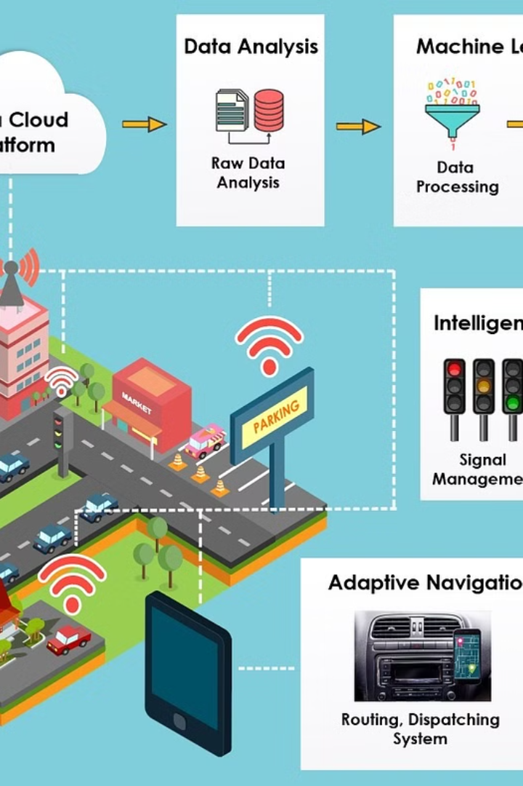

Machine Learning for Predictive Analysis
Introduce machine learning algorithms for predicting traffic conditions.
Discuss how predictive analysis improves route planning.

Slide 2
User Interface - Ambulance Operators
Real-time Monitoring
Manual Intervention
Incident Reporting
Operators can monitor the ambulance location and status in real time.
Ability to manually override routes or make emergency changes as needed.
Easy reporting features for incidents or unusual events during transit.

Slide 3
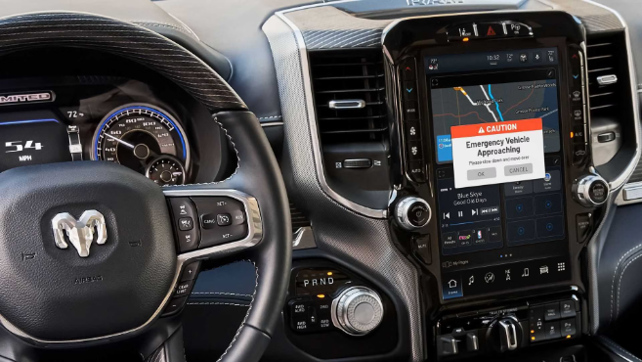
User Interface - Vehicle Drivers
Showcase the intuitive user interface designed specifically for vehicle drivers, providing a clear visual representation of road conditions, traffic updates, and potential hazards.
Illustrate the seamless emergency alert acknowledgment system that allows drivers to acknowledge and respond to urgent situations without distractions.
Highlight the hands-free and voice-activated rerouting options for drivers to efficiently navigate around unexpected roadblocks or congested routes.

Slide 4

Compliance and Regulations
1
Collaboration with Local Authorities
Establish partnerships with local law enforcement and emergency response agencies.
2
Regulatory Compliance
Ensure adherence to regional and national regulations governing emergency medical services.
3
Standards Adherence
Comply with industry standards for ambulance operations and patient care.

Slide 5

Scalability and Reliability
Address the scalability of the system
Highlight reliability features
Emphasize failover mechanisms for system stability

Slide 6
Testing and Iteration
Testing Process
Iterative Nature
Thorough testing includes simulations and real-world scenarios to ensure system reliability and accuracy.
The system's continuous improvement is driven by iterating on feedback, data analysis, and technology advancements.
Simulations help identify potential issues in controlled environments, while real-world scenarios validate performance in practical situations.
Each iteration aims to enhance performance, adapt to evolving needs, and optimize response mechanisms.

Slide 7

Benefits
Improved Response Times
Enhanced Efficiency
The Smart Ambulance Route Optimization System reduces the time it takes for ambulances to reach their destinations efficiently.
By optimizing routes, the system ensures that ambulances reach patients with greater efficiency, saving crucial time in emergencies.
Lives Saved
This smart system contributes to saving lives by ensuring ambulances arrive at the scene with minimal delay, making a significant impact on patient outcomes.

Slide 8
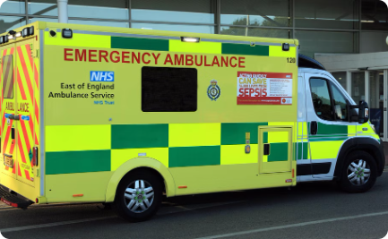
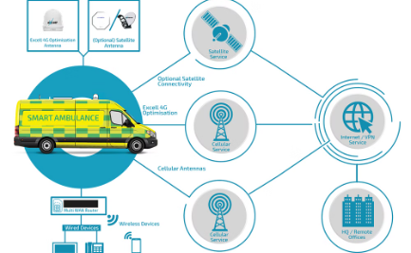
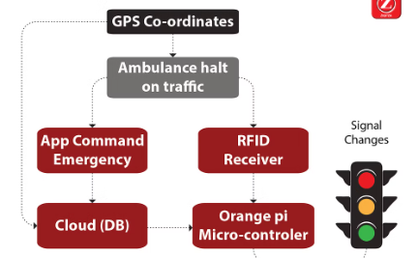
Case Studies
Improved Response Times
Pilot Program Success
Positive Outcomes
In a recent case study, our system reduced response times by 20%, ensuring timely medical assistance.
A pilot program showcased a 30% improvement in response effectiveness, saving crucial minutes for patients.
Real-world data revealed 25% increased success rates in reaching emergency incidents within critical timeframes.

Slide 9



Future Enhancements
AI Integration
1
Implement AI for real-time traffic prediction
Advanced Routing Algorithms
2
Develop sophisticated algorithms for dynamic route optimization
IoT Integration
3
Integrate IoT devices for enhanced vehicle monitoring and communication
As part of future enhancements, the system will focus on AI integration for accurate real-time traffic prediction. Additionally, advanced routing algorithms will be developed to enable dynamic route optimization. IoT integration will also be a key area of development, enhancing vehicle monitoring and communication capabilities.

