Slide 1

DAYANANDA SAGAR UNIVERSITY
SCHOOL OF ENGINEERING
Department of Computer Science and Technology
Major Project Phase-II
BREAST CANCER PREDICTION MODEL USING ML
Under the Supervision
Dr.Shaila S G
Department of CSE, DSU
Presented By:
Rahul Kumar - ENG19CS0243
Ruchith B M - ENG19CS0264
Sagar M A - ENG19CS0272
Sai Lakshmi Sridhar - ENG19CS0277

Slide 2
Overview
Abstract
Problem Statement
Introduction
State of the Art work
Novelty of idea & Societal/ environmental impact
Methodology
Design
Implementation
References

Slide 3
ABSTRACT
Women are seriously threatened by breast cancer with high morbidity and mortality. The lack of robust prognosis models results in difficulty for doctors to prepare a treatment plan that may prolong patient survival time.
Logistic Regression, Random Forest and Decision Tree which predict the breast cancer outcome have been compared in the paper using different datasets.
Sequential forward selection-based feature selection and Transfer learning Vgg16 mode for analysis feature extraction to distinguish between the benign and malignant tumors of breast.

Slide 4
Problem Definition
Breast cancer is one of the main causes of cancer death worldwide.
Computer-aided diagnosis systems showed the potential for improving diagnostic accuracy. But early detection and prevention can significantly reduce the chances of death. It is important detect breast cancer as early as possible.
The main issue pertaining to its cure is early recognition using several other methods.

Slide 5
Introduction
Second main cause of cancer death in women .
Breast cancer is most common malignant condition of breast.
Data mining and machine learning have been widely used in the diagnosis and prognosis of breast cancer.

Slide 6
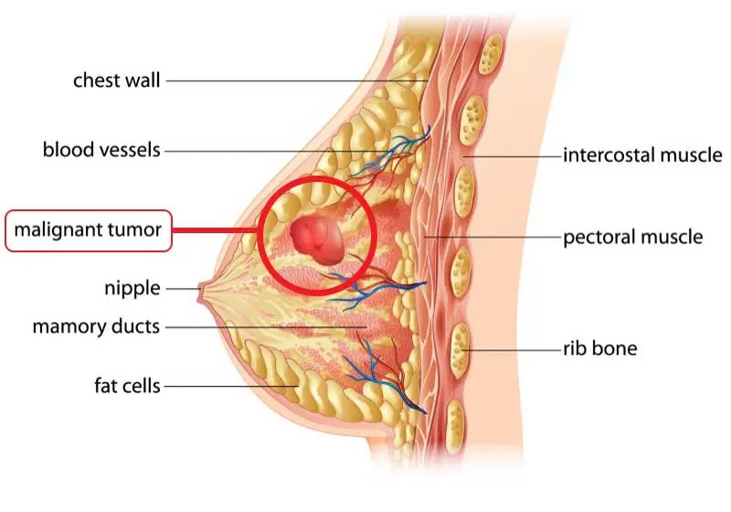

Slide 7
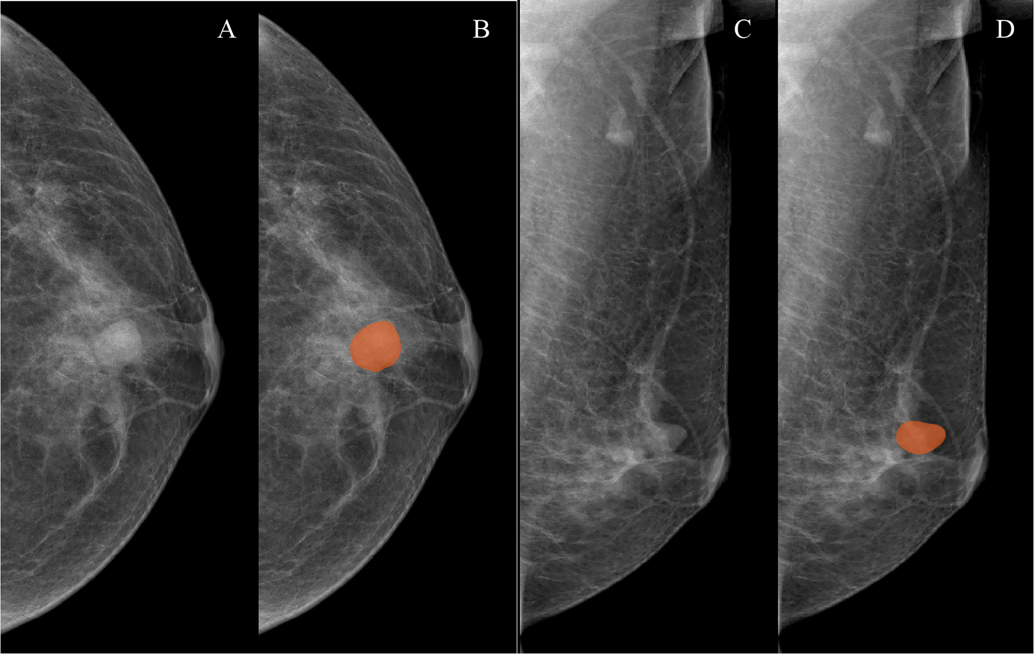

Slide 8
Scope of the project
As of 2022, on average, 1 in 8 U.S women (approx. 12%) would develop invasive breast cancer at some point during her life. 5-year survival rate for breast cancer is 100% with early detection and 15% with late detection (UK Cancer research) Machine learning (ML) techniques play a key role in healthcare in recent years. In the case of breast cancer, machine learning techniques can be used to distinguish between malignant and benign tumors for enabling early detection.
Most ML based applications focus on large data sets citing ML’s ability to handle big data.
Thus, it is interesting to analyze if the traditional non complex basic ML algorithms can achieve high accuracy classifications using small datasets.

Slide 9
Novelty of idea & Societal/ environmental impact
Implementing multiple models and comparing with best accuracy and percentage for deployment purposes.
Predicting the disease using machine learning algorithms
will be very useful for millons of patients to cure it in
early stage.

Slide 10
State of the Art-work
Author’s Name / Paper Title | Conference / Journal Name and year. | Technology / Design. | Results shared by author. | What you Infer.
Machine Learning Techniques to Diagnose Breast cancer by Alireza Osareh Et.al | 2019 27th IEEE | Feature Extraction And Feature selection | In this paper, they had The best overall accuracies for breast cancer diagnosis and prognostic risk of recrudescence and metastasis was achieved equal to 98.80% for dataset I by using a fine-tuned SVM-RBF classifier | Understood the concept of principal component of analysis
Discovering Mammography-based Machine Learning Classifiers for Breast Cancer Diagnosis BY Raúl Ramos-Pollán Et.al | 2020 Health & Medical informatics | Mammography imges | In this paper, we presented a first evaluation of a method to design mammography-based machine learning classifiers (MLC) for breast cancer diagnosis, allowing to characterize breast lesions according to BI-RADS classes (grouped by benign and malignant). The results of our investigation confirm that BCDR contains critical information to create robust datasets of features vectors allowing massive exploration of classifiers search spaces | Learnt the concept of Mammography imges

Slide 11
State of the Art-work
Author’s Name / Paper Title | Conference / Journal Name and year. | Technology / Design. | Results shared by author. | What you Infer.
Breast Cancer Classification Using Machine Learningb By Meriem AMRANE1 Et.al | 2019 IEEE Computer Engineering, Istanbul University | Bayesian classifier component | The research result shows that all the After an accurate comparison between our algorithms, we noticed that KNN achieved a higher efficiency of 97.51%, however, even NB has a good accuracy at 96.19 %, if the dataset is larger, the KNN’s time for running will increase. | Understood the concept of Analysis, and Cross -validation.
Machine Learning with Applications in Breast Cancer Diagnosis and Prognosis By Wenbin Yue Et.al | 2 February 2020,Brunel University London | Decision Tree | we will test these different novel PSO algorithms in combination with ANN via tuning weights to find out whether we can achieve a higher classification accuracy with WBCD data. Additionally, our novel PSO algorithms can be applied to SVM to resolve the problem of parameter optimization in kernel function. | Learnt the concept of Wisconsin breast cancer database (WBCD)

Slide 12
Methodology
Dataset Collection: The appropriate dataset(Memography images and winconsin Dataset) is collected from various websites like kaggle and oasis
Data cleaning: Data collected from this websites has to be filtered and images or data which are not normalized or inappropriate data has to be removed
Data Analyzing: The data collected is visualized using various python libraries to understand and interpret.
Using Ml algorithms for prediction: Using the cleaned dataset to train various models like logistic Regression DecisionTree, RandomForest etc.
Comparing results: Comparing results of various models to find efficient and optimized one among the following models

Slide 13
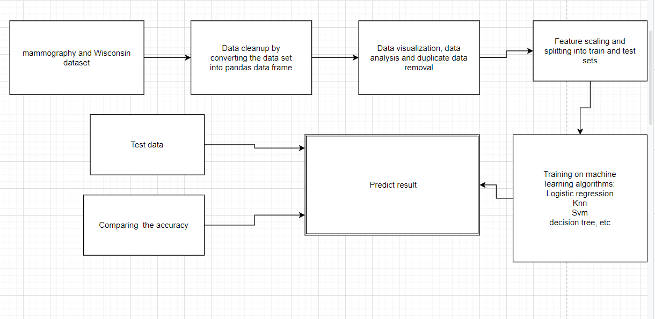
DESIGN

Slide 14
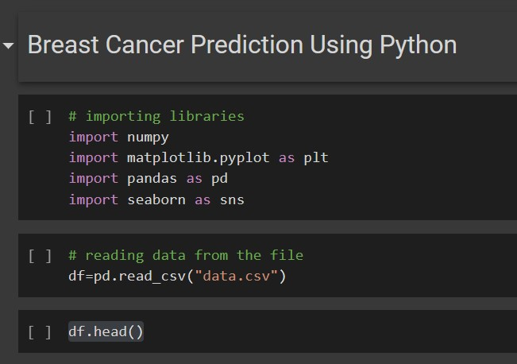
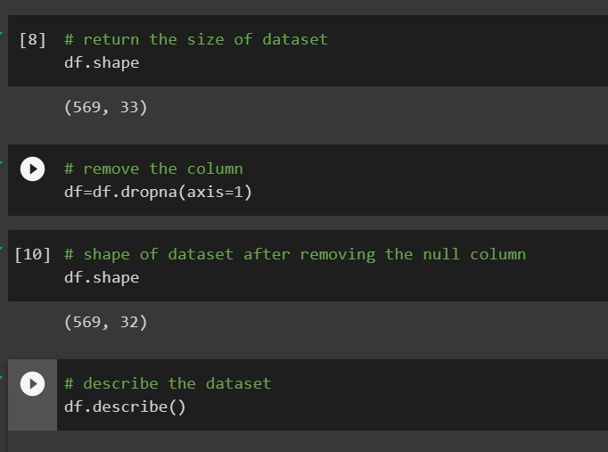
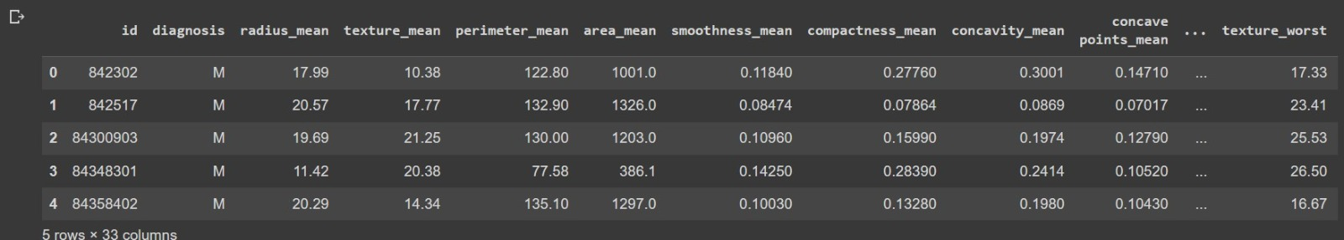
IMPLEMENTATION

Slide 15
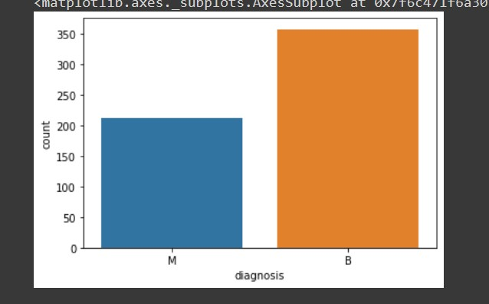
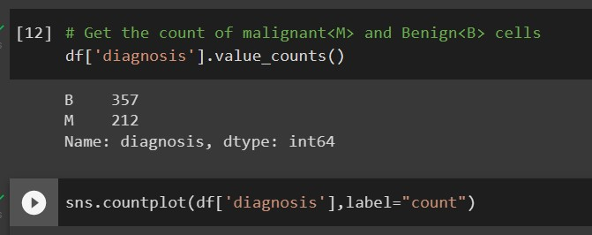
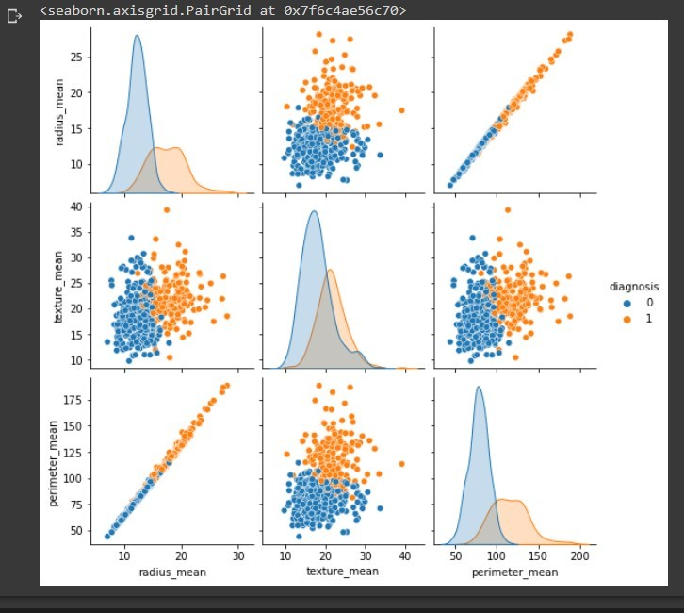
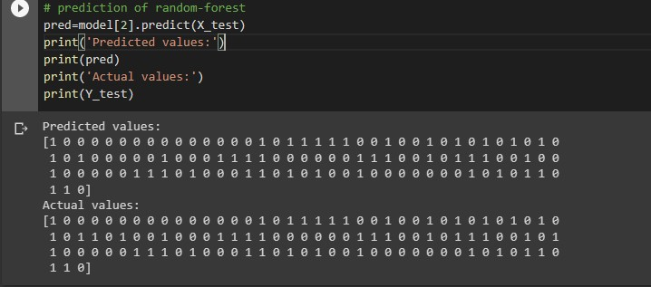

Slide 16
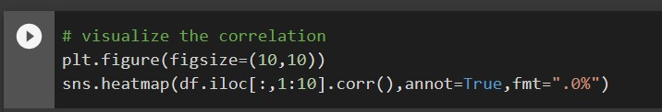
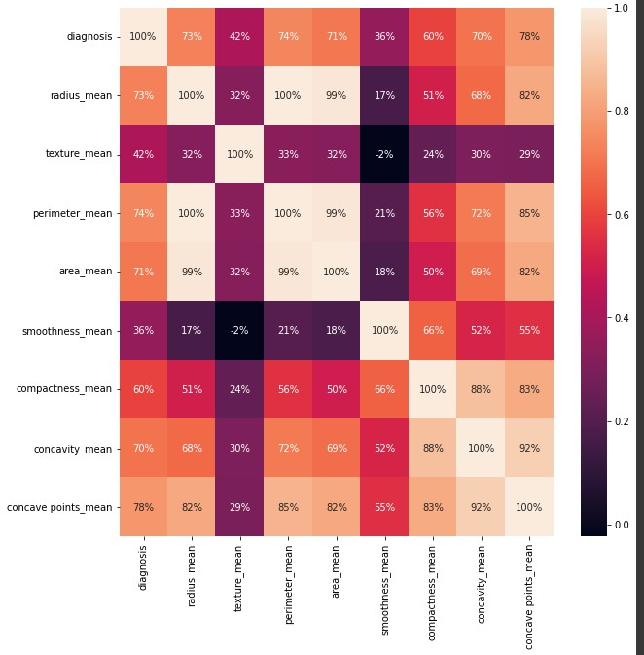

Slide 17
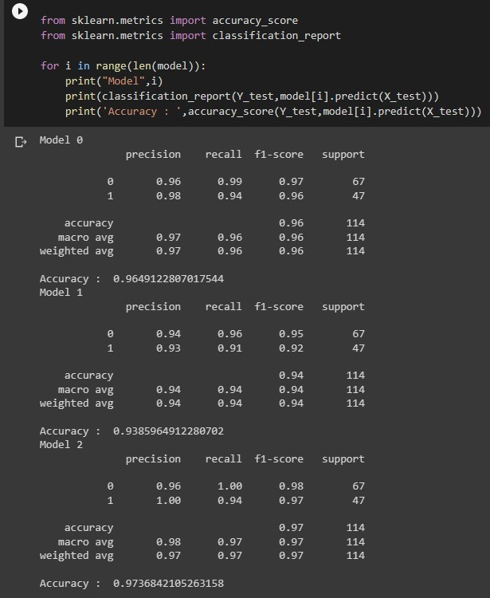
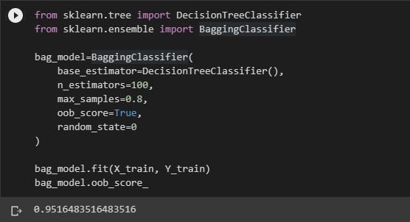

Slide 18
References
MF. Akay. “Support vector machines combined with feature selection for breast cancer diagnosis”.
S.Chakraborty, “Bayesian kernel probit model for microarray based cancer classification”,
T. Jinshan, R.R., X. Jun, I. El Naqa, Y. Yongyi, “Computer-Aided Detection and Diagnosis of Breast Cancer With Mammography
JF McCarthy, M.K., PE Hoffman, “Applications of machine learning and high-dimensional visualization in cancer detection, diagnosis, and management”

