Slide 1
Introduction to Databases & MySQL
. What is a Database?
A database is an organized collection of data that is stored and accessed electronically.
It allows us to store, manage, and retrieve data efficiently.
Think of a database as a digital filing cabinet where information is neatly organized in a way that computers can easily access.

Slide 2
Why do we need Databases?
To store large amounts of data in a structured way.
To allow multiple users and applications to access and modify data simultaneously.
To ensure data integrity and security.
To search and analyze data quickly.
Types of Databases
Relational Databases (RDBMS):
Store data in tables (rows and columns). Examples: MySQL, PostgreSQL, Oracle, SQL Server.
Data is organized with relationships between tables.

Slide 3
NoSQL Databases:
Store data in various formats like documents, key-value pairs, graphs, etc. Examples: MongoDB, Cassandra.
What is MySQL?
MySQL is an open-source Relational Database Management System (RDBMS).
It uses Structured Query Language (SQL) to access and manage data.
Originally developed by MySQL AB, now owned by Oracle Corporation.
Popular for web applications, especially with PHP (e.g., WordPress), and part of the LAMP stack (Linux, Apache, MySQL, PHP).

Slide 4
Features of MySQL
Open Source: Free to use and modify.
Cross-platform: Runs on Windows, Linux, macOS, etc.
High Performance: Fast query execution.
Scalable: Can handle small to large datasets.
Secure: User authentication and access control.
How Does MySQL Work?
You send a SQL query to MySQL server.
MySQL processes the query, searches the data.
Returns the results (like selected data) or performs the requested action (insert, update, delete).

Slide 5
Why are Databases Important?
Databases play a crucial role in almost every application and system because they provide several important benefits:
1. Efficient Data Storage
Databases allow large amounts of data to be stored in a way that is easy to organize.
They prevent data duplication and make sure data is consistent.
2. Data Retrieval and Manipulation
With databases, you can quickly retrieve specific information using queries.
You can also update, delete, or add ne
3. Data Integrity and Accuracy
Databases enforce rules to ensure the data entered is correct (e.g., age cannot be negative).
Constraints such as primary keys and foreign keys maintain relationships and prevent invalid data

Slide 6
4. Multi-user Access
Databases allow multiple users or applications to access and modify the data at the same time safely.
They handle conflicts and maintain data consistency.
5. Security
Databases provide access controls to protect sensitive data.
Only authorized users can view or modify certain parts of the data.
6. Backup and Recovery
Databases provide tools to back up data regularly.
In case of hardware failure or errors, data can be restored to prevent loss.
7. Data Relationships
Databases help represent and enforce relationships between different data, such as customers and their orders.
This makes data more meaningful and easier to analyze.

Slide 7
8. Support for Transactions
Databases can bundle multiple operations into a single transaction that either completes fully or not at all, maintaining data consistency.
Real-life Example of Importance
Imagine a bank without a database:
Customer accounts would be written on paper or in unorganized files.
Finding a customer's balance or transaction history would take a long time.
Multiple employees updating accounts simultaneously could cause errors or loss of data.
Security would be weak, risking sensitive information leaks.
With databases:
The bank can store millions of customer records safely.
Queries instantly retrieve balances or transactions.
Multiple users can update data without errors.
Data is backed up and secure.

Slide 8
What is RDBMS (Relational Database Management System)?
Definition:
RDBMS stands for Relational Database Management System.
It is a software system that manages relational databases.
In an RDBMS, data is stored in tables (also called relations), which consist of rows and columns
The tables are related to each other through keys, allowing complex data to be organized and retrieved efficiently.

Slide 9
Key Features of RDBMS:
Tables (Relations): Data is organized into tables with rows and columns. Each row is a record, and each column is an attribute or field.
Primary Key: Each table has a unique identifier called the primary key that uniquely identifies each record.
Foreign Key: Used to link tables together and maintain relationships between them.
SQL Support: RDBMS uses Structured Query Language (SQL) for querying and managing the database.
Data Integrity: Ensures accuracy and consistency of data through constraints like NOT NULL, UNIQUE, and CHECK.
ACID Properties: Supports Atomicity, Consistency, Isolation, and Durability — important for reliable transactions.
Multi-user Access: Multiple users can access and manipulate the database concurrently without data corruption.

Slide 10
Examples of RDBMS:
MySQL
Oracle Database
Microsoft SQL Server
PostgreSQL
SQLite

Slide 11
What is MySQL?
Definition:
MySQL is a popular open-source Relational Database Management System (RDBMS).
It uses SQL as the language to manage and manipulate data stored in databases.
MySQL was originally developed by MySQL AB, later acquired by Oracle Corporation.
It is widely used in web applications and supports multiple platforms such as Windows, Linux, macOS.

Slide 12
Why Use MySQL?
Open Source & Free: Anyone can use and modify it without cost.
Cross-Platform: Runs on many operating systems.
High Performance: Fast query processing even with large amounts of data.
Scalability: Can handle small to very large databases.
Security: Supports user authentication and permissions to protect data.
Support for Transactions: Ensures reliable data processing through ACID compliance.
Wide Community and Support: Large community of users and developers, lots of tutorials, and tools available.

Slide 13
How MySQL Works?
You create a database to organize your data.
Inside the database, you create tables to store different types of data.
You use SQL queries to add, update, delete, and retrieve data.
MySQL processes your queries and returns the results.

Slide 14
Introduction to SQL Commands
What is SQL?
SQL stands for Structured Query Language.
It is the standard language used to communicate with Relational Database Management Systems (RDBMS) like MySQL, Oracle, SQL Server, and PostgreSQL.
SQL allows you to create, read, update, and delete data stored in databases.
It also helps to define database structures (tables, relationships) and control access.
Types of SQL Commands
SQL commands are divided into several categories based on their purpose:

Slide 15
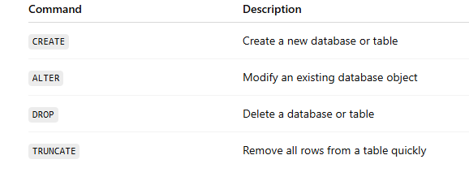
Data Definition Language (DDL)
Used to define or modify the structure of database objects such as tables, indexes, and schemas.
Common DDL commands:

Slide 16
Examples:
-- Create a table named students
CREATE TABLE students (
id INT PRIMARY KEY,
name VARCHAR(50),
age INT
);
-- Add a new column 'grade' to students table
ALTER TABLE students ADD COLUMN grade VARCHAR(5);
-- Delete the students table
DROP TABLE students;
-- Remove all rows from students (table structure remains)
TRUNCATE TABLE students;

Slide 17
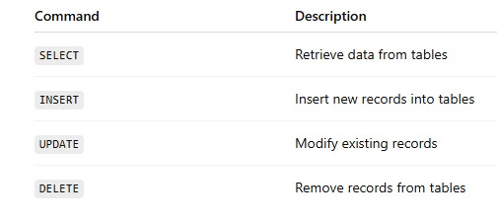
2. Data Manipulation Language (DML)
Used to manipulate data stored inside tables.
Common DML commands:

Slide 18
Examples:
-- Retrieve all records from students
SELECT * FROM students;
-- Insert a new student record
INSERT INTO students (id, name, age, grade) VALUES (1, 'Alice', 14, '9');
-- Update the grade of a student
UPDATE students SET grade = '10' WHERE id = 1;
-- Delete a student record
DELETE FROM students WHERE id = 1;

Slide 19
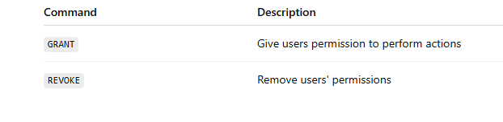
3. Data Control Language (DCL)
Used to control access and permissions on the database objects.
Common DCL commands:

Slide 20
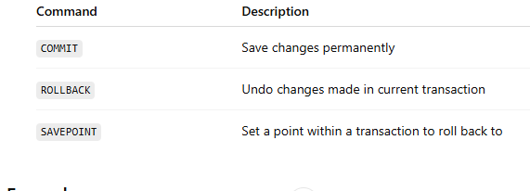
Example:
-- Give SELECT permission on students table to user 'student_user'
GRANT SELECT ON students TO 'student_user';
-- Remove permission
REVOKE SELECT ON students FROM 'student_user';
4. Transaction Control Language (TCL)
Used to manage transactions in the database.
Transactions ensure a set of operations execute completely or not at all.
Common TCL commands:

Slide 21
Example:
BEGIN;
UPDATE students SET grade = '11' WHERE id = 2;
-- If everything is good, save the change
COMMIT;
-- If something goes wrong, undo the change
ROLLBACK;

Slide 22
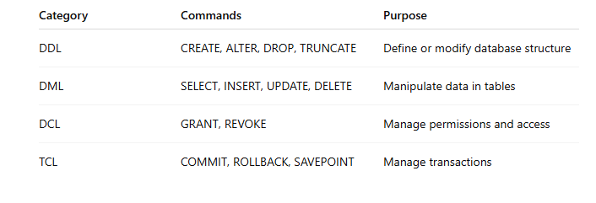
Summary Table of SQL Commands

Slide 23
Why Learn SQL Commands?
SQL commands form the core of interacting with databases.
They allow you to create and maintain database structure.
You can efficiently add, modify, and retrieve data.

Slide 24
Creating Databases and Tables
1. What is a Database?
A database is a structured collection of data stored electronically. In MySQL, databases hold tables, and each table stores rows of related data.
2. Creating a Database
Syntax
CREATE DATABASE database_name;
Example
CREATE DATABASE school;
Check Created Databases
SHOW DATABASES;
Use a Specific Database
USE school;
This command tells MySQL to use the school database for the operatios.

Slide 25
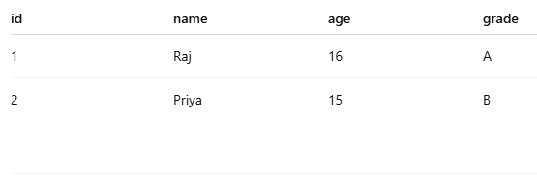
3. What is a Table?
A table is a collection of related data entries organized in columns (fields) and rows (records).
For example, a students table might contain:

Slide 26
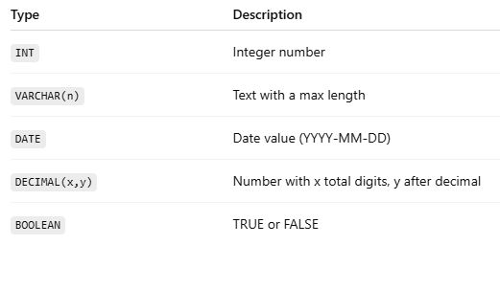
4. Creating a Table in MySQL
Syntax
CREATE TABLE table_name (
column1 datatype constraints,
column2 datatype constraints,
...
);
Common Data Types

Slide 27
5. Example: Create students Table
USE school;
CREATE TABLE students (
id INT PRIMARY KEY AUTO_INCREMENT,
name VARCHAR(50) NOT NULL,
age INT, grade VARCHAR(5),
admission_date DATETIME DEFAULT CURRENT_TIMESTAMP);
INSERT INTO students (name, age, grade, admission_date)
VALUES ('John Doe', 18, 'A1', CURDATE());
Explanation:
id: Auto-incremented unique identifier for each student.
name: Name of the student, cannot be NULL.
age: Student’s age.
grade: Optional grade.
admission_date: Defaults to today’s date if not specified.

Slide 28
6. View Created Tables
SHOW TABLES;
7. View Table Structure (Schema)
DESCRIBE students;
or
DESC students;
It shows the table's columns, their types, nullability, keys, and default values.

Slide 29
8. Creating Multiple Tables with Relationships (Foreign Key)
1. students Table (created before):
CREATE TABLE students (
id INT PRIMARY KEY AUTO_INCREMENT,
name VARCHAR(50) NOT NULL,
age INT, grade VARCHAR(5),
admission_date DATETIME DEFAULT CURRENT_TIMESTAMP);
Isme har student ka:
id = unique primary key
name, age, grade, admission_date = uske details

Slide 30
2. courses Table (New):
CREATE TABLE courses (
course_id INT PRIMARY KEY AUTO_INCREMENT,
course_name VARCHAR(100) NOT NULL
);
course_id = unique ID for each course (auto increment)
course_name = course ka naam
Example: "Mathematics", "Science", "Computer Programming"
3. enrollments Table (Bridge Table for many-to-many):
CREATE TABLE enrollments (
enrollment_id INT PRIMARY KEY AUTO_INCREMENT,
student_id INT,
course_id INT,
enrollment_date DATE,
FOREIGN KEY (student_id) REFERENCES students(id),
FOREIGN KEY (course_id) REFERENCES courses(course_id)
);

Slide 31
Purpose of this table:
Ek student multiple courses le sakta hai
Ek course multiple students ke pass ho sakta hai
Ye table many-to-many relationship ko implement karti hai
Columns:
enrollment_id → unique ID of enrollment
student_id → kis student ne course liya (foreign key to students)
course_id → kaunsa course liya (foreign key to courses)
enrollment_date → kab enroll hua

Slide 32
Working with Data – Insert Examples
Step 1: Insert Students
INSERT INTO students (name, age, grade, admission_date)
VALUES
('Raj Kumar', 20, 'A1', '2025-06-10'),
('Anita Singh', 19, 'B2', '2025-06-12'),
('Saurabh Mehta', 21, 'A2', '2025-06-13');
Step 2: Insert Courses
INSERT INTO courses (course_name)
VALUES
('Mathematics'),
('Physics'),
('Computer Programming');

Slide 33
Step 3: Enroll Students into Courses
-- Raj Kumar enrolls in Mathematics (student_id = 1, course_id = 1)
INSERT INTO enrollments (student_id, course_id, enrollment_date)
VALUES (1, 1, '2025-06-14');
-- Anita Singh enrolls in Physics (student_id = 2, course_id = 2)
INSERT INTO enrollments (student_id, course_id, enrollment_date)
VALUES (2, 2, '2025-06-14');
-- Saurabh Mehta enrolls in Computer Programming (student_id = 3, course_id = 3)
INSERT INTO enrollments (student_id, course_id, enrollment_date)
VALUES (3, 3, '2025-06-14');
-- Raj Kumar also enrolls in Computer Programming
INSERT INTO enrollments (student_id, course_id, enrollment_date)
VALUES (1, 3, '2025-06-15');

Slide 34
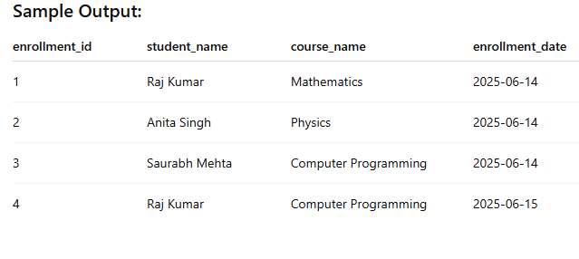
SELECT
e.enrollment_id,
s.name AS student_name,
c.course_name,
e.enrollment_date
FROM enrollments e
JOIN students s ON e.student_id = s.id
JOIN courses c ON e.course_id = c.course_id;

Slide 35
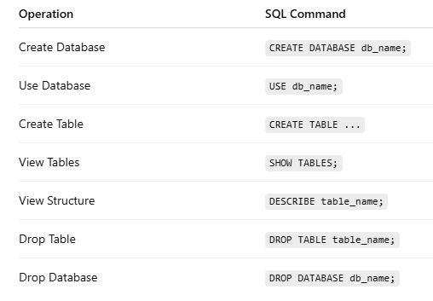
10. Drop or Delete Tables/Databases
DROP TABLE students;
Drop a Database
DROP DATABASE school;

