Slide 1

LIFE EXPECTANCY OF PEOPLE
Submitted by –
RAHUL KUMAR
IVY PROFESSIONAL SCHOOL

Slide 2

OBJECTIVE
Perform linear regression analysis to predict life expectancy
Find what factors does not affects average life span of a person
Find whether higher mortality rates ensures higher life expectancy
Find whether schooling play any role in increasing one’s life span
Find what other factors affects average life span of a person

Slide 3
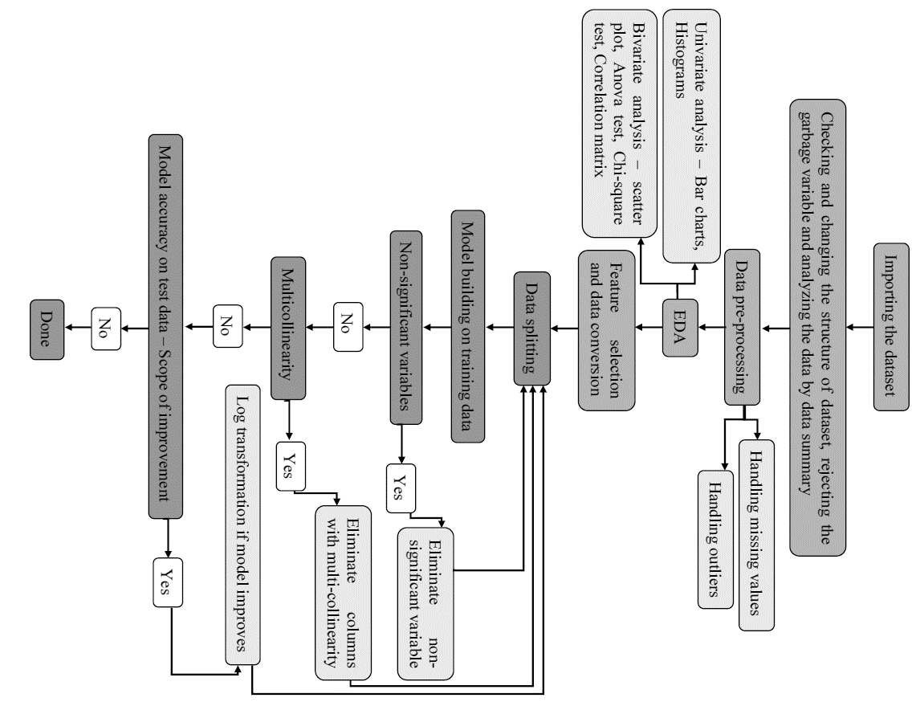

METHODOLOGY

Slide 4

Data
Data in CSV format
2938 data points and 23 variables
Dependent variable – “Life_Expectancy” (Continuous )
2 Character variables and rest numerical
Garbage variable - “Country” and “Year”

Slide 5
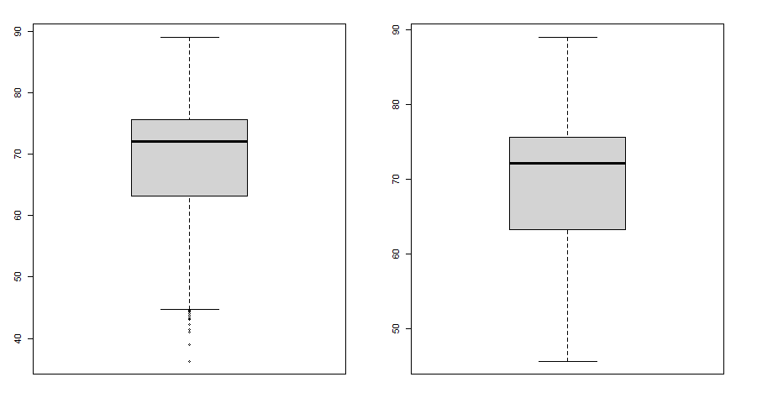
DATA PRE-PROCESSING
15 variables with less than 20% missing values
16 variables with outliers – most +ve outliers
Missing values treatment by replacement with mean, median or mode
Outliers treated by fixing range
Boxplot for “Life_Expectancy”

Slide 6
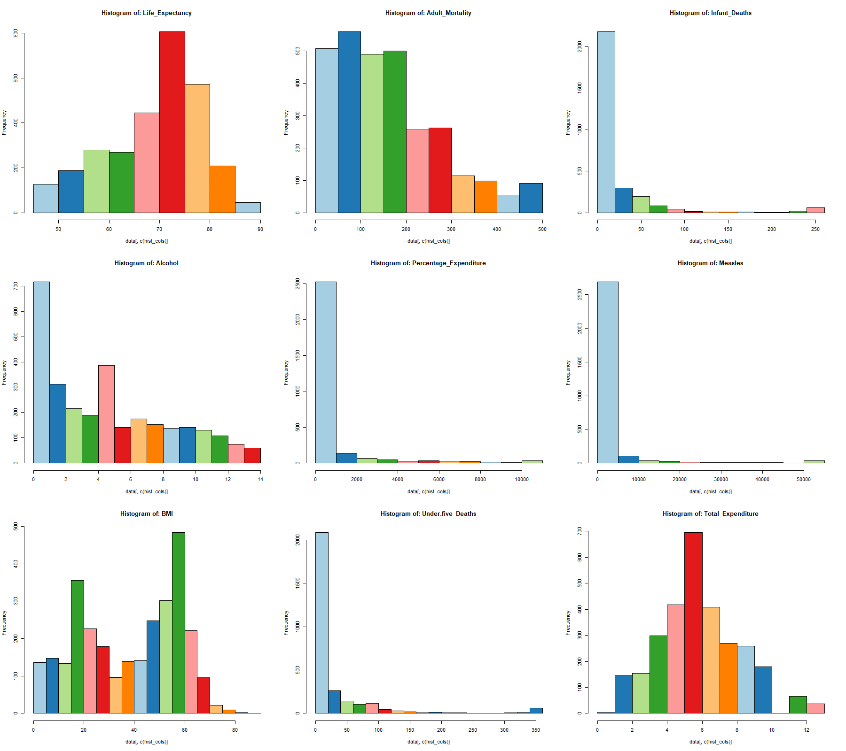
UNIVARIATE ANALYSIS
Histograms

Slide 7
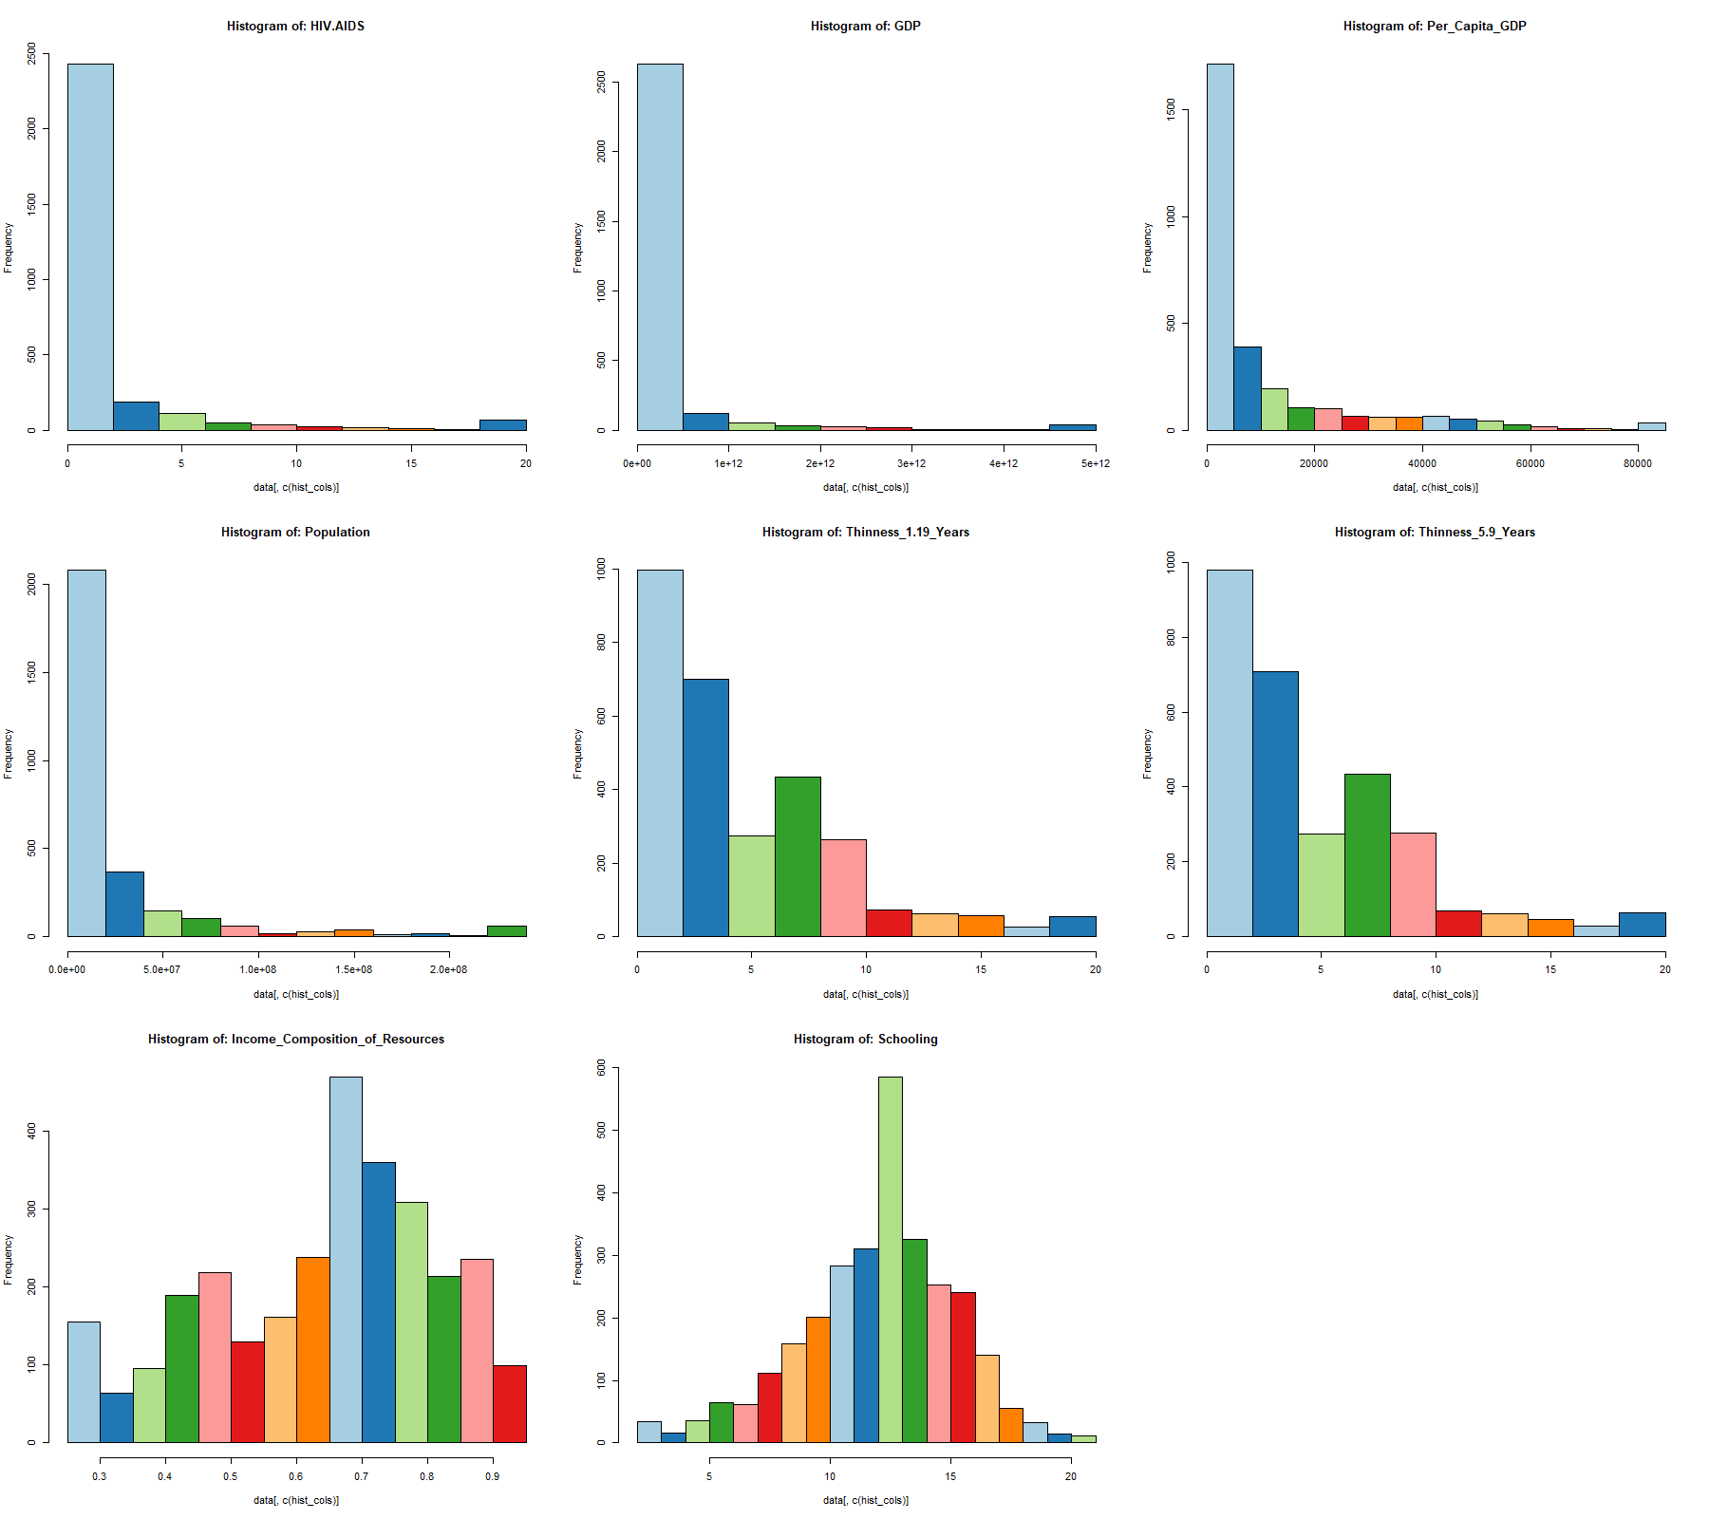
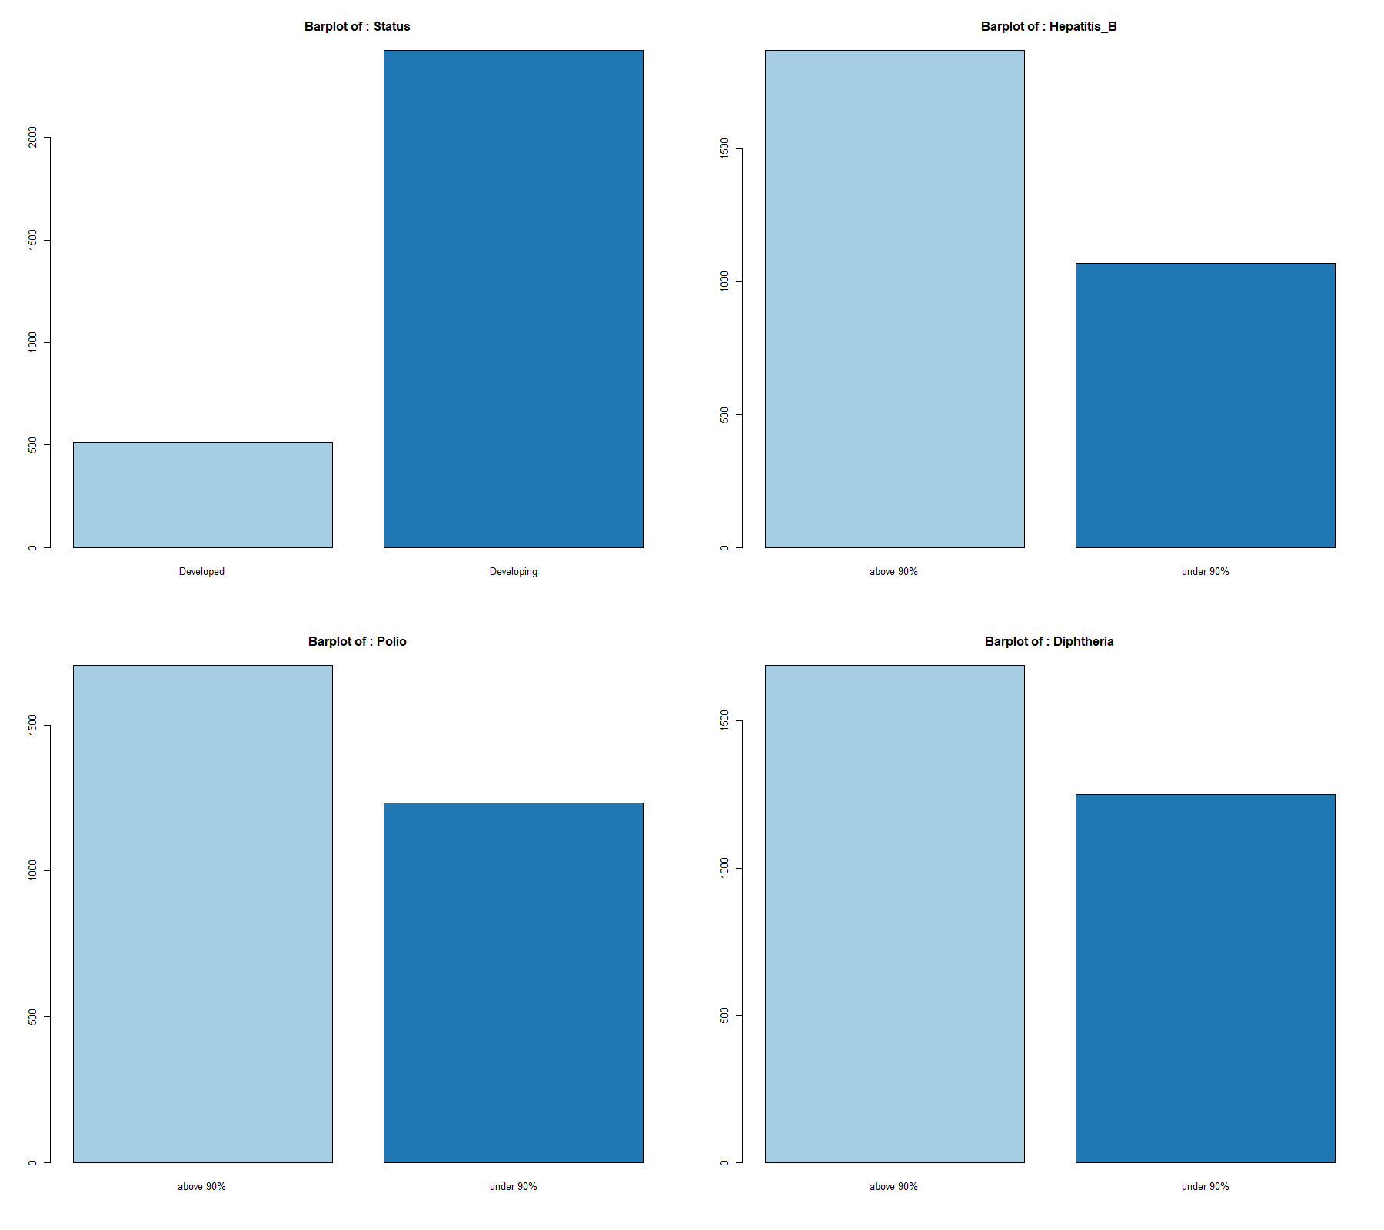
UNIVARIATE ANALYSIS
Histograms
Barplots

Slide 8
BIVARIATE ANALYSIS, Feature SELECTION AND DATA Conversion
Includes scatter plot, correlation matrix and ANOVA test
Acc. to ANOVA test every categorical variable is correlated
Acc. to scatter plot and correlation matrix 10 continuous variables have weak correlation
Elimination of weakly correlated variables
Conversion of categorical variables into numerical factors ( 1’s and 0’s)
Correlated Variables
Continuos | Categorical
"Adult_Mortality" | "Status”
"BMI", | "Hepatitis_B”
"Income_Composition_of_Resources" | "Polio”
"Schooling” | "Diphtheria"
“Per_Capita_GDP"
Per_Capita_GDP"

Slide 9


MODEL
Initial
Final
Linear regression model
Training data – 70% & Test data -30%
R2 value of 0.8323
Non-significant variables -"Status" and "Polio“
No multicollinearity
Linear regression
Training data – 70% & Test data -30%
R2 value of 0.8312
No non-significant variables
No multicollinearity

Slide 10

ACCURACY
MAPE = 4.204787
Median-APE = 3.045557
Mean Accuracy - 95.79521
Median Accuracy - 96.95444

Slide 11
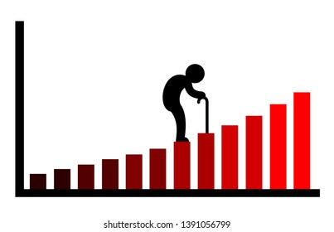
INSIGHTS
Factors like country, year, expenditure etc. does not affect the life expectancy of people
Reaching 15 years of age does not ensure a good life while schooling does
A country's GDP and income composition affect life expectancy more broadly
One can extend their life span by adopting a healthy lifestyle, having proper BMR, proper education, and getting vaccinated on time for each disease
Some parameters like pollution and environmental index are missing and can be included for better insights

Slide 12

Thank you !

