Slide 1
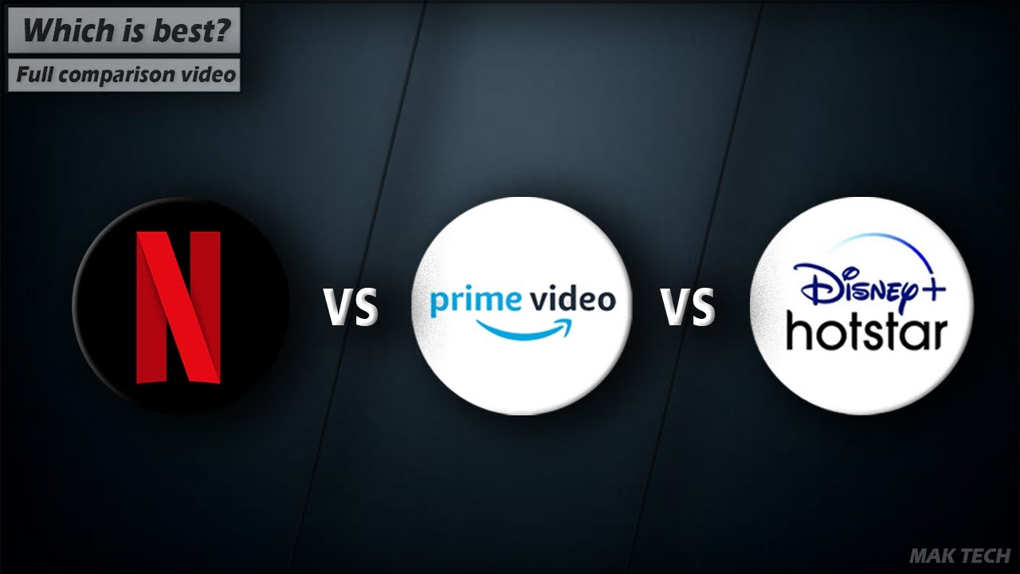
A CASE STUDY ON LEADING STREAMING SERVICES
A Research Project By Rahul Kumar

Slide 2


CONTENT
INTRODUCTION
OBJECTIVE
ANALYSIS
FINDINGS

Slide 3

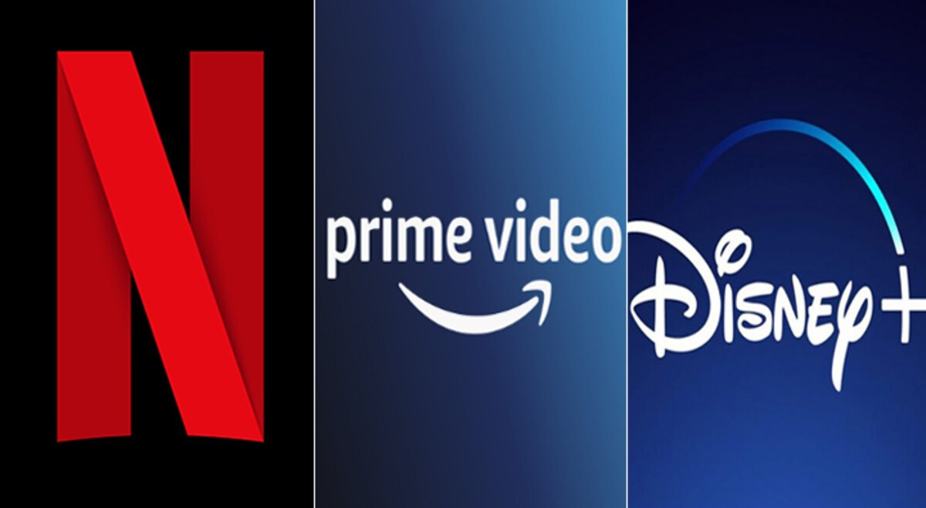






INTRODUCTION

Slide 4
To find where streaming services are most effective across major 5 countries and where they need to optimize their services
To find what sort of competition streaming services are facing in India
To find which streaming service is most effective in India
To find which streaming service is best based on rating, recent movies, richness in terms of language, genre and target audience
To find which streaming service is best for telecom, ecommerce, fintech companies and end users
OBJECTIVES

Slide 5
India is most effective in terms of library size/$ for both Netflix and Disney+
India is at 2nd in terms of effectiveness (library size/$) for Prime video
Australia is least effective in terms of library size/$ for both Netflix and Prime video
UK is least effective in terms of library size/$ for Disney+
PRICE AND LIBRARY SIZE WISE DATA ANALYSIS AROUND THE WORLD

Slide 6
Prime video is most effective in terms of both library size/$ and subscription cost
Netflix is most effective when talking in terms of library size only
Prime video has approximately 714 more movies per $ as compared to Netflix
Disney+ is least effective in terms of library size and library size per $ in India
PRICE AND LIBRARY SIZE WISE COMPARISION IN INDIA

Slide 7
Prime video as more 18+ movies (74%) while Disney+ has least
Difference is percentage of 18+ movies on Prime video and Netflix is very less (2%)
Disney+ is more rich in terms of all age group movies
DIFFERENT AGE GROUPS MOVIES ON EACH PLATFORM

Slide 8
According to average IMDb rating, Disney+ has most top rated movies while Prime video has least
According to average rotten tomato rating also, Disney+ has most top rated movies while Prime video has least
Netflix has average rated movies according to both
RATING WISE ANALYSIS OF DIFFERENT PLATFORMS

Slide 9
Netflix has most largest % of recent movies as compared to Prime video and Disney+
Disney+ as least percentage of recent movies
Disney+ is more rich in terms of all decade movies
NO OF RECENT MOVIES ON EACH PLATFORM

Slide 10
Number of Hindi movies are more on Netflix as compared to any other OTT
Number of English movies are more on Prime video as compared to any other
Total no of English and Hindi movies are more on Prime video as compared to any other
Prime video is most language rich platform for movies
LANGUAGE RICH OTT PLATFORMS

Slide 11
Disney+ is least genre rich platform for movies
Netflix is most genre rich platform for movies
The percentage of movies for each genre category goes down from Netflix to Disney+
GENRE RICH OTT PLATFORMS

Slide 12
OTTs | Cost | Library size | Library size/$ | Average Rating | All audience | Language rich | Genre rich | Recent content
Netflix
Prime Video
Disney+
FINDINGS

Slide 13
Streaming services are most effective in India across major 5 countries. It is least effective in Australia and hence need to optimize its services there
In India, Netflix need to provide low rates on its subscription to sustain in market as it has tough competition with prime video which is very good as compared to others
Netflix is most suitable when taking in terms of genre and recent content, Disney+ is more suitable in terms of rating and target audience while Prime video is more effective in terms of library size per $ of subscription and language richness
Platforms like Jio, Airtel, Flipkart, Phone-Pay etc. for their offer purposes can choose Prime video keeping in consideration its popularity and least cost in India
If money is not a problem, end users can go for Netflix keeping in consideration its largest library size, average rating, good no of recent movies, and richness in terms of genre
Disney+ has to work towards its library size and cost both to sustain in market with prime-video and Netflix. However when coming to average rating of movies on it and movies from different decades, it has better % of movies
FINDINGS

Slide 14
THANK YOU

