Slide 1

Weather HISTORY
Submitted by –
RAHUL KUMAR
IVY PROFESSIONAL SCHOOL

Slide 2

OBJECTIVE
Perform multiple linear regression analysis to predict temperature in Hungary
Find what factors does not affect temperature in Hungary
Find whether higher humidity ensures low temperature or not
Find whether wind speed and pressure play any role in increasing or decreasing the temperature or not
Find what other factors affects average temperature in Hungary

Slide 3

Data
Data in CSV format
96453 data points and 12 variables
Dependent variable – “Temperature (C)” (Continuous )
3 Character variables and rest numerical
Garbage variable - “Formatted Date”, ”Summary”, ”Loud Cover” and “Daily Summary”

Slide 4
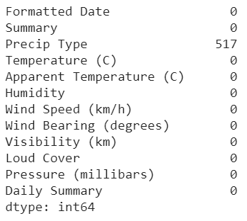
DATA PRE-PROCESSING
1 variables with less than 0.55% missing values
1 correlated variables with outliers – “Humidity”
Missing values treatment by replacement with mode
Outliers treated by eliminating data points with outliers
Missing values”

Slide 5
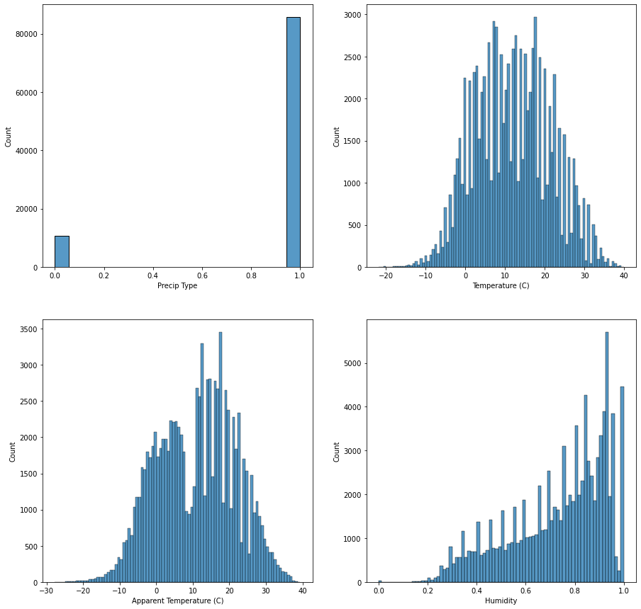
UNIVARIATE ANALYSIS
Histograms

Slide 6
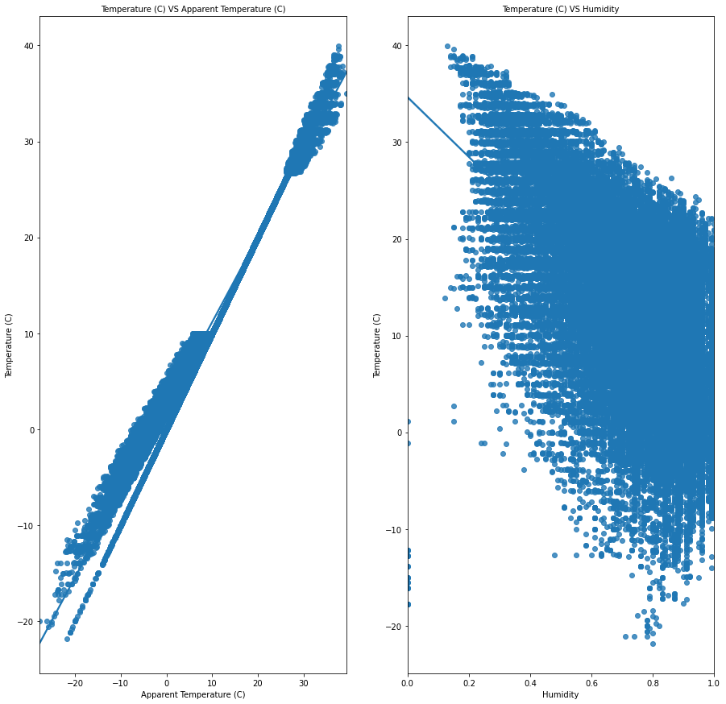
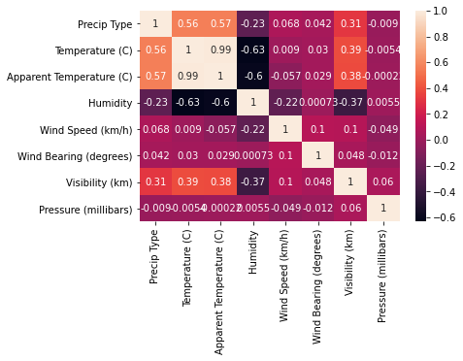
BIVARIATE ANALYSIS

Slide 7


MODEL
SKLEARN
STATS
Linear regression model
Training data – 85% & Test data -15%
R2 value of 0.9872
Multicollinearity detected (due to “Precip type”) and removed
Linear regression model
Training data – 85% & Test data -15%
R2 value of 0.987
Multicollinearity detected (due to “Precip type”) and removed

Slide 8

ACCURACY, COEFFICIENT AND INTERCEPT
R2 value for both the stats and sklearn model before and after removing multicollinearity = 0.9873
Coefficients by sklearn linear model : 0.85, -2.63
Intercept by sklearn linear model : 4.56
Coefficients by stats linear model : 0.84, -2.73
Intercept by stats linear model : 4.39

Slide 9
INSIGHTS
Factors like wind Speed (km/h), wind Bearing (degrees), pressure (mb) and visibility (km) does not affect the temperature of Hungary
Humidity does affect the temperature but with a negative correlation
Relative humidity combined with the air temperature also affects the temperature of Hungary but with a positive correlation

Slide 10

Thank you !

