Slide 1

WEBSITE AD CLICK BY USING LOGISTIC REGRESSION
Submitted by –
Rahul Kumar
Ivy Professional School

Slide 2
CONTENT
Business problem overview
Work flow
Dataset and pre-processing
Univariate analysis
Bivariate analysis
Model
Accuracy
Business recommendations

Slide 3
Business Problem Overview
Marketing a product through internet is now becoming more popular
Targeting the right audience is a big problem
Advertisement of irrelevant products can be very costly
Need of the hour - To derive a way for showing relevant advertisements to relevant people
Deployment of logistic regression model – To predict website Ad-click by using R

Slide 4
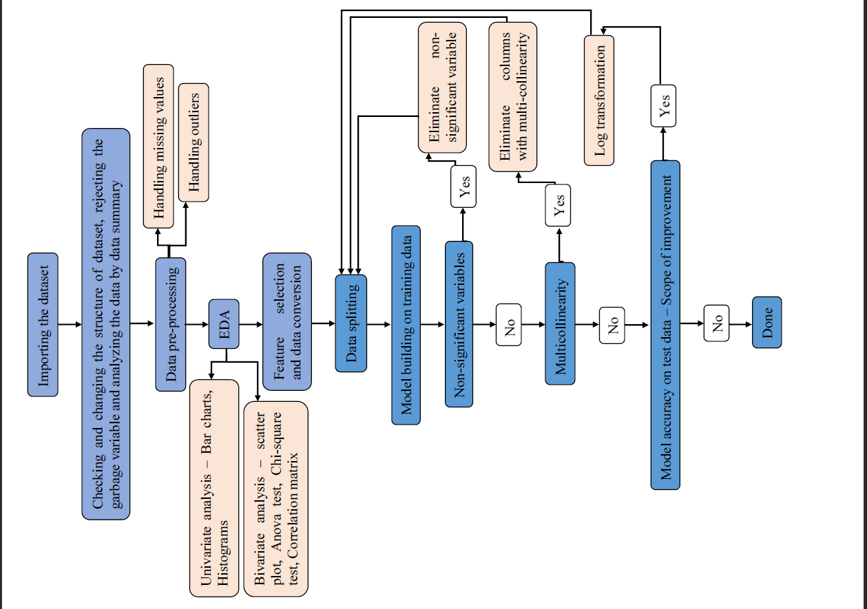
Work Flow

Slide 5
Dataset
CSV format dataset named as “Web_data”
Consists of 14 attributes and 6657 data points
7 of them are character variable and rest are numerical
Garbage variable is “Year”
Need of conversion of character variable to numerical (after conversion into factors)
Attribute of interest is "Clicked" (dependent variable)
Can have two possible outcomes – 1 (clicked) & 0 (not clicked)

Slide 6
Pre-Processing
Generally 2 steps -
1. Handling missing values
2. Handling outliers
Attributes having >20% missing value are eliminated
Missing values are replaced by either mean, median or mode
No missing value in “Web_data”
Outliers are detected by boxplots and treated by their replacement with either max. or min. value corresponding to a given attribute

Slide 7
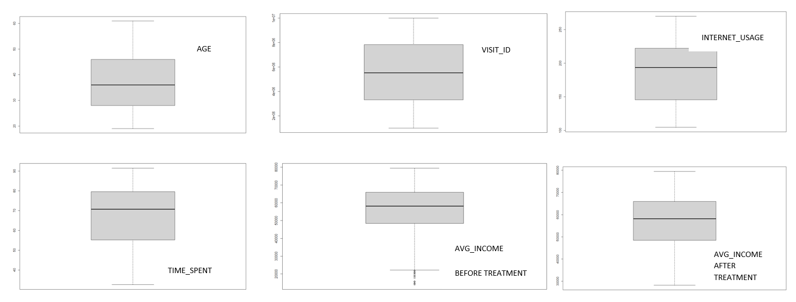
Pre-Processing
Attribute with outlier – “Avg_Income”

Slide 8

Univariate Analysis
Analysis of single variable at a time, include histograms (numerical data) & bar plots (categorical data)
According to bar plot most of the variable are balanced except “City_code”
Variables like “Ad_Topic” and “Country_Name” are having so many categories
Not possible to create dummy variables
According to histogram, variables like "Avg_Income", "Internet_Usage" and "Time_Spent" are little bit skewed
There are no outliers present
No variable is perfectly bimodal except “Internet_usage”

Slide 9
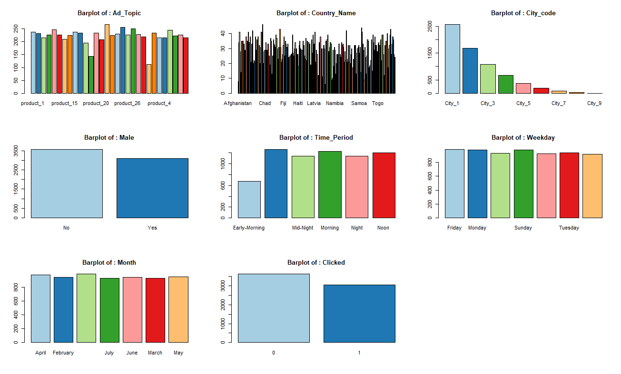
Univariate Analysis

Slide 10
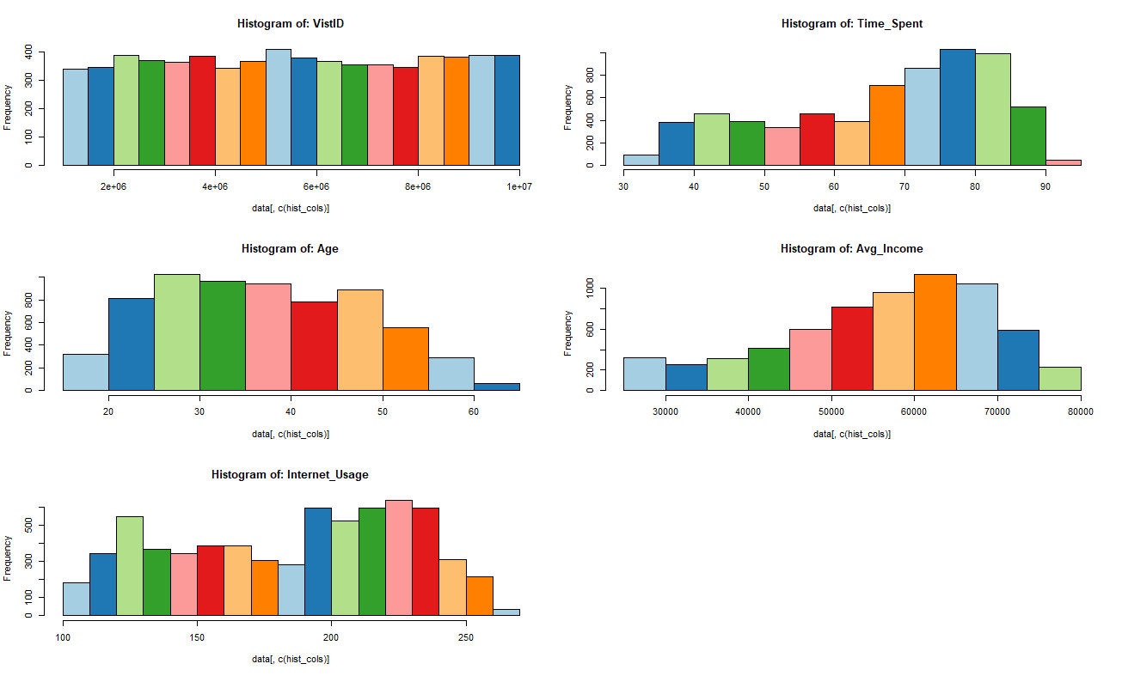
Univariate Analysis

Slide 11
Bivariate Analysis
Involve 2 variables, include scatter plot and correlation test
Correlation test
Correlation matrix ( for cont-cont )
ANOVA ( for cont-categorical )
Chi-square ( for categorical-categorical )
According to ANOVA test, non correlated independent variable with dependent variable is “VisitID”
According to Chi-square test, non correlated variables are “Weekday” and “Month”
According to correlation matrix, two independent variables “Time_spent” & “Internet_usage” are correlated weakly

Slide 12
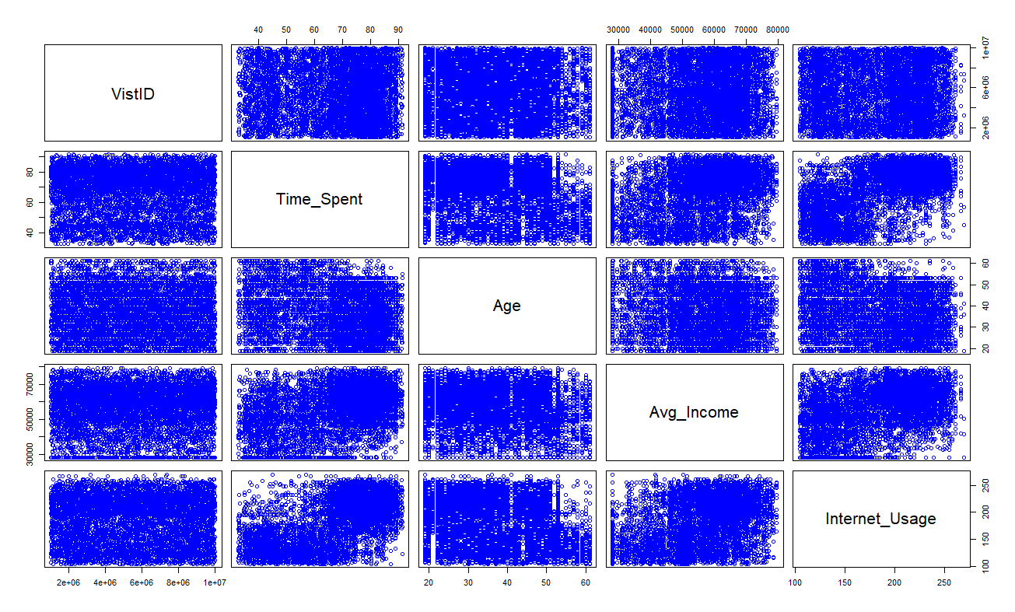
Bivariate Analysis
According to scatter plot, no variables are showing any clear relationship with each other

Slide 13
MODEL
Elimination of non correlated variable
Conversion of factors into numerical data
Splitting of data into training (4660) and test (1997) data
Ratio of splitting 70:30
Deployment of logistic regression model

Slide 14
Model
AIC score of 2029
Non significant variable - "Ad_Topic", "Country_Name", "Male" and "Time_Period“
Significant variable – “Age”, ”Avg_Income”, “Internet_usage”, “Time_spent” and “City_code”
No multicollinearity
Elimination of non significant variables and log transformation for model improvement

Slide 15
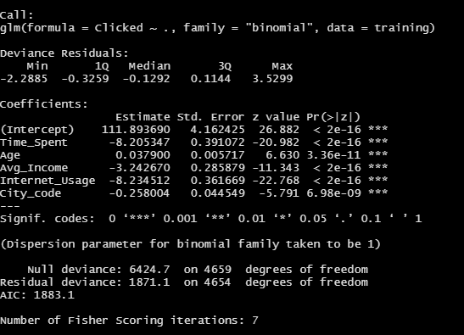
Model
Final model ( after improvement ) parameters –
Improved AIC score of 1883.1
All variables are significant and negatively correlated with the dependent variable except “Age”

Slide 16
Accuracy
Prediction on test data with a threshold of 0.5
Determination of threshold value by ROC curve
Accuracy before log transformation -
Parameters | Value
Accuracy | 92.79%
Precision | 0.94
Recall/Sensitivity | 0.9168
F1-score | 0.9350181
Specificity | 0.9423
Balanced accuracy | 0.9296

Slide 17
Accuracy
Accuracy after log transformation -
Parameters | Value
Accuracy | 93.24% (Improved)
Precision | 0.96 (Improved)
Recall/Sensitivity | 0.9146
F1-score | 0.9395432 (Improved)
Specificity | 0.9565 (Improved)
Balanced accuracy | 0.9355 (Improved)

Slide 18
Business Decision
Younger users spend more time on the website, users of age between 20 to 40 years can be the main target
Product made for middle-aged groups should be marketed here rather than products intended for people over the age of 50 or 60
Website is pretty popular as users spend between 32 to 91 minutes on it in one session means, costly advertisements are feasible
Average income of people visiting this website ranges from 13996 to 79485 means site visitors are people belonging to different social class
Company should advertise both its low cost product as well as high cost product here

Slide 19
Business Decision
Average income has negative correlation with the decision that whether a user will click on an AD or not (from parameters value in the final model)
People having less average income are more likely to click on the ad as compared to people with higher income
More focus on advertisement of mid ranged product
Decision whether a particular user is going to click on an AD or not depends on where he lives, depends on his age, what he earns, how much time he spends on that website
Audiences should be not be targeted on the basis of parameters like country, gender, time period, day, date or year.

Slide 20
THANK YOU

