Slide 1

Library Management System.

Slide 2

INDEX
Introduction
Objectives
Key Features
Flow Chart
Project Features
Screen Shots
Summary

Slide 3
INTRODUCTION
A Library Management System (LMS) is a website containing webpages that simplifies and automates the operations of libraries.
It is a complete system for managing library duties such as student signup and login, employee signup and login and forget password features.

Slide 4
Develop features for managing user accounts, including creating databases for the students and teacher information , storing for the future reference.
The main objective of the Library Management System (LMS) project is to design and implement an efficient and user-friendly system that automates the various tasks associated with managing a library.
OBJECTIVE

Slide 5
Key Features:
User Interface webpage.
Student login and signup webpage.
Student forget password webpage.
Employees login and signup webpage.
Employees forget password webpage.

Slide 6
FLOWCHART
User Sign up
Login Page
Database
Forget Password
Employee Sign Up
Login Page

Slide 7
Project Features
For Users:
We will have following features for a user:
New User Registration:
This feature allows new users to sign up for the system by providing the necessary details.
Student/Employee Login:
This feature will provide the authenticated access for registered users to login the system and enters the details respectively.
Student/Employee Forget Password:
This feature will provide the authentication for the access of forget password webpage if the user find difficulty in remembering the password.

Slide 8
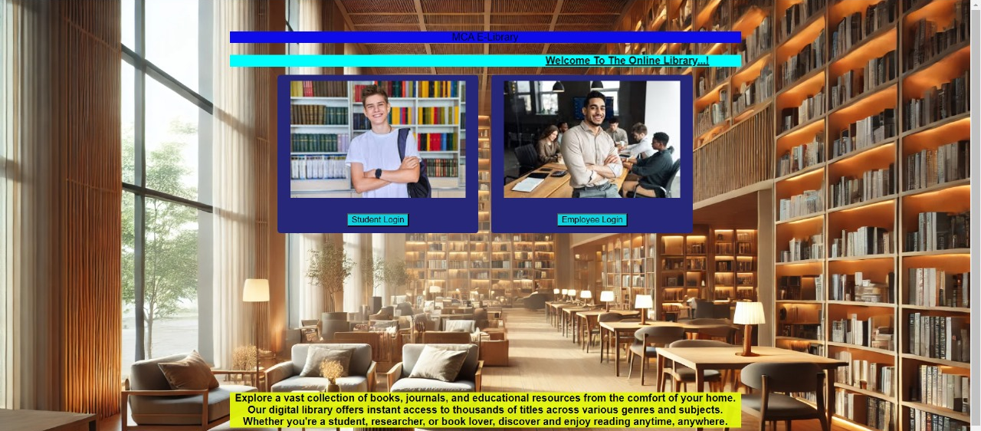
Home Page

Slide 9
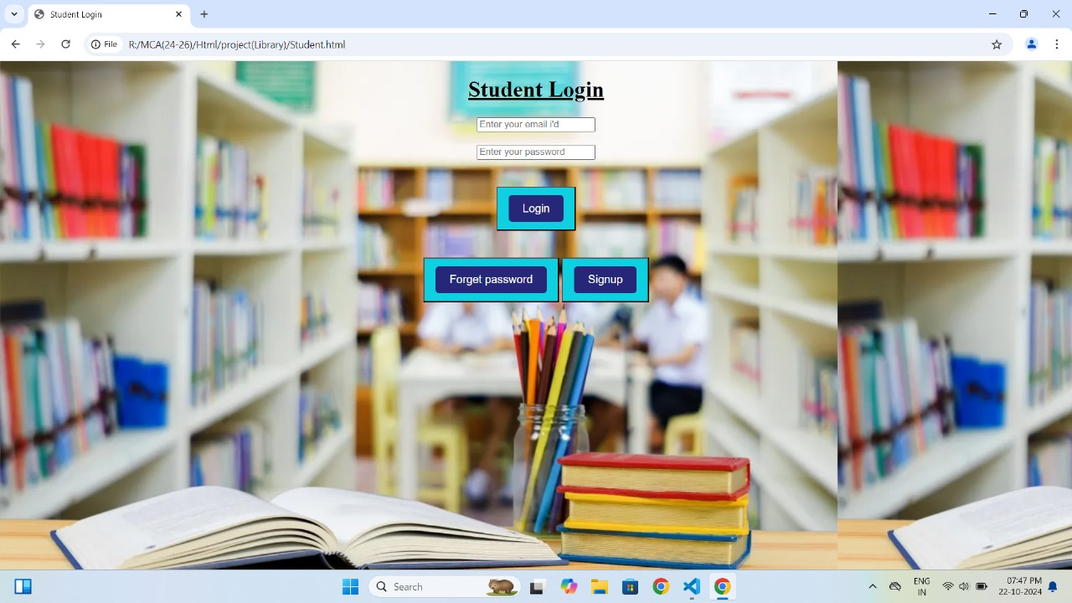
Student Login

Slide 10
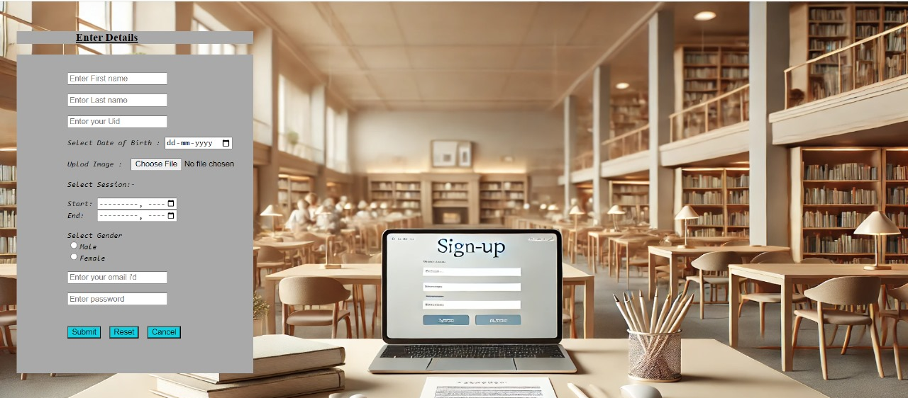
Student Sign-up Page

Slide 11
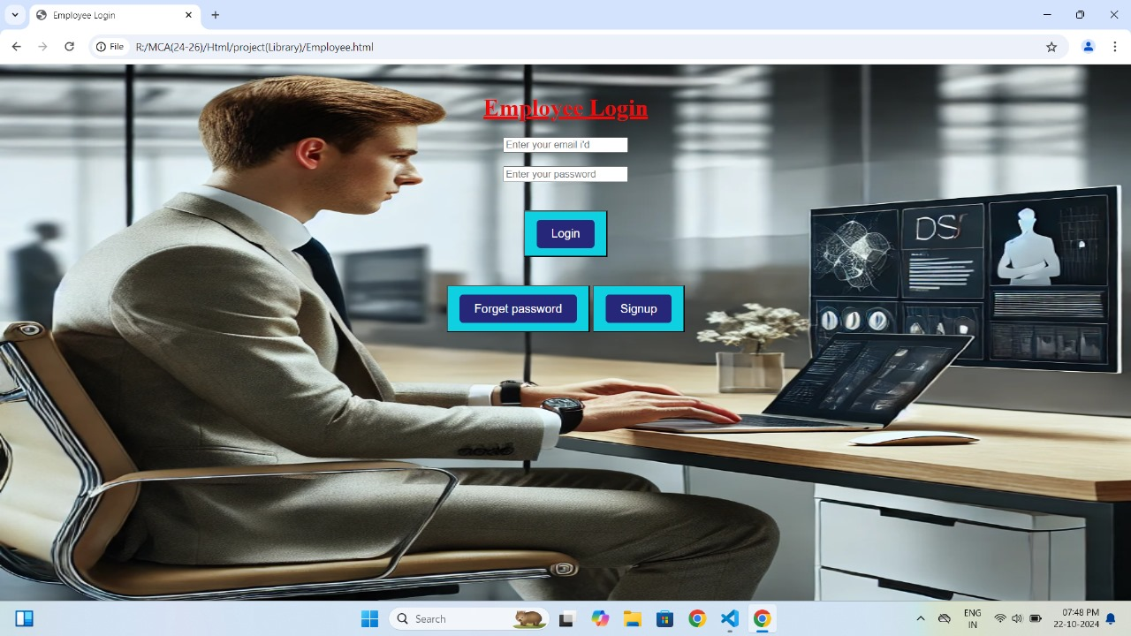
Employee Login

Slide 12
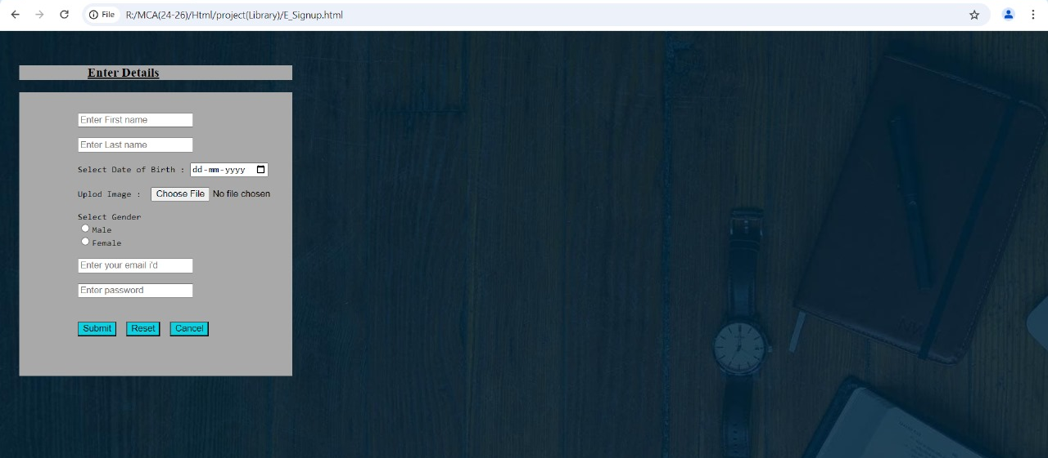
Employee Sign-up Page

Slide 13
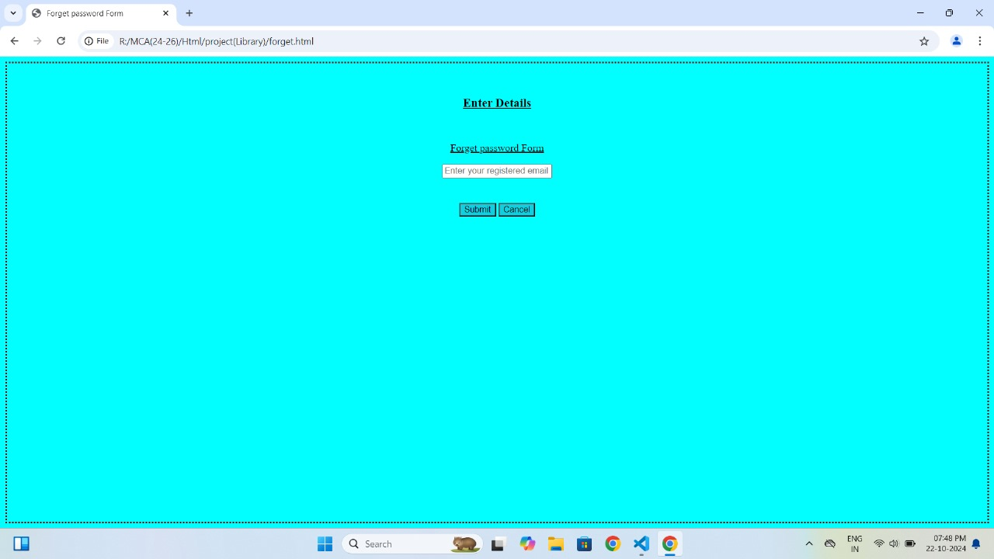
Forget Password

Slide 14

Summary
The Library management system needs to be Computerized to reduce human errors and to increase the efficiency. The proposed Library management system in this proposal will be a computerized management system developed to maintain all the daily work of library. Library management systems are designed to store all the information about the books and members.
The focus of this project is to lesson human effort and encourage efficient record keeping.

Slide 15
THANK YOU

