Slide 1
Unix Command/Scripting Basics
Speaker:
Rahul Kumar Singh

Slide 2
Unix :
What is “UNIX” ?
What is “Kernel” ?
What is “Terminal” ?
What is “Shell” ?
What is “Command Prompt” ?

Slide 3
Unix :
What is “UNIX” ?
UNIX is an OS.
What is “Kernel” ?
The kernel of UNIX is the hub of the operating system: it allocates time and memory to programs and handles the filestore and communications in response to system calls.
As an illustration of the way that the shell and the kernel work together, suppose a user types rm myfile (removing the file myfile). The shell searches the filestore for the file containing the program rm, and then requests the kernel, through system calls, to execute the program rm on myfile. When the process rm myfile has finished running, the shell then returns the UNIX prompt to the user, indicating that it is waiting for further commands.
What is “Terminal” ?
It's a program called a terminal emulator. This is a program that opens a window and lets you interact with the shell.
What is “Shell” ?
Simply put, the shell is a program that takes commands from the keyboard and gives them to the operating system to perform. The shell acts as an interface between the user and the kernel. It is a command-line interface that interprets a user's commands and script files, and tells the server's operating system what to do with them.
What is “Command Prompt” ?
When you first login to a server you will be dropped into the command prompt, or shell prompt, which is where you can issue commands to the server
E.g: user@hostname:~$

Slide 4
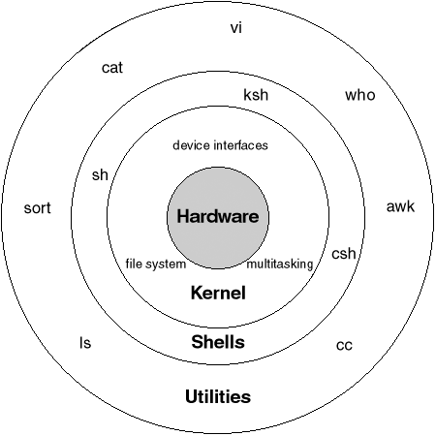
Unix:

Slide 5
Unix Basic Commands…

Slide 6
Unix Command :
cal: Calendar
Syntax: cal
cal 03 2012
date: Display the system date as well as time
Syntax: date
date +%m
date +%h
date + “%h %m”
echo/printf: Display the messages
name=Rahul
echo “Hi, welcome to unix basics”
echo “Hi $name”
printf “Hi, welcome to unix basics”
printf “ I am %s\n My age is %d\n" "$name" 23
clear: Clear the screen.
bc: Calculator
Syntax: bc
12 + 5
12*12 ; 2^12
9/5
scale=2
17/7
ibase=2
11001010
script: Recording your session
script -> to start
exit -> to stop
script –a -> to append
script logfile -> to record session in different file

Slide 7
Unix Command :
man: It is the system's manual viewer; it can be used to display manual pages, scroll up and down, search for occurrences of specific text, and other useful functions.
e.g. man cat
info: give detailed information about specific command
e.g. Info cat
history: List Last/All Executed Commands in
Linux.
sudo apt-get install software_name: to install/update new software. (you need super user privileges).
e.g: sudo apt-get update
e.g: sudo apt-get install java
software_name –version: to check version.
e.g: java version
adduser: you can create new user with command
useradd <name> and passwd <username>.
passwd: to change user password
userdel <username>: To delete user.
userdel –r <username>: To remove the user, their home folder, and their files.
cat /etc/passwd: list usernames.
groupadd: create new group
usermod: to modify user
e.g.: sudo groupadd cs
sudo useradd ravi
sudo usermod –a –G cs ravi
-a append
-g is use to delete user from existing group and add in new group
-G is use to add user in new group without removing from existing group

Slide 8
Unix Command : (Cont.)
who: display the users working on the system and the time of logging in.
who am I: display the current user details.
who –Hu: display the IDLE time along with column name
uname: display the name of your OS.
uname –r: display the version of OS.
uname –n: display the hostname (alternative command: hostname)
finger username: this command give lots of information about the user. E.g. last login , last mail read etc.
talk username: let you have typed conversation with user.
rlogin hostname/Ip: let you login to the remote host
telnet hostname/Ip: let you login to the host in the same network. Use exit to logout.
ping: to check the availability of a host available on the network.
e.g.: ping google.com
ssh username@ip: let you login to the sever.
e.g.: ssh root@10.195.40.167
Password less login:
ssh-keygen –t rsa
ssh-copy-id username@ip

Slide 9
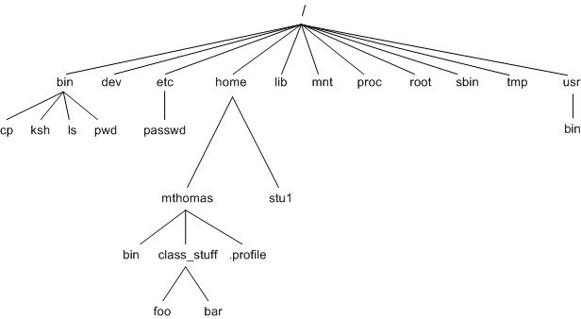
File System :
What is FILE ?
File is just a container for storing information's.
Types of FILE ?
Ordinary File: also known as regular file. It contains only data as stream of character.
Directory File:we commonly says it contain directory files and other directory but in reality it has only there name and number associated with the name.
Device File: All devices and peripherals represented by files.

Slide 10
Unix Command : (Cont.)
echo $HOME: Home Directory
pwd: print/present working directory
cd: change the current directory
e.g. cd directoryname
cd .
cd ..
cd fails when you don’t have proper permission to access the directory
mkdir: make new directory.
e.g. mkdir directoryname
rmdir: remove directory
cat filename: Dump a file to the screen in ascii.
more filename: Progressively dump a file to the screen: ENTER = one line down SPACEBAR = page down q=quit
less filename : Like more, but you can use Page-Up too. Not on all systems.
vi filename: Edit a file using the vi editor. All UNIX systems will have vi in some form.
head filename: Show the first few lines of a file.
head -n filename: Show the first n lines of a file.
tail filename: Show the last few lines of a file.
tail -n filename: Show the last n lines of a file.

Slide 11
Unix Command : (Cont.)
ls : listing directory contents
ls option:
-x Multicolumnar output
-F Marks executable with *,directory with / and symbolic links with @
-a show all files with . And .. And all hidden files also
-x display directory content eg: ls –x directoryname
-R list all the files and subdirectories in a directory list
-r sort file name in reverse order
-l long listing, show seven attributes of file
-t sort filename by last modified time
-lt sort listing by last modified tine
-u sort filename by last access time
-lu sort by ASCII collating sequence
-I display inode number

Slide 12
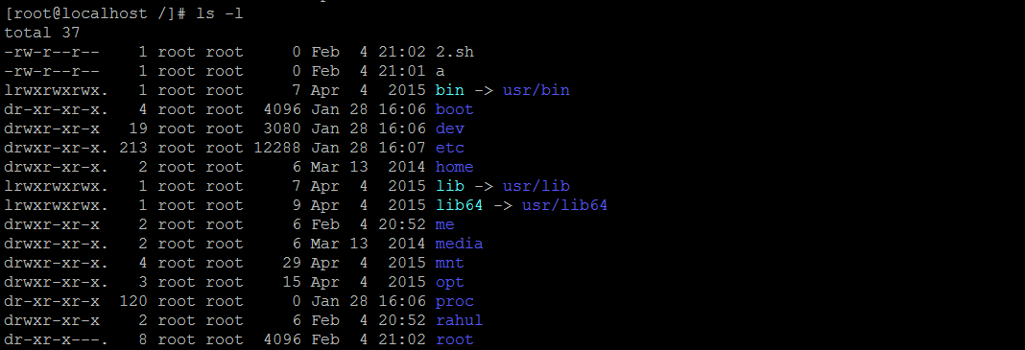
Unix Command : (Cont.)
Ls –l command output:

Slide 13
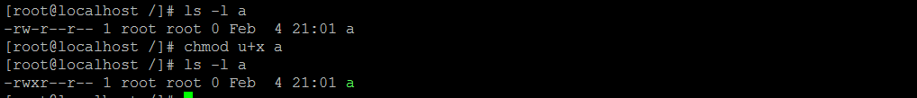
Unix Command : (Cont.) File Ownership
Chmod: Change permission
e.g. : chmod ugo+x filename
chmod go+x
chmod go-x
chmod a-x,go+w filename
chmod o+wx filename
chmod 777 filename

Slide 14
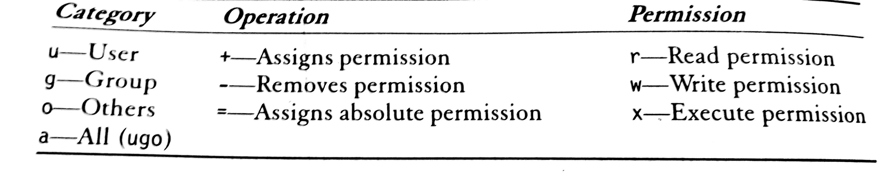
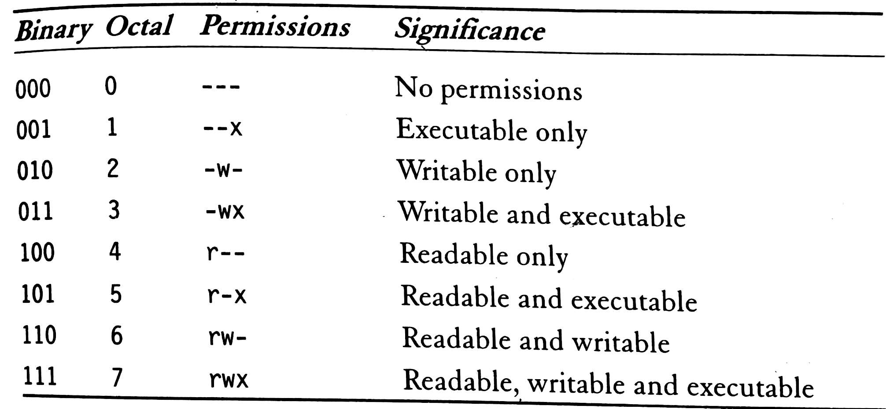
Unix Command : (Cont.)
File Permission Options Details
Permission Table In Binary And Octa

Slide 15
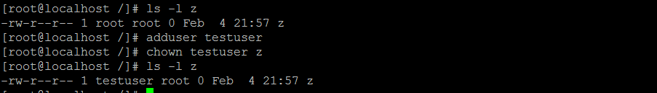

Unix Command : (Cont.) File Ownership
Chown: change the owner of the file.
Chgrp: change the group owner of the file.

Slide 16
Unix Command : (Cont.) File Handling
cat: display and create file
e.g. cat filename (display file content)
cat –n filename (display line number)
cat > foo ( create file )
cp: copy a file
Syntax: cp source destination
cp –I (interactive copy)
cp –r (copy directory structure)
touch: create text file
Syntax: touch a
rm: delete file
Syntax: rm filename
rm –rf (forcefully removal)
mv: rename/move file
Syntax : mv oldfilename newfilename
wc: Counting Lines, words and character in file.
Syntax : wc filename
wc –l (number of file)
wc –w (number of words)
wc –c (numbers of character)
cmp: compare two files.
Syntax : cmp file1 file2
comm: display common between files
diff: display difference between files
dos2unix and unix2dos
Syntax: dos2unix foo foo
dos2unix foo
dos2unix > foo.dos
vi: File editor (vi filename.extension)
:w to save
:q to quite
:wq to save and quite

Slide 17
Unix Command : (Cont.) Compressing and Archiving Files
gzip: Compressing file
Syntax: gzip filename.extention
wc –c zipfilename.gz (to check how much compressed)
wc –l zipfilename.gz give full details
gunzip./gzip –d: Decompress file.
tar: The archival program
Options: -c create an archive
-x extract file from archive
-t display file archive
Syntax: tar –cvf filename
tar –xvf filename.tar
tar –tvf filename.tar
zip/unzip: compression and archiving together
zip filename.zip filename directory
unzip filename.zip

Slide 18
Unix Command : (Cont.) Redirection of stdout/stdin/file/command
Example: Redirecting the linux date command to a file:
linux3-(6:28pm): date > output
linux3-(6:28pm): cat output
Sun Oct 6 18:28:32 EDT 2002
If we redirect stdout using a single > it will overwrite the contents of the file, erasing all previous contents.
linux3-(6:28pm): date > output
linux3-(6:28pm): cat output
Sun Oct 6 18:28:44 EDT 2002
Redirecting with >> appends to a file.
linux3-(6:30pm): date >> output
linux3-(6:30pm): cat output
Sun Oct 6 18:30:07 EDT 2002
Sun Oct 6 18:30:19 EDT 2002
Redirection of stdin <
linux3-(6:40pm): cat 1.dat
1 2
linux3-(6:40pm): avg < 1.dat
Enter the first integer: Enter the second integer: Average is: 1.500000
Redirection of output: >
example:$ ls > my_files
Redirection of input: <
example: $ mail kornj <input.data
Append output: >>
example: $ date >> logfile
tee: The tee command can be used to send standard output to the screen and to a file simultaneously.
make | tee build.log
Runs the make command and stores its output to build.log.
make install | tee -a build.log Runs the make install command and appends its output to build.log.

Slide 19
Unix Command : (Cont.)
grep: Scans the given files and displays the lines which match the given pattern.
Syntax: grep <pattern> <files>
e.g.
ls -l | grep "Feb"
ls -l | grep -i "carol.*aug“
grep error *.log Displays all the lines containing error in the *.log files
grep -i error *.log Same, but case insensitive
grep -I error *.log Same, but case sensitive
grep -v info *.log Outputs all the lines in the files except those containing info.
grep “patterns” switch filename
Switches:
-i: searches for the given pattern insensitive to case (matches both uppercase and lowercase)
-n: displays the numbers of the lines that match the target pattern
--recursive: searches from this working directory downward
-v: select all lines accepting those containing pattern
-c: count and display number of lines containing patter.
-l: display only name of the file containing pattern.
-e: use to match multiple patterns
e.g. grep –e “Test” –e “test” filename.txt

Slide 20
Unix Command : (Cont.)
find: recursively descends through pathlist and applies expression to every file.
Syntax: find path-list selection-criteria
e.g.
find / -name a.out –print
find . –name “*.c” –print
find . –name ‘[a-z]*’ –print
Find all files beneath home directory beginning with f
find ~ -name 'f*' -print
Find all files beneath home directory modified in last day
find ~ -mtime 1 -print
Find all files beneath home directory larger than 10K
find ~ -size 10k -print
sort: Sorts the lines in the given file in character order and outputs them.
sort <file>
sort -r <file> Same, but in reverse order.
sort -ru <file> u: unique. Same, but just outputs identical lines once.
more: progressive reading/displaying

Slide 21
Unix Command : (Cont.)
awk: awk is a utility/language designed for data extraction and printing specific fields.
e.g. ls –l | awk ‘{print $1}’
e.g. awk ' {print $1,$3} ‘
sed: sed is used for text processing.
e.g. cat report.txt | sed 's/Nick/John/g' > report_new.txt -> Replace every occurrence of Nick with John in report.txt
e.g. sed -n 12,18p file.txt -> Show only lines 12-18 of file.txt
e.g. sed 12,18d file.txt –> Show all of file.txt except for lines from 12 to 18
cut: cut is used for text processing. You can use this command to extract portion of text from a file by selecting columns.
e.g. cut -c2 filename
e.g. cut -c1-3 filename
e.g. cut -c-8 filename
e.g. cut -d':' -f1 /etc/passwd
e.g. grep "/bin/bash" /etc/passwd | cut -d':' -f1-4,6,7

Slide 22
Unix Command : (Cont.)
Hard Links: The default behavior for ln is to create hard links
A hard link to a file is a regular file with exactly the same physical contents (a file can have multiple file names).
When a file have hard link, its link count get increased and it can be access by any link and all this files(hard link) have common inode number.
While they still save space, hard links can't be distinguished from the original files.
If you remove the original file, there is no impact on the hard link contents.
The contents are removed when there are no more files (hard links) to them.
Syntax: ln filename linkname
e.g.
ln test.txt new
Use cases:
Protect from accidental deletion.
Save spaces
Symbolic link: It is a special file which is just a reference to the name of another one (file or directory):
Useful to reduce disk usage and complexity when 2 files have the same content.
Hard link has few limits, it cant be in between files in two different directory (/usr and /home) and it cant linked two directory within same file system.
Syntax: ln –s note note.sym
How to identify symbolic links:
ls -li displays -> and the linked file name.
GNU ls displays links with a different color.
Removing note.sym make no effect as new link can be created but removing note make the symbolic linkcpoint no where and lead to dangling symbolic link

Slide 23
Q/A

Slide 24
Thank-You

