Slide 1
Principal Component Analysis
Standardize features
Calculate the covariance matrix for the features
Calculate the eigenvalues and eigenvectors for the covariance matrix
Sort eigenvalues and their corresponding eigenvectors
Transform the original matrix
Pick k eigenvalues and form a matrix of eigenvectors

Slide 2
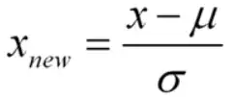
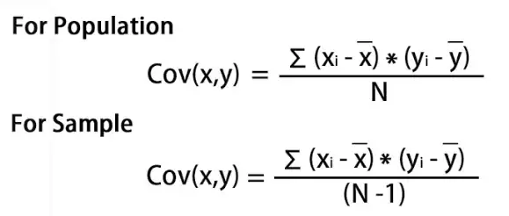
Standardize dataset using this formula for each feature Covariance Matrix e.g. for 2 features: [[var(x), cov(x,y)], [cov(y,x), var(y)]] Calculate Eigen values and Eigen Vectors: det(A-λI) = 0, A is standardized data, λ is eigen values, I is identity matrix; (A-λI)ν = 0, ν is eigen vectors which is calculated for each value of λ Sort λ is descending order and arrange eiger vectors respective to them Feature matrix * top k eigenvectors = Transformed Data Calculate covariance matrix for transformed data to find contribution of each PC towards total variance of data

