Slide 1
K Means Clustering
Raw Data
Decide K
Centroids
Calculate Distances
Group Data Points
End
Iterate Until No Change In Groups

Slide 2
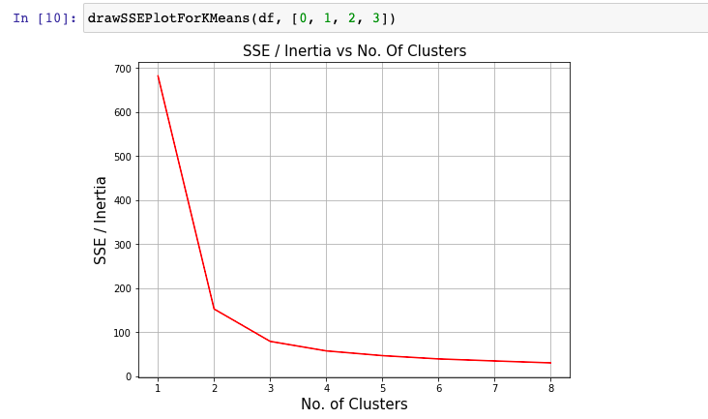
Decide K
Calculate Within-Cluster Sum of Square errors for multiple K values
SSE = Submission of Square of (Each cluster point – centroid) for every cluster
This is plotted on an Elbow plot and if this value is not changing significantly, that is decided as a K value

Slide 3
Algorithms
We initialize K number of centroids randomly in the data
e.g. {x1: 1,2,3,4,5; x2: 2,4,6,8,50} and k = 2
Initial centroids: 3,6 and 4,8
A distance from each data point is calculated and data points are grouped to nearest centroid
C1 = 1,2; 2,4; 3,6 and C2 = 4,8; 5;50 and new centroid is average of c1 and c2 i.e. 2,4 and 4.5, 29
Step 2 is repeated again
C1 = 1,2; 2,4; 3,6; 4,8 and C2 = 5,50 and new centroid is 2.5,5 and 5,50
No change is centroid after this iteration which is the end of clustering process

Slide 4
Advantages and Disadvantages
Ads
Unsupervised method which doesn't need labelled data
Helps in discovering hidden categories in data
Dis
Assumes clusters to be spherical in shape
Sensitive to centroid initialization
Different results for differet runs

