Slide 1
Portuguese Bank Marketing
Assignment Report

Slide 2
Project Description
The project analyzes the prior marketing campaign data of a Portuguese bank and aims to predict whether the customer will subscribe to fixed-term deposit products the bank is offering.

Slide 3
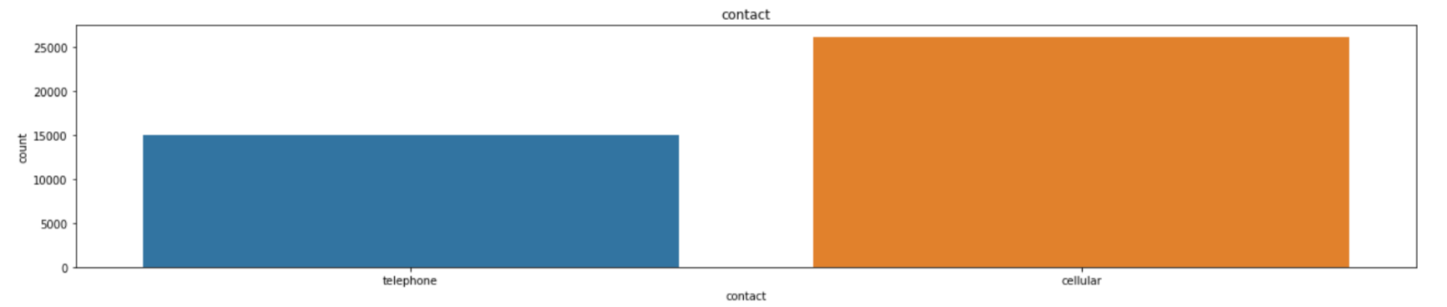
Plotting Categorical Data
Contact : This attribute is for communication purpose.

Slide 4
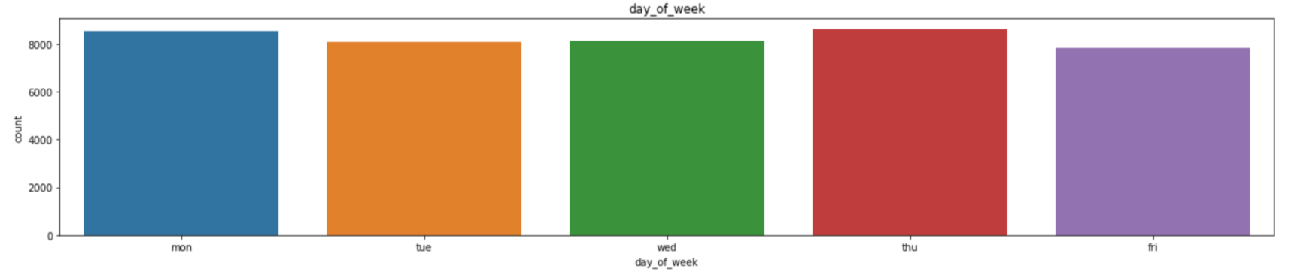
Day_of_week
This attribute represent the last contact day of week. Here we see that on thur-
sday the number of employee contacted is more as compare to others.

Slide 5
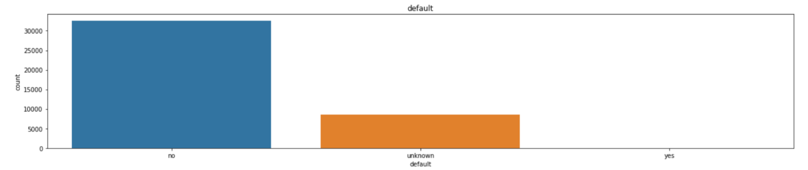
default
Here the attribute Default is shows that is there any credit in default? Here we see
that the value of no credit is more.

Slide 6
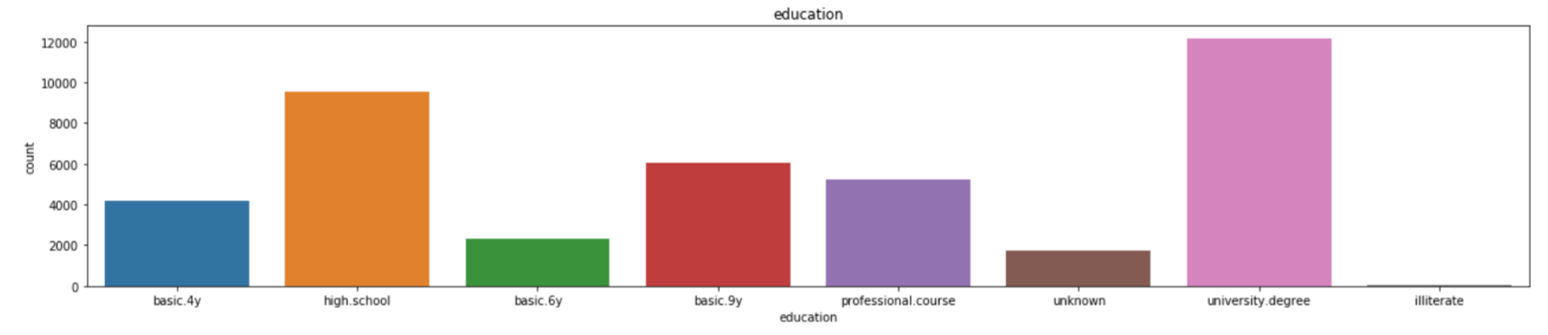
education
There is a lot of category in this attributes in which we can see that the number of empl-
-oyee from university degree is more.

Slide 7
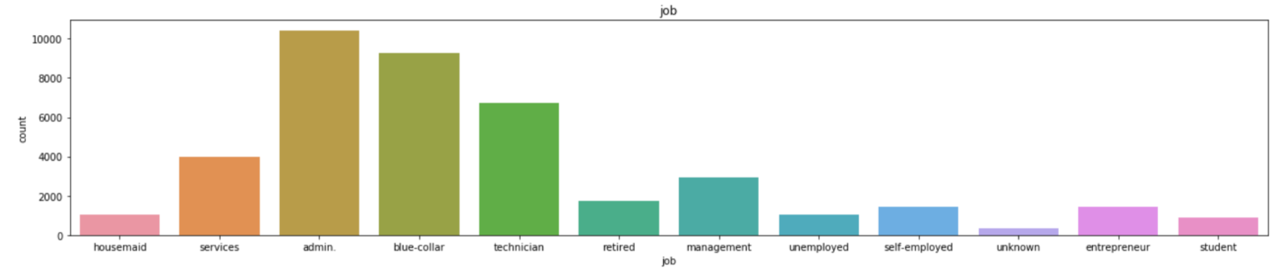
Job
This is categorical type variable which shows that type of job doing by employee.
Here admin has more number as compare to others.

Slide 8
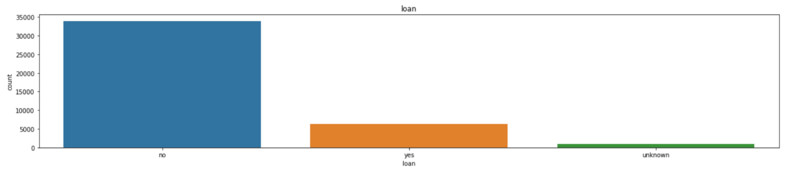
Loan
This attribute shows that whether employee has personal loan or not? This graph shows
that more number of employee has no any personal loan.

Slide 9
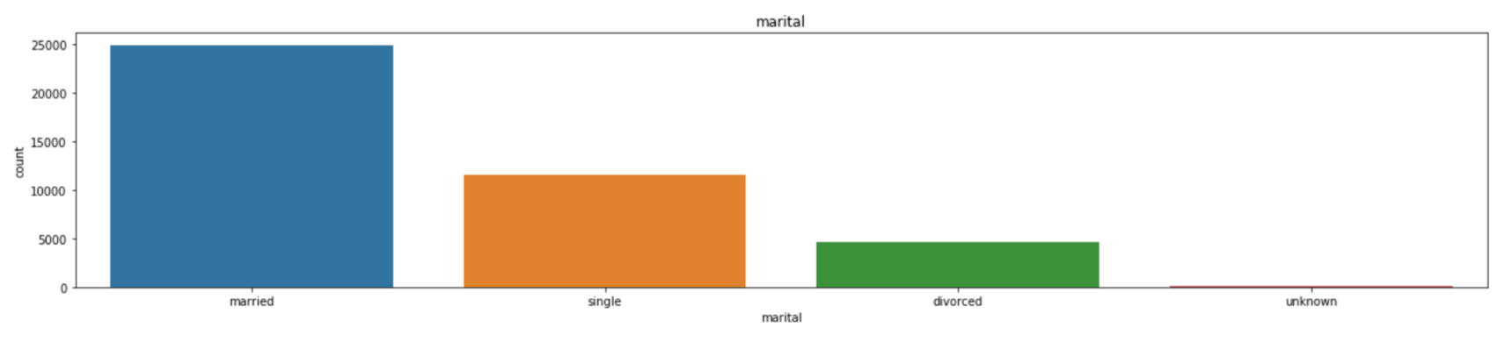
Marital
There is lot of category for marital status in which married people are more as compare
to others.

Slide 10
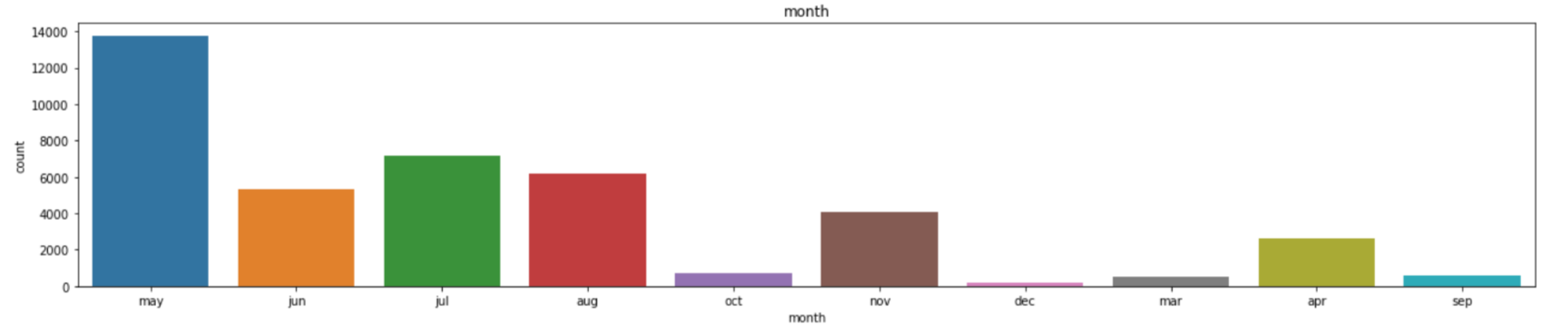
Month
This attribute will shows the last contact month of year. This shows that in may more
employee have been contacted.

Slide 11
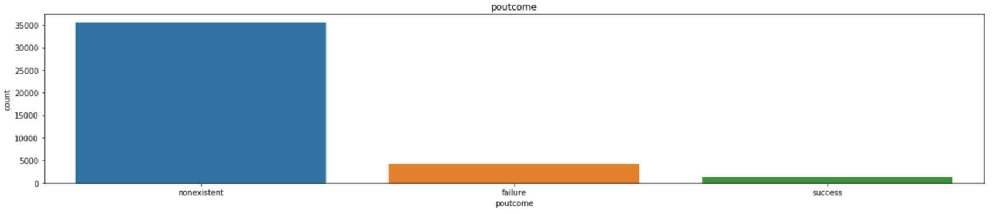
Poutcome
This attribute is used to show the outcome of the previous marketing campaign.
Here we see that the non-existent category is more.

Slide 12
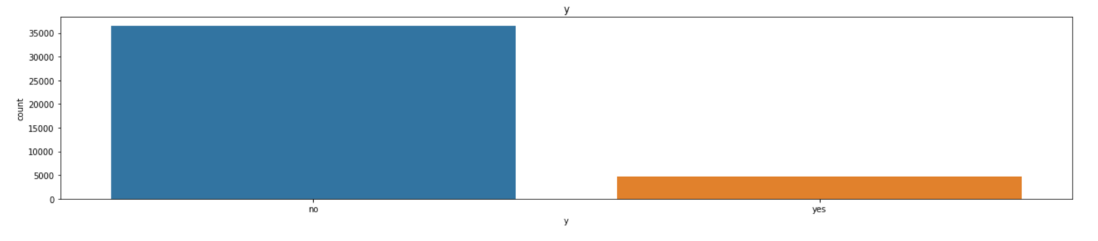
Y
Y is our result and has the information in yes and no that client subscribed a term
Deposit.

Slide 13
Analysis of above plots:
Plotting categorical data according to our output ‘y’ .
Normalized distribution of each class per feature and plotted difference between positive and negative frequencies. Positive values imply this category favors clients that will subscribe and negative values categories that favor not buying the product.

Slide 14
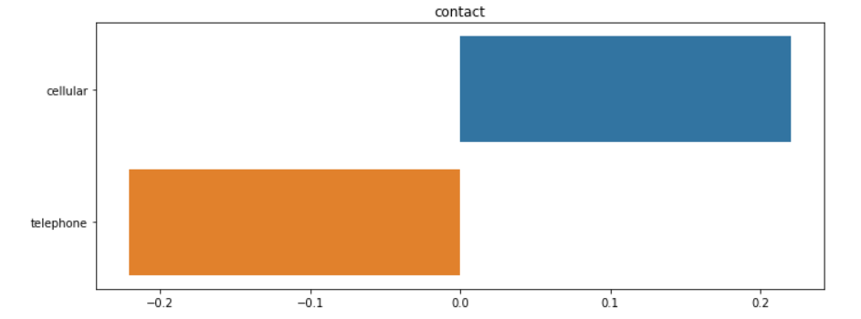
Contact

Slide 15
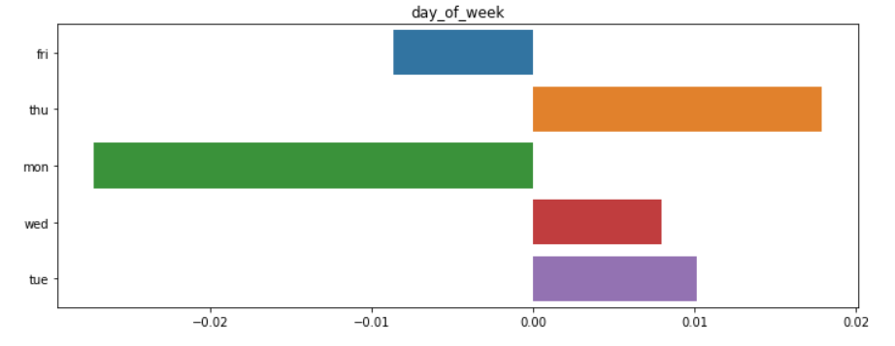
Day_of_week

Slide 16
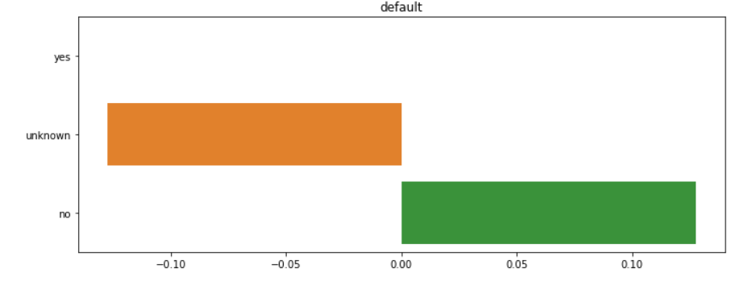
default

Slide 17
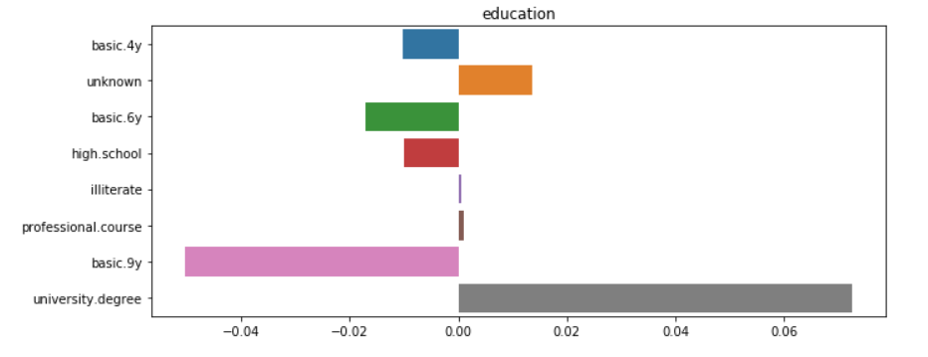
education

Slide 18
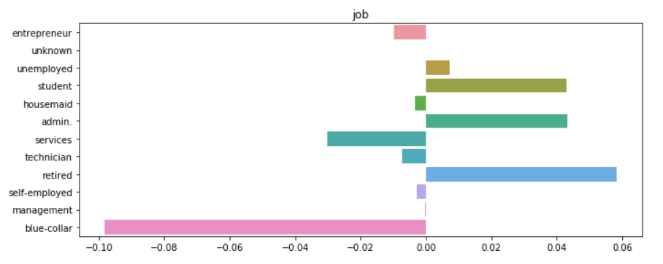
job

Slide 19
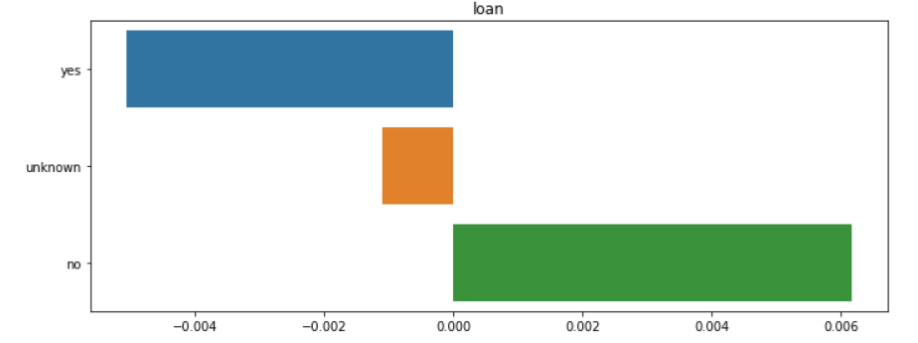
loan

Slide 20
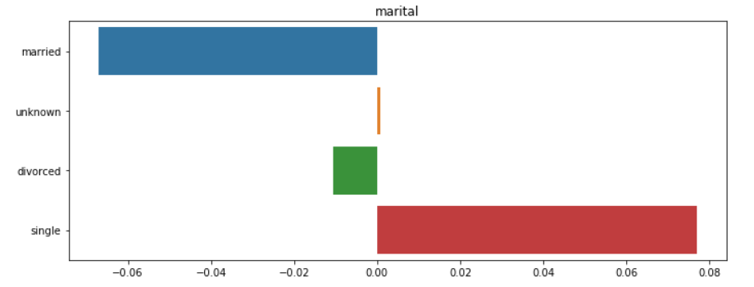
marital

Slide 21
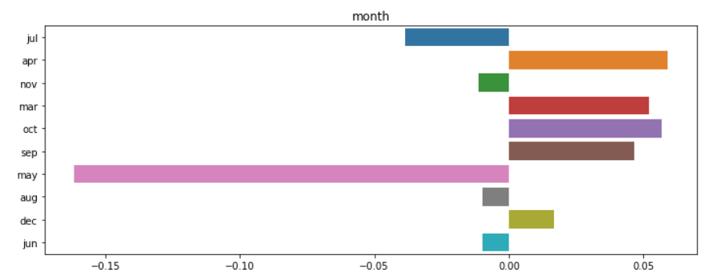
month

Slide 22
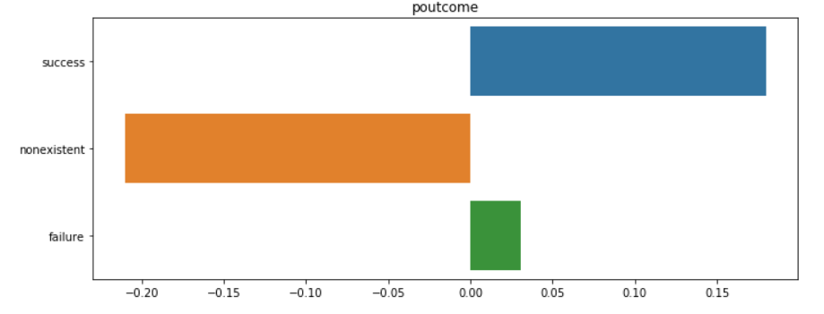
poutcome

Slide 23
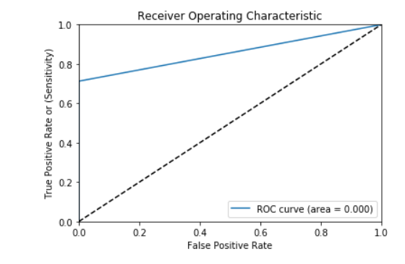
ROC Curve : Random Forest
The ROC curve. In a Receiver Operating Characteristic curve the true positive rate (Sensitivity) is plotted in function of the false positive rate (100-Specificity) for different cut-off points. Each point on the ROC curve represents a sensitivity/specificity pair corresponding to a particular decision threshold.

Slide 24
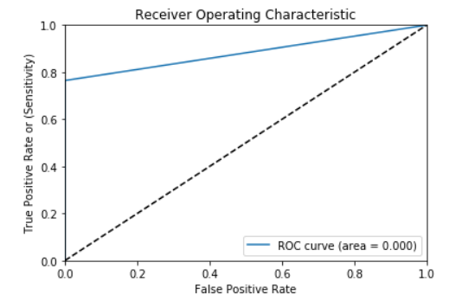
ROC Curve : XGB Classifier

Slide 25
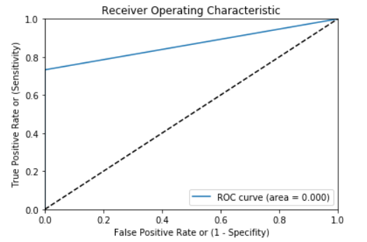
ROC Curve : Ensemble Method

Slide 26
Financial Benefits to the Market team
Recommended, the marketing team, ways to better target customers using feature importance maps and business intuition.
We will only target to that particular age group peoples which have positive response.
Try to engage peoples for longer duration calls and prioritize those customers who were part of previous marketing campaigns.
This will decreases no rates in our output and we aim only for those customers who take this.

