Slide 1

Wine Quality Analysis
Exploratory data analysis of 1,143 wine samples from the WineQT dataset
Notes:
Project report for the WineQT exploratory analysis notebook: what the data looks like and which chemical properties relate to wine quality.

Slide 2
Project at a glance
Objective
Find out which physicochemical properties of a wine relate to the quality score (3 to 8) given by tasters, as groundwork for a predictive model.
1,143
13
wine samples
columns in total
About the data
11 chemical measurements per wine, such as acidity, sugar, sulphates and alcohol
Target: quality, an integer score
Id is only a row identifier
0
0
missing values
duplicate rows
Notes:
The dataset has 1,143 rows and 13 columns, with no missing values and no duplicate rows, so no cleaning was needed before analysis.

Slide 3





How the analysis was done
STEP 1
STEP 2
STEP 3
STEP 4
STEP 5
Load and inspect
Check quality
Study distributions
Compare by quality
Map correlations
Preview rows, shape, data types and summary statistics
Count missing values and duplicate rows
Histograms with skewness, plus a swarm plot of alcohol
Violin and box plots of alcohol for each quality score
Pair plot and correlation heatmap of all columns
Notes:
Five steps, all done in Python with pandas, matplotlib and seaborn: inspect, check data quality, look at distributions, compare features against quality, then correlations.

Slide 4
Most wines score 5 or 6
83%
of wines are rated 5 or 6
2%
are rated at the extremes (3 or 8)
The target is imbalanced. Grades 3, 4 and 8 have very few examples, so a model will find them hard to predict.
Notes:
Counts by quality score: 3 = 6, 4 = 33, 5 = 483, 6 = 462, 7 = 143, 8 = 16 (read from the notebook's count plot; they total 1,143). Mean quality is 5.66.

Slide 5
Several features are right-skewed
A few extreme values stretch the tail
Chlorides peak at 0.611, against a median of 0.079
Residual sugar reaches 15.5, against a median of 2.2
Sulphates reach 2.0, against a median of 0.62
Density and pH are close to symmetric
Implication: consider log transforms or robust scaling before fitting linear models.
Notes:
Skewness values come from the titles of the notebook's histogram grid. Values above 1 indicate a strong right tail.

Slide 6
Summary statistics
Feature | Mean | Std dev | Min | Max
fixed acidity | 8.31 | 1.75 | 4.60 | 15.90
volatile acidity | 0.531 | 0.180 | 0.120 | 1.580
citric acid | 0.268 | 0.197 | 0.000 | 1.000
residual sugar | 2.53 | 1.36 | 0.90 | 15.50
chlorides | 0.087 | 0.047 | 0.012 | 0.611
free sulfur dioxide | 15.6 | 10.3 | 1.0 | 68.0
total sulfur dioxide | 45.9 | 32.8 | 6.0 | 289.0
density | 0.9967 | 0.0019 | 0.9901 | 1.0037
pH | 3.31 | 0.157 | 2.74 | 4.01
sulphates | 0.658 | 0.170 | 0.330 | 2.000
alcohol | 10.44 | 1.08 | 8.40 | 14.90
Total sulfur dioxide has the widest spread, from 6 to 289
Density barely varies (std dev 0.0019)
Alcohol ranges from 8.4% to 14.9%, mean 10.4%
Notes:
Mean, standard deviation, minimum and maximum for the 11 chemical features, from df.describe().

Slide 7
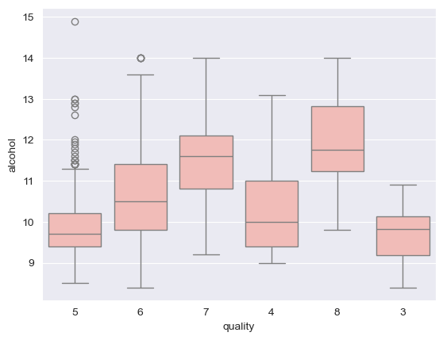
Better wines tend to have more alcohol
+0.48
correlation between alcohol and quality, the strongest positive link
Median alcohol rises from about 9.7% for quality 5 to about 10.5% for 6 and about 11.6% for 7
Quality 5 has many high-alcohol outliers, so alcohol alone does not decide the score
Grades 3 and 4 have few samples, so their boxes are less reliable
Notes:
Medians are read from the notebook's box plot and are approximate. The notebook also has a violin plot and a swarm plot of alcohol.

Slide 8
What relates to quality
Raises quality
Alcohol (+0.48), sulphates (+0.26), citric acid (+0.24)
Lowers quality
Volatile acidity (-0.41), total sulfur dioxide (-0.18), density (-0.18)
Little effect
Residual sugar (+0.02), pH (-0.05), free sulfur dioxide (-0.06)
No correlation passes 0.5, and correlation does not prove cause.
Notes:
Values are taken from the quality row of the notebook's correlation heatmap. The Id column is excluded because it is only a row identifier.

Slide 9

Several features move together
Strongest feature-to-feature correlations
fixed acidity and pH
-0.69
fixed acidity and density
+0.68
Why it matters
fixed acidity and citric acid
+0.67
Acidity measures overlap with each other, with density and with pH. In a linear model this makes coefficients unstable. Regularisation, tree-based models, or dropping redundant features can help.
free and total sulfur dioxide
+0.66
citric acid and pH
-0.55
volatile and citric acid
-0.54
density and alcohol
-0.49
Notes:
Pairs are read from the notebook's correlation heatmap. Burgundy bars are positive correlations, gold bars negative.

Slide 10


Key findings
Clean data
Imbalanced target
1,143 rows with no missing values and no duplicates.
About 83% of wines score 5 or 6; grades 3, 4 and 8 are rare.
Alcohol leads
Moderate links only
Alcohol is the strongest positive signal (+0.48); volatile acidity is the strongest negative (-0.41).
No single feature dominates, and several features are correlated with each other.
Notes:
Summary of the exploratory analysis.

Slide 11

Next steps
Prepare the data
Frame the target
Model and evaluate
Drop Id, which is only a row identifier
Transform skewed features: chlorides, residual sugar, sulphates
Scale features before modelling
Choose regression, or group scores into low, medium and high
Use a stratified train/test split
Use class weights or resampling for rare grades
Start with a linear baseline, then Random Forest and gradient boosting
Use cross-validation
Report F1 or RMSE and feature importance
Notes:
Suggested follow-up work. One housekeeping item in the notebook: quality was converted to a string for the violin and box plots, which is why the box plot categories are not in numeric order. Convert it back, or set the plot order, before modelling.

