Slide 1
Lending club case study
EXECUTIVE PG PROGRAMME IN MACHINE LEARNING & AI - JANUARY 2022
Rahul Kunjumon
Rashmi Kumbugowdana

Slide 2
Problem statement
We are working for a consumer finance company which specialises in lending various types of loans to urban customers. When the company receives a loan application, the company must decide for loan approval based on the applicant’s profile. Two types of risks are associated with the bank’s decision:
If the applicant is likely to repay the loan, then not approving the loan results in a loss of business to the company
If the applicant is not likely to repay the loan, i.e., he/she is likely to default, then approving the loan may lead to a financial loss for the company
Like most other lending companies, lending loans to ‘risky’ applicants is the largest source of financial loss (called credit loss). The credit loss is the amount of money lost by the lender when the borrower refuses to pay or runs away with the money owed. In other words, borrowers who default cause the largest amount of loss to the lenders. In this case, the customers labelled as 'charged-off' are the 'defaulters'.
If we can identify these risky loan applicants, then such loans can be reduced thereby cutting down the amount of credit loss. Identification of such applicants' using EDA is the aim of this case study.

Slide 3
Objective
We have been provided with a dataset which contains the information about past loan applicants and whether they ‘defaulted’ or not. The aim is to identify patterns which indicate if a person is likely to default, which may be used for taking actions such as denying the loan, reducing the amount of loan, lending (to risky applicants) at a higher interest rate, etc.

Slide 4
Procedure
Understanding the Data
We used Microsoft Excel to view the data, understand various fields available. We were aided by a Data Dictionary file which had one liners on the column data.
We used certain youtube videos to understand the lending domain and various analysis done in this domain
Cleaning the Data
Loan.csv file given to us had a raw data which is difficult to process at the first instant. Hence, it had to be cleaned to perform the data analysis.
We used Python libraries Pandas to import the file and perform the cleansing. Various actions performed were :
Removing Columns with more than 60 % Null values
Removing columns with just single unique data as it won't return any valid information as all rows have same value
Cleaning rows having Null Values
Necessary columns with null values were assigned appropriate values such that they don’t return errors during Analysis
Convert columns with dates to python readable format
Convert columns with strings like %, months etc. to integer format.(E.g., 8 Months to 8, 90% to 90)
Convert values with decimal to its nearest 2 places

Slide 5
Procedure cont’d
Data Analysis
Univariate Analysis :
Analysis on Loan Status
Analysis on Funded Amount over Charged off Loans
Analysis on Interest Rate over Charged off Loans
Analysis on Income over Charged off Loans
Analysis on DTI (Debt To Income Ratio) over Charged off Loans
Analysis on Loan Term over Charged off Loans
Analysis on Employment Length over Charged off Loans
Analysis on House Ownership over Charged off Loans
Analysis on Installment Size over Charged off Loans
Analysis on Verification Status over Charged off Loans

Slide 6
Procedure cont’d
Data Analysis
Bivariate Analysis :
Analysis on Funded Loan over Annual Income
Analysis on Funded Loan over Grade
Analysis on Funded Loan over Loan Status and Verification Status
Analysis on Funded Loan over Grade and Term

Slide 7
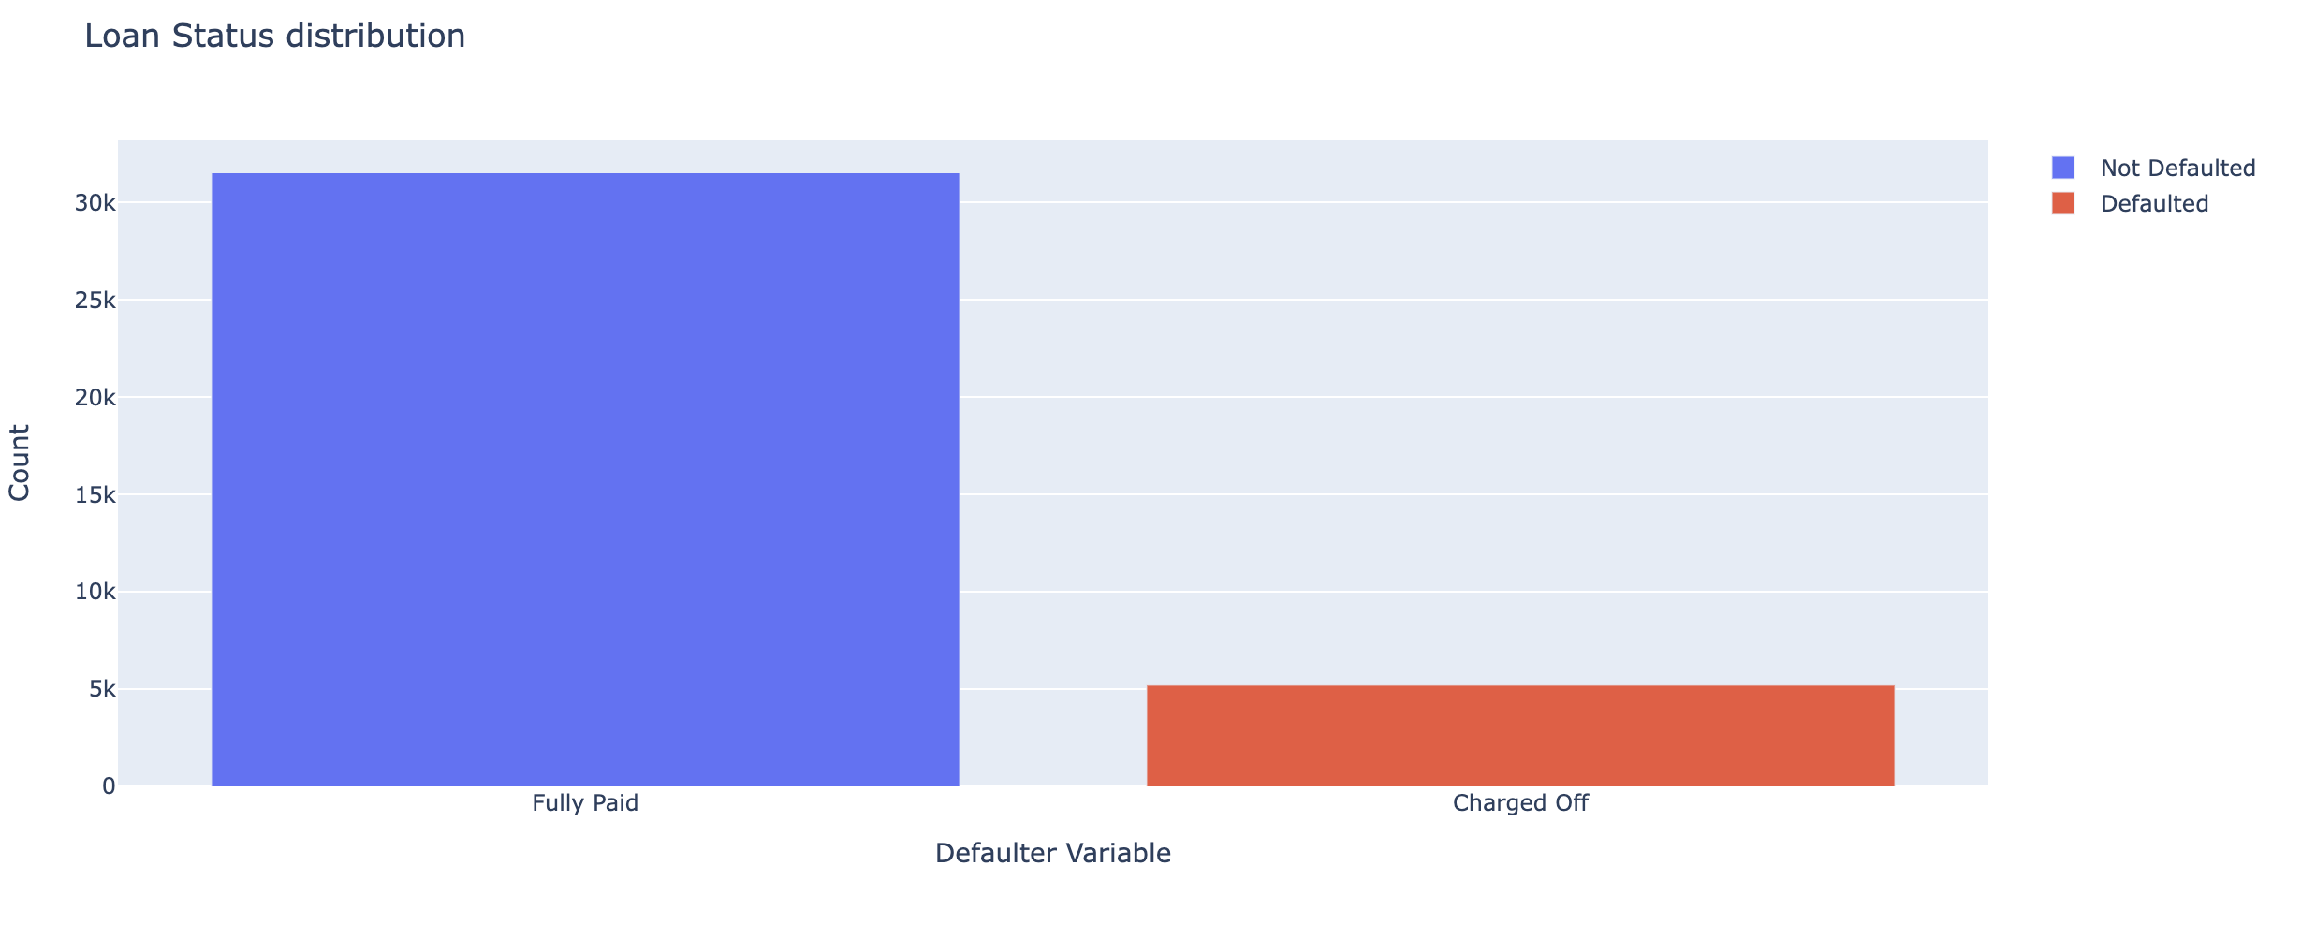
Univariate Analysis
Analysis on Loan Status
From the above graph, its evident that around 16 percent of the loan is charged off when compared with the fully paid Loans. Rise in this percentage over 20, would lead to drastic loss as per Industry standards

Slide 8
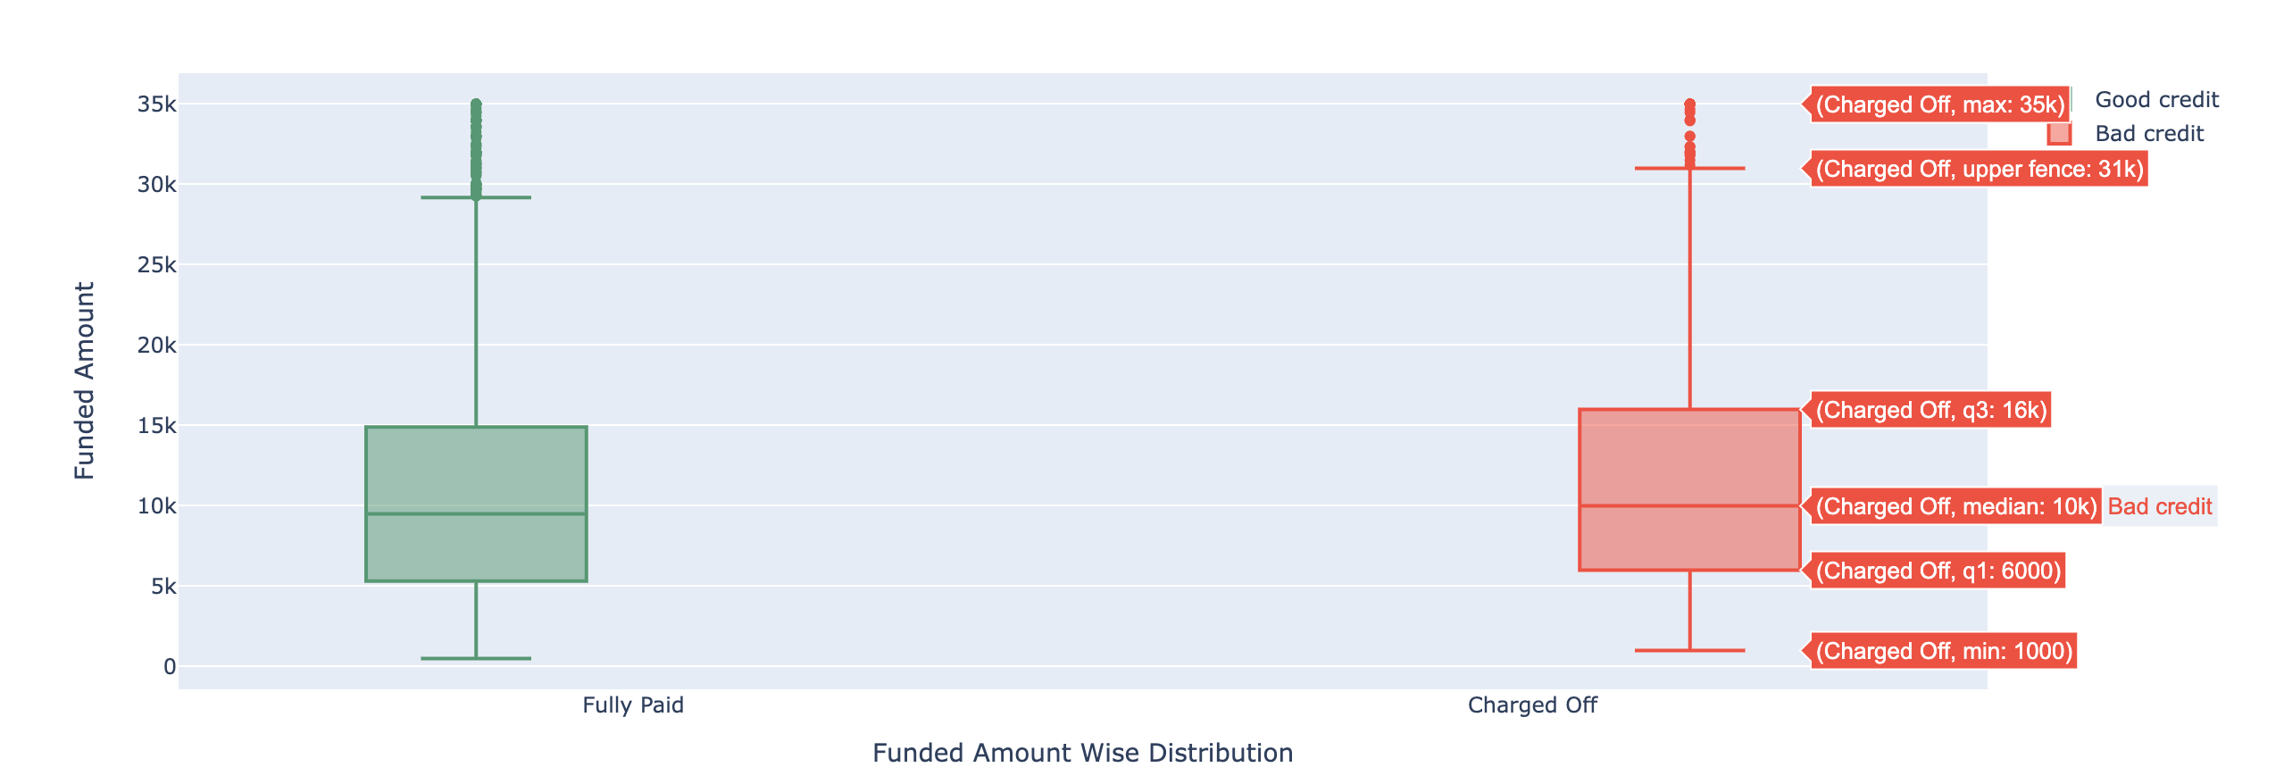
Analysis on Funded Amount over Charged off Loans
We Observe That most loan charged off are in the range of 6k to 16k. We must stricten the scrutiny of loans where request is in this particular range

Slide 9
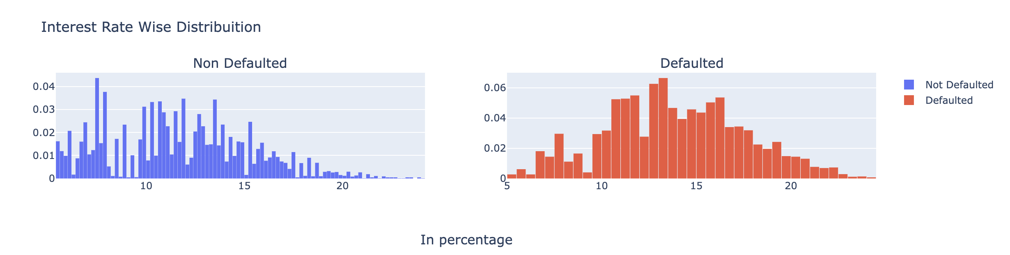
Analysis on Interest Rate over Charged off Loans
It is clearly evident that for interest below 10%, defaulting is low. It rises steep for interest above 10-16%.
It is advisable to provide short term loan at lower interest rate than higher interest rate loans

Slide 10
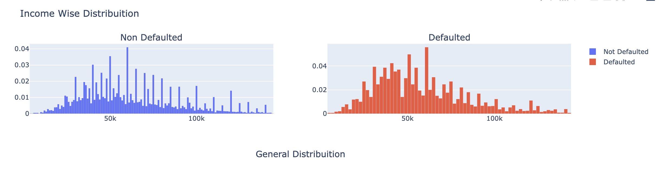
Analysis on Income over Charged off Loans
We observe that borrowers with income ranging from 30k – 50k seems to have higher default rates. This needs to be evaluated as it can be due to higher number of loans been taken by this income group. This shall be evaluated in Bivariate Analysis

Slide 11
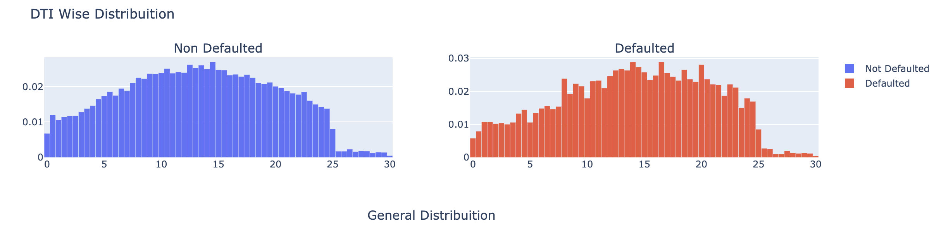
Analysis on DTI (Debt To Income Ratio) over Charged off Loans
The graph says very clearly that higher the DTI, higher is the chance to default. Loan approval needs to be scrutinized for DTI higher that 10.

Slide 12
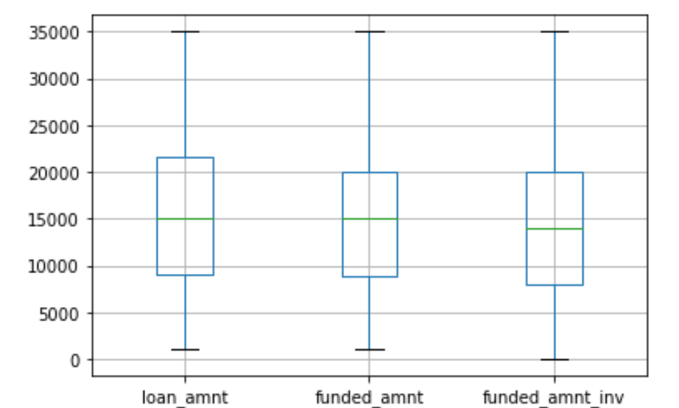
Analysis on Eligible and Verified on Loan amount applied and approved
Its observed that among the eligible and verified applicants the 50th percentile is about 12k and mostly getting approved.
Beyond that until 20K a bit lesser will be approved

Slide 13
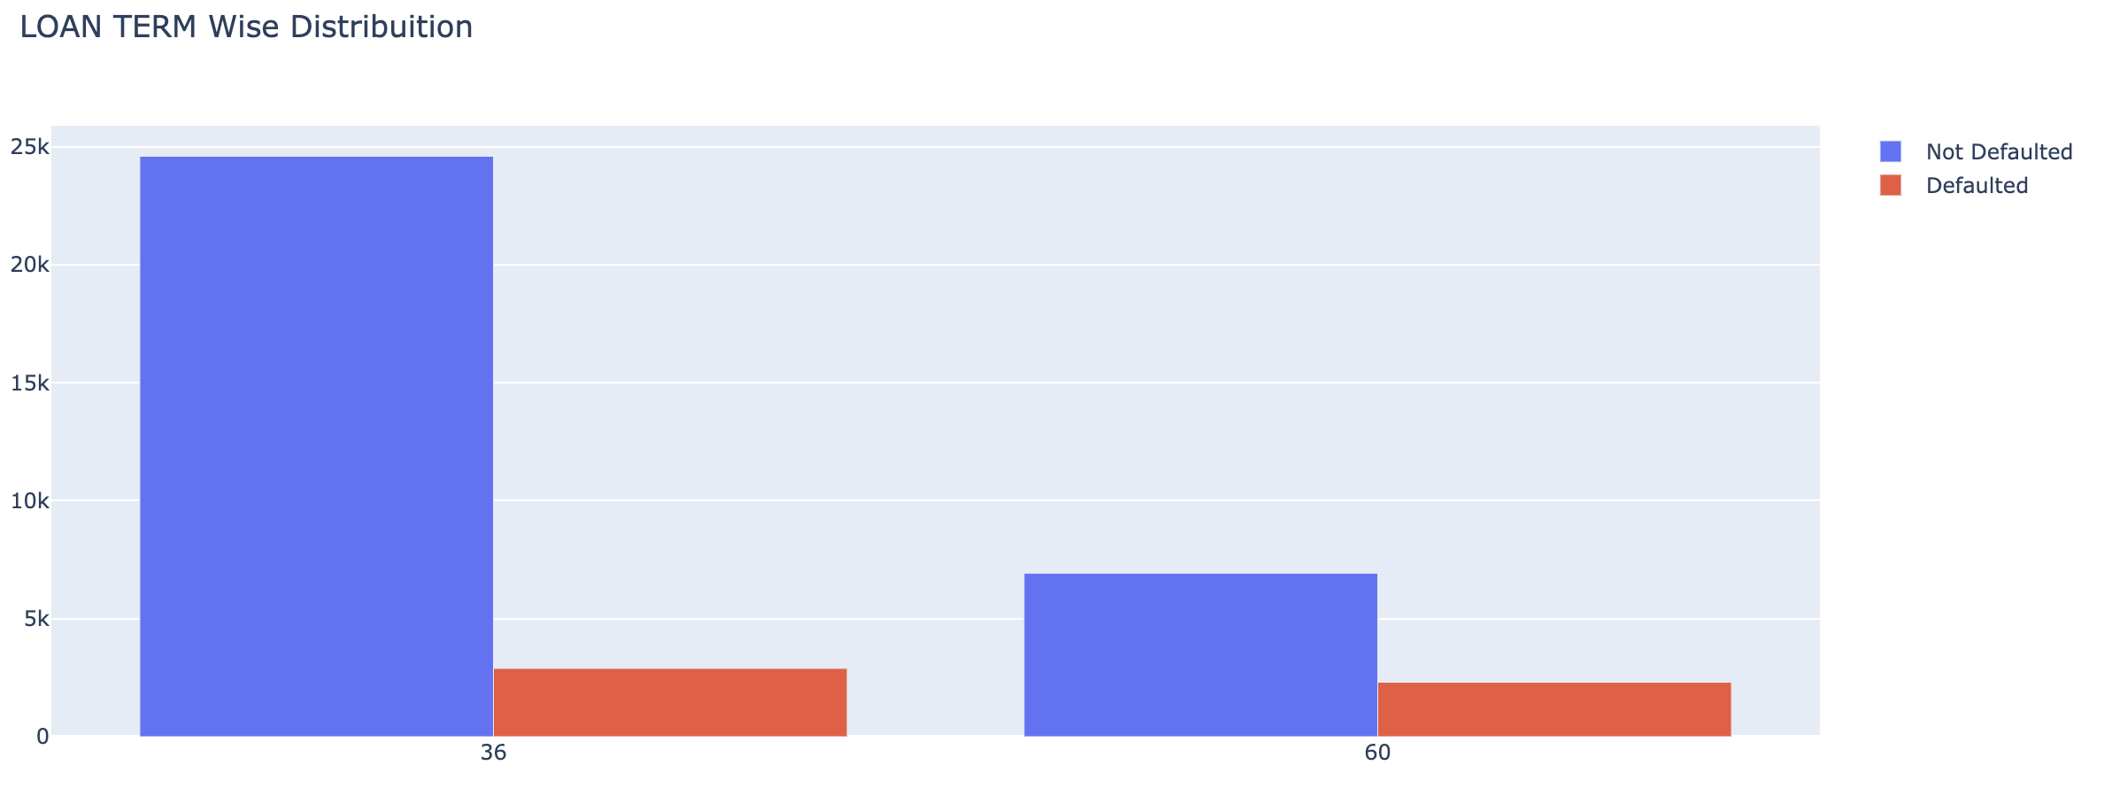
Analysis on Loan Term over Charged off Loans
Most of the loans taken were of 36 months duration. But the ratio of Default to full payment is higher for 60 months loan duration (ie, around 33 percent) which is high. Loan with higher duration needs to be scrutinized to see the long-term capability of the borrower

Slide 14
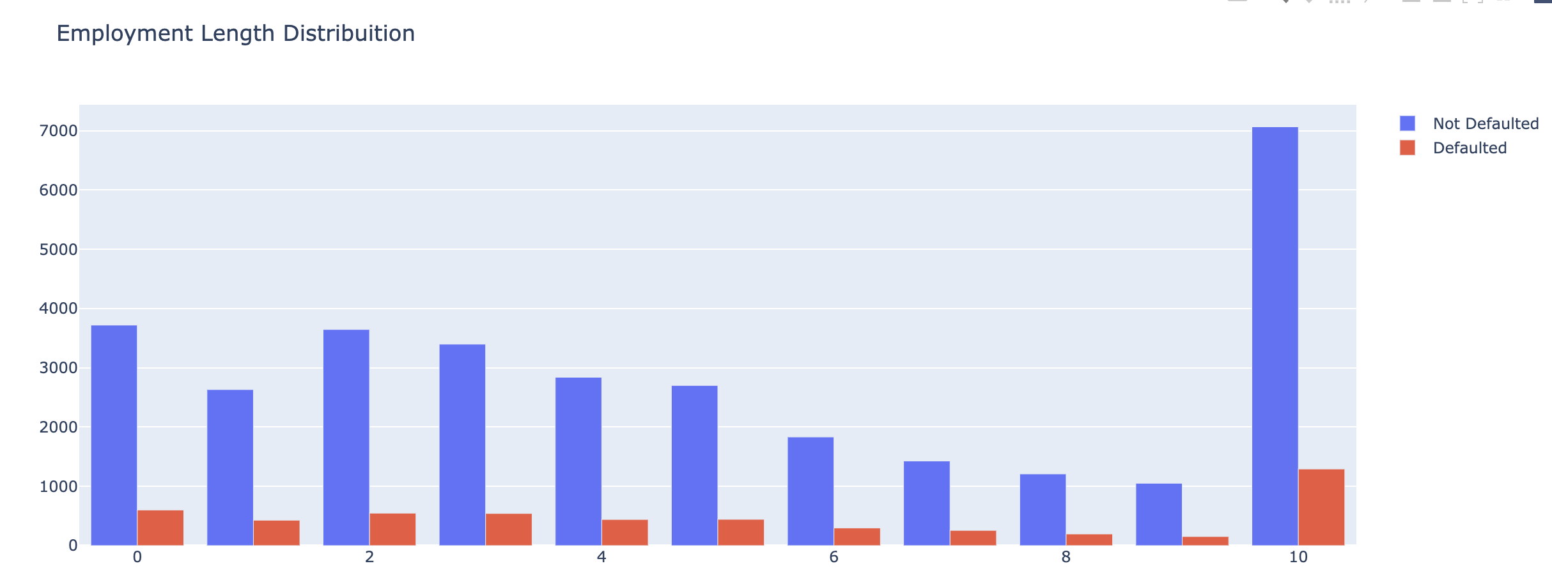
Analysis on Employment Length over Charged off Loans
We observe that most loans are taken by borrowers with 10+ years of employment, but, there is no strong ratio which describes them to be defaulted. Hence, we don’t have any significant conclusions on the same

Slide 15
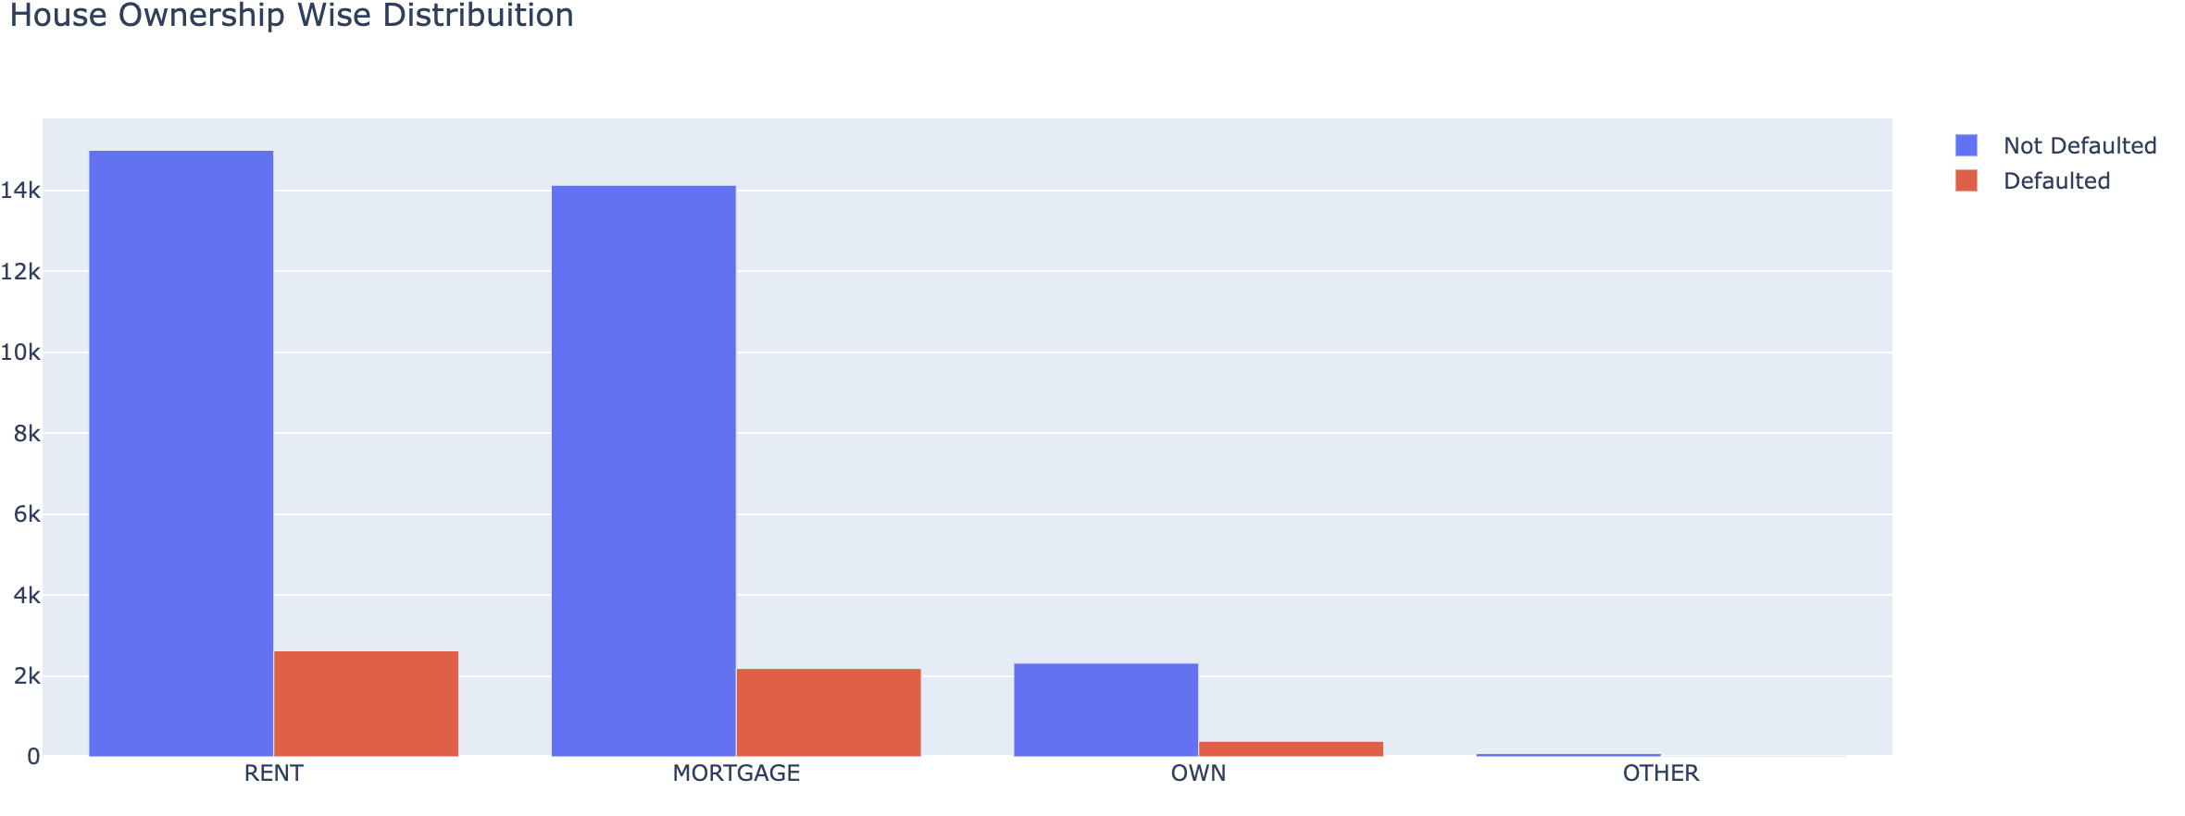
Analysis on House Ownership over Charged off Loans
Borrowers living in Rented or a Mortgaged house, tends to default 15 percent more than those who have own home. Its not advisable to give loans to Borrowers living in Rented or a Mortgaged house without scrutiny of their purchasing power.

Slide 16
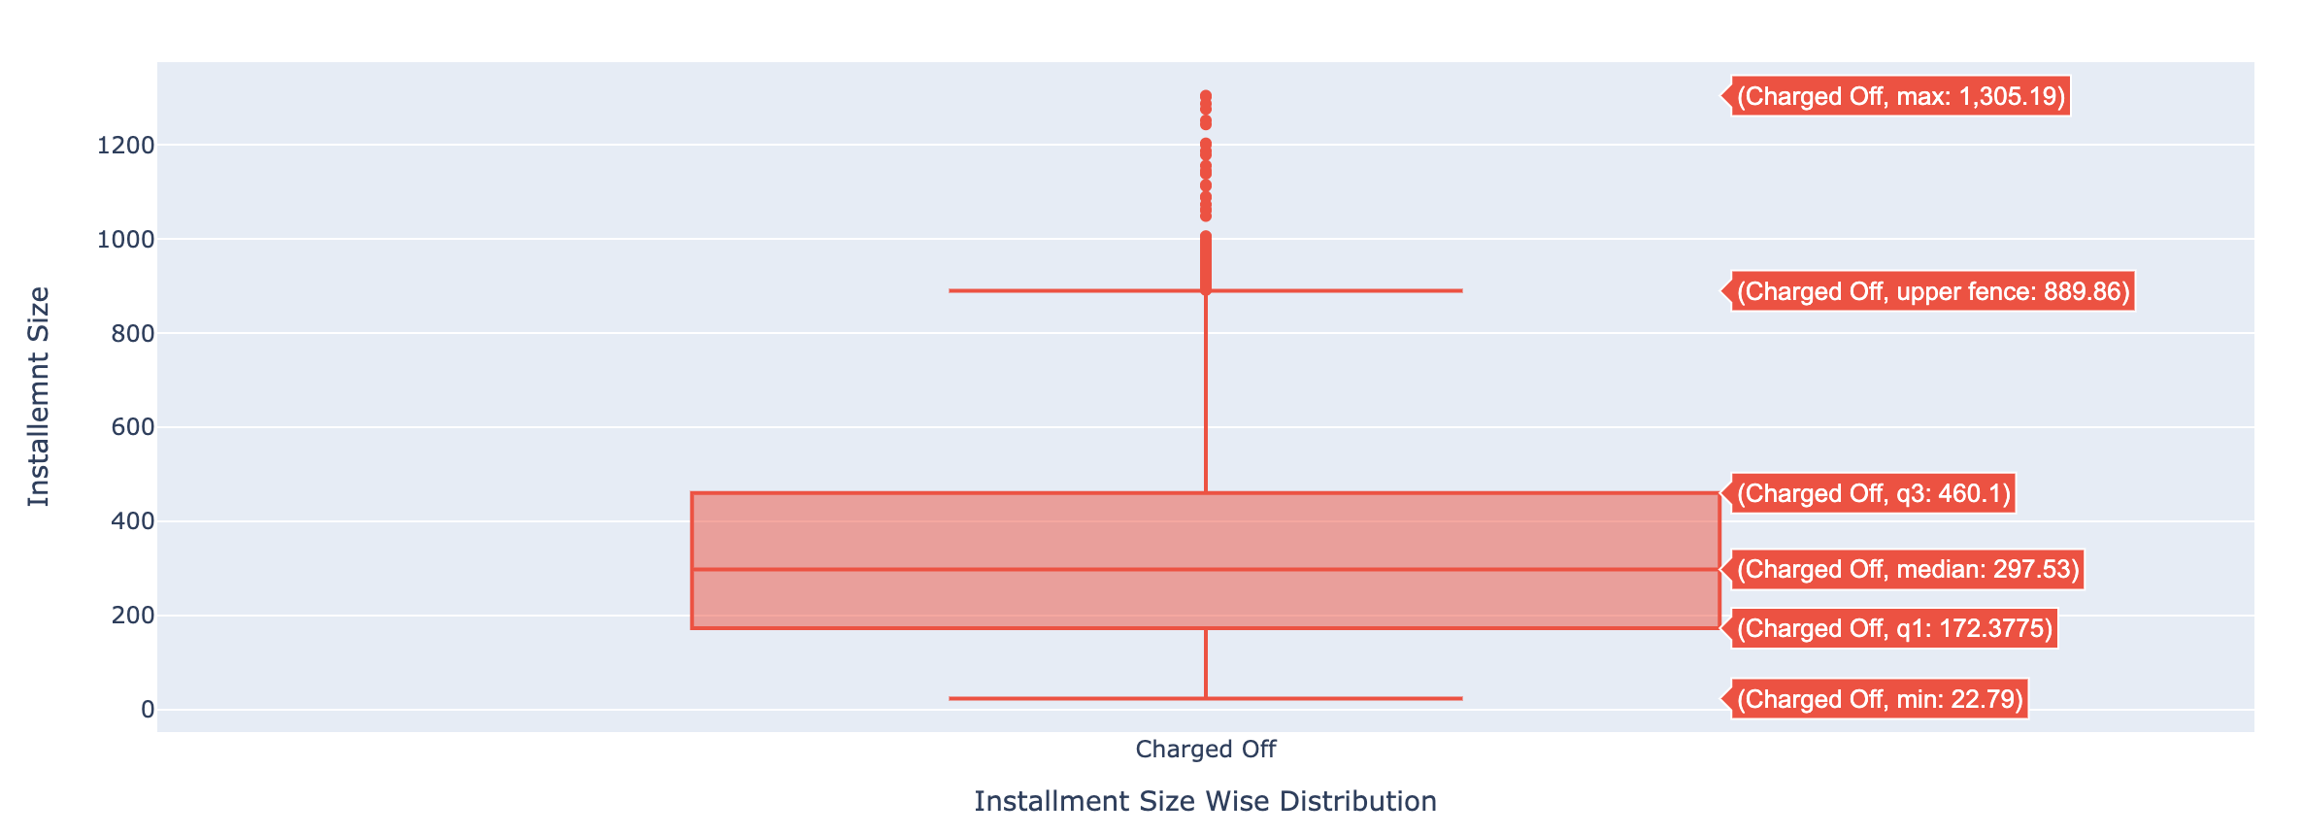
Analysis on Installment Size over Charged off Loans
Borrowers with installment size of 200 to 400 tends to default more. But this can be attributed to higher quantity of loans been taken in this range. But we also see a trend where higher the Installment size, higher is the chance to default

Slide 17
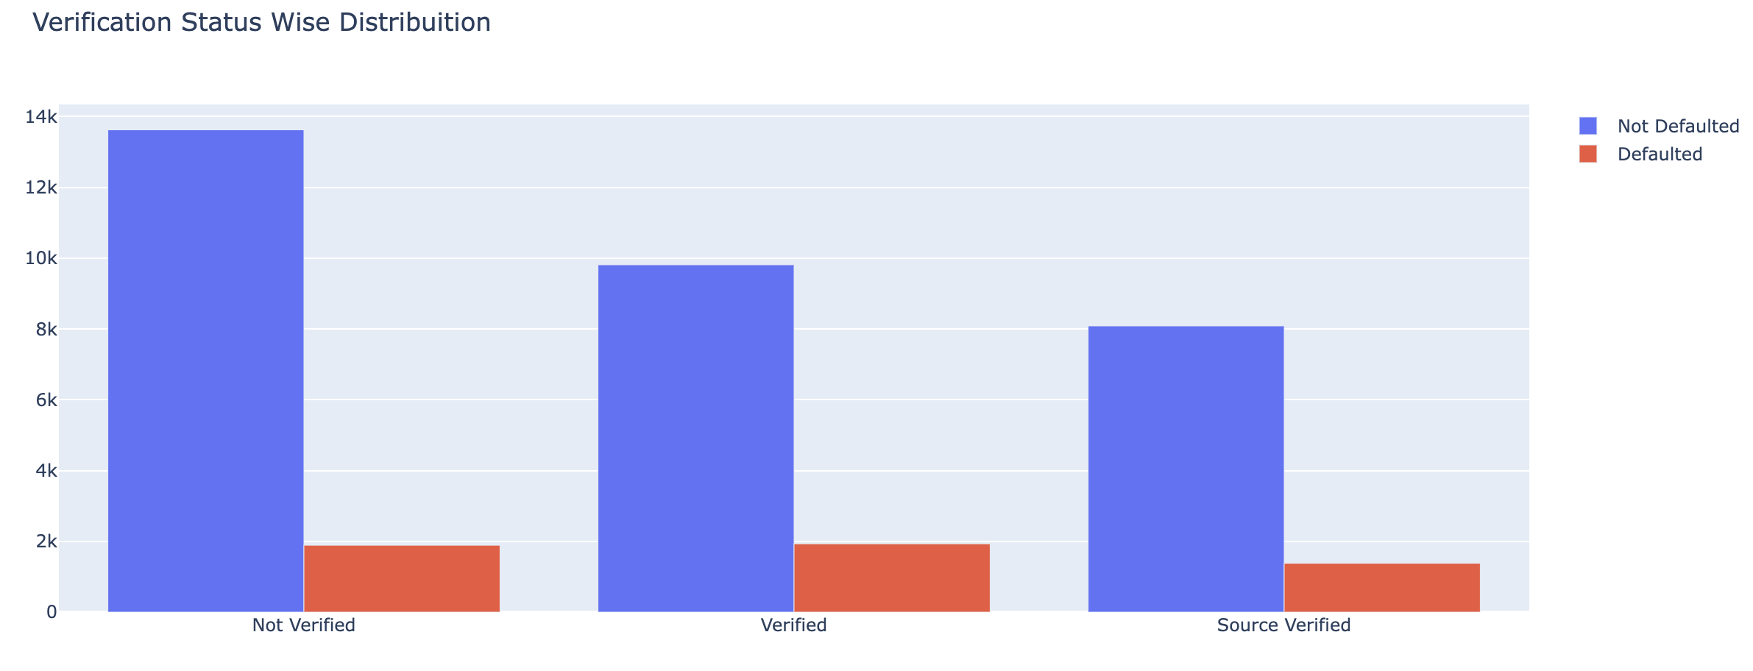
Analysis on Verification Status over Charged off Loans
Surprisingly, Verified loans are defaulting slightly higher than Not verified loans. This needs to be validated with further analysis.

Slide 18
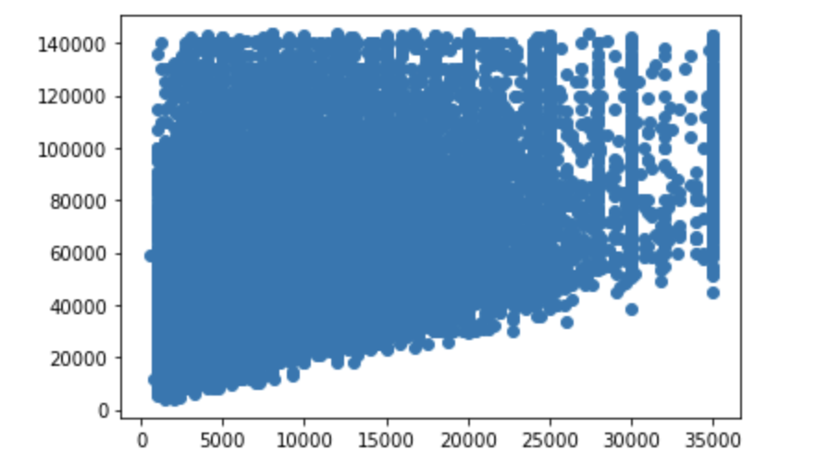
Bivariate analysis
Analysis on Funded Loan over Annual Income
X Axis : Funded Loan
Y Axis : Annual Income
We Observe that lower income group people tends to take more loans as the scatter plot is very dense here. With further analysis, we have observed that loans were given to people where loan amount is higher than the annual income. Which adds to the risk factor and must be avoided

Slide 19
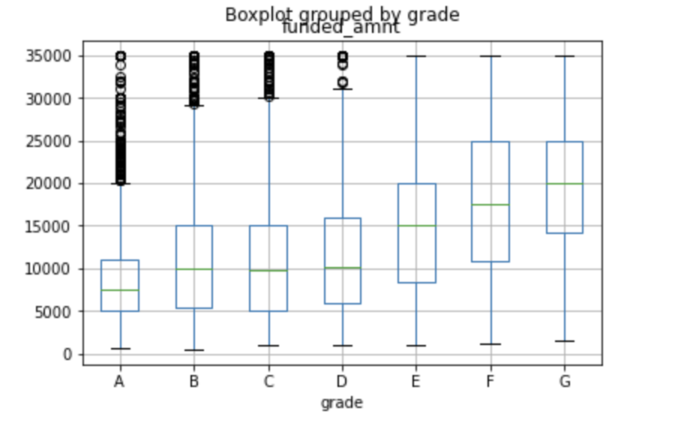
Analysis on Funded Loan over Grade
It is observed that most loans are taken by borrowers with lower grade. We would be further analyzing how much do they default in the further analysis.

Slide 20
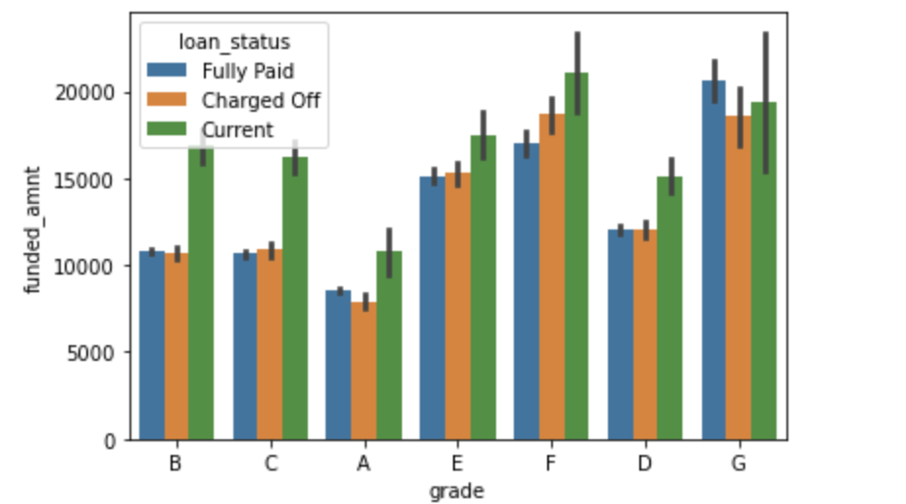
Analysis on Funded Loan over Grade and Loan Status
As we see in the graph, lower grade borrowers tends to take higher loans, as well as tends to default. Lending needs to be limited to employees with lower grades

Slide 21
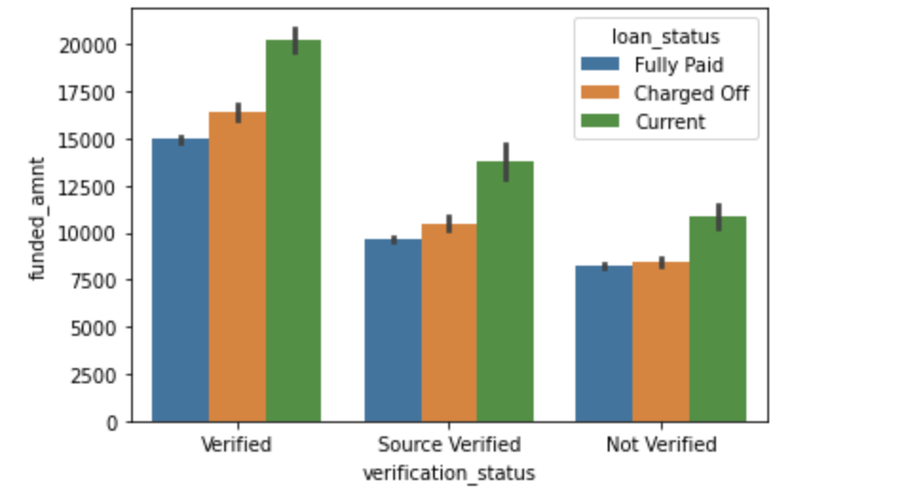
Analysis on Funded Loan over Loan Status and Verification Status
We had observed a reverse trend where verified Borrowers were defaulting more than the Not Verfied borrowers. This graph clearly tells that it's attributed to the higher quantity of loans being verified ones. No relevant conclusions are derived hence.

