Slide 1
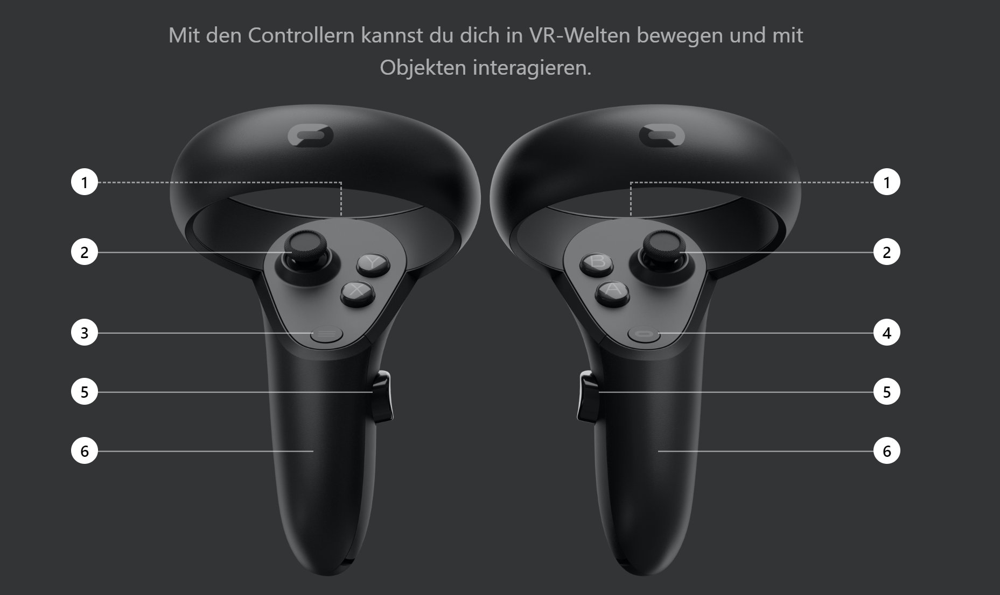
1
9
2
10
6
7
3
11
5
8
4
12
1 – Interact with GUI
2 – Hand-Steering Speed (pointing = direction)
3 – Help Menu (this one)
4 – Jumping (pointing = Target location)
5 – Object Factory Menu
6 – FPS Counter Menu
7 – Nothing
8 – Pick and Drop Object on/from Ray
9 – Nothing
10 – Move object attached to Ray
11 – Nothing
12 – Nothing

