Slide 1


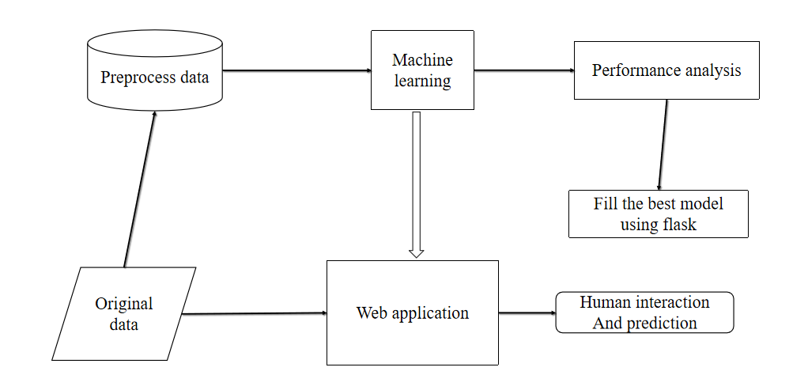
“PRECISION DIABETES PREDICTION USING ENSEMBLE MACHINE LEARNING MODELS”
Department of Artificial Intelligence & Data Science
School of Computing
10214AD601 MINOR PROJECT -1
SUMMER SEMESTER(2024-2025)
ABSTRACT
Describe The Solution
RESULTS
Explain the Technology Stack
The increasing global incidence of diabetes highlights the urgent need for innovative solutions to enhance early detection and management. This paper presents a web-based application designed to predict the likelihood of diabetes onset using advanced machine learning algorithms. The primary objective is to provide a user-friendly platform for personalized risk assessment, empowering users with accurate and reliable predictions. A comprehensive approach was adopted, analyzing a diverse dataset with consideration of key health indicators and lifestyle factors. The machine learning model developed for this purpose exhibits promising accuracy and reliability. The application prioritizes simplicity and accessibility, ensuring ease of use across various demographics. This tool holds significant potential for healthcare providers by offering insights into patient risk profiles and identifying risk factors at an early stage, thereby facilitating timely intervention. The intuitive design ensures effortless data entry, making it accessible to users with varied backgrounds. This project represents a substantial advancement in diabetes management, offering an easy and effective tool for early prediction.
The Early Diabetes Predictor project demonstrated effective diabetes risk prediction capabilities by implementing and testing various machine learning algorithms on the diabetes dataset. After evaluating multiple models, including Logistic Regression, AdaBoost, Random Forest, Decision Tree, and Gaussian Naïve Bayes, the Decision Tree model was selected due to its superior accuracy rate of 98.25% and consistent performance on test data. This accuracy highlights the model’s robustness in recognizing patterns associated with diabetes risk factors. The deployed web application, developed with Flask, enables users to easily input personal health data, such as age, BMI, blood pressure, and glucose levels. Through a simple and user-friendly interface, the application processes this data and provides an instant diabetes risk assessment. Real-time predictions were consistently delivered with high accuracy, showing the system’s reliability for practical use. During system testing, the application demonstrated seamless data processing, efficient model interaction, and accurate output generation. Furthermore, initial feedback suggests the application has potential for practical adoption, especially as future versions may include personalized dietary and lifestyle guidance. This enhancement would offer users actionable insights to manage their health proactively, positioning the Early Diabetes Predictor as a valuable resource for both early detection and diabetes management.
The Early Diabetes Predictor is a web-based application developed to estimate the likelihood of diabetes in individuals using machine learning. By leveraging a structured dataset containing various health indicators, this project aims to identify early warning signs of diabetes, providing users with an accessible risk assessment tool. Multiple algorithms including Logistic Regression, AdaBoost, Random Forest, Decision Tree, and Gaussian Naïve Bayes were tested for model accuracy, with the Decision Tree classifier achieving the highest accuracy of 98.25%
.
The application is built using Flask, enabling a user-friendly interface for data entry and real-time prediction results. Users can input specific health metrics, such as age, BMI, and glucose levels, to receive a risk evaluation. Future enhancements will include personalized health recommendations based on prediction results, providing actionable steps for diabetes prevention. Through the integration of machine learning and health informatics, the Early Diabetes Predictor serves as a proactive tool for early detection, aiming to empower individuals in managing their health effectively.
The technology stack for the Early Diabetes Predictor combines machine learning, web development frameworks, and data management tools to create an efficient, interactive application. Here’s a breakdown of the main components:
Application Development Stack
Frontend: (Flask)
Backend: (Python)
Environment: (Anaconda Navigator)
Machine Learning and Data Processing Stack
Data Handling: (Pandas and NumPy)
Machine Learning Algorithms: (Scikit-Learn)
Deployment and Data Storage: (Application)
TECH STACK
.
.
Describe the USE CASES
Early Diabetes Risk Assessment:
The system provides individuals with a personalized diabetes risk score, helping them understand their likelihood of developing diabetes based on their health information and enabling proactive health decisions.
Healthcare Screening Tool for Diabetes:
Healthcare providers use the application to quickly assess patients’ diabetes risk, aiding in prioritizing patients who may require further testing or preventive measures based on their risk profile.
Describe the DEPENDENCIES and SHOW STOPPERS
Dependencies:
Machine Learning Libraries
Web Framework
Anaconda Environment
Data Availability
Hardware Requirements
Database for Storing User Inputs
Show Stoppers:
Data Quality Issues
Model Accuracy
Deployment Environment
User Privacy Concerns
Algorithm Compatibility
Network Connectivity
Security Vulnerabilities
Explain the work flow of the solution
Team Members:
1. Rahul L(VTU21369) (22UEAD0050)
2. Ravi Prasad G (VTU23521) (22UEAD0052)
3. Anbarasu S (VTU26985) (22UEAD2001)
ACKNOWLEDGEMENT
Mrs.I.Farzhana / Assistant Professor
TTS 3212
Phone No: 6382032352
Email-ID: ifarzhana@veltech.edu.in

