Slide 1


title
Title : CCD 2026
Domain: COMPUTER VISION
TEAM : GSM
dp,
Objective:To build a fully automated system capable of detecting human subjects in classroom environments and accurately estimating student counts to enable attendance monitoring

Slide 2
title
Tech Stack
1)Programming Language : Python
2)Model Used : YOLO v8
3)Libraries Used : CV2,Numpy,Pandas,Matplotlib
4)Tools Used : Kaggle
dp,

Slide 3
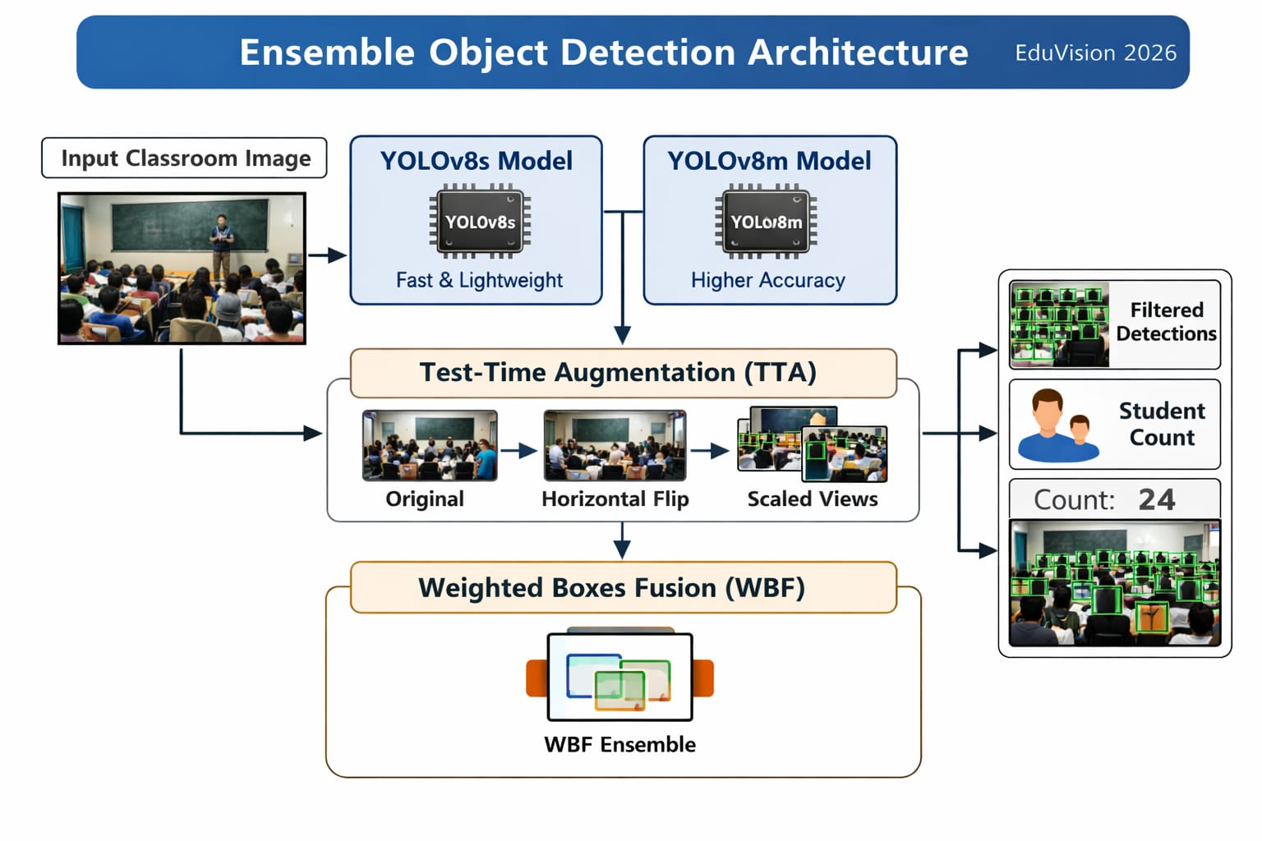
title
Architecture diagram of Performing model:
dp,

Slide 4
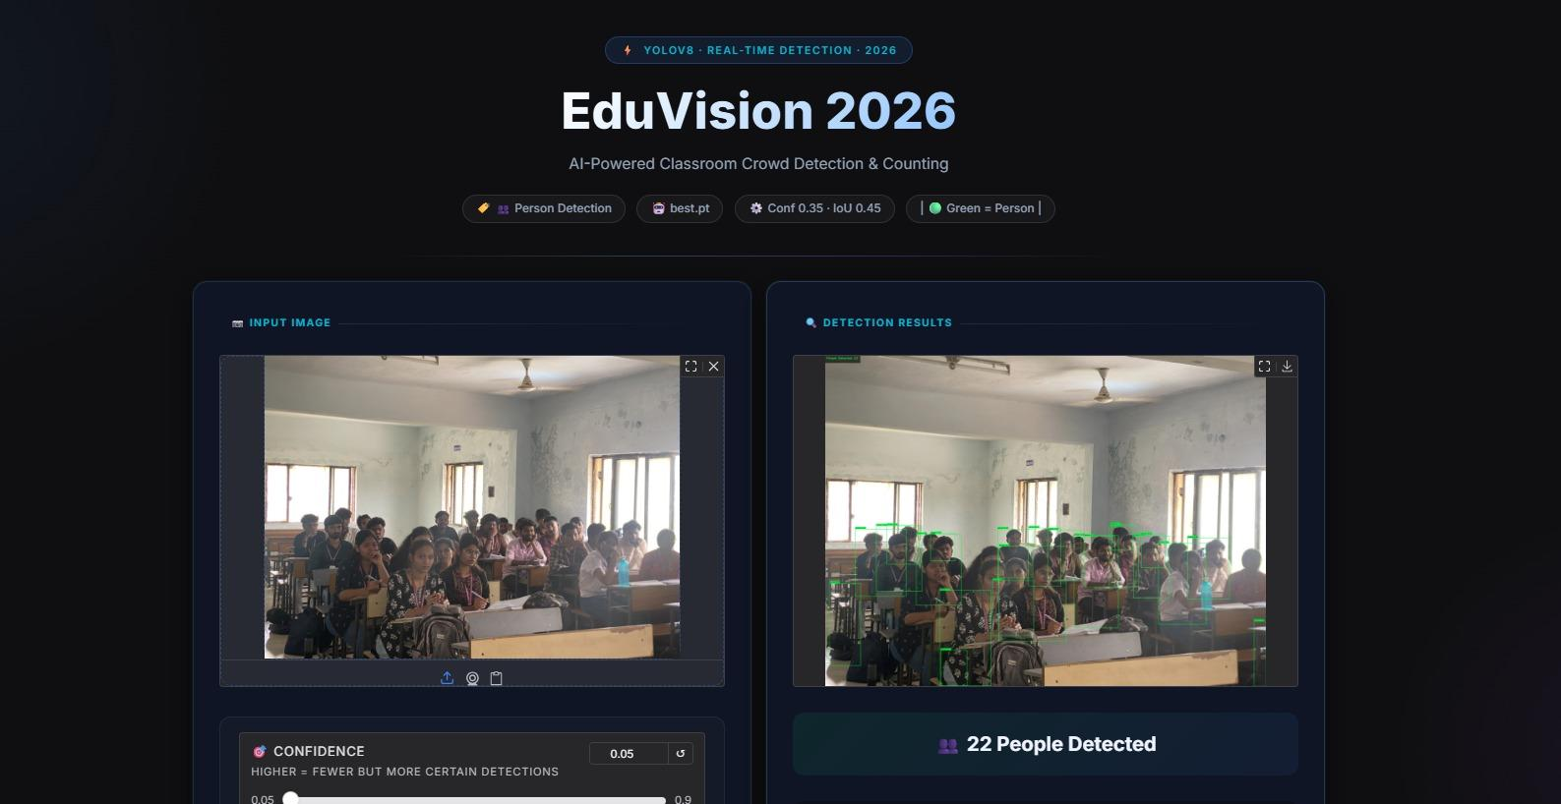
Result:

Slide 5
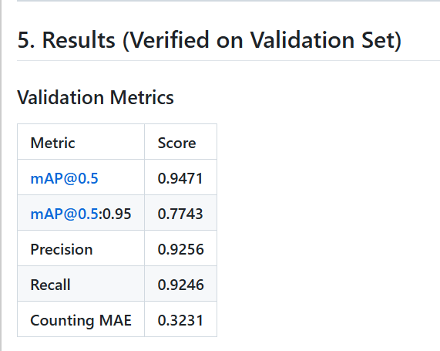
title
Performance metrics:
We have trained two models of yolo v8 (s&m)
We have implemented Weighted boxes Fusion to improve Map score and to reduce error
dp,

Slide 6
title
Conclusion:
1)Developed a robust classroom student detection and counting system using YOLOv8 ensemble architecture.
2)Effectively handled occlusions, small objects, and overlapping students through optimized augmentation and post-processing strategies.
3)Applied confidence tuning and filtering to reduce false positives and prevent double counting.
4)Followed a time-aware, safety-first training strategy to ensure reliable results.
5)Built a scalable and reproducible framework with potential for future expansion into multi-class detection and real-time deployment.
dp,

