Slide 1

LM Big Data Management in Finance (36320) Birmingham Business School

Slide 2
Artificial Neural Network-Basics (ANN)

Slide 3
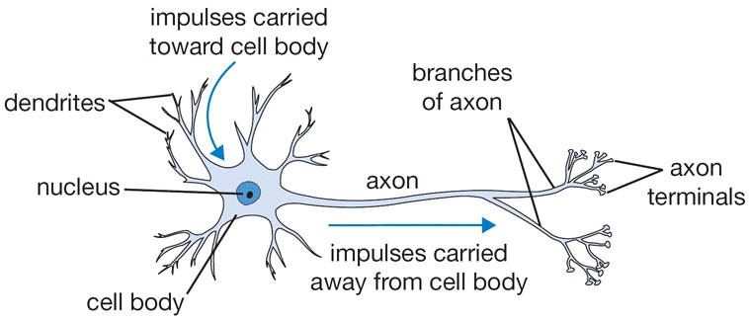
Biological motivation

Slide 4
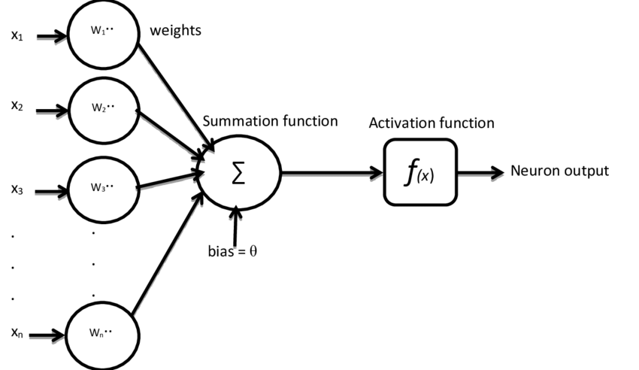
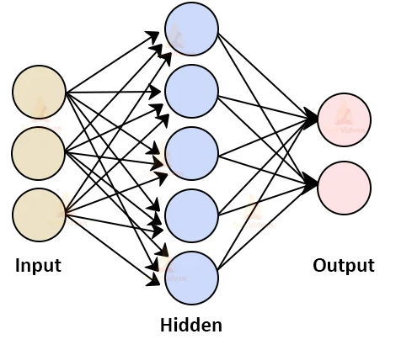

Biological motivation→ Algorithm
$$f\left(Σω_{i}x_{i}+θ\right)$$
Input layer: accepts the data vector or pattern
Hidden layers: They accept the output from the previous layer, weight them, and pass through a, normally, non-linear activation function.
Output layer: takes the output from the final hidden layer weights them, and possibly pass through an output nonlinearity, to produce the target values

Slide 5
Artificial neural networks
Artificial neural networks( ANNs)
Are composed of multiple artificial neuron nodes, which imitate biological neurons of the human brain.
Unlike biological neurons, there is only one type of link that connects one neuron to others.
The neurons take input data and simple operations are performed on those data.
The result of these operations is passed to other neurons.
Whether the result will be passed, is determined by the activation function
The activation function plays an important role for both feature extraction and classification.
Artificial Neural Networks are capable of learning non-linear functions.

Slide 6
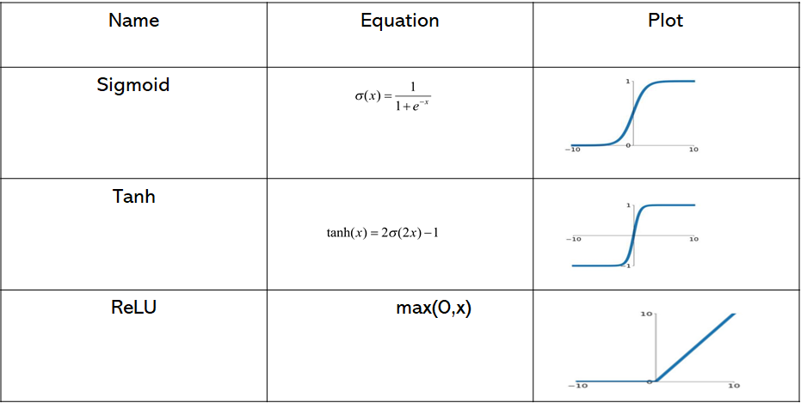


Activation functions
Each neuron performs a dot product with the input (x_{i}) and its weights (w_{i}) , adds the bias and applies the non-linearity or activation function.
The activation function of ANNs helps in learning any complex relationship between input and output.
$$f\left(x\right)=y=f\left(Σω_{i}x_{i}+θ\right)$$
Notes:
Some of the important activation functions used in deep learning

Slide 7
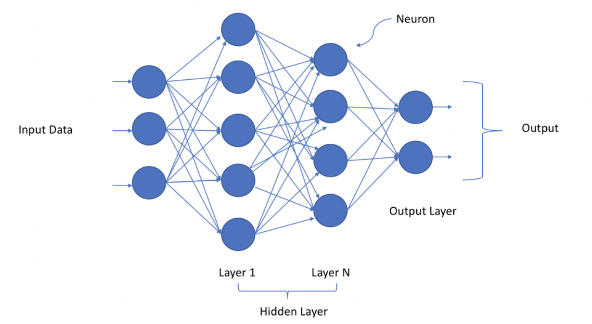
ANN to Deep Neural Net (DNN)

Slide 8
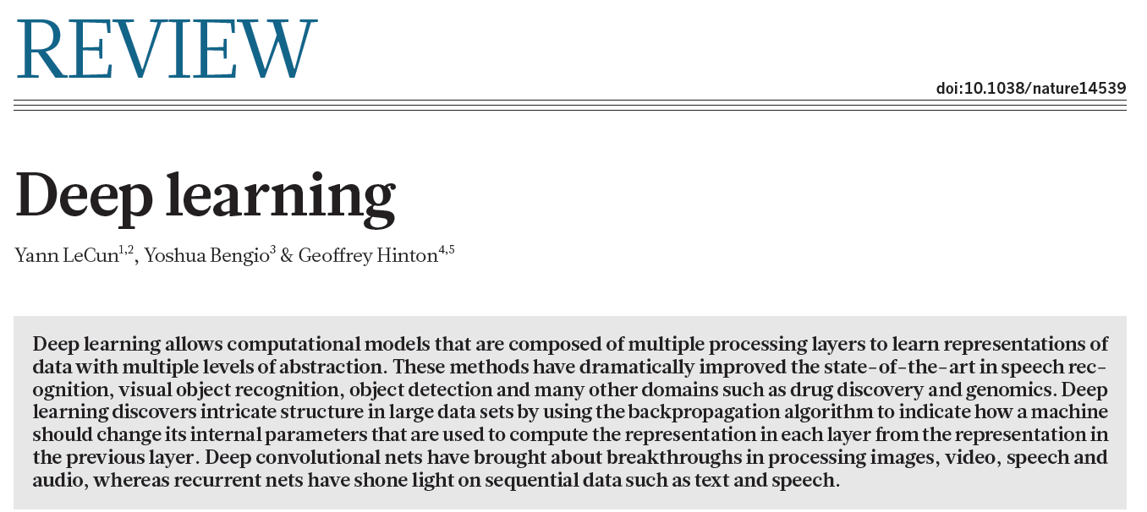
Deep learning
Deep neural network(DNN) is a subset of machine learning.
Deep refers to the number of layers
The system uses many layers of nodes to derive high-level functions from input data.
Transforming the data into a more abstract component
Artificial Intelligence
Machine Learning
Deep Learning

Slide 9
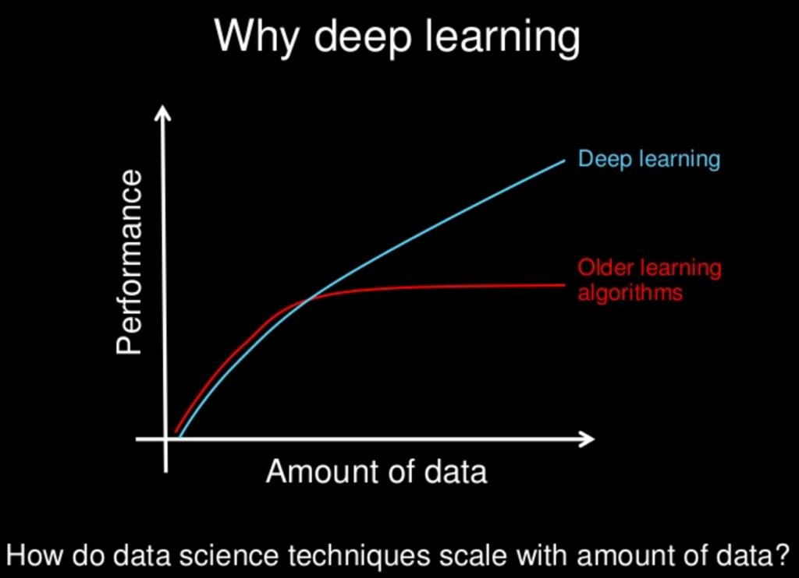
Why deep learning
As we construct larger neural networks and train them with more and more data, their performance continues to increase.
This is generally different to other machine learning techniques that reach a plateau in performance.

Slide 10
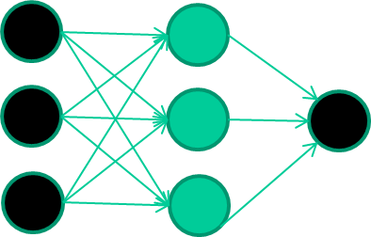
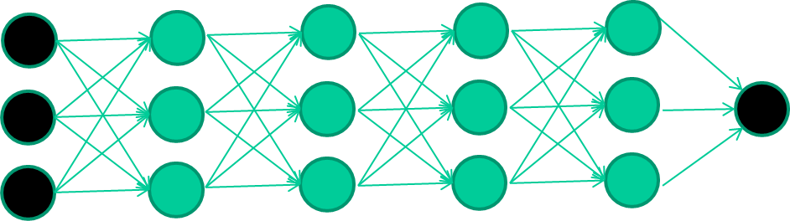
ANN vs. Deep learning ?
ANN
Deep learning
ANN are used usually with 1 hidden layer
Not good at learning weights with many layers
Many hidden layers are included
In each layer intermediate features are important for difficult classification tasks

Slide 11
Types of DNN
Feed forward deep neural network (FF-DNN)
Fully-Connected NN–feed forward or multilayer perceptron (MLP)
Convolutional neural network (CNN)
feed forward, sparsely-connected, weight sharing
Recurrent NN (RNN)
feedback
Long Short-Term Memory (LSTM):
feedback + storage

Slide 12
How DNN works
Neuron : DNN is consist of multiple neurons, The neurons take input data and simple operations are performed on those data. The result of these operations is passed to other neurons(storing and identifying information)
Layer : DNN is composed of input and output layers, and one or more hidden layer
Weight :the connection between two neurons of successive layers would have an associated weight.
Input : matrix or vector of inputs.
Output : Feature maps (matrix)
Activation function Whether the result will be passed, is determined by the activation function The activation function plays an important role for both feature extraction and classification
Learning mechanism (optimizer) : will help the neural network incrementally update the weights (that were randomly initialized) to a more suitable weight that aids into correct prediction of the outcome

Slide 13
Feed forward deep neural network (FF-DNN)
A deep neural network (DNN) can be considered as stacked neural networks, i.e., networks composed of several layers.
Feed forward deep neural network(FF-DNN): is multilayer perceptrons (MLP)
DNNs where there is more than one hidden layer and the network moves in only forward direction (no loopback).
FFDNN are suitable in both classification and prediction.
When the FF-DNN is used as a classifier, the input and output nodes will match the input features and output classes.
The most important concepts in a FF-DNN are weights, biases, nonlinear activation and backpropagation.

Slide 14
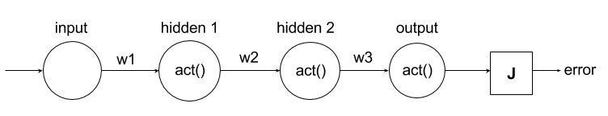
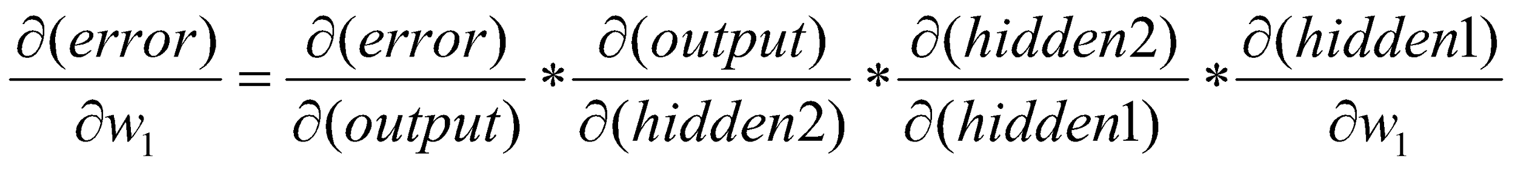
How DNN works

Slide 15
Back-propogation algorithm
Phase 1:propagation
Each propagation involves the following steps
Propagation forwards to the network to generate the output values
Calculation of the cost(error term)
Propagation of the output activations back through the network using the training pattern target in order to generate the deltas (difference between the targeted and actual outputs) of all outputs and hidden neurons
Phase 2: weight update
Following steps must be followed for each weight
The weights output delta and input activations are multiplied to find the gradient of the weight
Ratio of the weight gradient is subtracted from weight

Slide 16
Other aspects
Deep learning R
Why is it generally better than other methods on image, speech and certain other types of data?
H2o
Tensorflow
Deepnet
nnet
neuralnet
kerasR
Keras (uses TensorFlow as a backend)
Series of layers between input & output involved in
Feature identification
Processing in a series of stages
Very similar with our brains function

Slide 17
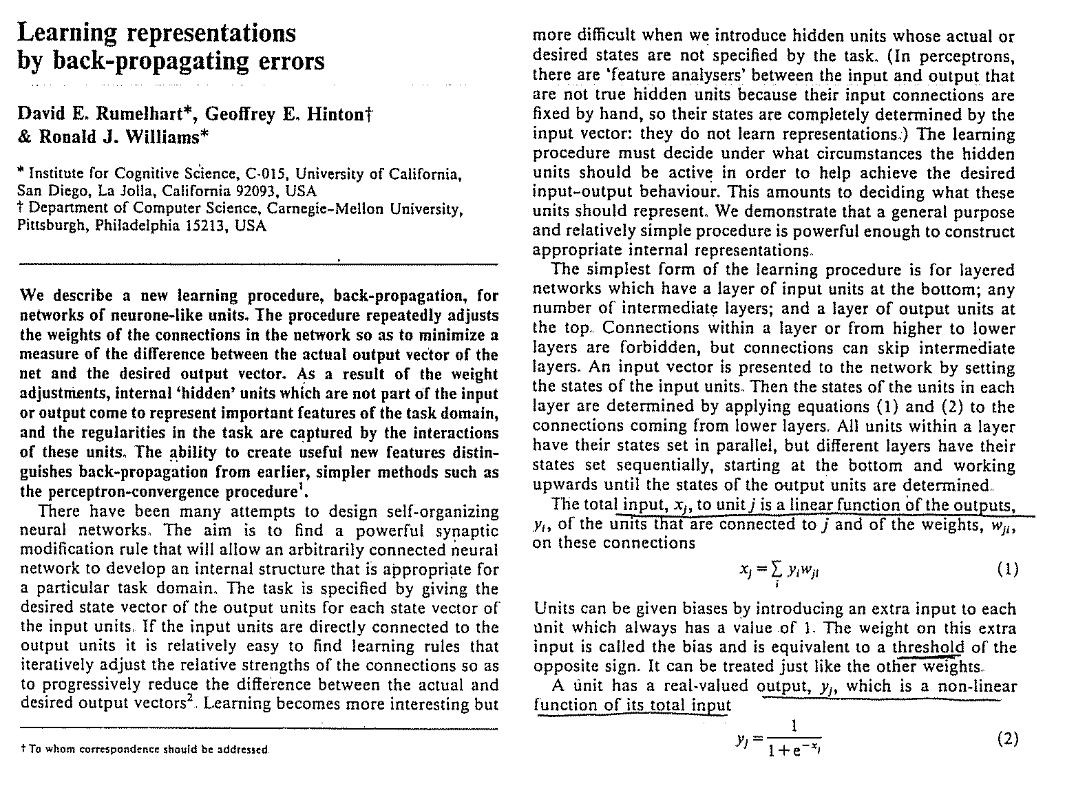

Slide 18
