Slide 1

LM Big Data Management in Finance (36320) Birmingham Business School
Dr. Animesh Acharjee

Slide 2
Methods
Machine learning methods
Regularization
LASSO
Elastic Net
Decision tree
Random Forest
XGBoost
Kernel Based
SVM
Neural Network based
ANN
Deep learning
LSTM

Slide 3
Decision Tree & Random Forest

Slide 4
What is a decision tree?
A decision tree consists of three different building blocks:
Nodes
The nodes identify the splitting feature and implement the partitioning operation on the input subset of data
Branches
the branches depart from a node and identify the different subsets of data produced by the partitioning operation
Leaves.
The leaves, at the end of a path, identify a final subset of data and associate a class with that specific decision path

Slide 5
Example binary classification tree
The root contains all samples
Each subsequent node contains a subset of the samples
Each decision rule splits up the samples into two subgroups
Every rule is of the form
x > t for continuous x
x ∈ A for categorical x
Only one variable per rule
Same variable can be used again
Each leaf more or less ‘pure’
A new sample is run through the tree and one looks for the leaf it ends up
Regression Trees: average of the values at that leaf

Slide 6
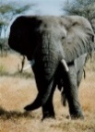
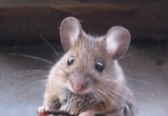

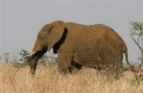
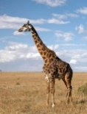
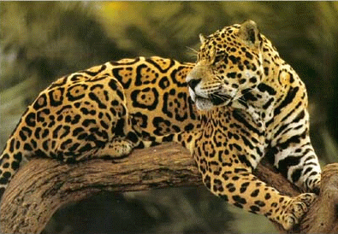

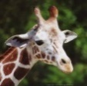

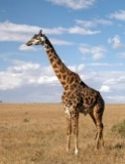
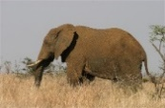

Example-1: Identify / separate species
No
Colour Grey ?
Yes
Neck > 1.5 m ?
Mass > 2000 kg ?
Mass > 2000 kg ?
No
Yes
No
Yes

Slide 8
Criteria for splitting
Search, per step, ‘best’ variable and split point
Each step: splitting only one of the nodes into two
There are different ways to control how many splits are generated
Gini Index
The Gini index is based on Gini impurity. Gini impurity is defined as 1 minus the sum of the squares of the class probabilities in a dataset.
Entropy
Entropy is a concept that is used to measure information
Information Gain
How good a feature is for splitting, the difference in entropy before and after the split is calculated.

Slide 9
Stopping criteria
All nodes are pure (single class) or have a ‘final’ number of elements, e.g. 5
Prune the tree back somewhat
Remove splits with low decrease in impurity
To protect against overfitting
Unpruned trees
Low bias (end nodes have maximum purity)
High variance
Widely different rules if the data or the samples change a little

Slide 10
Example 2: Spielberg movies
yes
yes
yes

Slide 11
Random Forest

Slide 12
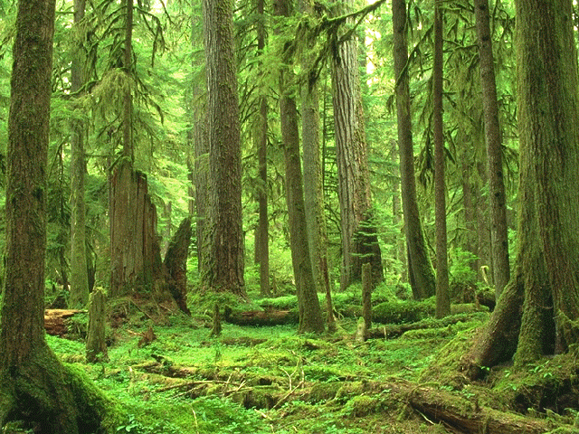
Random forests (Breiman 2001)
Both classification and multiple regression
Handles high numbers of variables (p >> n)
Handles categorical and continuous predictors
Two-class and multi-class
Robust to large numbers of noise variables
Incorporates interactions between variables
Internal cross validation
Variable importance is estimated
Proximities between cases are computed
can be used to do clustering (unsupervised)
Extension of ‘Classification and regression trees’ (CART)

Slide 13
Random forest
Ensemble method
not one tree, but many
Each single tree unpruned
Low bias, high variance
Introduce two forms of ‘randomness’
Random training sets
Random variable selection at each node
Effects
Individual trees are weak learners
Low bias, low correlation, high variance
Averaging over the trees retains low bias and reduces variance !
‘Bagging’ = bootstrap aggregation

Slide 14
Bootstrap

Slide 15
Internal cross validation using ‘out of bag’ samples

Slide 16
New sample: each tree casts vote, then majority voting

Slide 17
Variable importance
Idea: change values of a variable and check whether the OOB error changes dramatically
For each variable x do the following:
For each tree of a forest permute the values of x for the ‘out of bag’ samples
Redo the classification for the OOB samples
Compare the OOB error with original OOB error
If unchanged, or just a bit: variable was not so important
If error increases a lot: variable was important
Also: quantify the increase in impurity

Slide 18
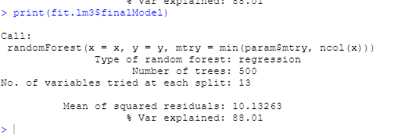
Random Forest using caret
fit.rf <- train(medv~., data=training, method="rf", metric="RMSE", preProc=c("center", "scale"), trControl=control)

