Slide 1
Power System Fault Detection and Classification
MACHINE LEARNING PROJECT
Presented By:
RAHUL KUMAR SINHA-BIT SINDRI, DHANBAD-INFORMATION TECHNOLOGY

Slide 2
OUTLINE
Problem Statement
Proposed System/Solution
System Development Approach
Algorithm & Deployment
Result
Conclusion
Future Scope
References

Slide 3
Problem Statement
Design a machine learning model to detect and classify different types of faults in a power distribution system. Using electrical measurement data (e.g., voltage and current phasors), the model should be able to distinguish between normal operating conditions and various fault conditions (such as line-to-ground, line-to-line, or three-phase faults). The objective is to enable rapid and accurate fault identification, which is crucial for maintaining power grid stability and reliability.

Slide 4
Proposed Solution
1 Data Collection
Gather Data: Collect high-resolution voltage and current phasor measurements (e.g., from Phasor Measurement Units - PMUs) under different conditions:
Normal operating conditions
Fault conditions: line-to-ground, line-to-line, three-phase faults
Data Labeling: Label each data segment with the corresponding state for supervised learning.
2. Data Preprocessing
Filtering & Noise Reduction: Use filters (e.g., low-pass filter) to eliminate noise.
Windowing: Segment data into fixed-length windows (e.g., 100-200 ms) for analysis.
Normalization: Scale features for consistent ranges.
3.Model Selection
Use robust classification algorithms suitable for Multiclass-Classification:
Random Forest Classifier : it provides robustness and also haves high accuracy.
4. Validation & Testing :-
Simulate various fault scenarios to validate model robustness.
Conduct field tests under controlled conditions to ensure reliability.

Slide 5
System Approach
HARDWARE , SOFTWARE AND STORAGE REQUIREMENT :-
1.watsonx.ai Studio:
It offers a collaborative environment with tools for data preparation, model development, testing, and deployment, all within a cloud-based interface.
2. watsonx.ai Runtime:
It provides 8 virtual CPU and 32 GB of RAM.
3. Cloud object Storage:
In the free lite version, we are provided with 25 GB per month storage

Slide 6
Algorithm & Deployment
In this Algorithm section, we would see the machine learning algorithm chosen for predicting Power fault Detection.
Algorithm Selection:
Here Random Forest Classifier is chosen because Random Forest tends to deliver excellent predictive performance by combining multiple decision trees to reduce overfitting and increase generalization which is required here for predicting the power fault type.
Data Input:
The inputs taken here are fault type, fault location , voltage, current , power load, Temperature, wind speed, weather , component nature, Duration of fault and Down Time these are the parameters taken here as the inputs.
Training Process:
Input Data: The Random Forest Classifier uses the extracted features along with labels indicating the fault type.
Model Training: Train the Random Forest classifier on this labeled dataset so it learns to distinguish patterns associated with different faults.
Prediction Process:-
Prediction: The Random Forest analyzes the incoming features and predicts whether a fault exists and its specific type.
Decision-Making: The system can trigger alerts, isolate faulty sections, or initiate corrective actions based on the prediction.
.

Slide 7
Result
THE RESULTS OF THE POWER SYSTEM FAULT DETECTION AND CLASSIFICATION BY THE USAGE OF WATSONX.AI STUDIO AS A MACHINE LEARNING MODEL ON IBM CLOUD PLATFORM ARE GIVEN AS THE FOLLOWING:-

Slide 8
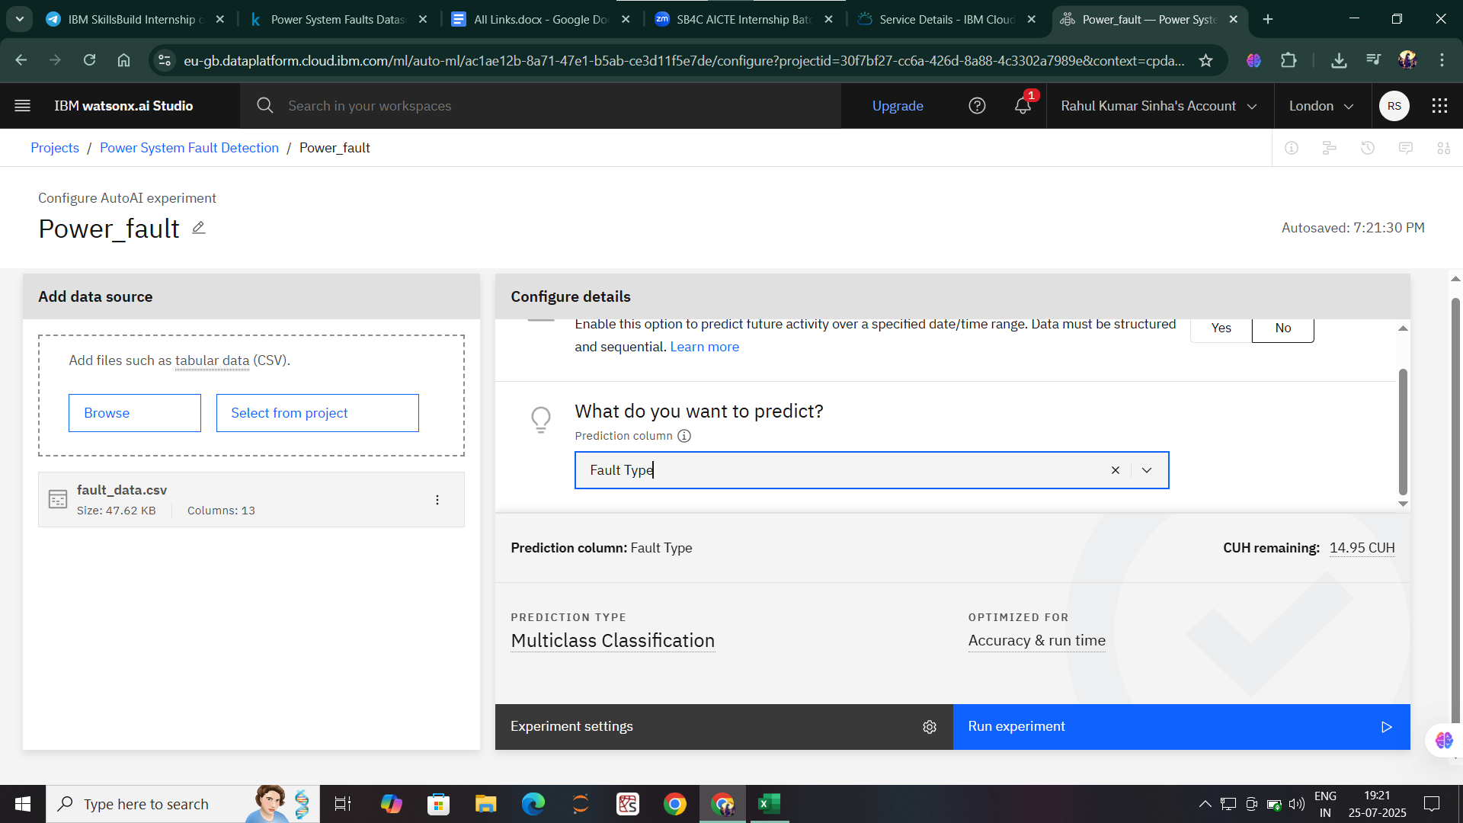
Result

Slide 9
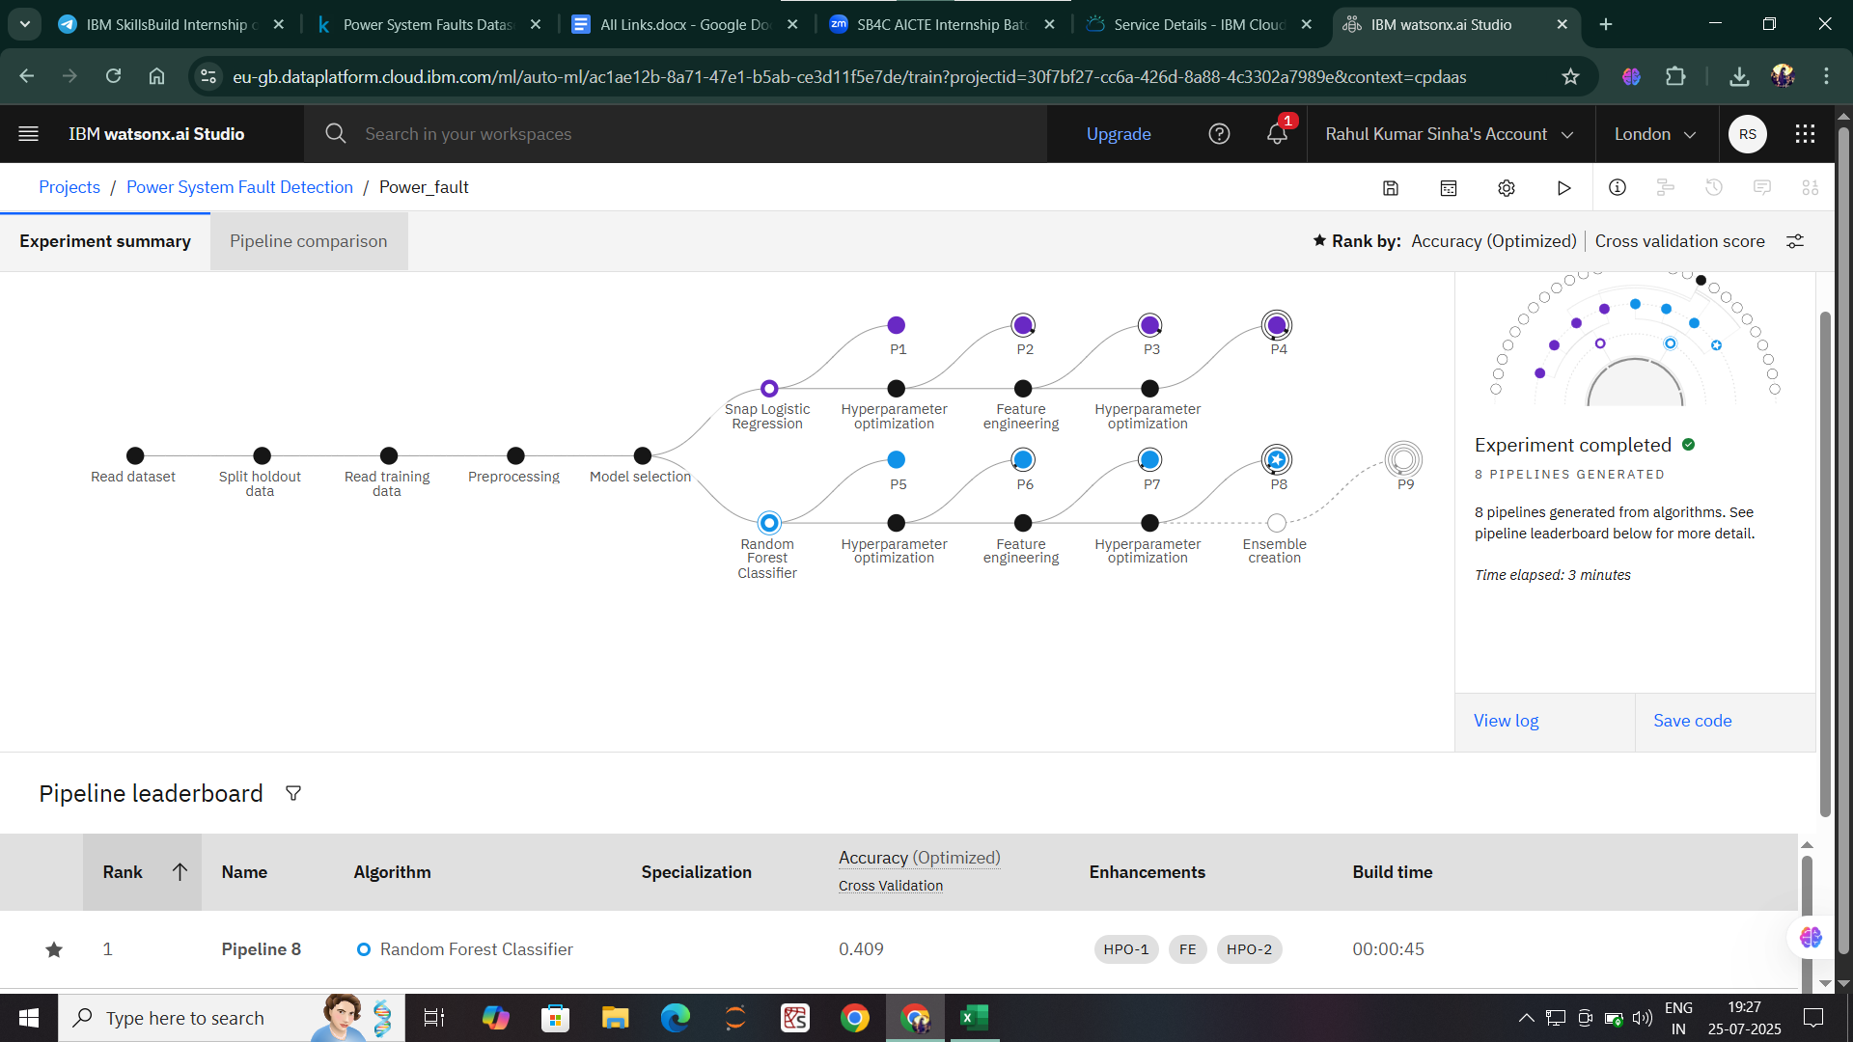
Result

Slide 10
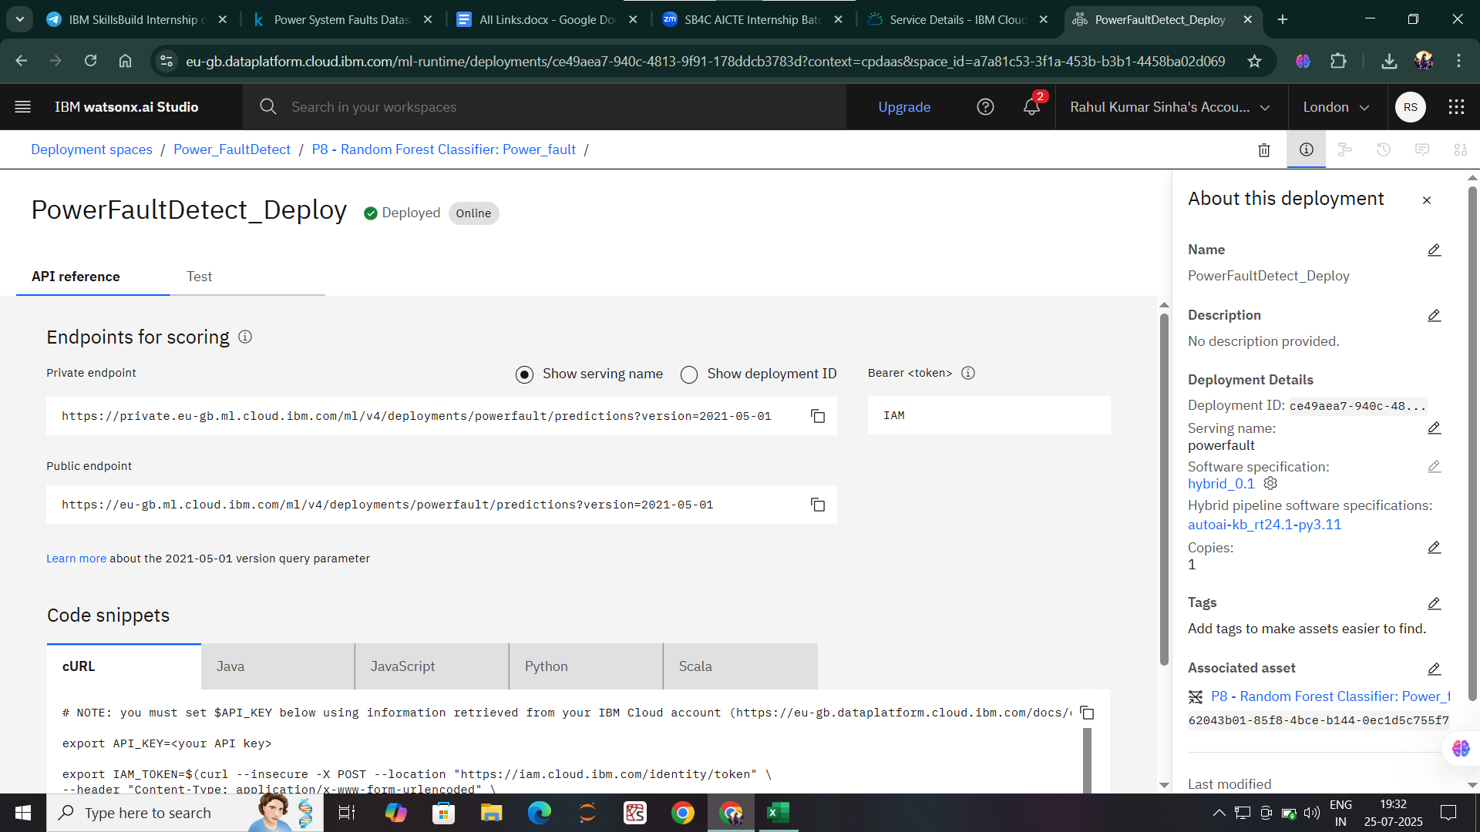
Result

Slide 11
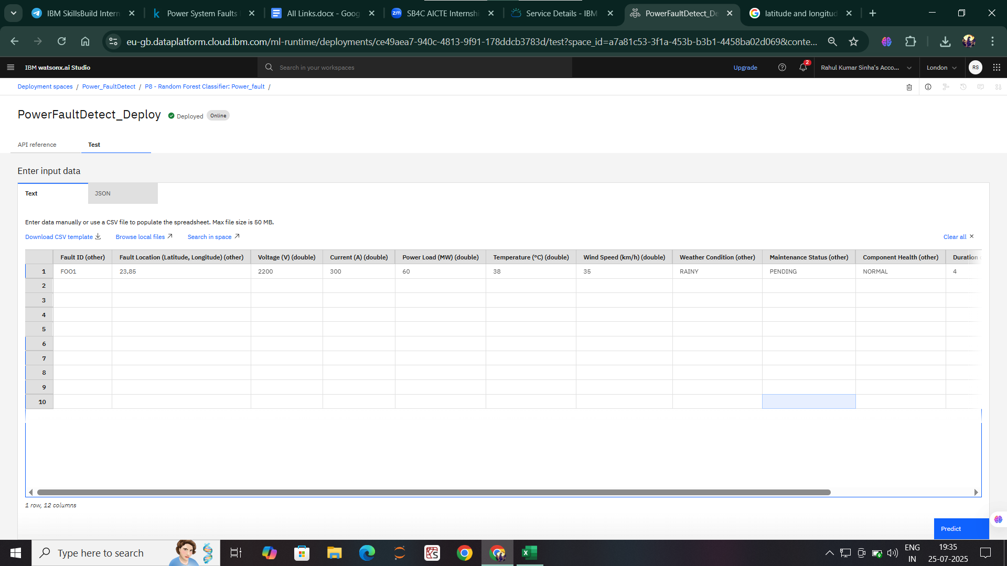
Result

Slide 12
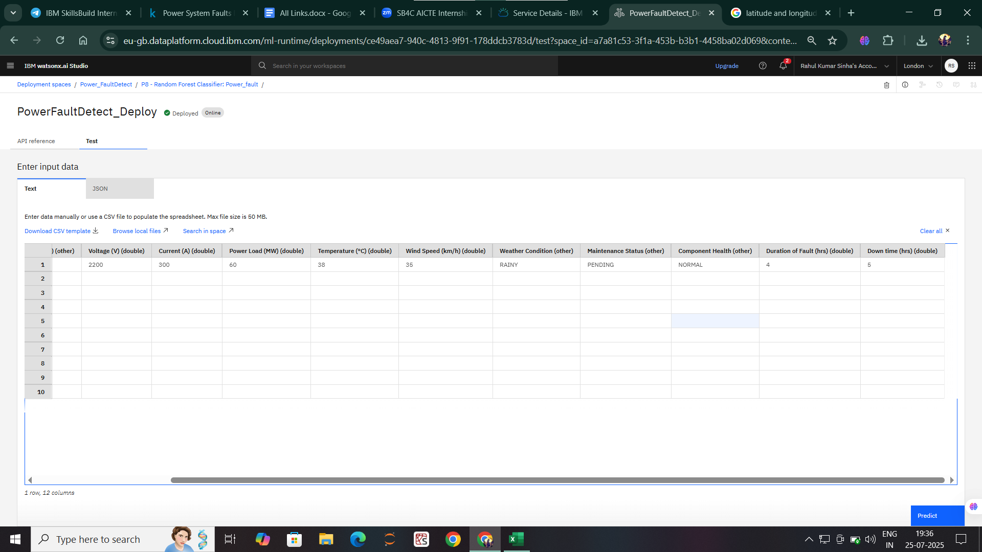
Result

Slide 13
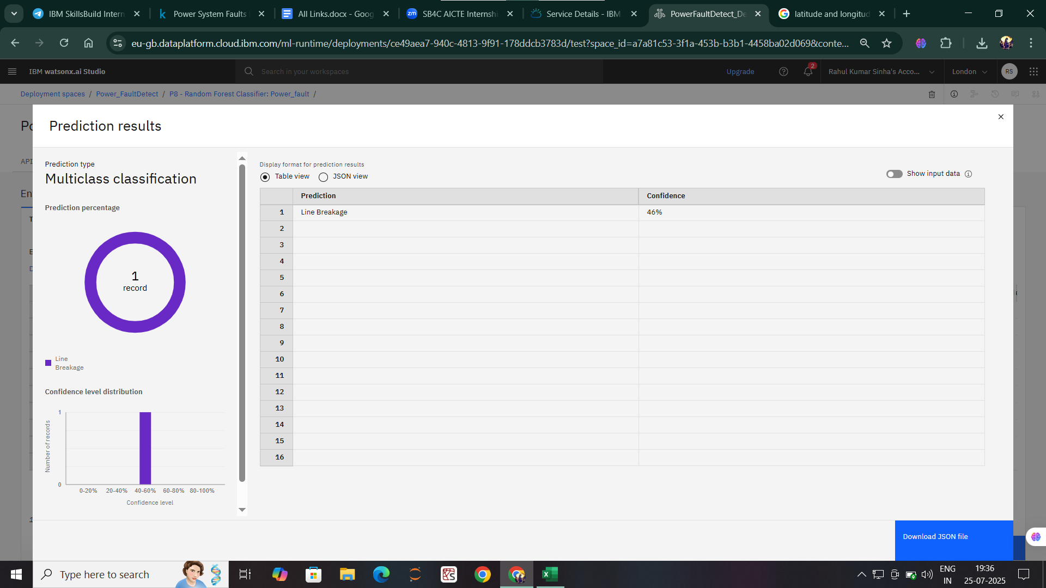
Result

Slide 14
Conclusion
In practical scenarios, utilities might implement this by training a Random Forest with labeled fault data collected during system tests or historical event logs. Once trained, sensors detect anomalies, and the model classifies the faults, enabling rapid and accurate response.
Implementing a Random Forest classifier for power system faults faces challenges like limited and imbalanced fault data, noise in sensor measurements, selecting relevant features, ensuring real-time processing, adapting to system changes, integration with existing systems, maintaining model accuracy over time, and explaining model decisions. Overcoming these requires good data management, feature engineering, computational resources, and ongoing model updates.

Slide 15
Future scope
This System can be further modified in future by the implementing the following standards:-
1. Integration with IoT and Smart Grids
Combining fault detection with IoT sensors for real-time, high-resolution monitoring.
Enabling more accurate and faster fault diagnosis across extensive smart grid networks.
2. Hybrid Models
Integrating Random Forest with other machine learning algorithms (like deep learning) to improve accuracy and handle complex fault scenarios.
Using ensemble techniques for more robust fault classification.
3. Automated Data Collection and Self-Training
Developing systems that automatically collect and label data, allowing continuous model learning and adaptation to evolving system conditions.
4. Enhanced Interpretability
Improving explainability of model decisions for better trust, regulatory compliance, and system diagnostics.
5. Predictive Maintenance
Transitioning from fault detection to fault prediction, enabling preventive maintenance and reducing downtime.

Slide 16
References
1.Websites :-
www.google.com
www.Wikipedia.com
www.Kaggle.com
2.Books:-
“Mathematics for Machine Learning" by Deisenroth, Faisal, and Ong

Slide 17
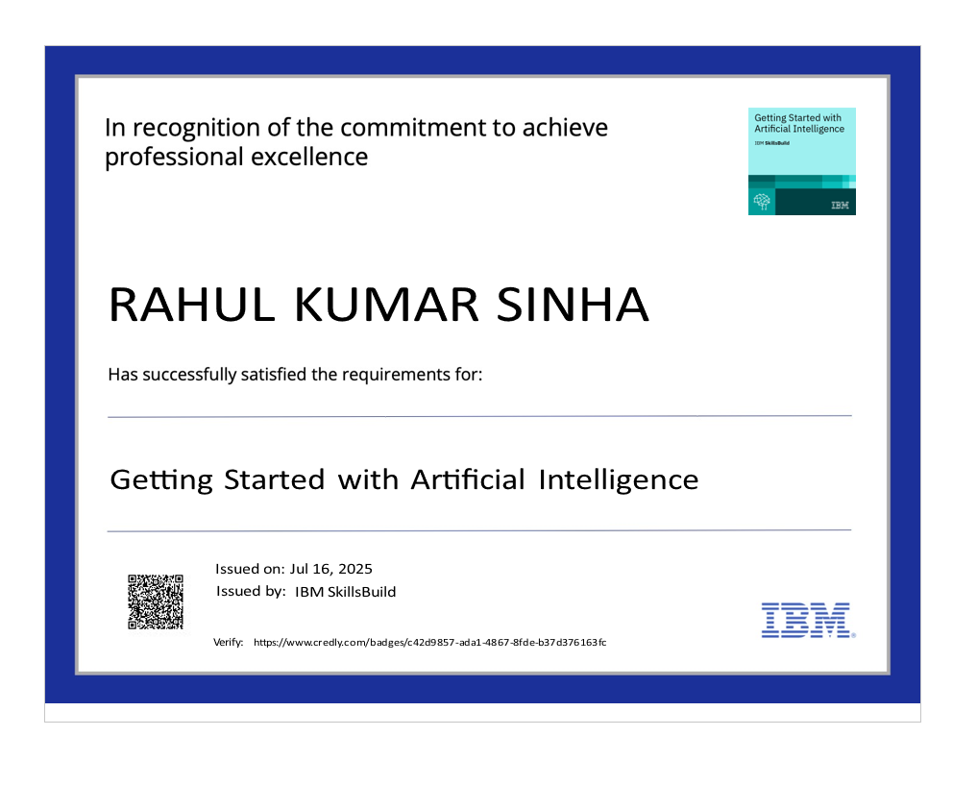
IBM Certifications

Slide 18

IBM Certifications

Slide 19
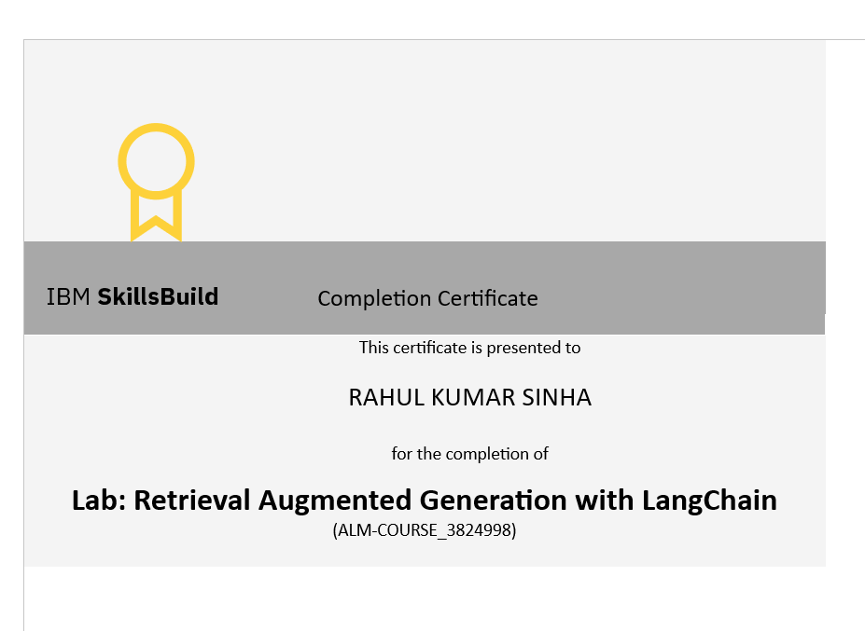
IBM Certifications

Slide 20
THANK YOU !!

