Slide 1
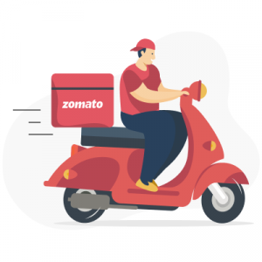
SPREADSHEET PROJECT
Zomato Restaurant Expansion Strategy
A Data-driven Analysis & Recommendation
By: RAHUL M
Date:26/09/2025

Slide 2
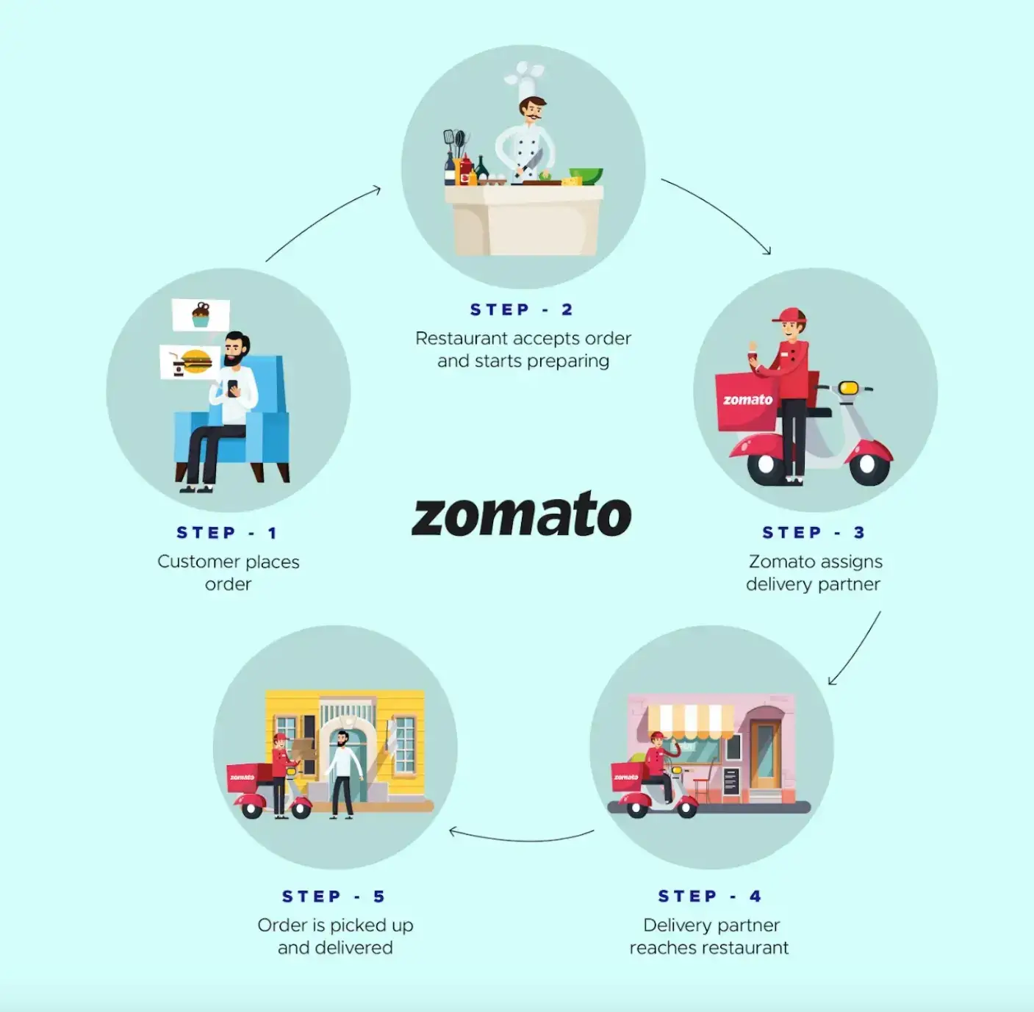
What is Zomato & how does it work?
Step 1
Users may browse and order food from various restaurants via the desiccated app or website.
Step 2
When restaurant owners receive an order request, they prepare a dish.
Step 3
As the food is prepared for delivery, it is given to delivery companies.
Step 4
The delivery service delivers food to the customer's preferred location.
Step 5
Customers can make purchases and provide evaluations based on their experience using the payment options.

Slide 3
Agenda
01
02
03
04
05
Problem objective/ Statement
Objective
Of Project
Data Description & Methodology
Key Metrics & Visualisation
Strategic Recommendation and Dashboard

Slide 4

Zomato is aiming to expand its presence by identifying new strategic locations for restaurant openings. This project uses data-driven insights to suggest optimal areas for expansion based on ratings, price, votes, and cuisines.

Slide 5
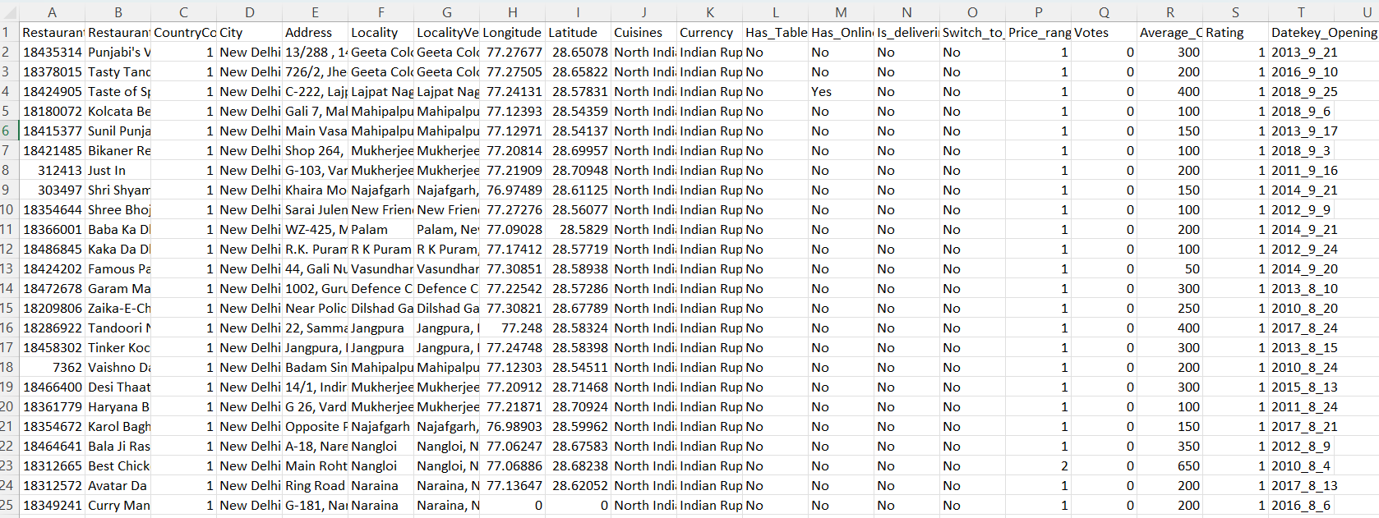
Problem Statement
You are hired as a consultant data analyst by Zomato where the team is looking for expansion and opening restaurants. Your task is to come up with strategies/suggestions about opening newer restaurants.

Slide 6
Data Overview
Detailed Restaurant Information:
Covers IDs, names, addresses, and locations.
2. Geographical Data:
Provides longitude and latitude for precise location mapping.
3. Categorical Data:
Includes location (Country Code, City), cuisine types, and currency.
Total restaurants | 9528
Total Country | 150
Total Cities | 140
Total Cuisines | 1821
Service offered | Table booking , Online Delivery
Average Rating | 2.9
Average Price in INR | Rs. 811
4. Service Indicators:
Shows availability of table booking, online delivery, and current delivery status.
5. Financial Metrics:
Contains price range, average cost for two, and rating.
6. Temporal Aspect:
Includes the opening date of each restaurant.

Slide 7
Objective Of Project
Determine possible nations for Zomato's growth.
Examine market patterns and the distribution of restaurants at various price points.
To enhance service delivery, collect feedback and customer satisfaction statistics.
Analyze customer ratings & votes to learn more about customer engagement &the amount of competition in target areas.
Examine pricing tactics to make sure they are profitable and competitive.
Analyze the tastes and habits of consumers in prospective markets.

Slide 8
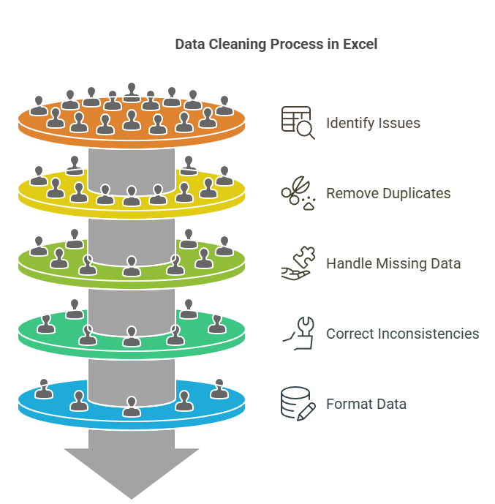
Methodology
Data Cleaning:
Handled missing values in the Longitude & Latitude column as well as Cuisines column.
Resolved inconsistencies in Restaurant ID entries
Applied conditional formatting to detect and remove extra spaces
Standardized City column and removed unwanted columns
Data Preprocessing:
Enriched data by adding country using VLOOKUP on country code.
Extracted month and year from date key opening using the text function to enable time-based trend analysis.
Data Analysis Tools:
Used pivot tables and pivot charts for dynamic summarization and visualization, enabling clear and actionable insights.

Slide 9
Key Metrics And Visualization
No of Restaurant opened each year:
Presented a comparative analysis of consumer involvement by evaluating the number of restaurants that open yearly.
A year with large number of restaurants indicates more consumer involvement.
Example from Chart: Year 2011, 2017 and 2018

Slide 10
Average no. of Voters in each Country:
I calculated the average number of voters per restaurant by country to provide a comparative analysis of customer participation.
A country with significant proportion of voters indicates more interaction with customers.
Example from Chart: Indonesia, UAE, Turkey

Slide 11
Count Of Restaurants:
Calculated the total number of restaurants per country visualizing these insights through intuitive charts for better Strategic Decision Making.
It will be very advisable to open up the new restaurants. Like- Brazil, Sri Lanka, Canada, Australia…

Slide 12
Avg. Rating Of Restaurants In Each Country:
It is crucial to understand ratings of restaurants in order to develop marketing plans and assess performance.
High rating: Philippines, Turkey [These countries face major market demands]
Low rating: Canada, Singapore [Improvements must be made]

Slide 13
Recommended Cities:
Cities like Yorkton, Consort from Canada.
And city Colombo from Sri Lanka, and city Singapore can be considered as chosen cities for opening restaurants, as the rating is low but has an online delivery option available with lesser count of restaurants.
Cities like Flaxton, Macedon, Penola and some others, which can be selected from Australia.

Slide 14
Analysis of Cuisine over Rating:
Normally the cuisines with the highest avg. ratings like Brazil, Canada, Australia and Indonesia received most of the grand ratings overall.
Consequently, it was recommended to select cuisines with a rating which is <=3.5. The cuisine of restaurants with high ratings like >=4.5 is more inclines to change.
A rating of 4 is more consistent and trustworthy.

Slide 15
Top five cuisines:

Slide 16
Country-wise Cost vs Rating:
Singapore has the highest average cost (~₹13,362) with a strong average rating (4.1).
New Zealand and Qatar show a balance of high cost (~₹10K) and high rating (4.3–4.5).
India and Sri Lanka have the lowest average costs (~₹623 and ₹594), yet India’s average rating is relatively low (2.8), while Sri Lanka maintains a strong 4.3.

Slide 17
Analysis of Table Booking & Delivery:
Used doughnut charts to show the distribution of booking and delivery options, providing clear insight into service availability.
New restaurants should offer at least table booking or online delivery—ideally both—to improve ratings.

Slide 18
Analysis of Food Expenditure:
Singapore dominates food spending with over ₹2.6 lakh, accounting for the vast majority of total expenditure.
In contrast, countries like Sri Lanka, Brazil, and Canada contribute marginally, highlighting a significant spending gap across countries.

Slide 19
Analysis of Price Range:
India emerges as the leading country in terms of the number of restaurants, offering the most extensive variety in pricing options—from budget-friendly eateries to premium dining experiences.
Indonesia ranks the lowest in terms of restaurant count and diversity in pricing, indicating limited market saturation and potentially untapped opportunities for entry.

Slide 20
However, the number of restaurants decreases sharply as the price range increases — most restaurants fall into the lower price range.
Price Range 1: Most restaurants (4444) but lowest average rating (2.38)
Price Range 4: Fewest restaurants (586) but highest average rating (3.84)

Slide 21
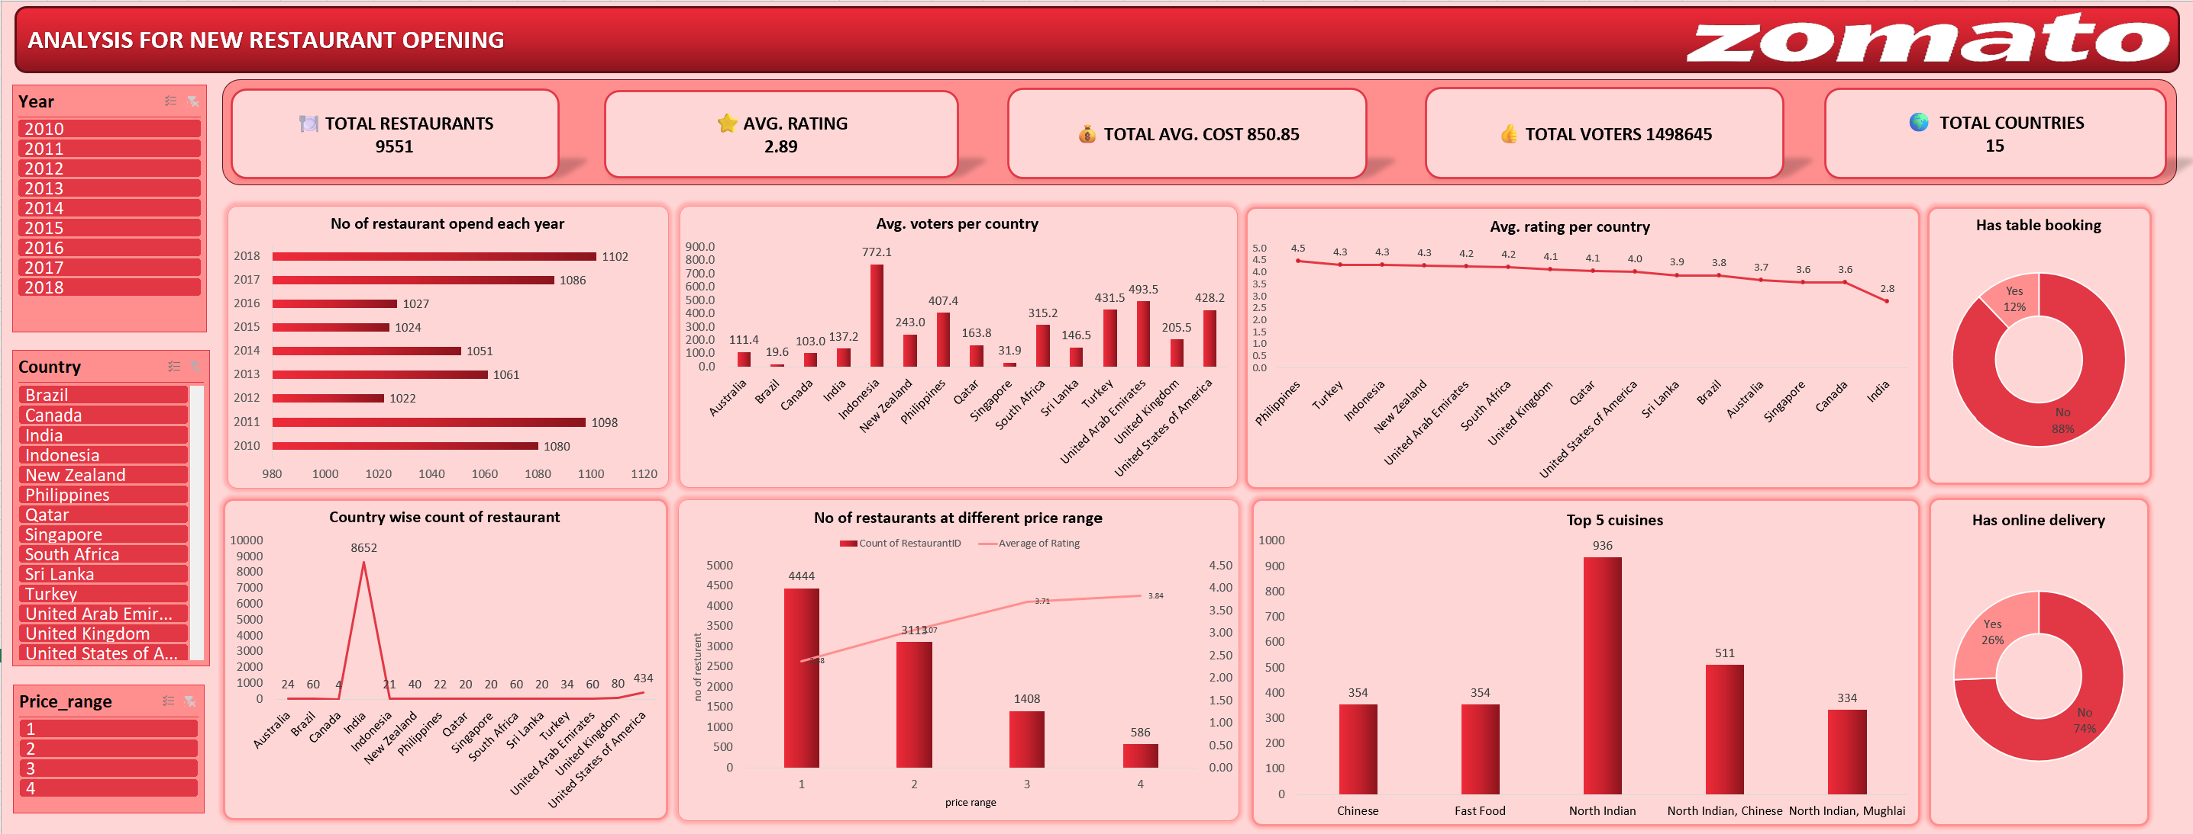
Dashboard

Slide 22
Effective Recommendations:
Put the attention on creating new eateries in nations with plenty of potentials and friendly rivalry.
For the best market entry , give preference to nations with fewer restaurants.
Areas with room for expansion or higher level of customer intersections are highlighted by restaurant density analysis.
Effective development that increases profitability.
Finding the largest rival aids in comprehending the market and their tactics. Strategizes for differencing newer eateries can benefit from this information.
Understanding customer sentiment can provide insights into preferences and areas for improvement and high-quality cuisines and strategic pricing help to attract and retain customers effectively .
Adding an online delivery and booking system will increase customer satisfaction and boost rating an votes.

Slide 23
Final Outcomes:
Data Integrity: Addressed inconsistencies in restaurant IDs and missing values, reinforcing the importance of clean data for reliable insights and decision-making.
Customer Satisfaction: Analyzed average ratings alongside the number of restaurants, advocating for enhanced cuisine variety and quality to improve customer experiences.
Top Cuisines: Identified the 10 highest-rated cuisines, providing a clear view of customer preferences and helping target marketing strategies effectively.
Market Opportunities: Highlighted regions with significant restaurant density and performance, suggesting optimal areas for expansion and new location openings.
This analysis not only uncovers critical insights about market dynamics and customer preferences but also paves the way for strategic actions that can enhance market penetration and customer satisfaction.

Slide 24
Thank You

