Slide 1
FlyPrice: Analyzing and Forecasting Flight Fares
University Of Maryland Baltimore County
DATA 606
Dr. Chaojie (Jay) Wang
Author Name: Sai Rahul Maddula
LG56610
GitHub Profile: https://github.com/rahulmaddula3/UMBC-DATA606-Capstone

Slide 2
Introduction
Flight prices fluctuate due to demand, seasonality, and timing. 'FlyPrice' aims to provide a cost-saving tool for travelers and businesses by predicting flight fares based on critical factors affecting price trends
Using over 300,000 booking records, 'FlyPrice' analyzes variables like airline, departure time, stops, and days until departure to forecast fares in USD. With a clean, interactive Streamlit UI, users can easily access price predictions and gain insights into fare patterns."

Slide 3
Dataset Overview
The FlyPrice dataset from EaseMyTrip contains 300,153 flight bookings, capturing essential details for fare prediction.
Key attributes include airline (six options), flight details (flight number, source, and destination cities), and timing(categorized departure and arrival times). It also includes stops (zero, one, or two), flight duration (0.83 to 49.83 hours), days left until flight (1 to 49 days), and ticket prices.
This dataset provides a solid basis for analyzing and predicting fare trends.

Slide 4
About the Data
Source: EaseMyTrip
Dataset Size: 300,153 records
File Size: Approximately 50 MB
Attributes: 11 columns
Comprehensive Data: Covers multiple airlines, cities, timings, and fare variations to support accurate predictions.
Broad Range: Flight durations from under 1 hour to nearly 50 hours and prices from $13 to $1,458.

Slide 5
Dataset Dictionary
Column Name | Data Type | Definition | Potential Values
Airline | Object | Name of the airline | 'SpiceJet', 'AirAsia', 'Vistara', etc.
Flight | Object | Unique flight number | Unique alphanumeric values
Source City | Object | Origin city of the flight | 'Delhi', 'Mumbai', 'Bangalore', etc.
Departure Time | Object | Time category for departure | 'Morning', 'Evening', 'Night', etc.
Stops | Object | Number of stops on the flight | 'Zero', 'One', 'Two'
Arrival Time | Object | Time category for arrival | 'Afternoon', 'Night', etc.
Destination City | Object | Destination city of the flight | 'Delhi', 'Mumbai', 'Bangalore', etc.
Class | Object | Ticket class | 'Economy', 'Business'
Duration | Float | Duration of the flight in hours | Numeric values (e.g., 2.17, 49.83)
Days Left | Integer | Days remaining until the flight | Integer values (e.g., 1, 49)
Price | Float | Ticket price in USD | Numeric values (e.g., 13.1, 1458)

Slide 6
Target Variable: Price
The price column is our target variable for prediction, representing ticket fares in USD. It’s the main focus of our analysis and machine learning models, aiming to accurately forecast flight prices.
Features/ Predictors
The key features used for predicting flight fare include Airline, Flight, Source City, Destination City, Departure Time, Arrival Time, Stops, Class, Duration, and Days Left. Each of these attributes provides important insights that contribute to understanding fare patterns and enhancing the accuracy of predictions.

Slide 7
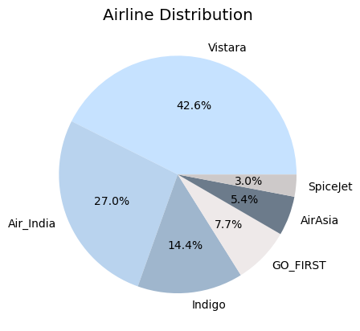
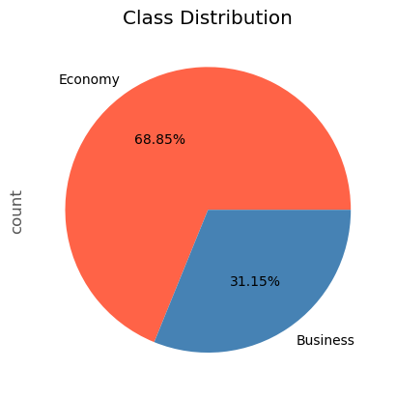
Exploratory Data Analysis

Slide 8
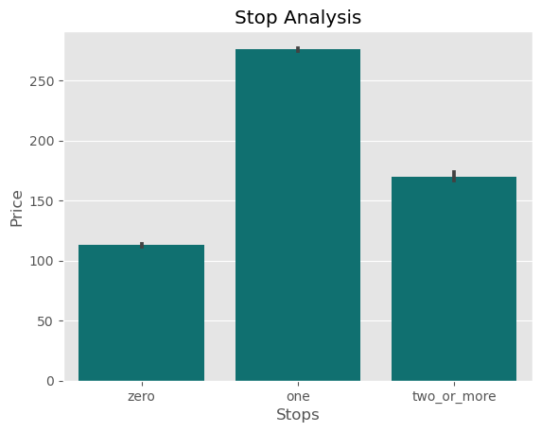

Slide 9
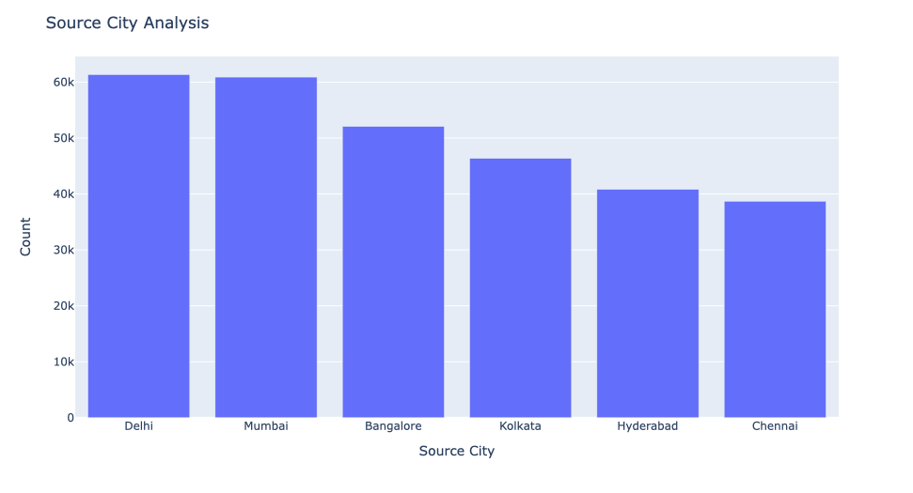

Slide 10
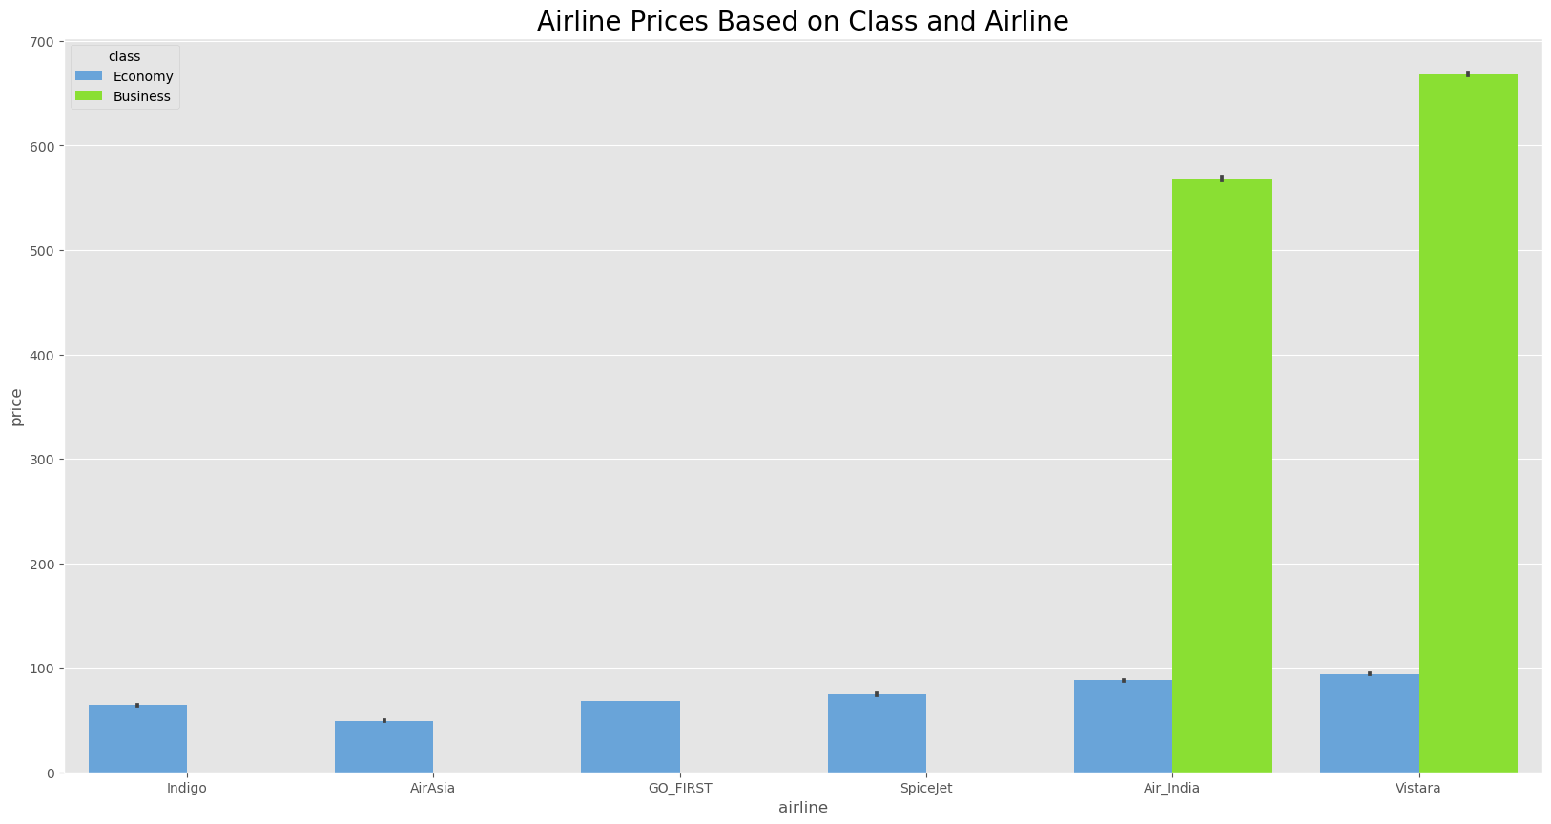

Slide 11
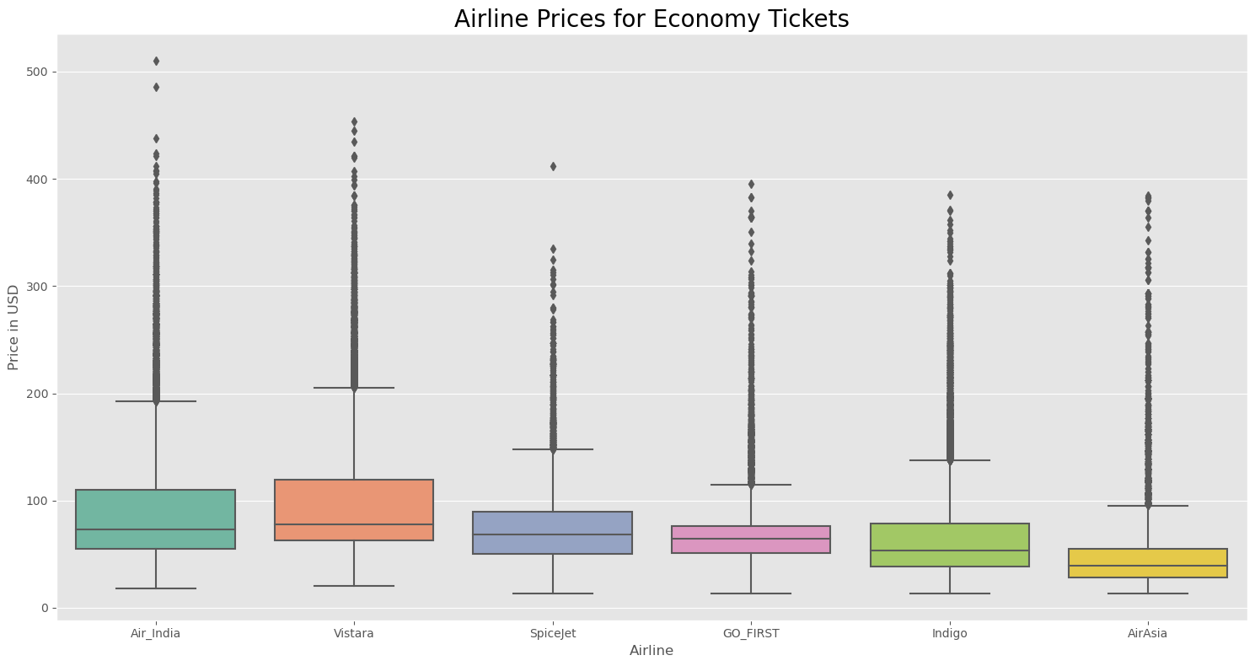

Slide 12
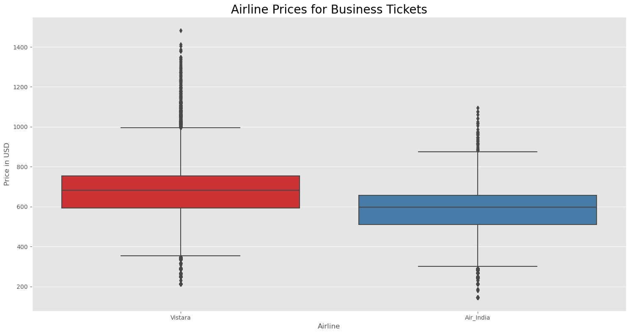

Slide 13
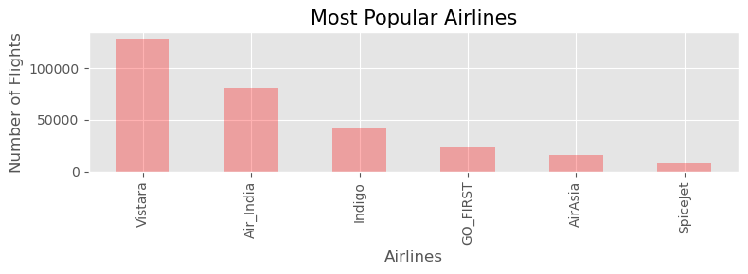

Slide 14
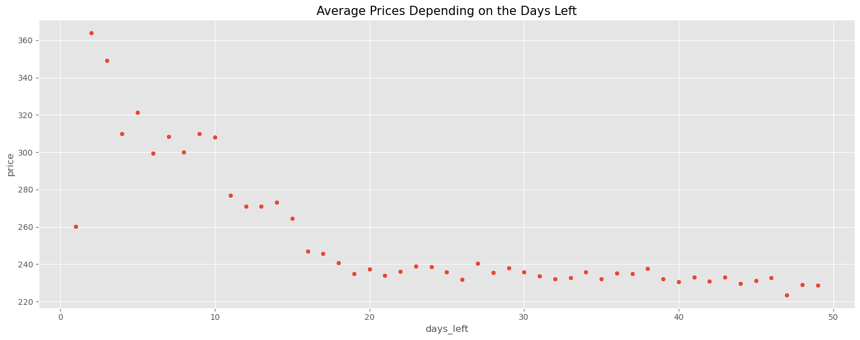

Slide 15
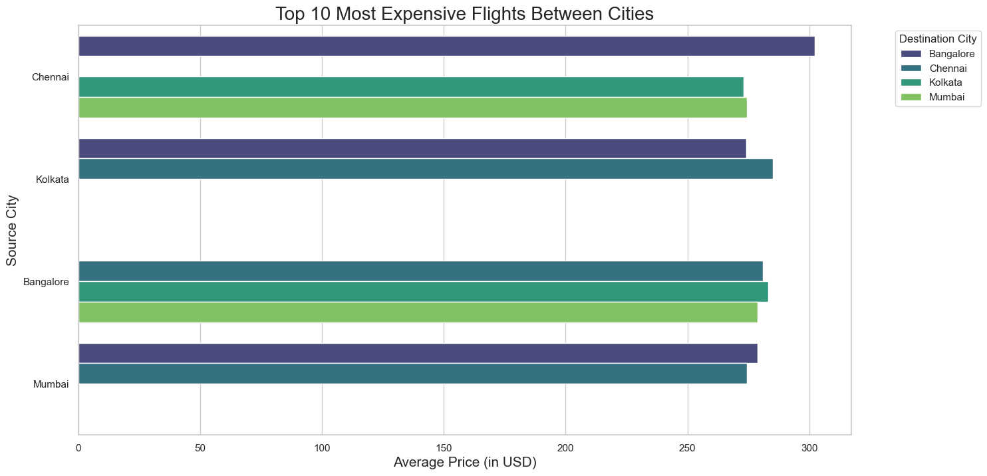

Slide 16
Machine Learning Predictions
In this project, machine learning techniques are applied to analyze and predict flight fares based on various factors.
By leveraging machine learning algorithms, we can build predictive models that estimate flight fares based on factors such as airline, departure time, number of stops, and days until the flight.
These predictive models can help airlines and travel platforms understand pricing trends, optimize pricing strategies, and provide competitive fare estimates to enhance customer satisfaction.

Slide 17
Data Preprocessing
Data Cleaning: Removed duplicates and handled missing values to ensure data quality.
Normalization/Scaling: Standardized numerical features to bring all values within a similar range.
Encoding Categorical Data: Applied one-hot encoding to transform categorical variables (e.g., airline, city) into binary features.
Dropped unnecessary columns (e.g., 'Unnamed: 0') to streamline the dataset.
Skewness Analysis: Analyzed the distribution of the target variable (price) and noted right skewness, indicating a majority of lower fares.

Slide 18
Model Evaluation
Splitting the dataset into training and testing sets using train_test_split.
Fitting the model on the training data using the fit method.
Making predictions on the testing data using the predict method.
Calculation of evaluation metrics:
Mean Absolute Error (MAE)
Mean Squared Error (MSE)
R-squared.

Slide 19
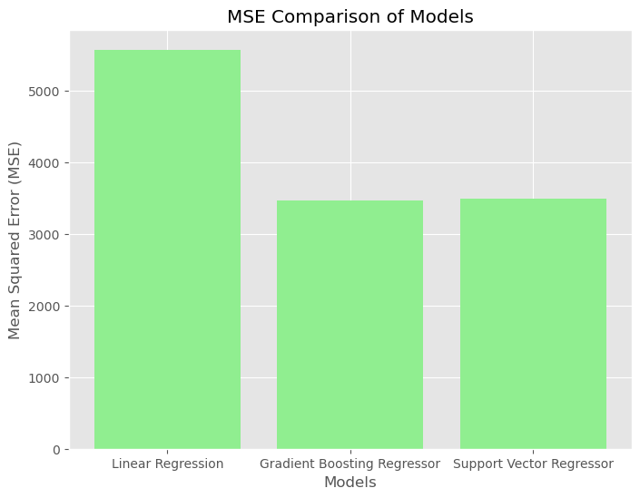
Comparison of models
Linear Regressor:
R² Score: 0.9255
Mean Absolute Error: 51.26
Mean Squared Error: 5575.24
Gradient Boosting Regressor
R² Score: 0.9536
Mean Absolute Error: 34.86
Mean Squared Error: 3469.16
Support Vector Regressor (SVR) :
R² Score: 0.9534
Mean Absolute Error: 31.64
Mean Squared Error: 3489.17

Slide 20
Streamlit UI
Streamlit web application utilizes a pre-trained machine learning model to predict flight fares based on user inputs.
Users input flight-related information through an intuitive interface, including factors like source and destination cities, travel class, and days left until departure. The application processes this information and sends it to the trained model.
The model predicts flight fare based on historical data, providing users with an estimated cost displayed on the interface. This integration of machine learning and web technology offers a practical tool for fare estimation, enhancing user accessibility to pricing insights.

Slide 21
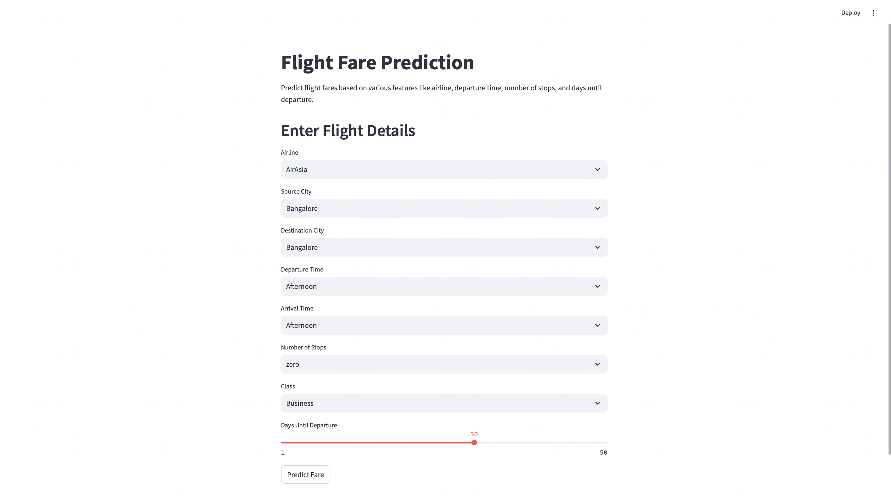

Slide 22
Limitations
Data Availability: The model is limited by the scope of the available dataset, which may not cover all possible flight routes, seasons, or booking behaviors.
Feature Constraints: Additional factors like weather, holiday seasons, and demand surges aren't accounted for, which could improve prediction accuracy.
Future scope
Incorporate External Data: Integrate data on seasonality, weather, and holidays to capture more complex patterns affecting flight prices.
Model Deployment: Develop a real-time fare prediction tool using Streamlit to provide instant predictions based on user input.

Slide 23
Conclusion
Successful Fare Prediction: Developed a predictive model for flight fares based on various features like airline, departure time, stops, and days until departure.
Gradient Boosting Regressor as Best Model: Among the models tested, Gradient Boosting Regressor achieved the highest accuracy, with the lowest Mean Squared Error (MSE) and high R² score.
High Prediction Accuracy: The Gradient Boosting model effectively captures complex relationships, providing reliable predictions for fare estimates.
Feature Insights: Important features like days until departure and number of stops were found to have a significant impact on fare prices, aiding in better understanding of price patterns.
Potential for Real-Time Application: The model can be integrated into a real-time fare prediction tool, offering users dynamic pricing information.
Future Improvements: Adding more data sources, such as holiday and demand information, could further refine the model's accuracy and applicability.

