Slide 1
Industrial Brain AI
AI-Powered Knowledge Platform for Industrial Operations • Manufacturing • Safety • Compliance
⚠ The Problem
✦ The Solution
◆ Key Innovations
▸ Knowledge trapped in 1000s of unstructured PDFs
▸ AI Copilot with evidence-grounded answers
▸ Intent-Aware Hybrid RAG Pipeline
Manual search causes excessive downtime
▸ Hybrid search: SQL + Vector + BM25 + Graph
▸ Multi-Agent Orchestration System
▸ Compliance gaps missed until audit failures
▸ Automated compliance auditing (ISO/OSHA)
▸ Evidence-Only AI (no hallucinations)
▸ Tribal knowledge lost when experts retire
▸ Knowledge Graph linking all plant entities
▸ Page-Level Citation Traceability
▸ Reactive maintenance → costly breakdowns
▸ Predictive failure pattern detection
▸ Document-Type Isolation for safety
1,231
7,714
86/100
90.5%
12
5
6
10
Documents Ingested
Chunks Indexed
Brain Score
System Confidence
DB Tables
AI Agents
Docker Services
Document Categories
React • Vite • Tailwind • FastAPI • LangChain • PostgreSQL • ChromaDB • Redis • Gemini • Groq • Docker • Nginx
Rahul Mahaseth

Slide 2
System Architecture
End-to-end data flow from user query to AI response
👤 User
React + Vite Frontend
Nginx Reverse Proxy
FastAPI Backend
🧠 AI Orchestrator & Intent Classifier
SOP Agent
RCA Agent
Compliance Agent
PostgreSQL 12 Tables • 1231 Docs
ChromaDB Vector Embeddings
Redis Cache + Queue
Knowledge Graph Nodes & Edges
Celery Workers Background Tasks
HYBRID RETRIEVAL PIPELINE
Intent Detection
Query Rewriting
Metadata Filter
SQL Search
Vector Search
BM25 Keyword
Graph Traversal
Cross-Encoder Re-ranking
Context Compression
LLM Inference (Gemini 1.5 / Groq Llama)
Hallucination Guard & Citation Validator
✅ Grounded AI Response with Page-Level Citations
90.5%
< 5-10%
Avg. Confidence
Hallucination Risk
Rahul Mahaseth

Slide 3
Intelligence Modules
Four specialized AI agents powering industrial decision-making
🤖 AI Copilot — Conversational Knowledge Engine
🔍 Root Cause Analysis — AI Failure Detective
▸ Chat interface with conversation history (Today/7d/30d)
▸ Multi-agent diagnostic engine for equipment failures
▸ Intent-aware routing: troubleshooting, manual lookup, procedure
▸ Queries Knowledge Graph for all linked incidents & logs
▸ Hybrid retrieval: SQL + BM25 + Vector + Knowledge Graph
▸ Analyzes chronology to separate root cause from symptoms
▸ Evidence-only generation — never fabricates information
▸ Generates Fishbone (Ishikawa) diagram analysis
▸ Rich Markdown responses with tables, code blocks, cards
▸ Suggests corrective actions based on historical patterns
▸ Page-level citations linking back to source documents
▸ Cross-references SOPs and maintenance manuals
▸ Confidence scoring on every response (avg 90.5%)
▸ Produces structured investigation reports
📋 Regulatory Compliance — 24/7 Automated Auditor
⚡ Failure Intelligence — Predictive Pattern Discovery
▸ Maintains database of ISO 22000, OSHA, GMP frameworks
▸ Aggregates metadata from all incident & maintenance logs
▸ Cross-references plant activities against standards
▸ NLP clustering of similar failures (bearing, seal, motor)
▸ Identifies compliance gaps and missing certificates
▸ Statistical heatmap of failure frequencies per asset
▸ Assigns risk scores (Critical/High/Medium/Low)
▸ MTBF (Mean Time Between Failures) analysis
▸ Generates audit-ready reports on demand
▸ Predictive risk scores for individual equipment
▸ Tracks compliance status across all departments
▸ Enables shift from reactive → predictive maintenance
▸ Proactive alerts before regulatory deadlines
▸ Identifies systemic issues across the entire facility
Rahul Mahaseth

Slide 4
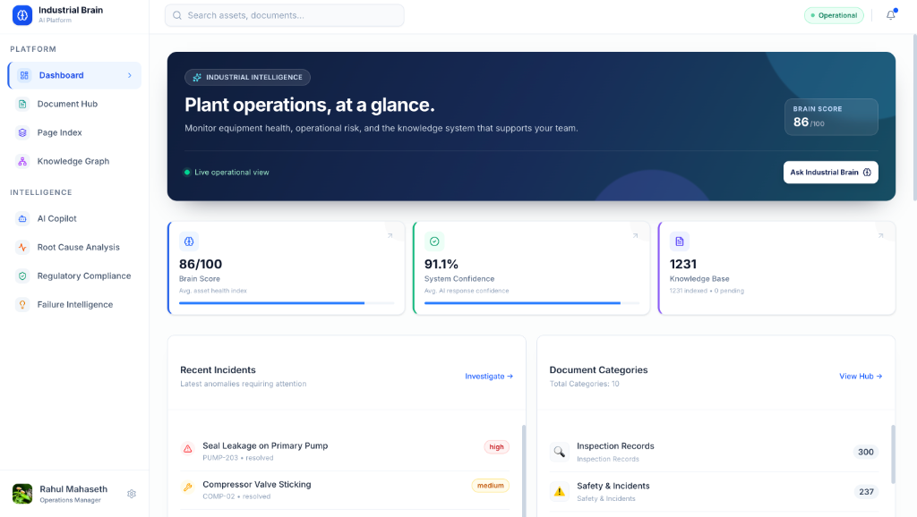
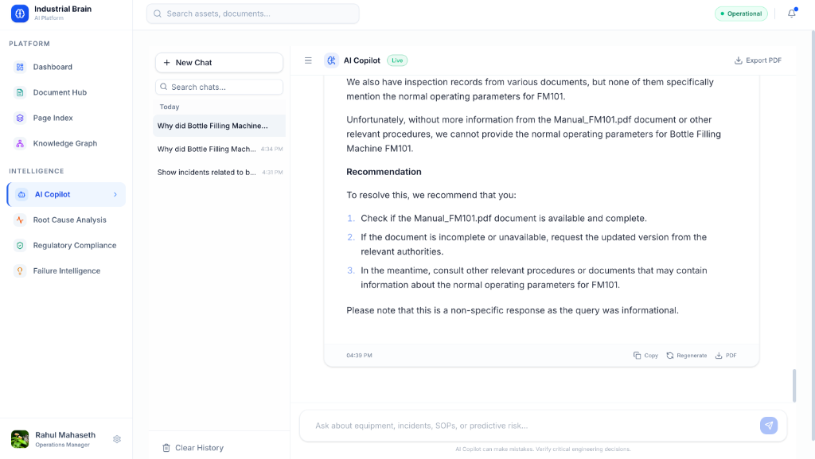
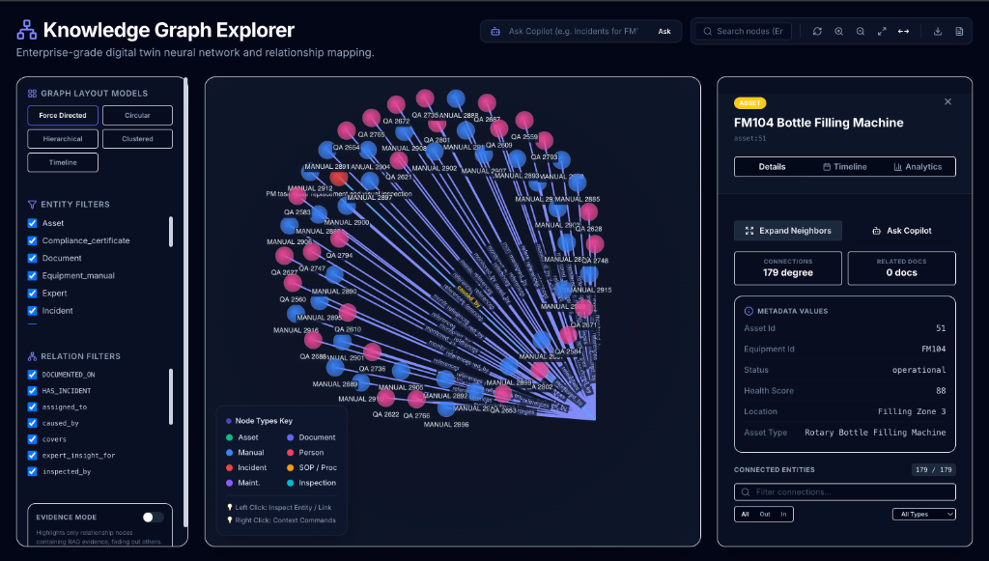
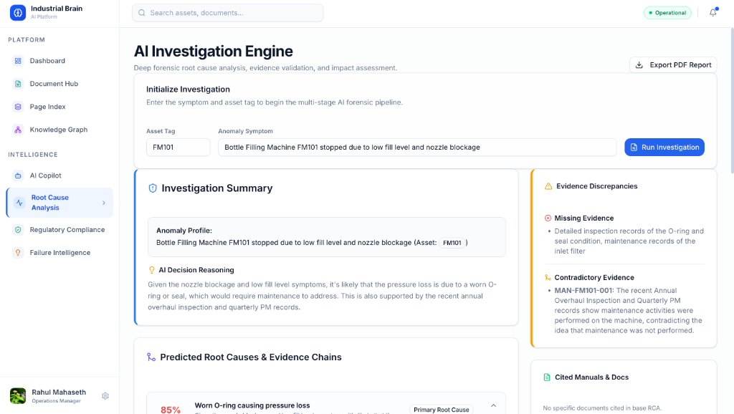
Product Demo & Features
Live screenshots from the running application
Dashboard — Real-time Asset Health & Metrics
AI Copilot — Evidence-Based Q&A
Knowledge Graph — Entity Relationships
Root Cause Analysis — AI Investigation
Rahul Mahaseth

Slide 5
Results, Impact & Future Scope
Measurable outcomes and the roadmap ahead
📊 Key Results & Impact
📁 Document Intelligence Stats
🚀 Future Scope & Roadmap
▸ 1,231 industrial documents ingested
▸ Inspection Records: 300 files
▸ Predictive Maintenance ML Models
▸ 7,714 pages indexed with full-text search
▸ Safety & Incidents: 237 files
▸ Live IoT Sensor Integration
▸ 10 document categories auto-classified
▸ QA Reports: 200 files
▸ Complete Digital Twin Synchronisation
▸ Brain Score: 86/100 avg asset health
▸ Root Cause Analysis: 200 files
▸ Multi-Plant Knowledge Sharing
▸ 90.5% average AI response confidence
▸ Standard Operating Procedures: 100 files
▸ Edge AI for Offline/Air-Gapped Sites
▸ < 5% hallucination risk (evidence-only)
▸ Compliance Certificates: 80 files
▸ Voice-Controlled Copilot (Hands-Free)
▸ Seconds to retrieve vs hours of manual search
▸ Equipment Manuals: 60 files
▸ Mobile App for Field Technicians
▸ Knowledge Graph: assets, SOPs, incidents linked
▸ Maintenance Records: 54 files
▸ Automated Report Generation
TRADITIONAL SEARCH vs INDUSTRIAL BRAIN AI
Feature | Traditional Search | Industrial Brain AI
Retrieval Method | Keyword-based (BM25 only) | Hybrid (SQL + Vector + BM25 + Graph)
Answer Format | List of file links (no context) | Synthesized answer with exact page citations
Failure Diagnosis | Manual log review (hours/days) | AI Root Cause Analysis in seconds
Compliance Tracking | Spreadsheets & manual audits | Automated ISO/OSHA gap analysis + risk scoring
Rahul Mahaseth

