Slide 1
DISEASE PREDICTION SYSTEM

Slide 2
OBJECTIVE
Our main aim is to provide a quick medical diagnosis to the patients living in rural areas.
Nowadays, it is very useful for post-covid contactless system in rural health service.
The goal is to provide access to medical specialists.
This system enhance quality of health care.

Slide 3
INTRODUCTION
The Disease Prediction System is a web-based application aimed at predicting the likelihood of a user having a specific disease based on various input parameters such as symptoms, medical history, and demographic information. The system utilizes machine learning algorithms to analyse the input data and generate predictions, helping users assess their health condition and seek appropriate medical attention if necessary.
AIM
The aim of the Disease Prediction System is to develop an intelligent platform capable of predicting the likelihood of different diseases based on user-provided data. By analyzing a comprehensive range of factors such as symptoms, medical history, lifestyle habits, and demographic characteristics, the system aims to offer personalized health assessments to users. Ultimately, the goal is to empower individuals to take proactive measures for disease prevention, early intervention, and better management of their health.

Slide 4
GOAL
The goal of the Disease Prediction System is to revolutionize healthcare delivery by leveraging advanced technology to empower individuals with proactive health management tools. By accurately predicting disease risks and providing personalized recommendations, the system aims to facilitate early detection, preventive care, and improved health outcomes for users. Ultimately, the goal is to contribute to the reduction of disease burden, healthcare costs, and mortality rates through informed decision-making and timely intervention.

Slide 5
Machine Learning and it's Algorithm
Machine Learning uses programmed algorithms that learn and optimise their operations by analysing input data to make predictions within an acceptable range. Machine learning algorithms they can be divided into three broad categories according to their purposes. These three categories are: supervised, unsupervised and semi-supervised.
In supervised machine learning algorithms, a labelled training dataset is used first to train the underlying algorithm. This trained algorithm is then fed on the unlabelled test dataset to categorise them into similar groups.
For disease prediction the learning model include Linear Regression, Support Vector Machine, Decision Tree, Random Forest, Naïve Bayes, K-nearest neighbour, Artificial Neural Network.

Slide 6
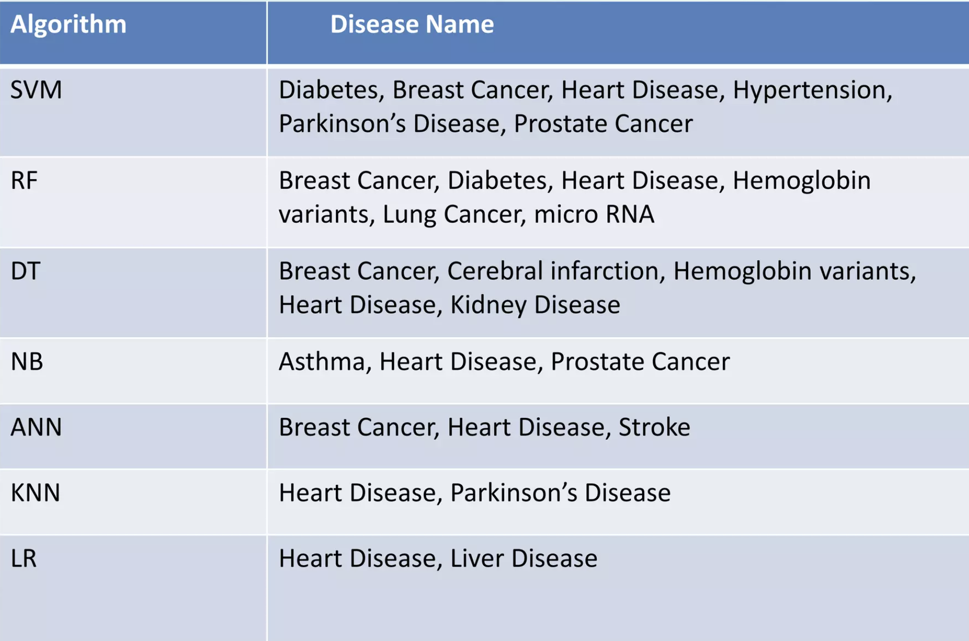
From previous referenced paper we show that this seven algorithms give the best result for following types of predicted diseases.

Slide 7
Expected Outcome
﻿Experiments are conducted in order to evaluate the performance of the proposed system.
﻿For the given symptoms using seven types of supervised machine learning algorithm, the system predicts any kind of diseases. Then the predicted diseases list forward to the doctor. At last doctor choose the correct disease from forwarded list. And the doctor suggest for medicine.

Slide 8
Future Planning
In future we will try to implement this system which prescribe medicine from the past history.
We will arrange the video conferencing for talking to doctors at any time of the day, wherever we are.

Slide 9
Algorithm
Support Vector Machine: Support vector machine (SVM) algorithm can classify both linear and non-linear data. It first maps each data item into an -dimensional feature space where n is the number of features. It then identifies the hyperplane that separates the data items into two classes while maximising the marginal distance for both classes and minimising the classification errors.
Logistic Regression: Logistic regression (R) is a powerful and well established method for supervised classification . It can be considered as an extension of ordinary regression and can model only a dichotomous variable which usually represents the occurrence or nonoccurrence of an event. LR helps in finding the probability that a new instance belongs to a certain class. Since it is a probability, the outcome lies between 0 and 1.

Slide 10
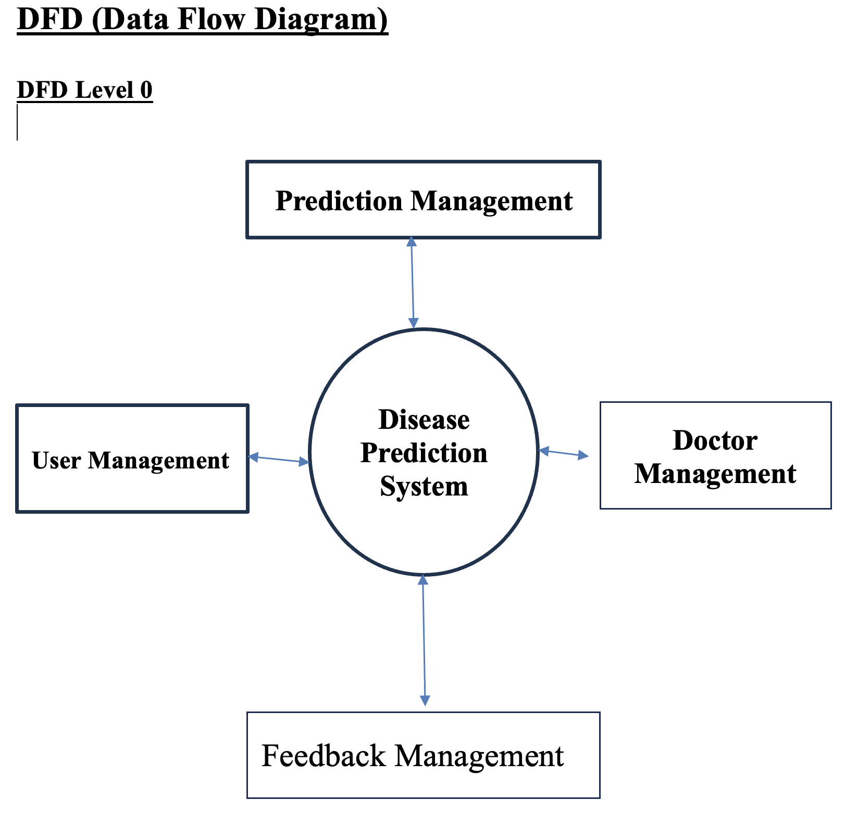

Slide 11

OUTPUT SCREEN
1.

Slide 12

2.

Slide 13

3.

Slide 14
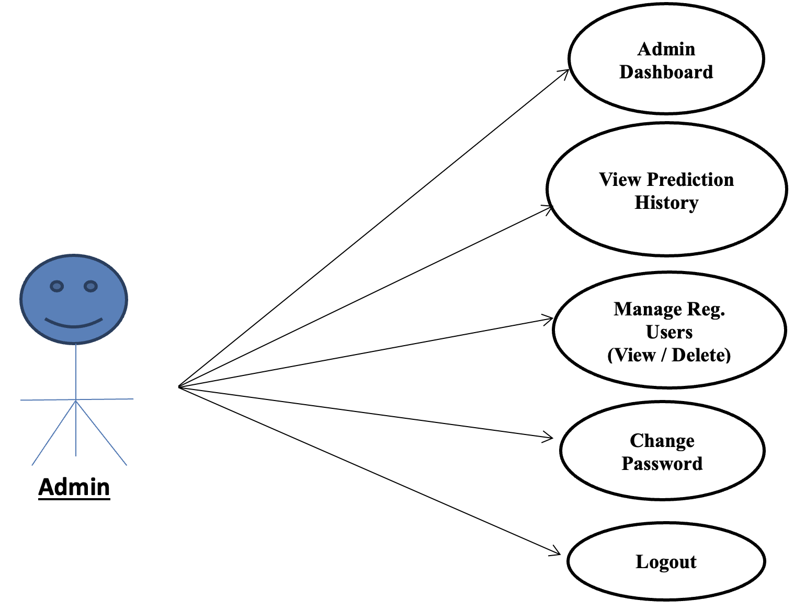
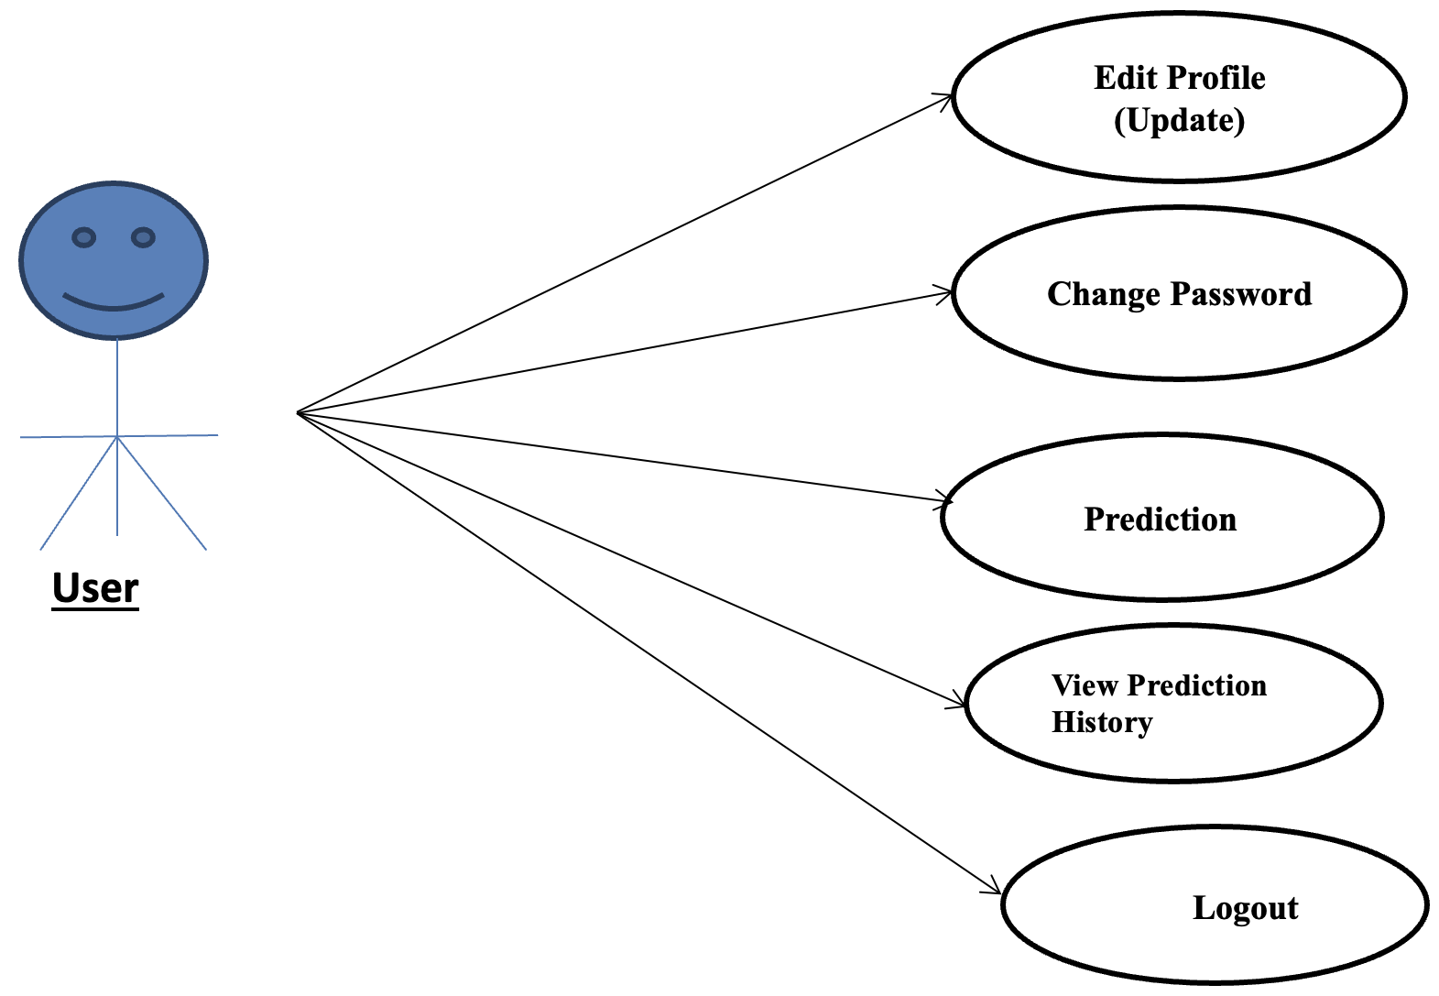
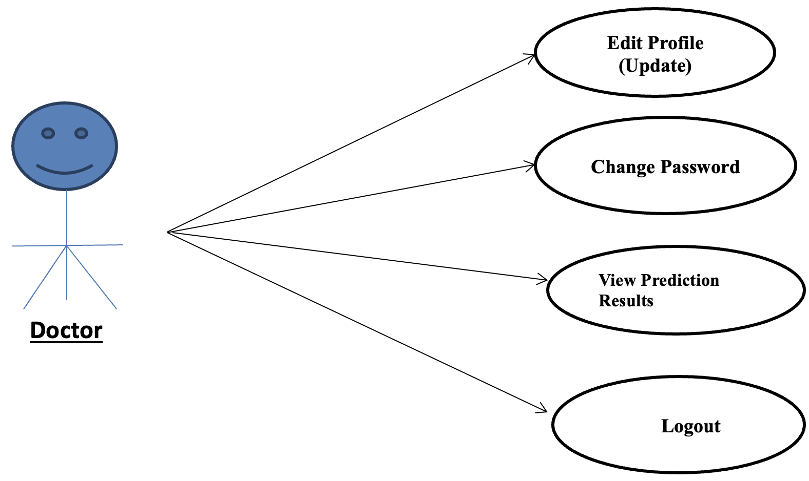
USECASE DIAGRAM

Slide 15
Decision Tree: Decision tree (DT) is one of the earliest and prominent machine learning algorithms. A decision tree models the decision logics i.e., tests and corresponds outcomes for classifying data items into a tree-like structure. The nodes of a DT tree normally have multiple levels where the first or top-most node is called the root node. All internal nodes (i.e., nodes having at least one child) represent tests on input variables or attributes. Depending on the test outcome, the classification algorithm branches towards the appropriate child node where the process of test and branching repeats until it reaches the leaf node . The leaf or terminal nodes correspond to the decision outcomes. DTs have been found easy to interpret and quick to learn, and are a common component to many medical diagnostic protocols.
, Naive Bayes: Naive Bayes (NB) is a classification technique based on the Bayes' theorem .This theorem can describe the probability of an event based on the prior knowledge of conditions related to that event. This classifier assumes that a particular feature in a class is not directly related to any other feature although features for that class could have interdependence among themselves.

Slide 16
Random Forest: A random forest (RF) is an ensemble classifier and consisting of many DTs similar to the way a forest is a collection of many trees .DTs that are grown very deep often cause overfitting of the training data, resulting a high variation in classification outcome for a small change in the input data. They are very sensitive to their training data, which makes them error-prone to the test dataset. The different DTs of an RF are trained using the different parts of the training dataset. To classify a new sample, the input vector of that sample is required to pass down with each DT of the forest. Each DT then considers a different part of that input vector and gives a classification outcome.
Artificial Neural Network: Artificial neural networks (ANNs) are did set of machine learning algorithms which are inspired by the functioning of the neural networks of human brain. They were first proposed by McCulloch and Pitts and later popularised by the works of Rumelhart et al. in the 1980s. ANN algorithms can be represented as an interconnected group of nodes. The output of one node goes as input to another node for subsequent processing according to the interconnection. Nodes are normally grouped into a matrix called layer depending on the transformation they perform.

Slide 17
K-nearest neighbour: The K-nearest neighbour (KNN) algorithm is one of the simplest and earliest classification algorithms. It can be thought a simpler version of an NB classifier. Unlike the NB technique, the KNN algorithm does not require to consider probability values. The 'K' is the KNN algorithm is the number of nearest neighbours considered to take 'vote' from. The selection of different values for 'K' can generate different classification results for the same sample object.

Slide 18
Computational Complexity of Algorithms
The train time complexity of KNN= O(knd) where k=no of neighbors, n=no of training examples and d=no of dimensions of data
Space complexity=(Ond)
Train time complexity of LR=O(nd)
Space complexity=O(d)
Training time complexity of SVM=0(n^2)
Run time complexity=O(k* d) where k=no of support vector
Training time complexity of DT=0(n*log(n)*d) where n=no of points in the training set
Run time complexity=O(maximum depth of tree)

Slide 19
Training time complexity of RF=0(n*log(n)*d*k)
Run time complexity=O(depth of tree * k)
Space complexity=O(depth of tree * k)
Training time complexity of NB=0(n* d)
Run time complexity=O(c* d) where c=no. of classes
Complexity of ANN:
since output functions of neurons are in general very simple to compute i would assume those costs to be constant per neuron.
Given a network with n neurons, this step would be in O(n).
Given the fact, that the number of neurons n for a given problem can be regarded as a constant, the overall complexity of O(n^2) equals 0(1).

