Slide 1


SAMS Student’s Auditorium Management Software
1
Group 11
Team Members
Sourabh Soumyakanta Das
Rushil Venkateshwar
Rahul Mandal

Slide 2
Problem Overview SAMS provides a very Interactive and easy way to manage all bookings, shows , expenses of shows and management of Employees.
2
There can be 3 types of employees that can be handled by the Software.
Requires Login:
Manager: Manages all Employees, can add show with date-time, get all details related to show and salesperson.
Salesperson: Can book/cancel tickets for spectators.
Audit Clerk: Adds expenses for different shows.
Spectators do not have to login, they can view available seats for the desired show by clicking seat details button on homepage.

Slide 3
Salient Features
3
User-friendly, easy to use GUI
Easy management of shows and employees by manager
OTP verification of employee using email
All details of employees, show details, transactions and expenses are stored in database
Easy Access to all transaction of particular salesperson
Easy Access to balance sheet, show wise or year wise.
Interactive Seat availability feature to query about seats.

Slide 4
Importance of Project
4
Rising Digital Development: Nowadays, every businesses and startups are totally digital. It is very important to keep pace with the growing digital world.
Reduced paperwork: All the database is stored digitally, reducing the need of paper to store database.
Convenience: Software works on all platforms and is easy to use.

Slide 5
Language and Resources used
5
Python
Flask
WTForms
Flask-SQLAlchemy
SMTP for OTP verification
HTML
Bootstrap CSS

Slide 6
Challenges Faced
6
Implementation of database system to store details of employees, expenses and details of booked/cancelled seats for a show. And retrieve old data whenever needed.
Implementation of Realtime booking and cancellation of seats and graphical seats page.
Interlinking of webpages for proper functioning.
Implementation of OTP verification for each Employee through their email.

Slide 7
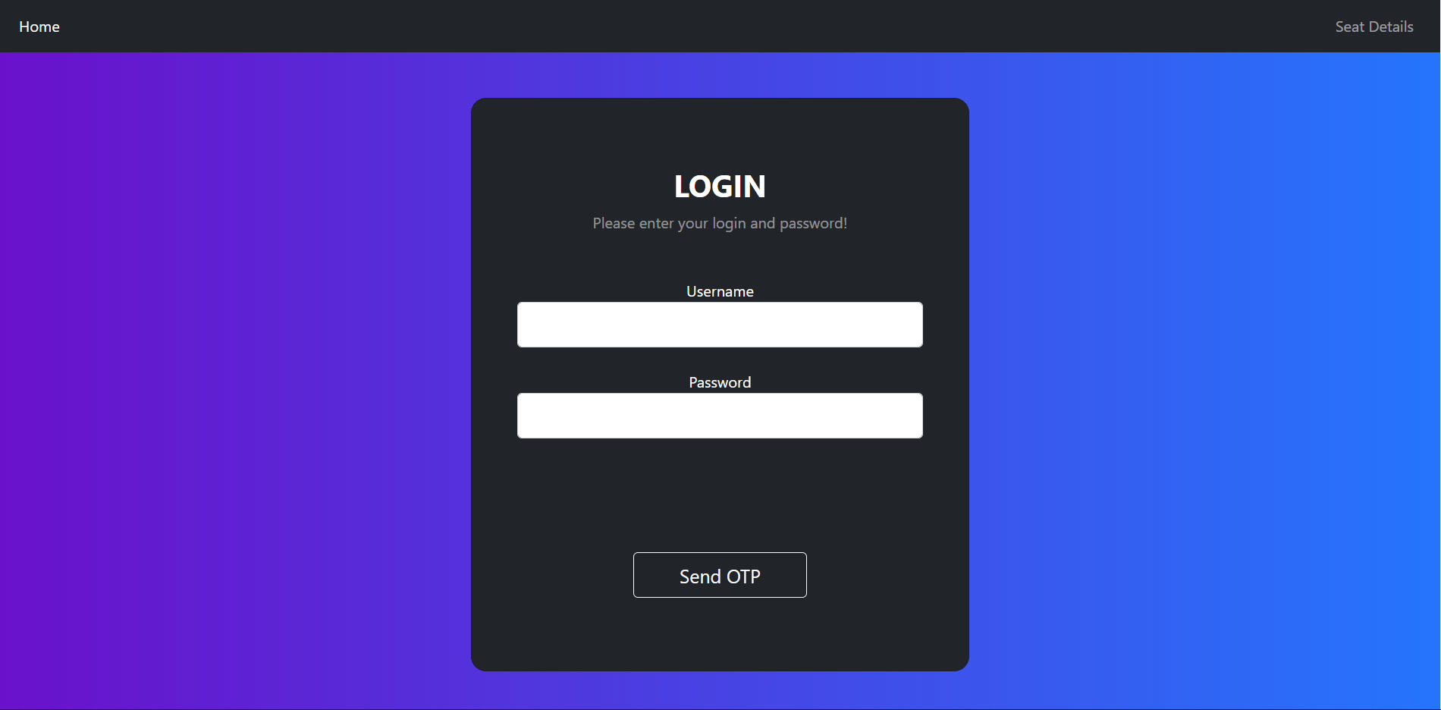
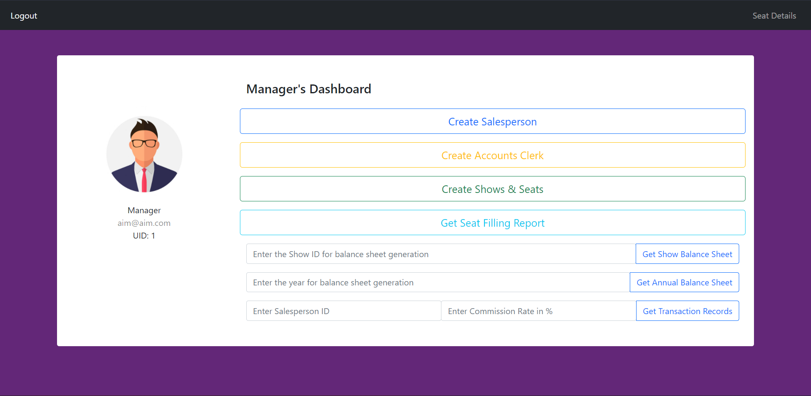
Challenging Use Cases
7
OTP Based Login
Employees in addition to username and password also have to verify OTP sent to their email ID.
Manager’s Dashboard
Most of the operations are to be done by manager like creating shows, managing employees, getting balance sheet and details of transactions.

Slide 8
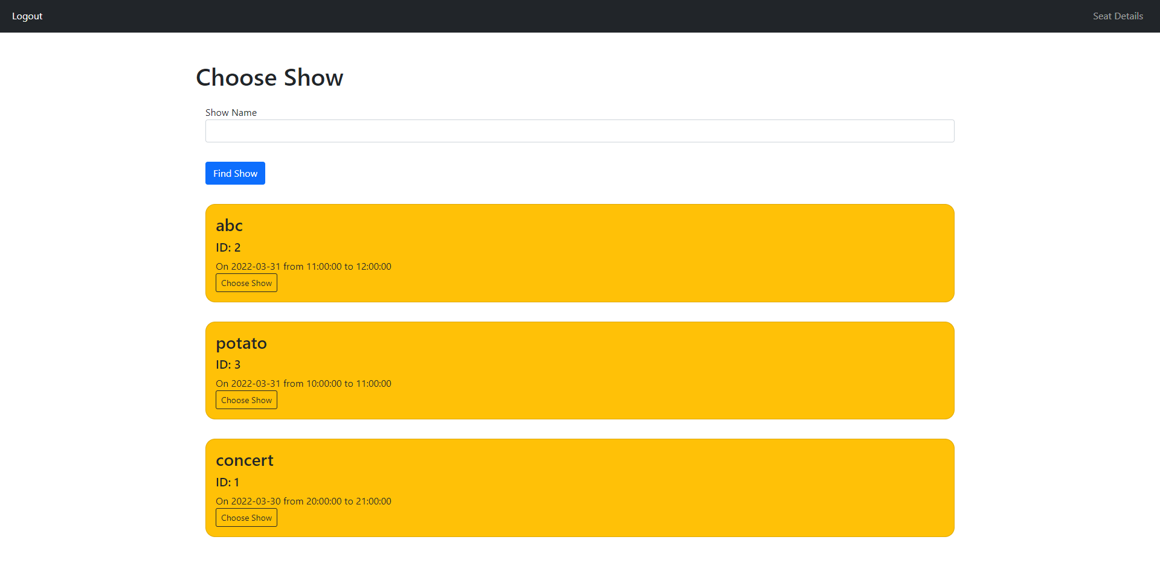
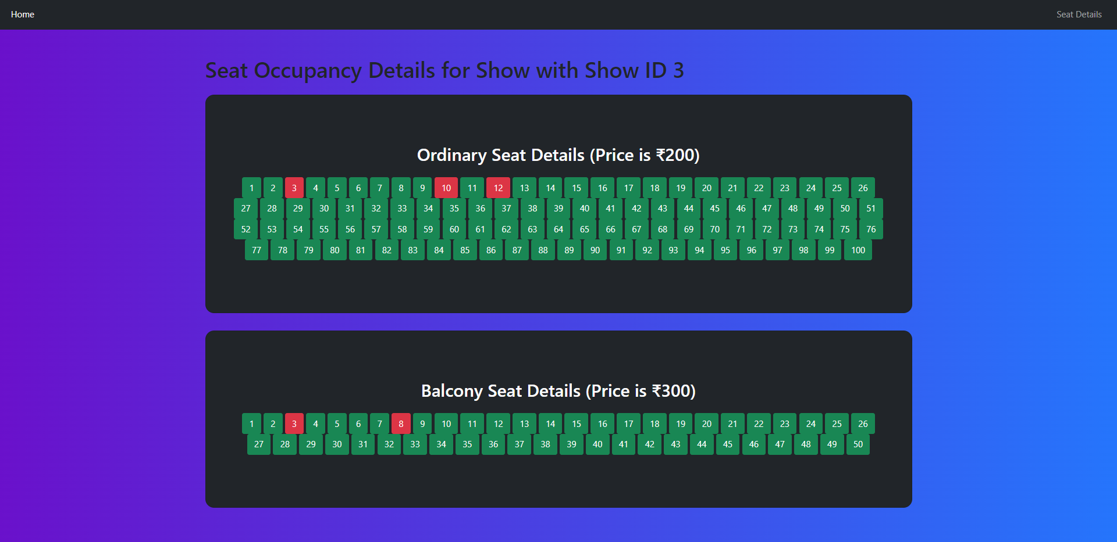
Challenging Use Cases
8
Choose Show Option
This option is used in booking/cancellation of seats and for spectator menu to book/cancel/query from the available shows.
Spectator Menu
This option is for spectator to query for the available shows.

Slide 9
Future Improvements
9
Token based login system.
Increased number of auditoriums.
Facility of Online Payments for booking tickets.
Employees can update their profiles details on their own.
More bug fixes and Improvements.

Slide 10
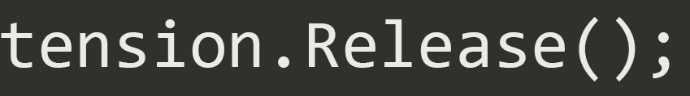
10
Thank you

