Slide 1


PolyVerse
A Deep-learning Neural Network model for polymer properties prediction.

Slide 2

PROBLEM STATEMENT
Design and development of deep learning based model for material properties prediction.

Slide 3
BUSINESS CASES
Quality control and property verification for polymer manufacturer: Manufacturers can cross-check polymer properties before mass production.
Predicting polymer applications for industries:
Suggests potential applications for a given polymer.
Predicting key properties for high-performance polymers (such as Aerospace, Electronics): PolyVerse provides critical polymer properties like tensile strength, ionization energy, electron affinity, LogP, and refractive index.

Slide 4
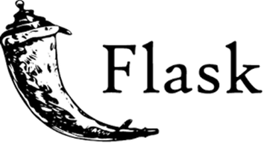

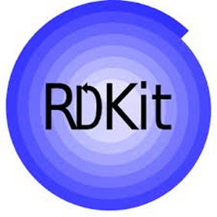
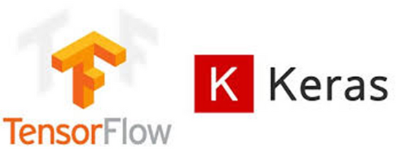
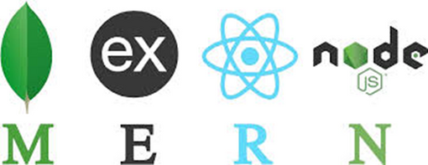
TECH STACK
Full Stack: MERN, Flask API
ML Frameworks: TensorFlow, Keras, Pickle
Data Processing Tools: RDKit, Pandas
Storage Solutions: Excel, MongoDB
Sources: Excel, RDKit, TensorFlow,Keras, MERN, Flask

Slide 5
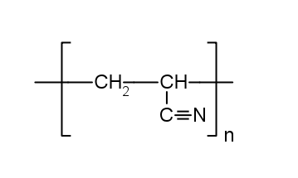
SMILES
•What is it?
Simplified Molecular Input Line Entry System.
•What does it mean?
A text-based representation of molecular structures.
•How it works?
Atoms are represented by element symbols (C, O, N, H, etc.).
Bonds are denoted by symbols (-, =, # for single, double, triple).
Numbers and parentheses indicate rings and branches.
•For example:
Polymer name: Polyacrylonitrile Structure:
Molecular formula: (C₃H₃N)_{n}
SMILES Notation: C=CC#N

Slide 6
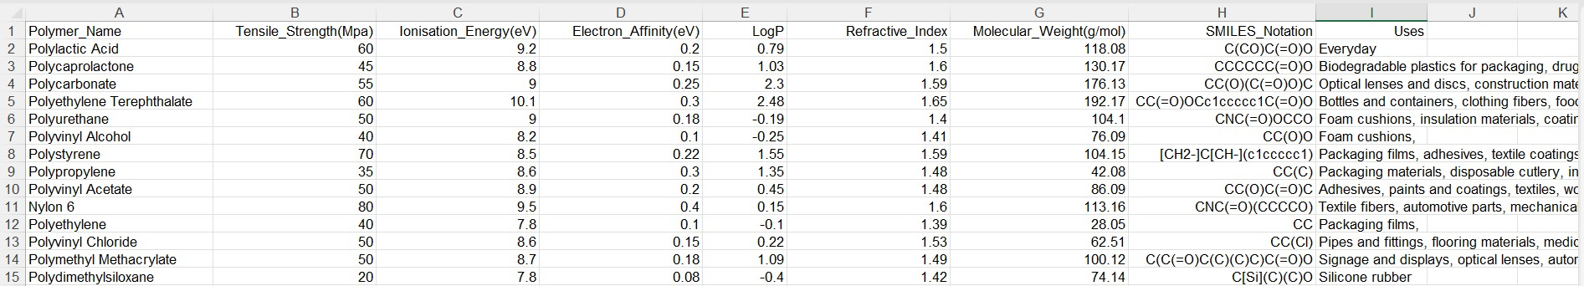
DATASET
Fig 1: Infographic of dataset 108 rows × 9 columns

Slide 7
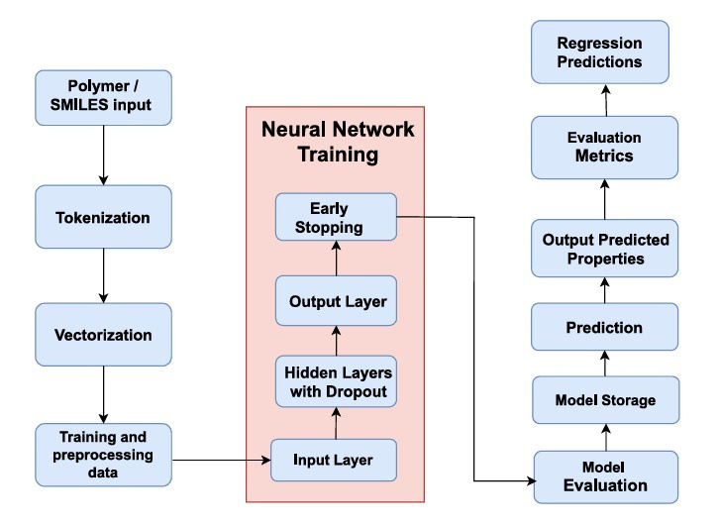
DATAFLOW DIAGRAM
Fig 2: Dataflow diagram of PolyVerse

Slide 8
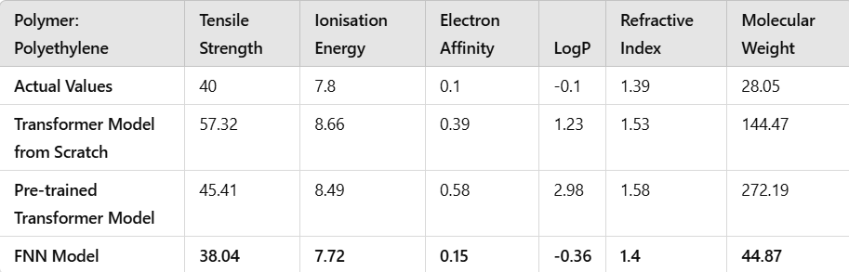
RESULTS
Table 1: Comparison of different models for polymer properties prediction

Slide 9
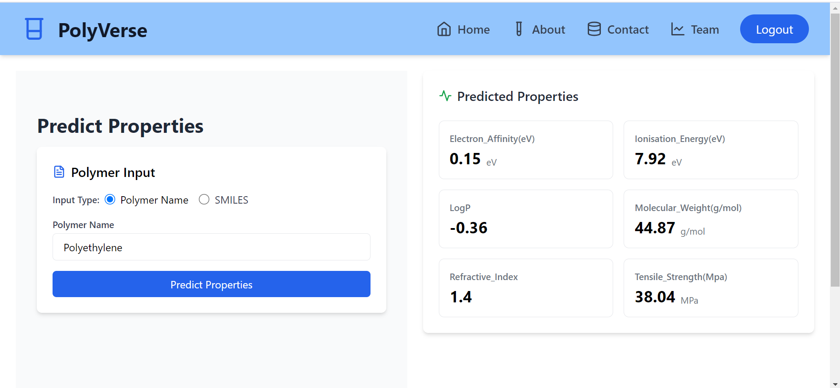
Fig 4: Interface of PolyVerse polymer properties prediction

Slide 10
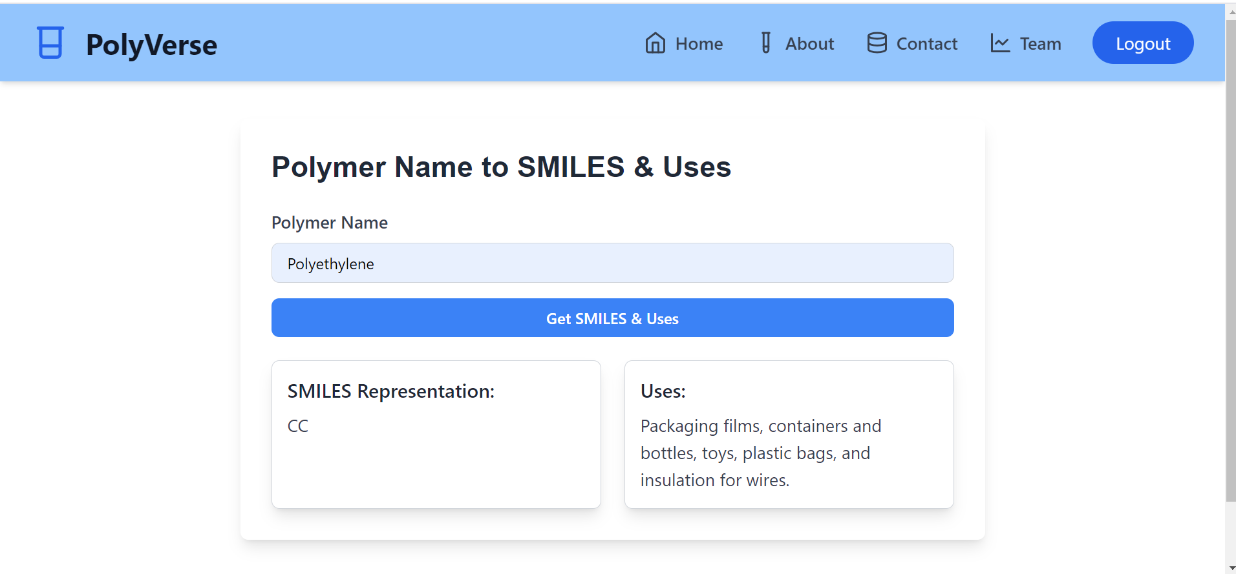
Fig 5: Interface of PolyVerse SMILES and uses page

Slide 11

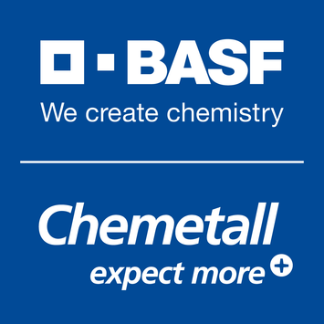


TARGET AUDIENCE
Material Science Researchers
Chemical and Polymer Manufacturers
Pharmaceutical Companies
Life Sciences Companies
Sources: Dow, BASF,Dr.Reddy’s,Johnson&Johnson

Slide 12
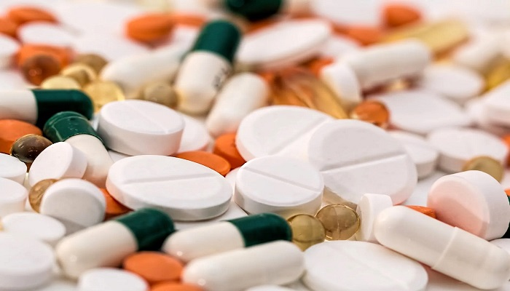
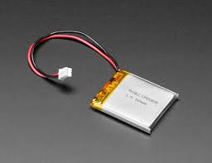
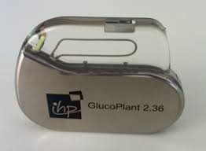
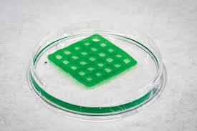
Applications in Life Sciences
Drug Delivery Systems
Biodegradable Polymers
Polymer-Based Biosensors
Conductive Polymers
Sources: IMG1 , IMG2, IMG3, IMG4

Slide 13
CONCLUSION
Developed a chemically aware polymer tokenizer using libraries and deep learning framework to accurately predict polymer properties, bridging computational models with experimental approaches and accelerating novel material design.

Slide 14

THANK YOU

Slide 15
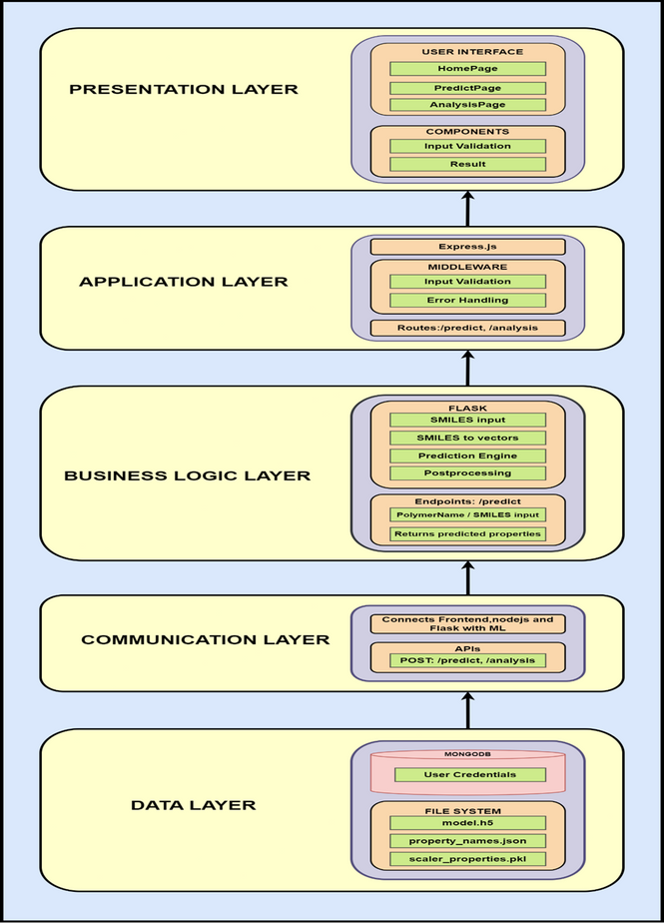
1. Architectural Diagram:
FIG 1: Architectural Diagram Of PolyVerse

Slide 16
FUTURE SCOPE
Custom polymer design: Custom polymer can be created from existing polymers by combining desired polymers to obtain the desired properties.
Sustainable polymer suggestions: The suggestions for biodegradable polymers to maintain environmental balance.
Product design: The design of a specific properties where certain polymers can be used are predicted.

Slide 17
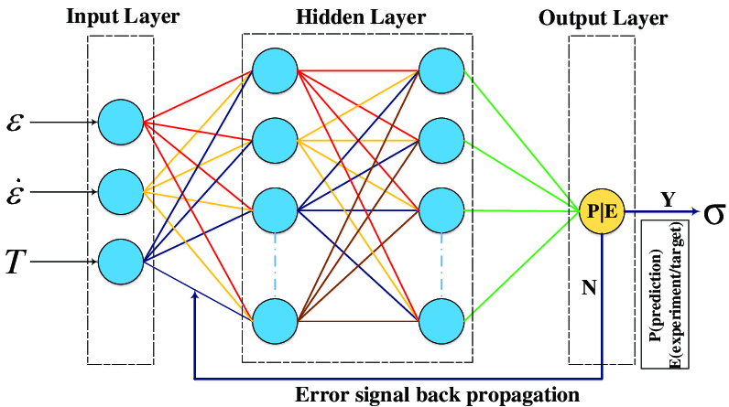
FNN MODEL

Slide 18
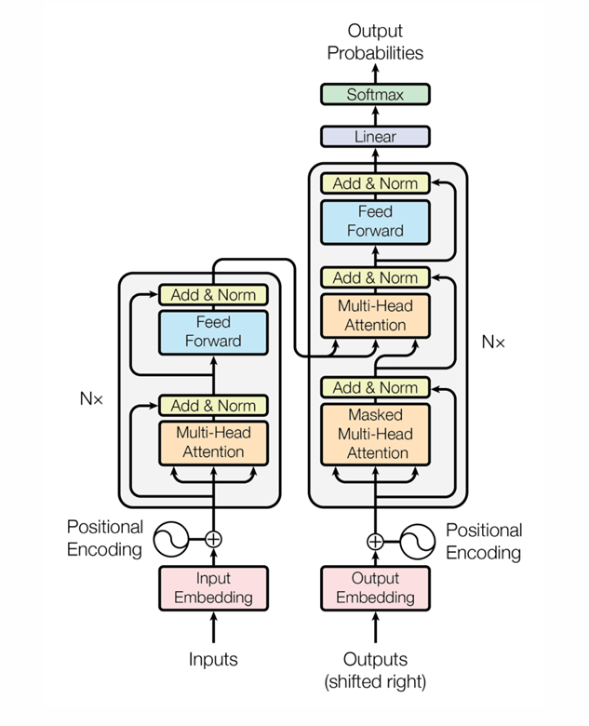
TRANSFORMER

