Slide 1
UEZ Technical Consultancy Project
Delight Supported living Ltd

Slide 2
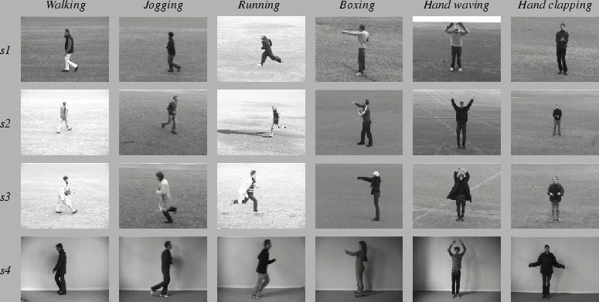
Dataset – KTH dataset
The current video database containing six types of human actions (walking, jogging, running, boxing, hand waving and hand clapping) performed several times by 25 subjects(humans) in four different scenarios:
outdoors s1,
outdoors with scale variation s2,
outdoors with different clothes s3,
Indoors s4 as illustrated below.
Currently the database contains 2391 sequences. All sequences were taken over homogeneous backgrounds with a static camera with 25fps frame rate.
The sequences were down sampled to the spatial resolution of 160x120 pixels and have a length of four seconds in average.

Slide 3
Dataset
In our experiments all sequences were divided with respect to the subjects into a training set (8 persons), a validation set (8 persons) and a test set (9 persons).
The classifiers were trained on a training set while the validation set was used to optimize the parameters of each method. The recognition results were obtained on the test set.
To reduce the computation complexity and memory requirement, the original input frames 160×120 are reduced to 120×120 resolutions in our experiments.
Steps:
Load Data
Preprocess the data(dividing the data into training, validation and test set)
Create the model(3D CNN)
Train the model
Validate the model
Test the model

Slide 4
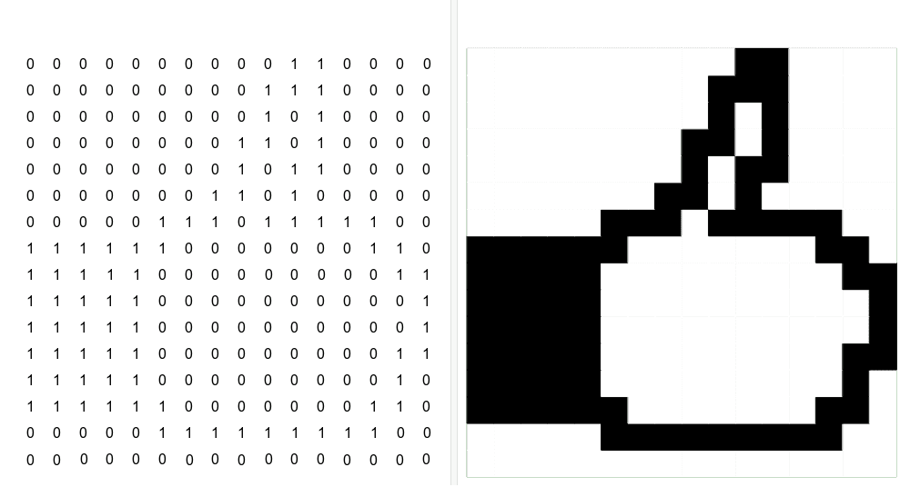
Model - 3D CONVOLUTIONAL NEURAL NETWORKS
2d Image Pixels

Slide 5
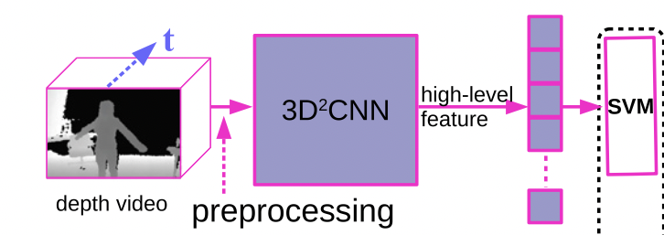
Model

Slide 6
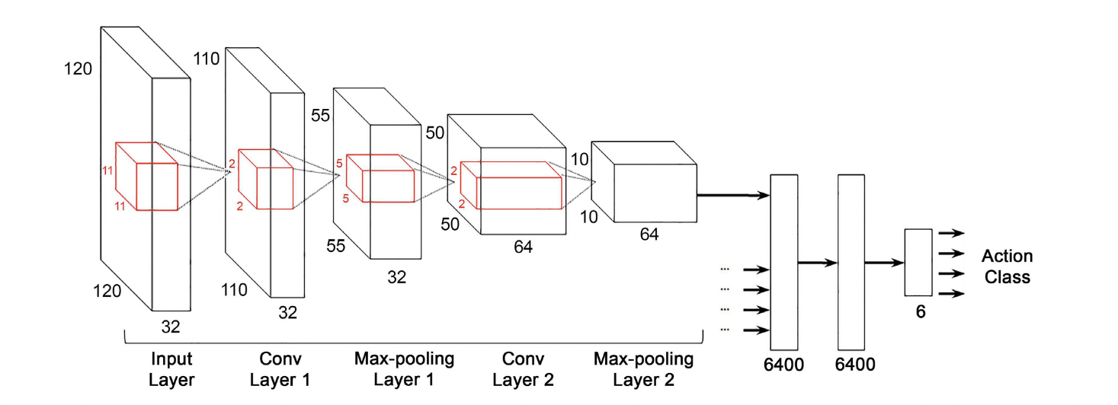
CNN architecture

Slide 7
Thank you

