Slide 1
MusicGen
Music Generation using LSTM
Rahul Manusmare (18120005)

Slide 2
Music is Instrumental sounds combined in such a way as to produce beauty of form, harmony, and expression of emotion
-Oxford Dictionary

Slide 3
Real World Problem
Creating music
Requires skills and imagination
Takes time

Slide 4
CS Problem
Creating music
Large Files
Discrete Time Values
Sings similar to existing ones, but, with some differences, can be made
New variations
Combinations of songs

Slide 5
Dataset
DataSet is in the form of MIDI files.
All the MIDI files collected are having single Piano Track Music.
Around 100 MIDI Piano Track are used to train the model of one genre.

Slide 6
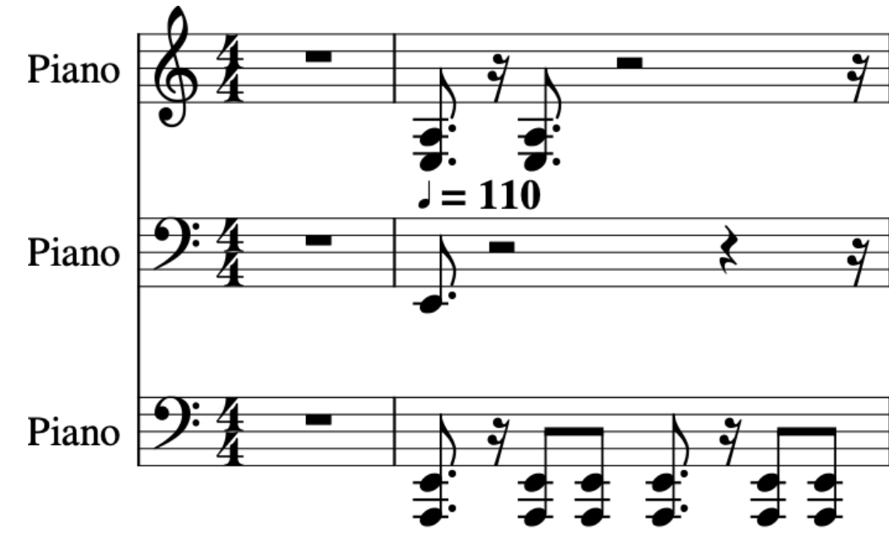
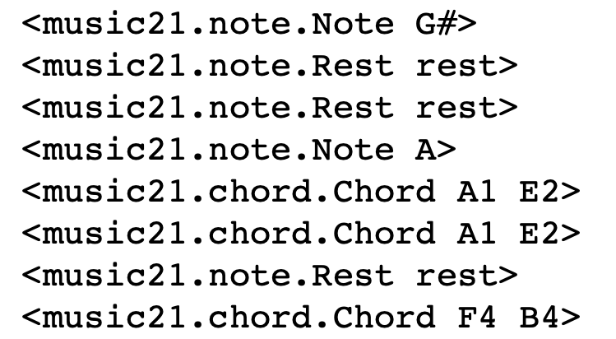
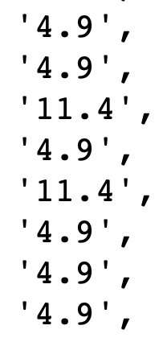
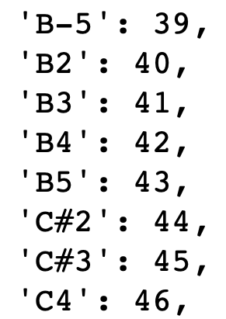
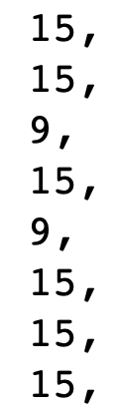
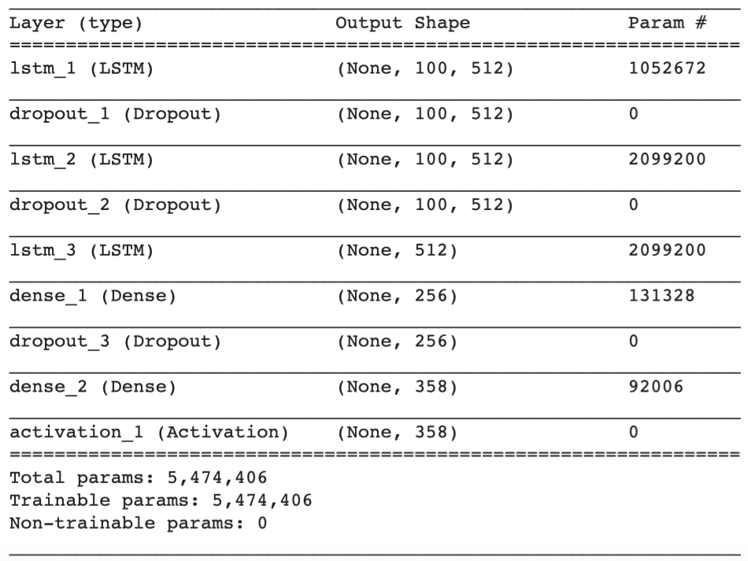
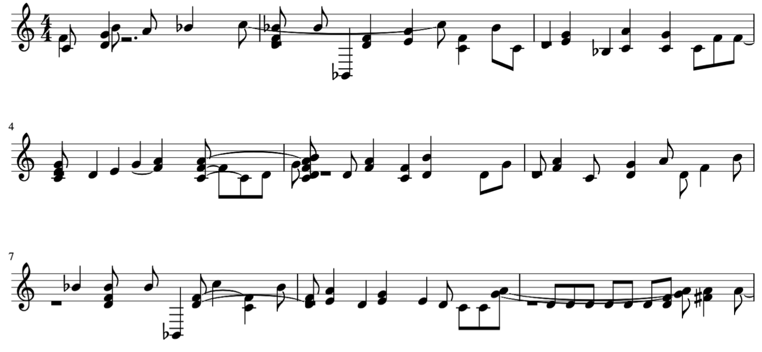
Approach
Step I : Input music files
Step II : Encoded music file into notes
Step III : Trained model with generated notes
Step IV : Generate music with trained model

Slide 7
Music generation is an ‘ART’.
We no longer have to wonder how Mozart and Frédéric Chopin created their compositions.

Slide 8
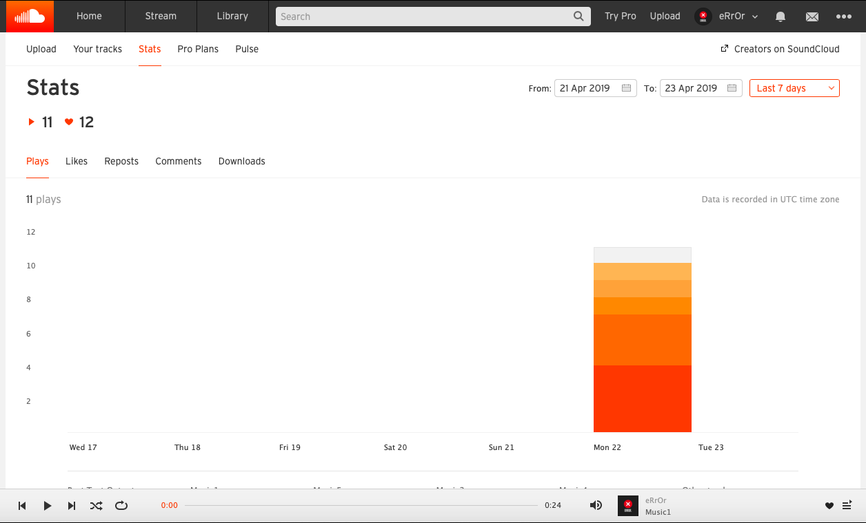
SoundCloud Response

Slide 9
Thank you

