Slide 1

Case Study
By Rahul Mahipati Bagal

Slide 2
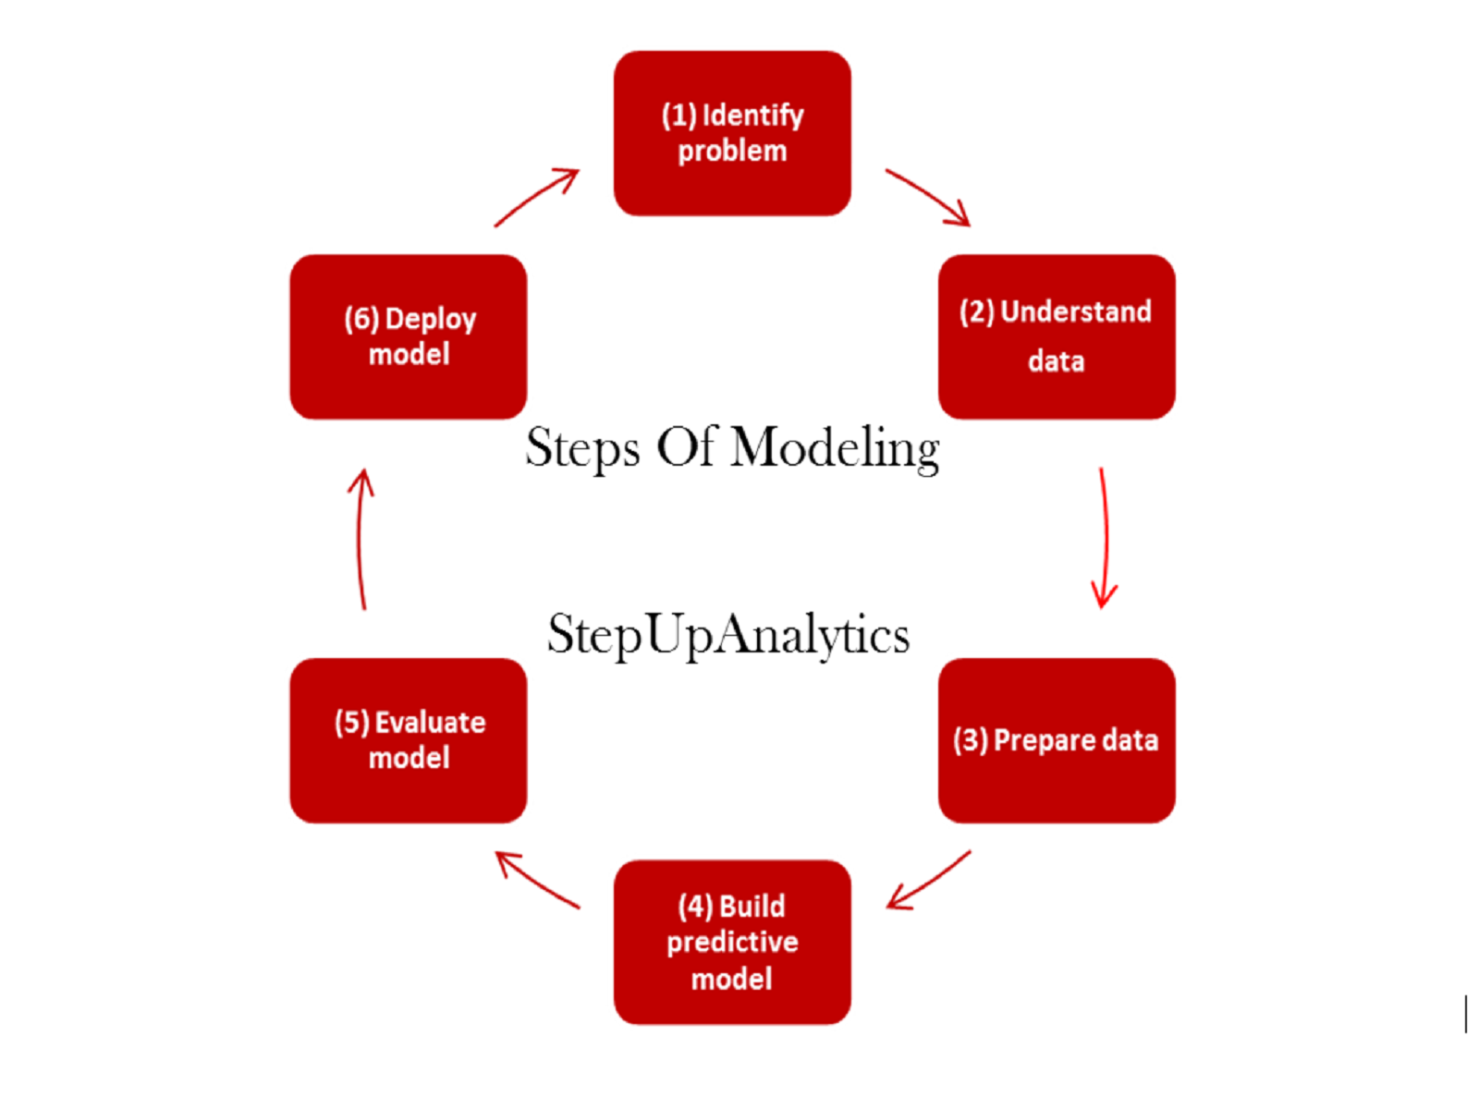
Steps Of Modelling

Slide 3

Data Preprocessing and Anomalies Detection
Assumptions:
Customer_id with 0 is treated as testing/company employer's entry field
If TRANSACTION_DATE is null then it is invalid transaction
Created transaction id based on customer id and TRANSACTION_DATE
ACTUAL_PRICE Column:
Removing the fields that having more than one decimal points in the ACTUAL_PRICE Columns
Value greater than $100000, remove the fields
DISCOUNTED RATIO : Should be less than 1
CUS_BIRTH_DATE_1: loading the fields to single date format as it is having different date formats. “en” value is replace with “not available along with NAN’s

Slide 4
Hypothesis Testing
Anova test w.r.t Actual Price
 | sum_sq | df | F | PR(>F)
C(GENDER) | 8428070.929 | 2 | 0.19943 | 0.8192
Residual | 1.47256E+11 | 6969
 | sum_sq | df | F | PR(>F)
C(MODELYR) | 32318529230 | 22 | 88.96214 | 0
Residual | 1.16961E+11 | 7083
anova test w.r.t Buying Price
 | sum_sq | df | F | PR(>F)
C(MODELYR) | 32471082110 | 22 | 88.30393 | 0
Residual | 1.18389E+11 | 7083
TUKEY’S HSD POST-HOC COMPARISON : Refer the excel file
We can notice that the randomness of the data is high

Slide 5
predictive modelling – step 1
Features creations:
RFM
Features from transaction dates
Features from sales i.e profit, neutral or loss based on actual sales
Dummies for categorical variables
Fill “not_available” for missing values so we can captures maximum information's

Slide 6
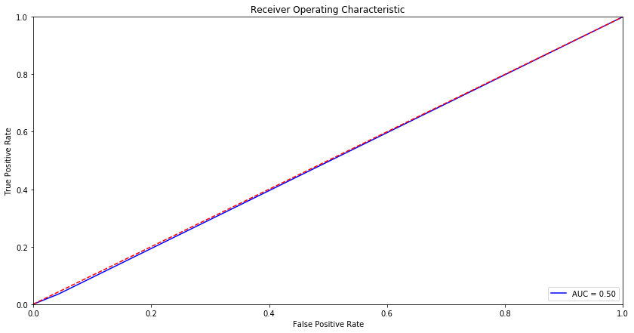
predictive modelling – step 2
Objective : customers’ tendency scores to buy a new car in the next 3 months
Model Tested:
Random Forest
XGBoost
XGBoost performed well when compared with Random forest
Results
Accuracy : 0.9448763250883392
Sensitivity : 0.957258834765998
Specificity : 0.03508771929824561
ROC AUC: 0.498758
Precision: 0.035088
Recall: 0.011050
F1 score: 0.016807
As expected from hypothesis testing
that data has high randomness

Slide 7
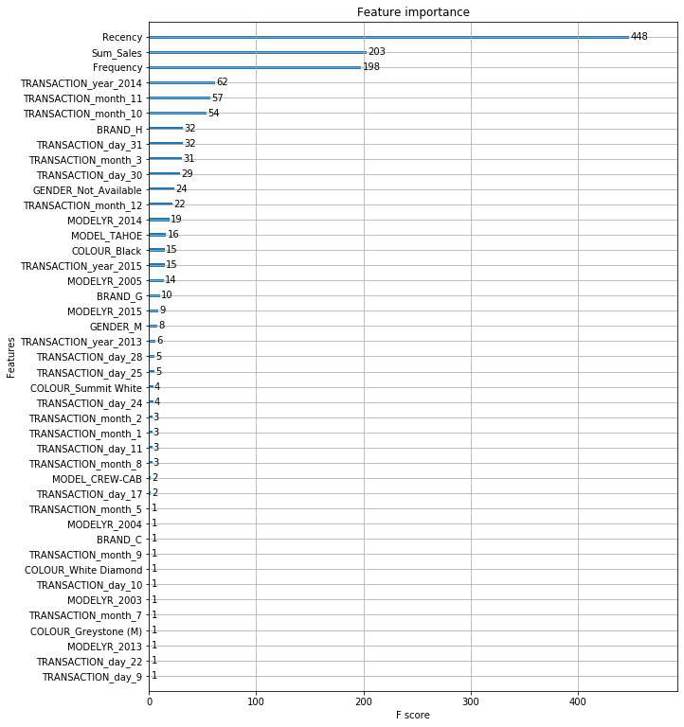
Features Importance's

Slide 8


