Slide 1

ABC Retail
Marketing and sales analysis
January 2020 to December 2022
Rahul Mahipati Bagal
Data Scientist

Slide 2

The four business questions
The analysis answers each question with evidence and a conclusion.
Q1
Are all media channels effective in driving sales?
Q2
Which is the most important channel?
Q3
Do macroeconomic factors influence sales?
Q4
Did COVID affect sales, and why?
02

Slide 3

Data structure and analysis fields
File/Data Source: Excel
The analysis combines monthly retail performance with quarterly macroeconomic data.
Data area | Columns / rows | Role in analysis
Monthly retail file | 36 rows; Jan 2020–Dec 2022 | Main analysis timeline
Target | sales_m: Sales ($M) | Outcome to explain
Media spend | digital_m, radio_m ($M); tv_m ($M) | Primary marketing predictors
Macroeconomy | gdp_pp: quarterly GDP change (%) | Separate Q3 model extension
Time controls | trend, sin12, cos12 | Gradual growth and annual seasonality
COVID flags | covid_lockdown; covid_relaxation | Separate Q4 period comparisons
Unit note: TV starts in thousands of dollars and is converted to millions before modelling.
05

Slide 4
36 months of data, with consistent spend units
No missing values or duplicate months in the analysis data.
Input | Source unit | Model treatment
Sales, Digital, Radio | $ million | Retain original units
TV | $ thousand | Divide by 1,000
US GDP growth | Quarterly change | Map to months, use percentage points
The dataset contains 12 quarters of GDP information.
03

Slide 5
Monthly sales vary substantially
Monthly observations across 12 quarters. Sales are in $ million.
Observed sales range from $86.4M to $439.2M. Raw movements alone do not explain why.
04

Slide 6

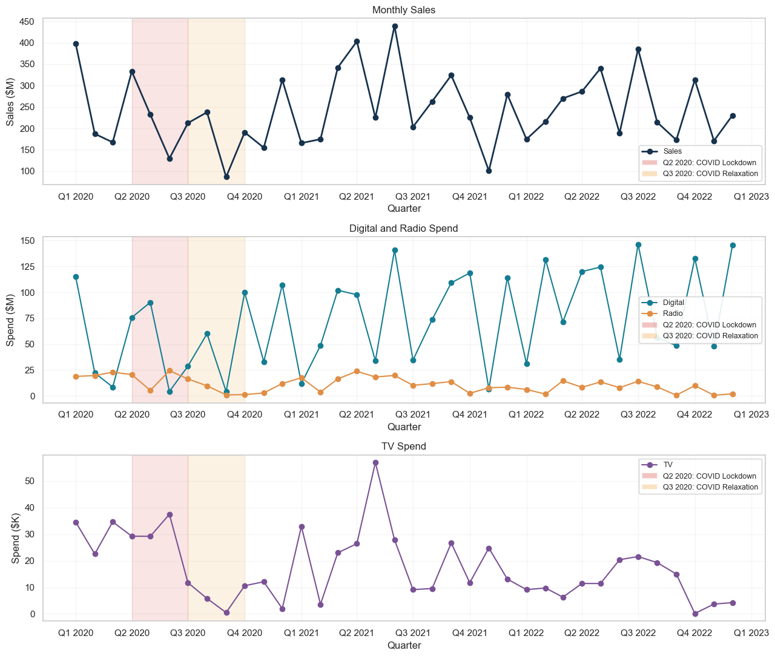
EDA: monthly sales and media over time
Sales, Digital, Radio and TV are shown together with the highlighted Q2/Q3 2020 COVID periods.
  Sales fluctuate a lot month to month.
  Digital varies much more than Radio.
  TV falls sharply in Q3 2020 and again late 2022.
05

Slide 7
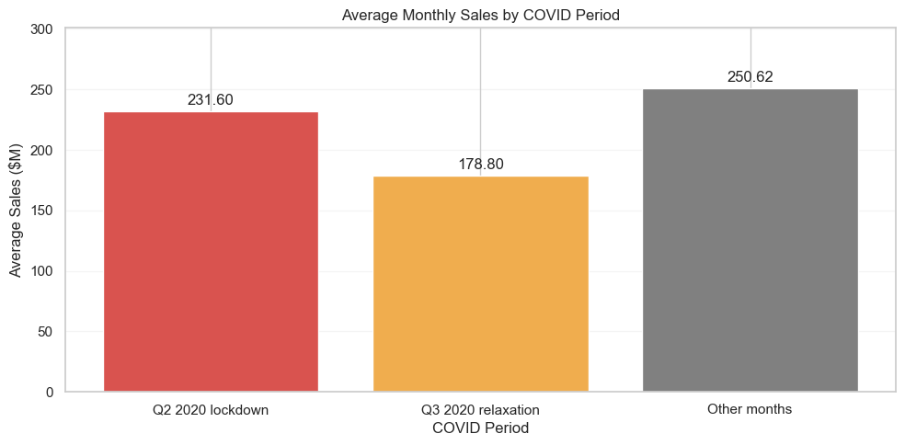
EDA: average monthly sales by COVID period
A descriptive comparison across lockdown, relaxation and the other months in the sample.
  Average monthly sales were lowest during Q3 2020 ($178.8M), compared with Q2 lockdown ($231.6M) and other months ($250.62M).
06

Slide 8
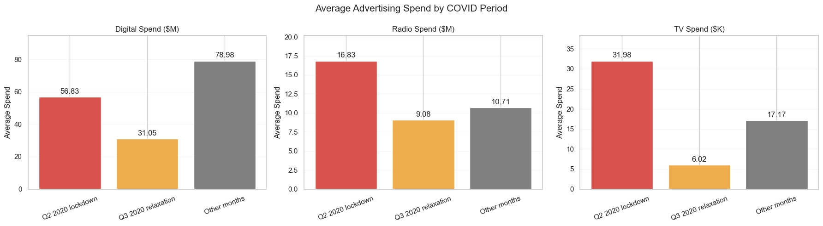
EDA: average advertising Spend by COVID period
Digital, Radio and TV budgets are compared across the same three period groups.
All three channels recorded their lowest average spending during Q3 2020 (relaxation).
Digital spending was highest during other months ($78.98M), compared with $31.05M during relaxation.
Radio and TV spending were highest during lockdown, not during relaxation.
Average monthly sales were also lowest during relaxation ($178.8M), suggesting that advertising and sales declined during the same period. However, this does not establish causation.
07

Slide 9
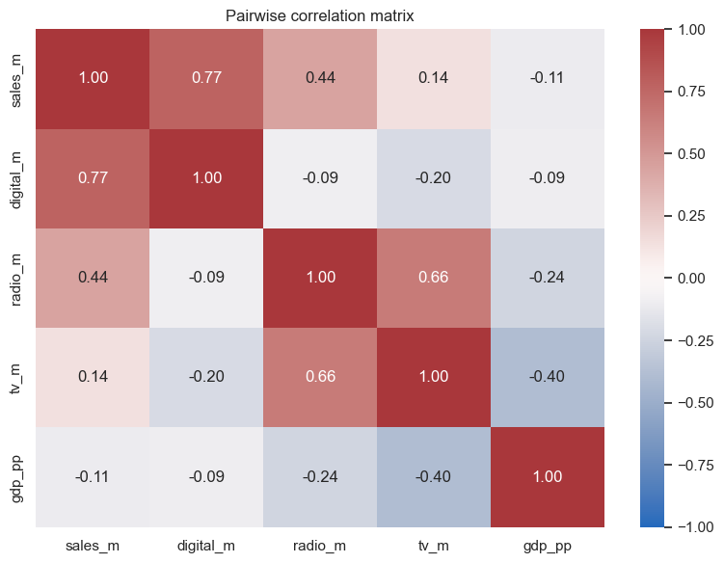
EDA: pairwise correlations
Heatmap of raw relationships. Regression is still needed to control for overlap, trend and seasonality.
Key unadjusted findings
  Sales–Digital: 0.77 (strongest raw positive relationship)
  Sales–Radio: 0.44 (moderate positive relationship)
  Sales–TV: 0.14 (weak raw relationship)
  Sales–GDP: -0.11 (weak negative relationship)
  Radio–TV: 0.66 suggests those two media can move together.
08

Slide 10
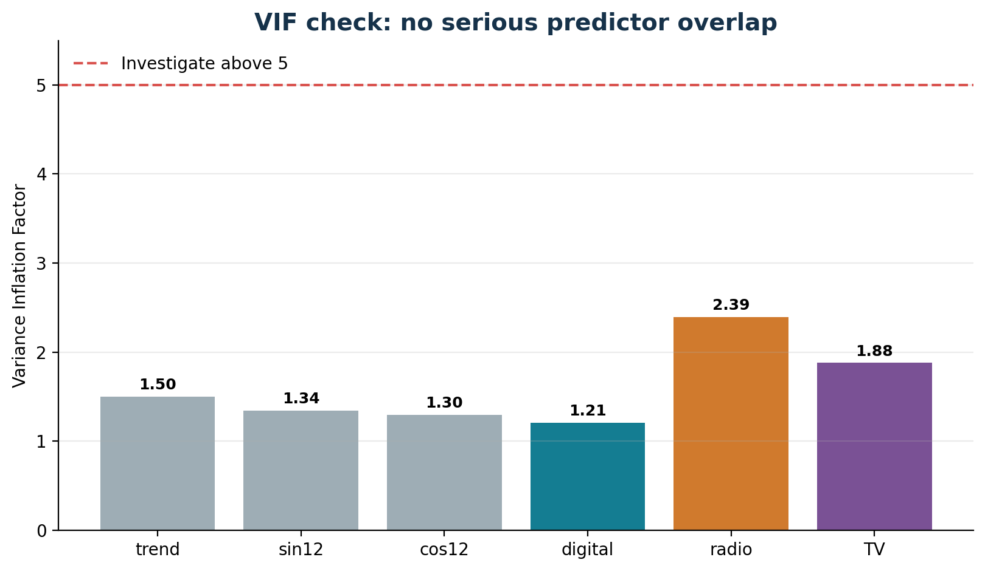
VIF check: predictor overlap is manageable
VIF checks multicollinearity among predictors, not whether causality is proven.
Takeaway
• All VIF values are below 2.5.
• This suggests no severe multicollinearity in Model 1.
• Low VIF does not remove omitted-variable bias.
22

Slide 11

Hypothesis testing: what did the evidence support?
α = 0.05. Holm adjustment is used for individual media-channel tests; GDP and COVID are separate extensions.
Question | Test / statistic | Decision p-value | Decision | Business interpretation
All media jointly | Wald/F = 73.28 | < 0.001 | Reject H₀ | At least one media channel is associated with sales.
Digital | t = 8.951 | < 0.001 | Reject H₀ | Positive adjusted association; strongest supported channel.
Radio | t = 5.562 | < 0.001 | Reject H₀ | Positive adjusted association; supporting evidence.
TV | t = -1.261 | 0.217 | Do not reject | Insufficient adjusted evidence for TV.
GDP | t = 1.045 | 0.305 | Do not reject | No statistically detectable GDP association.
COVID lockdown | t = -0.901 | 0.375 | Do not reject | No detectable adjusted lockdown-period difference.
COVID relaxation | t = -0.440 | 0.664 | Do not reject | No detectable adjusted relaxation-period difference.
Key insights
• Digital and Radio pass the statistical tests.
• The joint media test is significant, but this does not mean all channels are effective.
• TV is inconclusive after controls; do not scale TV based only on this model.
• GDP and COVID terms are not statistically detectable in the adjusted extensions.
10

Slide 12
Q1. Are all media channels effective?
No. The evidence supports positive associations for Digital and Radio, but not all three channels.
Channel | Holm-adjusted p-value | Conclusion
Digital | < 0.001 | Positive supporting evidence
Radio | < 0.001 | Positive supporting evidence
TV | 0.217 | Insufficient evidence
Joint test: F = 73.28, p < 0.001
The joint test supports at least one channel. It does not establish that all three are effective.
07
Notes:
Source: Final_Analysis(3).ipynb. Q1 and Section 6.3. Approximate HAC Wald/F-type test F(3,29)=73.281, p=1.210422e-13. Individual p-values use Holm correction.

Slide 13
Q2. Which is the most important channel?
Digital ranks first by both adjusted measures, followed by Radio and TV.
Standardized coefficient
Partial R²
Digital: standardized coefficient 0.813 and partial R² 0.813.
08
Notes:
Source: Final_Analysis(3).ipynb. Q2. Standardized coefficient measures signed association on comparable scales. Partial R-squared measures each channel’s reduction in residual variation relative to the model without it. These are not additive revenue shares.

Slide 14
Q3. Do macroeconomic factors influence sales?
The supplied GDP measure has no statistically detectable adjusted association with sales.
GDP result | Estimate
Sales change per 1 percentage point | +$0.602M
95% confidence interval | −$0.578M to +$1.782M
p-value | 0.305
The interval includes zero. This result does not rule out other economic influences.
09

Slide 15
Q4. Did COVID affect sales, and why?
Sales were lower during the defined COVID phases than during the other months.
These raw averages also reflect differences in advertising and timing.
10

Slide 16
Q4. No clear COVID difference after adjustment
Both period estimates remain statistically inconclusive after media, trend and seasonality controls.
Phase | Adjusted change ($M) | 95% interval ($M) | p-value
Q2 lockdown | −38.33 | −125.61 to +48.94 | 0.375
Q3 relaxation | −9.47 | −53.66 to +34.71 | 0.663
Why? The data do not identify a cause.
Only three months per phase and no pre-pandemic baseline limit the comparison.
11

Slide 17
How much confidence should we place in the results?
The findings support prioritizing tests, while several limitations constrain interpretation.
Small sample
36 months. Newey–West results are approximate.
Predictor overlap
VIF 1.21–2.39 suggests no serious multicollinearity.
GDP coverage
12 quarters. National GDP may miss local conditions.
Marketing response
The model omits carryover and diminishing returns.
These observational results estimate adjusted associations. They do not establish causal ROI.
12

Slide 18

Retail next step: test before scaling budget
Use the model as a prioritization tool, then measure incremental sales and profit.
1
Choose matched stores or regions
2
Increase Digital in treatment group
3
Hold Radio / TV policy stable
4
Measure incremental sales and profit
24

Slide 19


