Slide 1


Meaningful Insights and Recommendations for AI Initiatives
RAHUL MENON
MARCH 7, 2024

Slide 2
Executive Summary
Business Problem
Insights & Recommendation
In today's industries, automation is extensively employed, wherein AI is utilized by companies to minimize expenses, save time, and reduce waste, while also enhancing productivity, reducing errors, and managing business processes in real-time. Nonetheless, there are several potential hazards and downsides associated with AI that can have unfavorable effects on humans.
Invest in R&D using new technology like ChatGPT to innovate new products. Companies can integrate projects with a cloud platforms. To improve cybersecurity and ethics, they can develop cutting-edge technology, perform market research, and focus on real-time and healthcare projects. Improving employee benefits will help retain top talent.

Slide 3






Methodology
Investigate who was conveying which feelings and at what time they were expressed.
News Article related to AI
Filtering Relevant Articles
News Articles
Preprocessing - Clean up noise an reductant data
(Non English and Web Crawled Data)
Analyze the topics
and sentiments
trend in the data
Providing recommendations on failing initiatives

Slide 4

Preprocessing of News Article
Our original dataset comprised around 200k news articles. The goal was to eliminate data that wasn't relevant. By removing duplicates and filtering entries based on text length and pertinent keywords, we narrowed it down to approximately 132k records.
Non-English Articles
Irrelevant Article
Short Articles
News Article
200k
Preprocessing
- Removal Stopwords
- Treating CamelCase
- URL & Symbols
- Custom Stopwords(All right reverse, login etc)
Relevant Articles
~132k

Slide 5
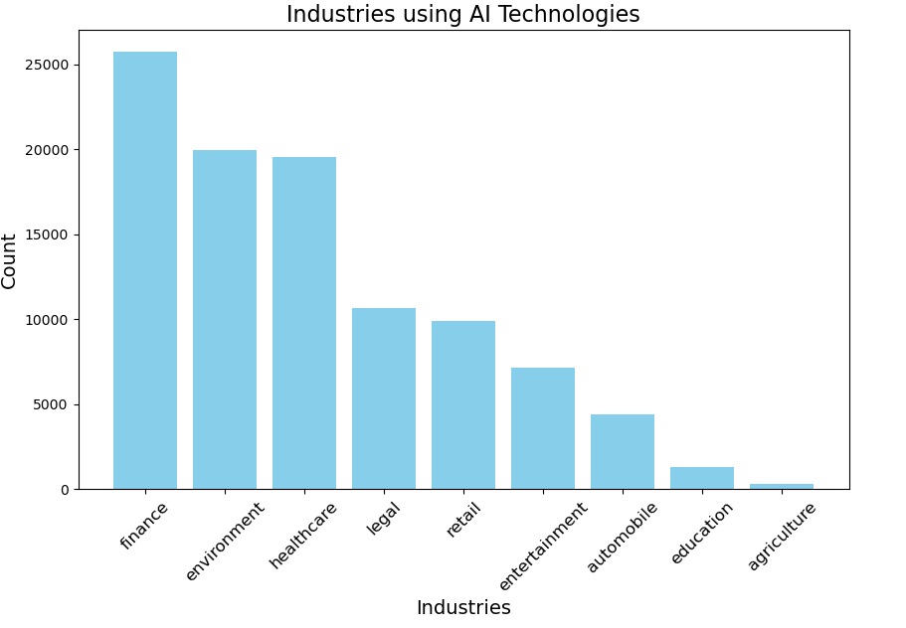
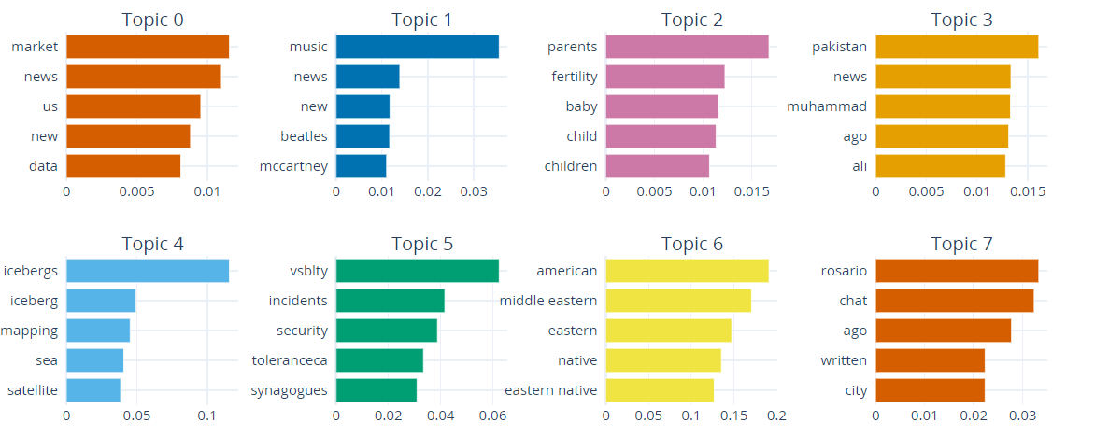
Identify Industries using Keyword Search and BERTopic
Tech
Entertainment
Healthcare
.
Environment
The finance, healthcare, and legal sectors are at the forefront of artificial intelligence adoption, with significant influences noted in their evolution. Finance leads with a 28% adoption, leveraging AI for market predictions and customer service enhancement. Healthcare follows at 21%, where AI has revolutionized diagnostics and treatment personalization. The legal sector's adoption stands at 20%, utilizing AI for document analysis and legal research. These industries have capitalized on AI to drive innovation and operational efficiency.
Notes:
Embracing change is vital for growth, and that's exactly what we're doing with our new system, and we're taking a three-fold approach.

Slide 6
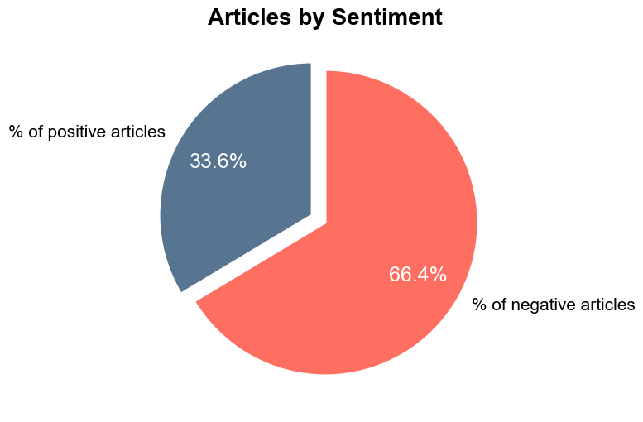

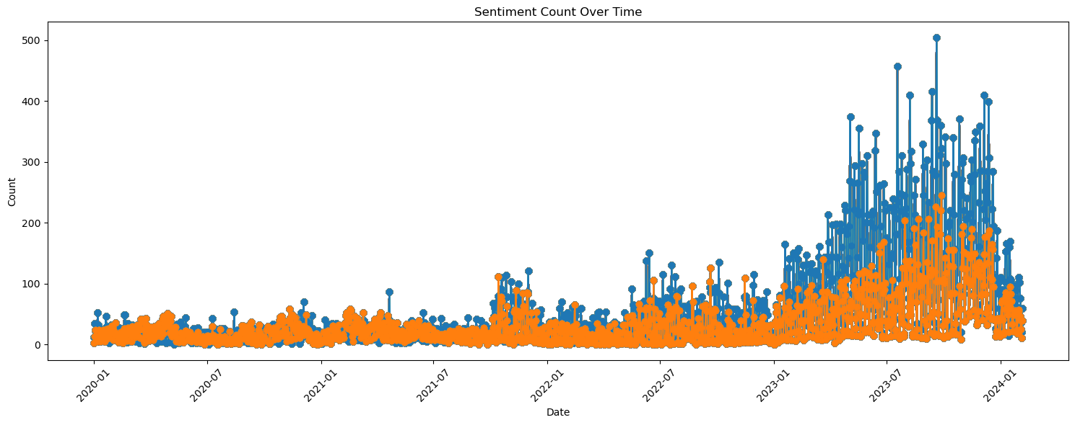
Detecting the Sentiment of the News Articles Using Logistics Regression trained on YELP data
The chart shows that most news stories about AI are negative, with two out of every three articles expressing worries or doubts. This negativity is often linked to fears that AI will take over simple office jobs, making people anxious. Moreover, the intense competition between big technology companies to be the top in AI since 2023 has probably made these fears worse. However, not all the news is bad; about one-third of the articles are positive, highlighting how AI can make things more efficient and help with work tasks. The graph also shows changes in how people feel about AI over time, with occasional jumps that might relate to news regarding the developments in AI.
User Interface
Notes:
·Customer Segment: High-Value Customers (A and B)
·User Behavior: Both like history books
·Recommendation Strategy:
·Targeted Content: Recommend history-related books on the user's homepage.
·Personalization: Use the user's interest in history books to personalize the recommendations further.
·Display Format: Showcase the top picks in a prominent location on the homepage.
·Implementation Details:
·Data Points Used: Past purchase data, browsing history, and rating preferences for books related to data science.
·Algorithm: Collaborative filtering to find similar users who also like data science books and content-based filtering to match the book's features with the user's interests.
·User Interface:
A section titled "Top Pick for You" highlighting books in the data science genre.
A will be recommended B’s past “liked” history books on her homepage.
Afterwards, we will give a Buy-One-Get-One to A to encourage adding more items in their cart.
·Early Access Alerts: Send personalized alerts or display notifications for early access to sales or new products.

Slide 7
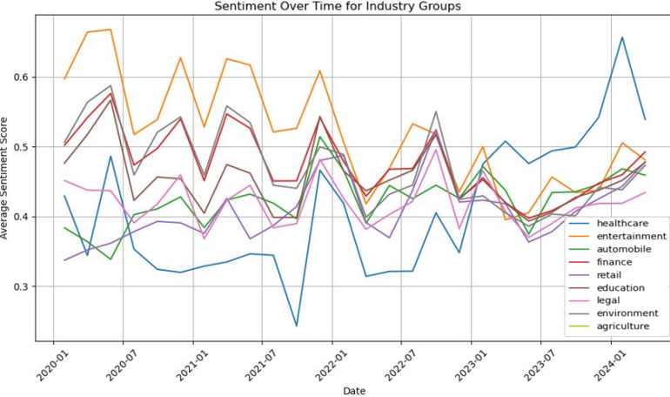
Sentiment Analysis over Time for Industries
There is a generally positive reception towards AI integration across several industries from 2020 to 2024. Healthcare and entertainment consistently show higher sentiment scores, reflecting successful AI applications in patient care and media personalization. Notable peaks in the automobile sector hint at major AI advancements, possibly autonomous vehicle technologies. Meanwhile, the sharp sentiment shifts in finance around late 2021 could point to AI's impact on market dynamics. While the graph shows a trend towards greater approval of AI, the variability across industries signifies differing public perceptions and possibly debates surrounding AI's role in each sector.
Notes:
Experimented with a couple of models and went ahead with K-Means, an unsupervised clustering model as it is simple, easy to understand and :
1. Clear clusters observed which can help identify distinct customer segments​
2. Seamless integration for assigning segments to new customers, ​demonstrated model's adaptability to diverse data
3. Customer segments can be utilized for curating personalized recommendations for each segment
4. Continuous model refinement can be done to accommodate for evolving customer dynamics

Slide 8
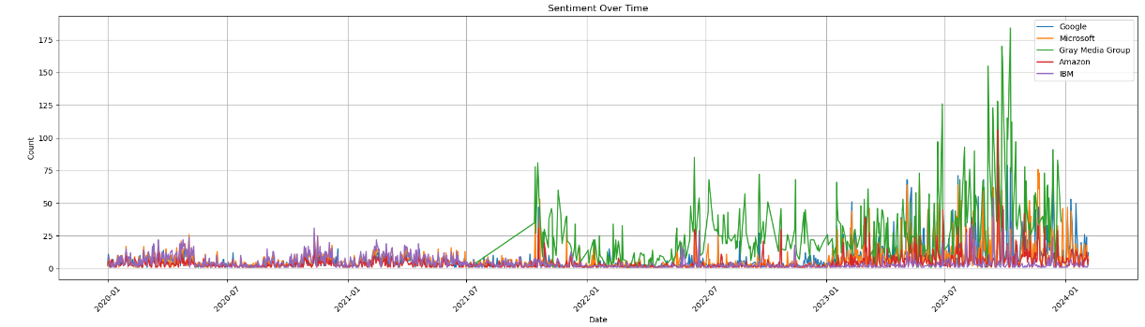
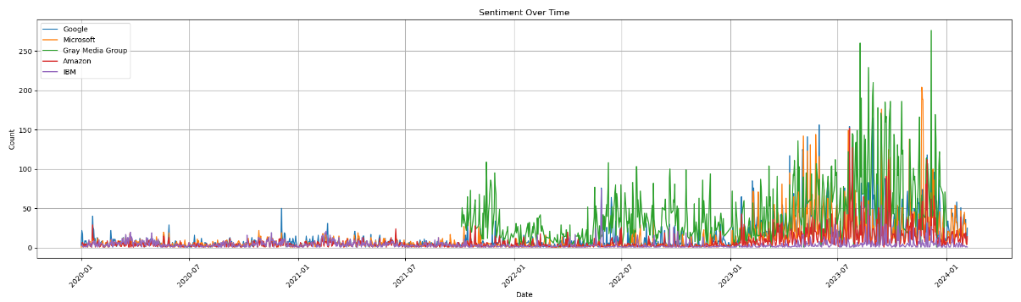
Sentiment of Top 5 Organizations over time
The sentiment graph up to 2024 shows Gray Media Group with fluctuating public sentiment, likely due to impactful corporate events. The positive spikes for IBM could be related to AI advancements, while Gray Media Group’s is due to media technology successes. The negative sentiments might reflect AI regulatory challenges. Google, Microsoft, and Amazon display stable sentiment, attributed to innovations like Google’s Bard, Microsoft’s integration of ChatGPT, and Amazon’s AWS achievements. Occasional negative sentiment spikes across these companies could stem from industry-wide issues like competition and AI regulation debates.
Notes:
Experimented with a couple of models and went ahead with K-Means, an unsupervised clustering model as it is simple, easy to understand and :
1. Clear clusters observed which can help identify distinct customer segments​
2. Seamless integration for assigning segments to new customers, ​demonstrated model's adaptability to diverse data
3. Customer segments can be utilized for curating personalized recommendations for each segment
4. Continuous model refinement can be done to accommodate for evolving customer dynamics

Slide 9
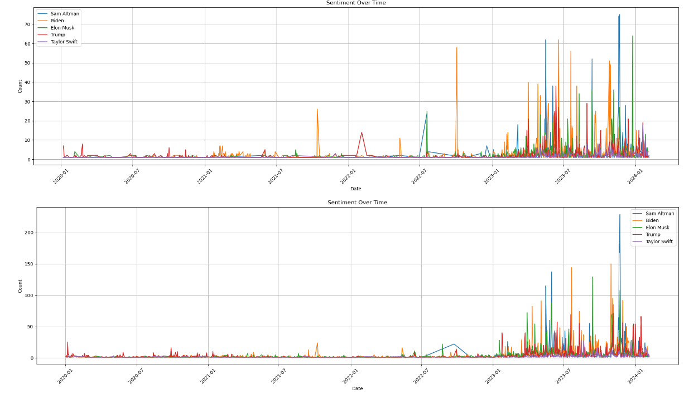
Sentiment of Top 5 Personalities over time
Sam Altman's peaks in positive sentiment align with OpenAI's GPT releases, suggesting approval of their AI advancements. Joe Biden's positive sentiment is linked to election campaigning, indicating favorable responses to his political activities.
Elon Musk's sentiment is dual-faceted: Positive spikes correspond with Tesla's technological progress in autonomous driving, while negative spikes are tied to controversy, particularly his Twitter acquisition, which has drawn substantial criticism. These insights showcase the direct influence of professional milestones and public actions on public sentiment.
Notes:
Experimented with a couple of models and went ahead with K-Means, an unsupervised clustering model as it is simple, easy to understand and :
1. Clear clusters observed which can help identify distinct customer segments​
2. Seamless integration for assigning segments to new customers, ​demonstrated model's adaptability to diverse data
3. Customer segments can be utilized for curating personalized recommendations for each segment
4. Continuous model refinement can be done to accommodate for evolving customer dynamics

Slide 10
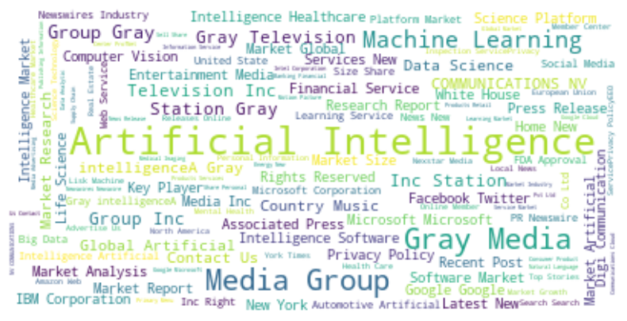
Success Stories of companies investing toward AI – Targeted Positive Sentiment
Companies | Articles
Gray Media Group | 20090
Google | 13370
Microsoft | 12864
IBM | 8742
intelligenceA Gray Media Group Inc Station | 5936
Apple | 4991
Amazon | 4970
Gray Media Group as a dominant force in AI-related media coverage, followed by tech heavyweights like Google, Microsoft, IBM, Apple, and Amazon. These companies' significant roles in AI advancements are evidenced by the frequency of terms like AI, ML and Market which point to the sector's global importance and the technological focus on software and data science. Less prominently, but still importantly, words such as "Research," "Healthcare," and "Financial Service" reflect AI's reach across various industries. The table suggests that Gray Media Group's AI initiatives are most frequently featured in articles, with other tech giants also receiving considerable attention, indicating their influential position in the AI market.
Notes:
Experimented with a couple of models and went ahead with K-Means, an unsupervised clustering model as it is simple, easy to understand and :
1. Clear clusters observed which can help identify distinct customer segments​
2. Seamless integration for assigning segments to new customers, ​demonstrated model's adaptability to diverse data
3. Customer segments can be utilized for curating personalized recommendations for each segment
4. Continuous model refinement can be done to accommodate for evolving customer dynamics

Slide 11
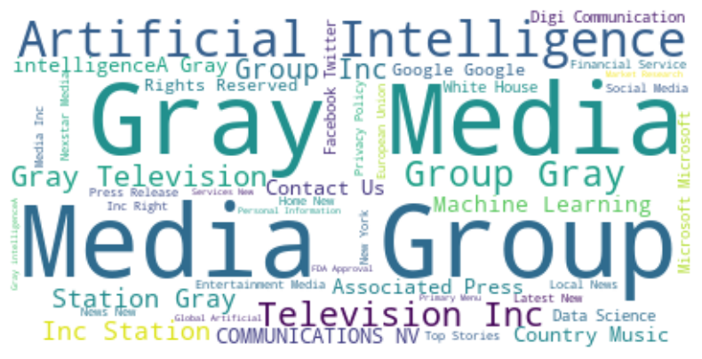
Failure of AI – Targeted Negative Sentiment
Companies | Articles
Gray Media Group | 20090
Google | 29057
Microsoft | 26834
Gray Television Inc | 25142
Amazon | 14416
IBM | 10827
GPT | 10488
The adoption of AI technologies has had an adverse effect on Gray Media and its associated media group companies. Despite their investment in these new technologies, it has not contributed to the companies' success.
AI serves as a support but cannot replace human creativity in areas such as entertainment, art, music, and certain aspects of media, where emotional richness, cultural relevance, and uniqueness are critically important.
Notes:
Experimented with a couple of models and went ahead with K-Means, an unsupervised clustering model as it is simple, easy to understand and :
1. Clear clusters observed which can help identify distinct customer segments​
2. Seamless integration for assigning segments to new customers, ​demonstrated model's adaptability to diverse data
3. Customer segments can be utilized for curating personalized recommendations for each segment
4. Continuous model refinement can be done to accommodate for evolving customer dynamics

Slide 12
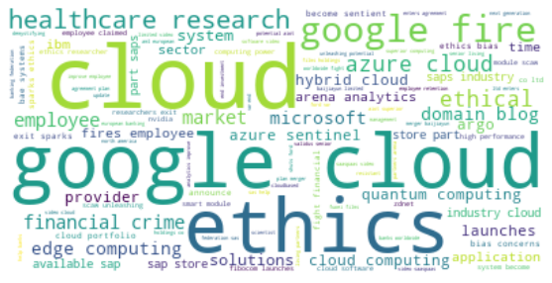
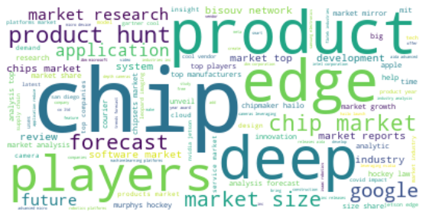
Recommendations and Actionable Insights
To determine the actions to increase success rate of AI project, I analyzed words mostly discussed in Sentiment timelines and made a filter of possible things to improve from negative sentiment and things to be continued from positive articles.
- Invest in R&D for new product innovation using - newer technology like ChatGPT.
- Develop cutting edge technology for market research.
- Improve cybersecurity and maintain ethics using the new tech.
- Promote integrating projects with cloud platforms.
- Boost real-time projects and Healthcare projects.
Improve employee benefits.
Notes:
Experimented with a couple of models and went ahead with K-Means, an unsupervised clustering model as it is simple, easy to understand and :
1. Clear clusters observed which can help identify distinct customer segments​
2. Seamless integration for assigning segments to new customers, ​demonstrated model's adaptability to diverse data
3. Customer segments can be utilized for curating personalized recommendations for each segment
4. Continuous model refinement can be done to accommodate for evolving customer dynamics

Slide 13
THANK YOU

