Slide 1




LIFE CARE
Care you can believe in

Slide 2
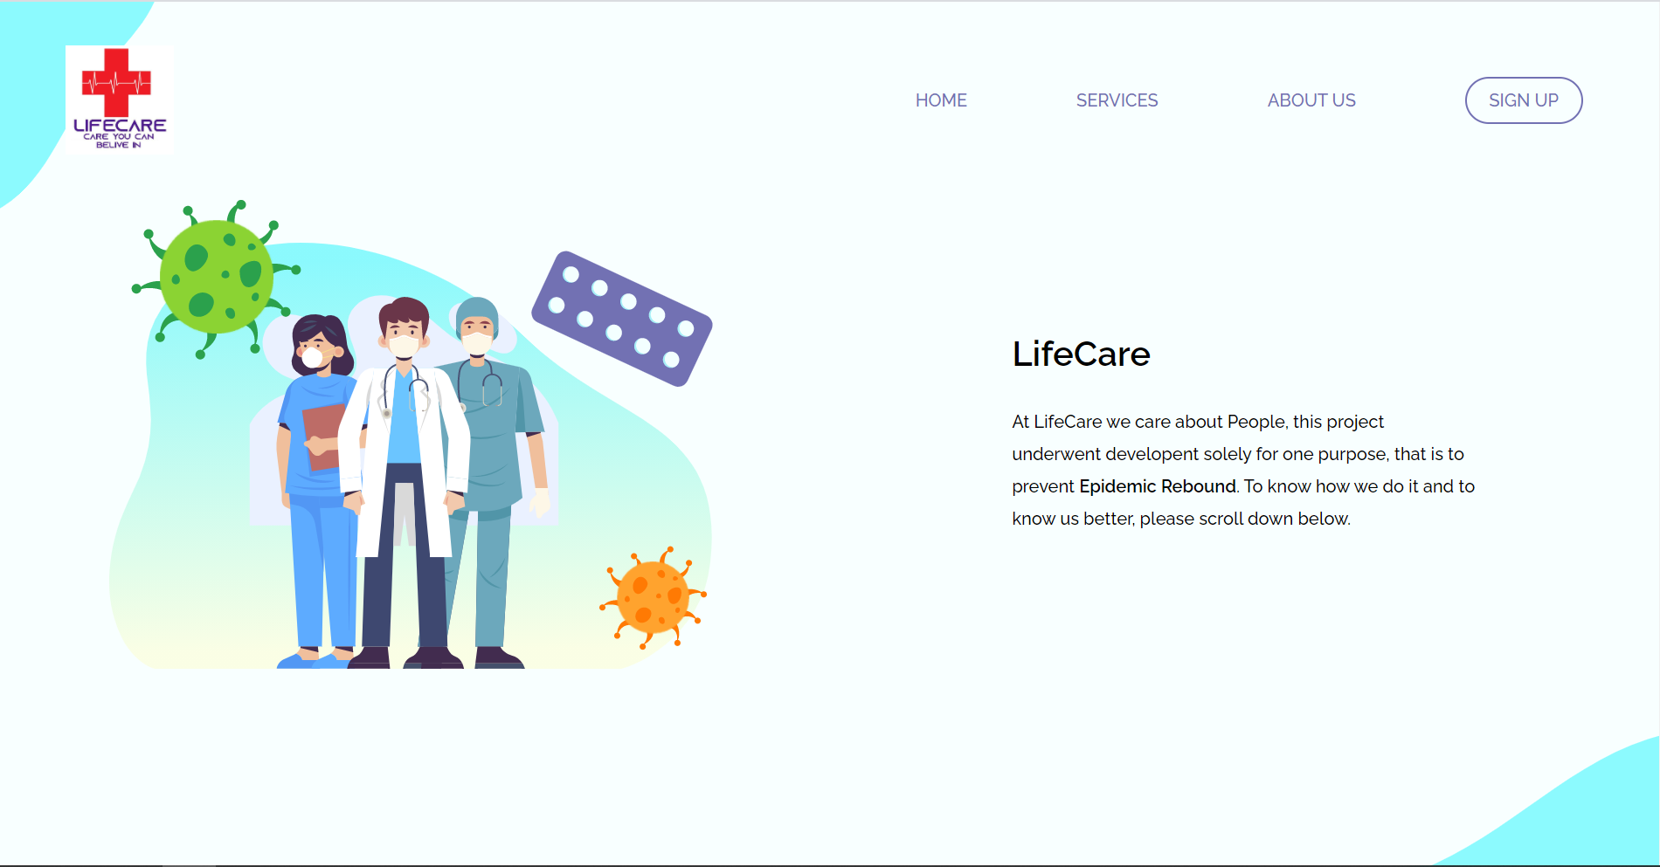
MAIN-PAGE

Slide 3

Online Medical Platform (Lifecare)
Guided by -
Prof. Amar Singh
Submitted by - Rakshit Sharma 1702913086 Rahul Choudhary1702913082 Pahul Kalra 1702913069 Rahul Mishra 1702913083
Presentation No.: 3 Group no. .: G 42
DEPARTMENT OF INFORMATION TECHNOLOGY,
KIET GROUP OF INSTITUTIONS, GHAZIABAD, UTTAR
PRADESH
(AFFILIATED TO DR. A.P.J. ABDUL KALAM TECHNICAL UNIVERSITY,
LUCKNOW, UTTAR PRADESH, INDIA)

Slide 4






Contents
01 ABSTRACT
02 INTRODUCTION
03 FEASIBILITY STUDY
04 OBJECTIVES
05 PLANNING OF WORK
06 TECHNOLOGY
07 USE CASE & DFD
08 REFERENCES

Slide 5
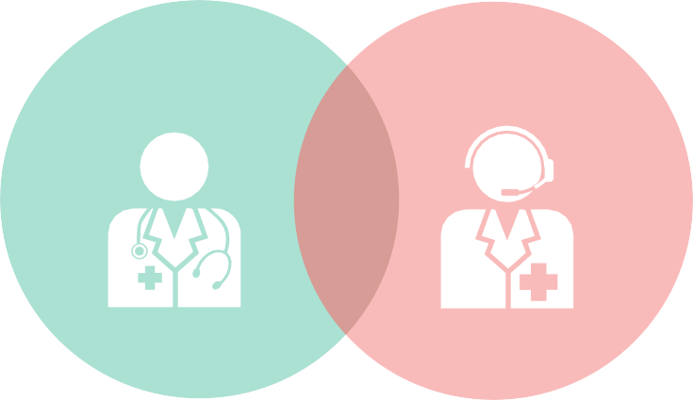
Problem Statement
Why do we use this project?
In our project people can book an appointment with a doctor nearby him/her or even at distance and can have a high-quality video chat with him/her.
This takes care of any physical
meeting or waiting in queues at a
doctor’s premises for hours, or just to travel to his/her premises.
Also to prevent this in the coming future, our platform also informs the user about the ongoing outbreaks in different areas and other diseases that may be spreading at a fast rate.
Our platform tackle this by providing alerts and proper precautions that one may take so that he/she is immune from it.
Keeping the current scenario in mind, we are still feeling the wrath of COVID-19 and it has created a situation where people are scared just to go out and consult doctors even when their health are deteriorating.
People are even scared to go out and buy medicines. Some people are just too busy to go to a doctor and wait in long queues for an appointment.
And during this pandemic we now knew surely that people are aware o technology and use it.
They are not a layman anymore and can adapt to change.

Slide 6

ABSTRACT
Problems
Life is becoming too busy to get medical appointments in person
Maintain a proper health care
Unaware of symptoms and preventions of diseases
Main idea
Provide ease and comfort to patients to consult the doctors on video call
Book appointment for physical meeting if needed
Lifecare contains
Past health reports of the user
Alert the user for ongoing diseases that are most active in the environment so user get aware of symptoms and preventions of that disease
Lifecare suggestions
List of the doctors that are available
Routine checkups remainders
Lifecare facility
Delivers medicines at your doorstep
Ease of appointments

Slide 7

I N T R O D U C T I O N
It is a Web based system where patient can consult and get appointment of doctor easily. The appointment module is an electronic paper less application designed with high flexibility and ease of usage, implemented in single clinics and polyclinics.
The most important thing is to do all these in just few clicks on internet at home or through mobile. This system will take care of your health and doctor consultation and appointment process gets easier
& convenient.
This is a web based application that overcomes the issue of managing and
booking appointments according to user’s
choice or demands.

Slide 8

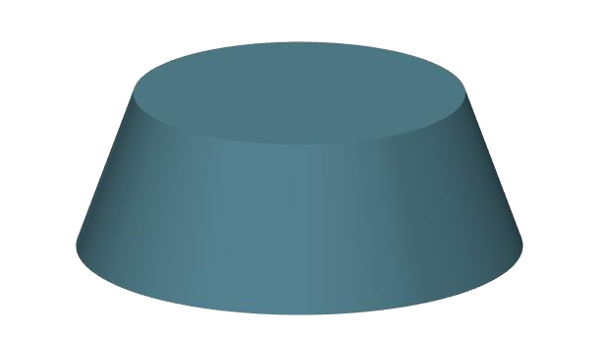
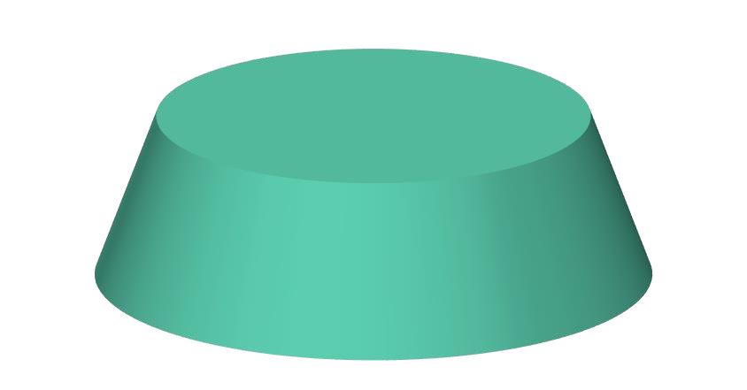


FEASIBILITY STUDY
This is concerned with specifying equipment and Software that will successfully satisfy that user requirements . Technical feasibility is concerned with the availability of hardware and software required for the development of the system . We have use Visual Studio code (1.51) 2020 for designing Front End and SQL Server as Back End.
TECHNICAL
The procedure is to determine the benefit and savings that are expected from the candidate system and compare them with the cost. In this software the cost of Visual Studio 2015 and SQL Server with cost of all efforts given by me like Time and other expenses are included.
ECONOMICAL
The operational feasibility assessment focuses on the degree to which the proposed development projects fits in with the existing business environment and objectives with regard to development schedule, delivery date , corporate culture and existing business processes . In this software we used Images, Site Maps, Navigation tools 2D 3D effects Which makes the software is to operate.
OPERATIONAL

Slide 9
OBJECTIVES
Smart medical consult and booking system that provides patients or any user an easy way
of booking a doctor’s appointment online
Alert the user for ongoing diseases that are most active in the environment so user get aware of symptoms and preventions of that disease
This system will take care of your health and doctor consultation and appointment
process gets easier & convenient.
This application suggest the list of the doctors that are available and user can consult on virtual meet as well as physical if needed
Online Doctor
Lifecare contains all the health report of the user and also give routine checkups remainders.
It gave to facility to deliver the medicines at your doorstep.

Slide 10
PLANNING OF WORK
Complete Backend & Bug fixes and add Additional Features
Optimising and
Upgrading
June 2021
April 2021
Data Gathering, Start Frontend Part
Start Backend Part & optimize front end
Dec 2020
Feb 2021

Slide 11
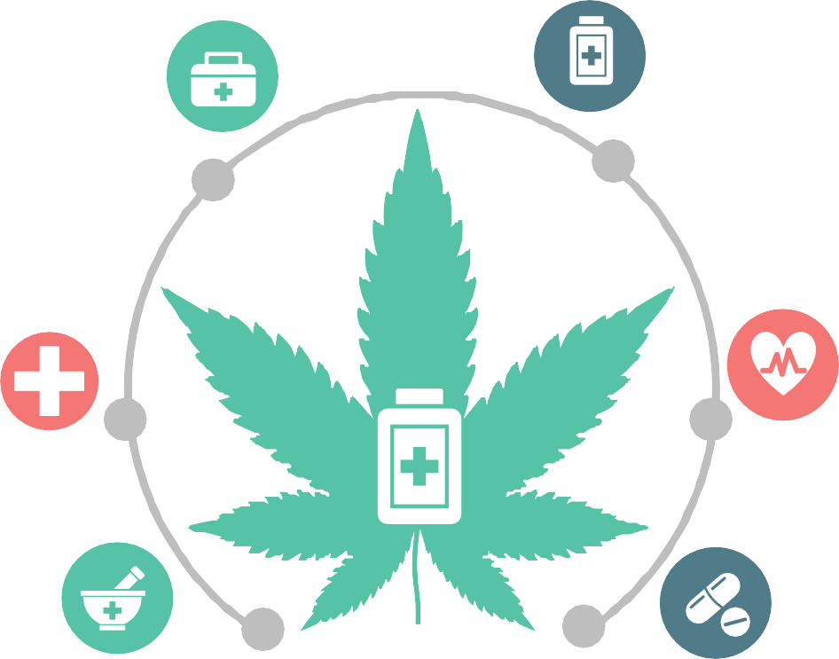
TECHNOLOGY
CSS
Stands for "Cascading Style Sheet." Cascading style sheets are used to format the layout of Web pages. They can be used to define text styles, table sizes, and other aspects of Web pages that previously could only be defined in a page's HTML.
HTML
HTML stands for Hyper Text Markup Language. It is the standard markup language for creating Web pages. It describes the structure of a Web page which consists of a series of
elements. HTML elements tell the browser how to display the content.
PHP
The PHP Hypertext Preprocessor (PHP) is a programming language that allows web developers to create dynamic content that interacts with databases.
PHP is basically used for developing web
based software applications.
JavaScript
JavaScript is a text-based programming language used both on the client-side and server-side that allows you to make web pages interactive. It gives web pages interactive elements that engage a user.
NodeJs
Node.js is an open source, cross-platform runtime environment for developing server- side and networking applications.
Mysql
MySQL is one of the best RDBMS being used for developing various web-based software applications. MySQL is developed, marketed and supported by MySQL AB, which is a Swedish company.

Slide 12
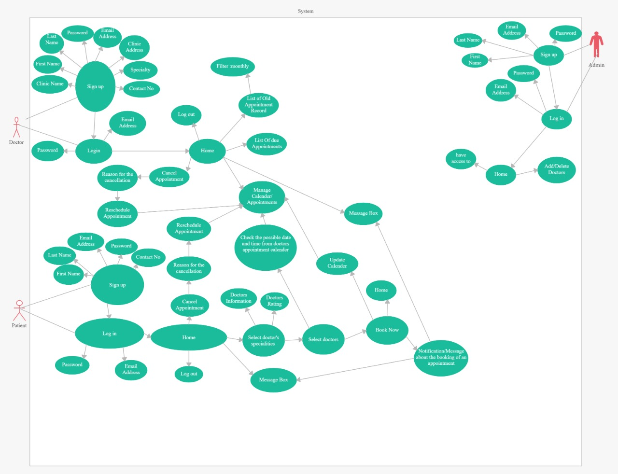
USE-CASE DIAGRAM

Slide 13
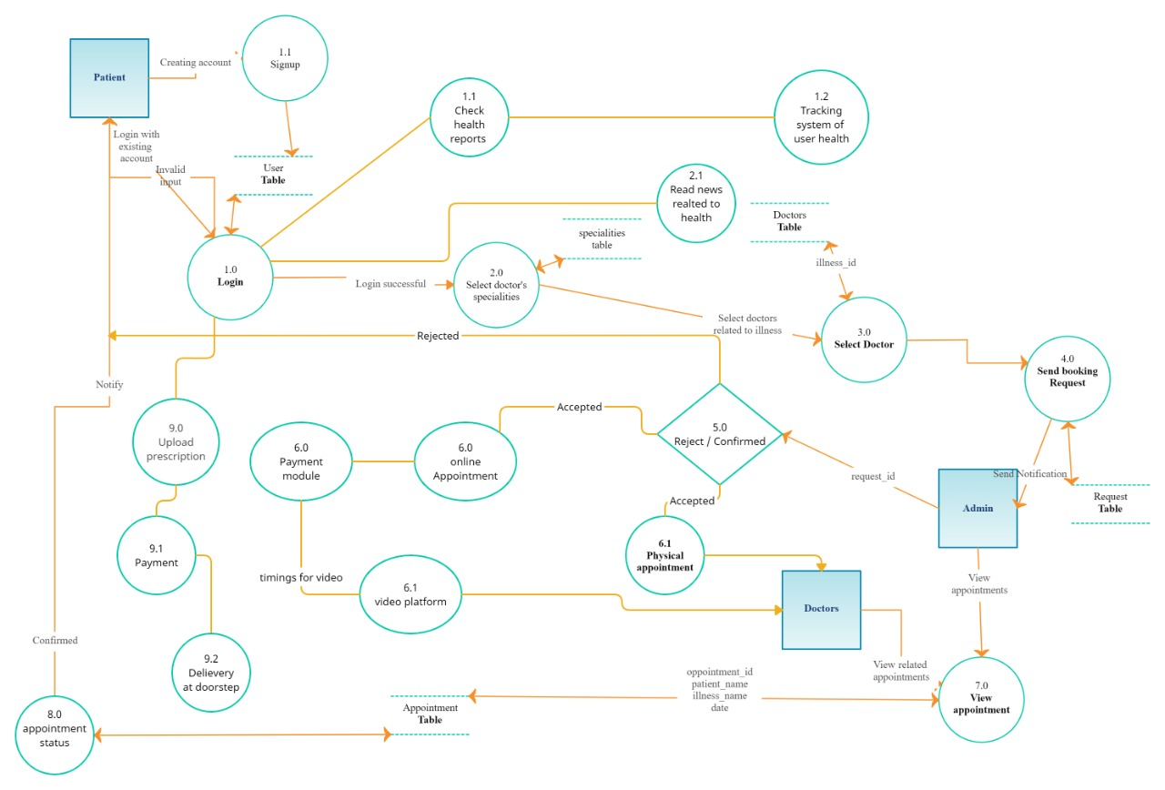
DATA-FLOW DIAGRAM

Slide 14

References
https://www.php.net/docs.php/
https://dev.mysql.com/doc/
https://stripe.com/docs/
https://nodejs.org/en/docs/guides/
https://nodejs.org/dist/latest-v14.x/docs/api/
https://www.w3schools.com/html/html_intro.asp
https://www.w3schools.com/css/default.asp
https://www.w3schools.com/js/default.asp
https://code.visualstudio.com/docs/nodejs/nodejs- tutorial
https://developer.mozilla.org/en-
US/docs/Web/JavaScript
https://www.w3schools.com/bootstrap/bootstrap_ver. asp

Slide 15

References
https://stripe.com/docs/stripe-js
https://www.sitepoint.com/webrtc-video-chat- application-simplewebrtc/
https://pusher.com/tutorials/webrtc-video-call-app- nodejs
https://www.w3schools.com/css/css_rwd_intro.asp
https://www.w3schools.com/css/css_grid.asp
https://www.w3schools.com/php/DEFAULT.asp
https://www.w3schools.com/sql/default.asp
https://www.w3schools.com/sql/default.asp
https://getbootstrap.com/docs/4.1/getting-
started/introduction/

Slide 16


Thank You

