Slide 1


Introduction to Help Hub
The purpose of this search tool application is to facilitate the sharing and discovery of problem statements within a community of users. Registered users can contribute by posting their problem statements, which include descriptions and keywords, and provide valid contact information. These posts can then be searched by anyone using relevant keywords, promoting collaboration and problem-solving within the community.

Slide 2
User Registration and Login
Registration
Login
Security
New users can create an account by providing their username, contact information, password, and department affiliation.
Registered users can log in to their accounts using their credentials to access personalized features and functionality.
Help Hub ensures the privacy and security of user data through robust authentication and authorization mechanisms.

Slide 3
Searching for Posts
1
Keyword Search
2
Personalization
3
View
Users can search for relevant posts by entering keywords related to the topics they're interested in.
Logged-in users can save their search preferences for faster and more personalized access to content.
Posts can be viewed by every user, for creation for posts users need to login.

Slide 4
Technologies Used
JavaServer Pages (JSP): The application was developed using JSP, a technology for building dynamic web pages.
MySQL Database: MySQL is used to store user credentials in the users table and post information in the posts table.
Tomcat Server: The application is hosted on a Tomcat server, configured locally to run offline, eliminating the need for an internet connection.
Client-Side Validation: JavaScript is used to ensure that all forms are validated before being submitted, enhancing the user experience and ensuring data integrity.
Database Design(Mysql Database)
Users Table: Stores user credentials such as username and password, and contact details, with the primary key being user_id.
Posts Table: Stores information about posts, including the problem statement, description, keywords, and contact details, with the primary key being post_id. The foreign key user_id links each post to the user who created it.
Comments Table: Stores information of comments and timestamp.

Slide 5

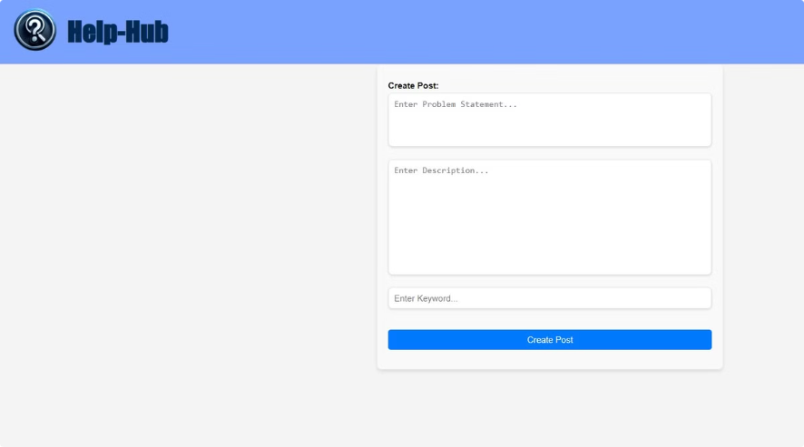
Post Management
Create Posts
Logged-in users can create new posts to share their knowledge and expertise with the Help Hub community.
Delete Posts
Logged-in users have the ability to remove their own posts from the platform if they no longer wish to be displayed.

Slide 6

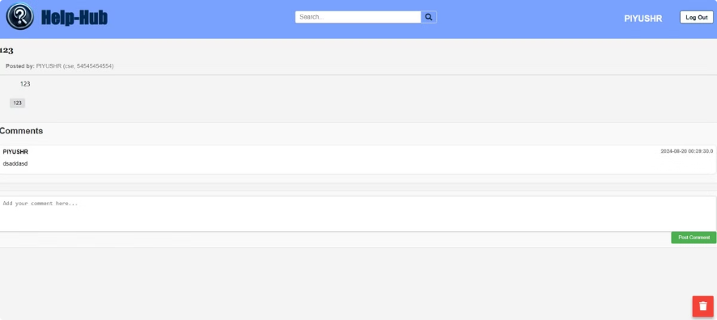
Comments
→Logged-in users can comment under posts. They can add comments under posts after displaying them.
→Non-Logged in users cannot comment under posts. They can view the comments.

Slide 7
Potential Improvements
Advanced Search Filters: Introduce advanced search filters such as date ranges, post categories, and user-specific searches to refine the search experience.
User Analytics Dashboard: Develop a user dashboard providing insights into their activity, such as posts created, comments made, and interaction statistics. This would give users a sense of their contributions and engagement on the platform.
User Moderation Tools: Introduce tools for content moderation, allowing administrators to manage inappropriate posts and comments. This can include features for reporting, flagging content, and admin review.

Slide 8
Future Vision for Help Hub
1. Expansion of Features:
Introduce collaboration tools, such as group discussions and shared workspaces, enabling users to work together on complex issues.
2.Scalability and Performance:
Plan for scaling the infrastructure to handle increased user traffic and data, possibly by migrating to cloud-based solutions.
Implement microservices architecture to improve the platform's scalability, allowing it to handle more concurrent users and feature expansions seamlessly. 3.AI-Driven Enhancements:
Integrate AI-driven chatbots for instant user assistance, guiding them through common queries or directing them to relevant posts

Slide 9
Conclusion
The search tool application developed for BEL is a robust platform that facilitates the sharing and discovery of problem statements within a user community. With secure user registration, login, post creation, and search capabilities, the application is designed to be both user-friendly and functional.
The local configuration on a Tomcat server ensures that the application can operate efficiently in offline environments, making it a suitable solution for BEL's requirements.

