Slide 1

Vertex K Labelling using Algorithmic Approach
Group 4

Slide 2

Introduction
What is Vertex K-labelling?
Vertex k-labelling in graph theory entails assigning labels to vertices, adhering to constraints like unique weights and ensuring the maximum label is within the limit of k.

Slide 3
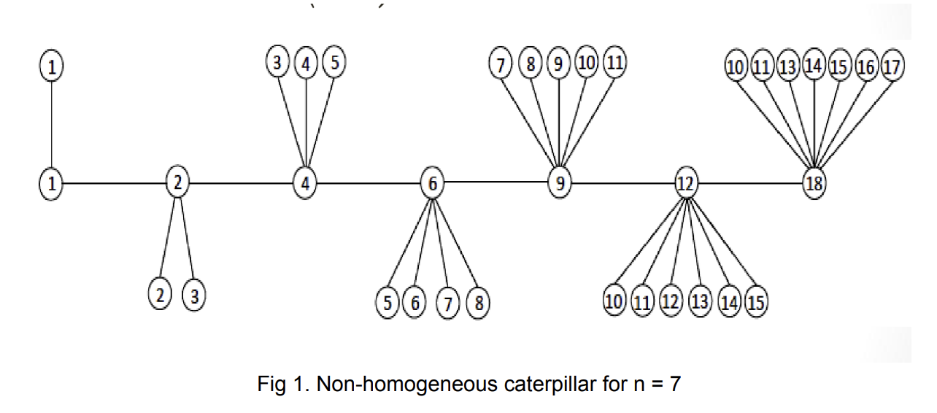
Why this is a non-homogeneous caterpillar?
The graph is non-homogeneous due to inconsistent numbers of connected edges for each root node, disrupting uniformity in its structure.

Slide 4
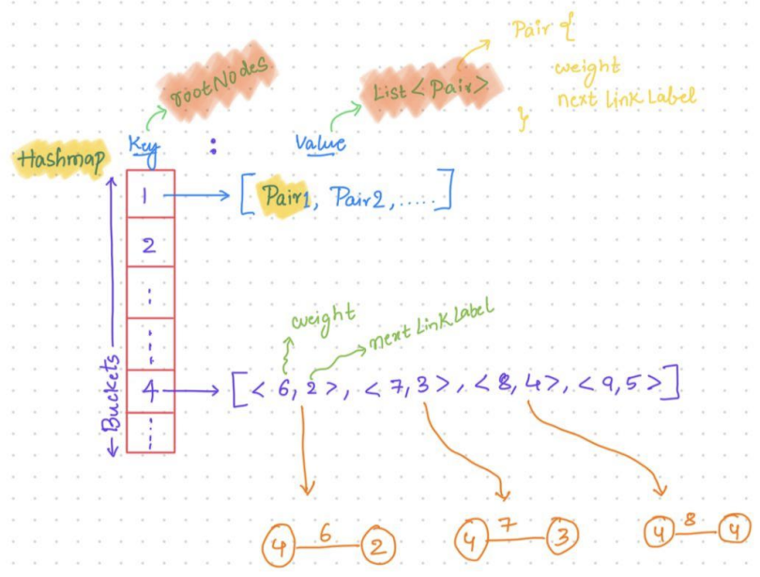
Data structure used to represent/store the graph in memory
Hashmap<Integer,List<Pair>>
Hashmap: The above Graph is represented using a hashmap by using the keys of the hashmap to represent the root vertices of the graph and the values of the hashmap to represent the edges and respective weights of the graph.
Pair: This is a user-defined data structure that holds the next node of the root node with the respective weight.
Why not matrix or Adjacency list?

Slide 5
Conceptual View of the Implemented Algorithm
Objective: Labelling the Edge Irregular Non-homogeneous caterpillar using the concept of Vertex K Labelling.
Base Values: Min Label is 1 and Min weight =2
Approach: Initiated with an initial root node set to 1 and assigned a weight of 2 to its child node, the algorithm follows a linear incrementation of weights, adding 1 at each iteration. Subsequently, the labeling of the next node is determined based on the accumulated weight, ensuring a systematic and sequential progression in the labeling scheme.
Handling Edge Case of Algo: At the final root node, considering the mathematical property to label the root node.

Slide 6
Labelling of Non-Homogeneous Caterpillar using Proposed Approach
N = 7 , T = 35, K = 18
15
14
17
16
18
9
15
16
10
13
33
32
33
4
8
32
11
14
31
31
17
34
19
1
5
18
19
34
3
7
17
11
29
8
10
30
13
35
2
9
16
20
35
7
28
3
6
10
30
29
1
2
4
6
9
12
28
16
21
18
15
4
5
11
27
K value
14
22
26
15
2
3
5
10
12
13
25
8
23
24
14
Out of K Limit
6
11
7
12
13
Achieved a maximum label of 18 within the specified limit K !!!!

Slide 7
Algorithm
LabelingAlgorithm(N)
Start
No of Vertices (V) = N * (N + 3) / 2
Max Label (K) = ceil(V / 2)
Initialize the graph (HashMap) with Root Node as a Key, List of Connected Vertices as Value
Add Root Node 1 to the graph with weight of 2
Initialize weight = 3 , edge Count = 3 , current RootNode = 2
for i : 2 to N
for j : 1 to edge Count
Assign next Link = weight – current Root Node
Create Pair
Graph compute If Absent(current Root Node, k -> new Array List<>()).add(pair)
Weight++
Current Root Node = (i == N - 1) ? K and add pair to hashMap : weight – current Root Node
end
edge Count++
Check if weight is not used

Slide 8
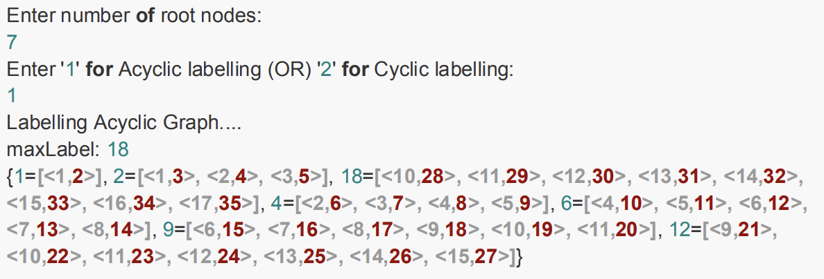
Demo Run Output

Slide 9
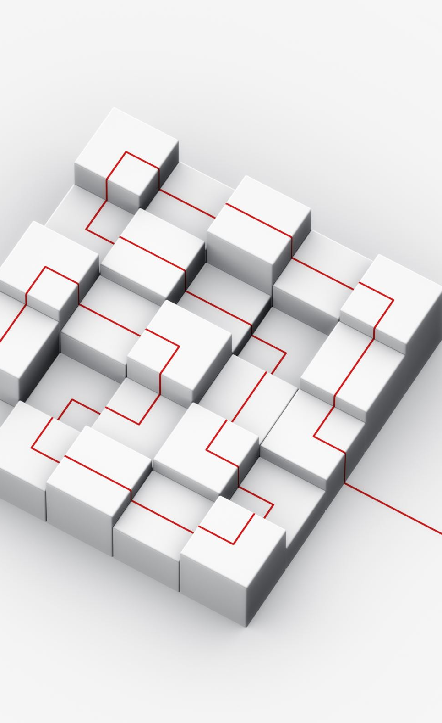
Design strategy
The chosen design strategy is Greedy, where labels are assigned to vertices based on the next available minimum weight, excluding the last root node. The final label for the last root node is then assigned greedily, utilizing the maximum possible label (k).

Slide 10
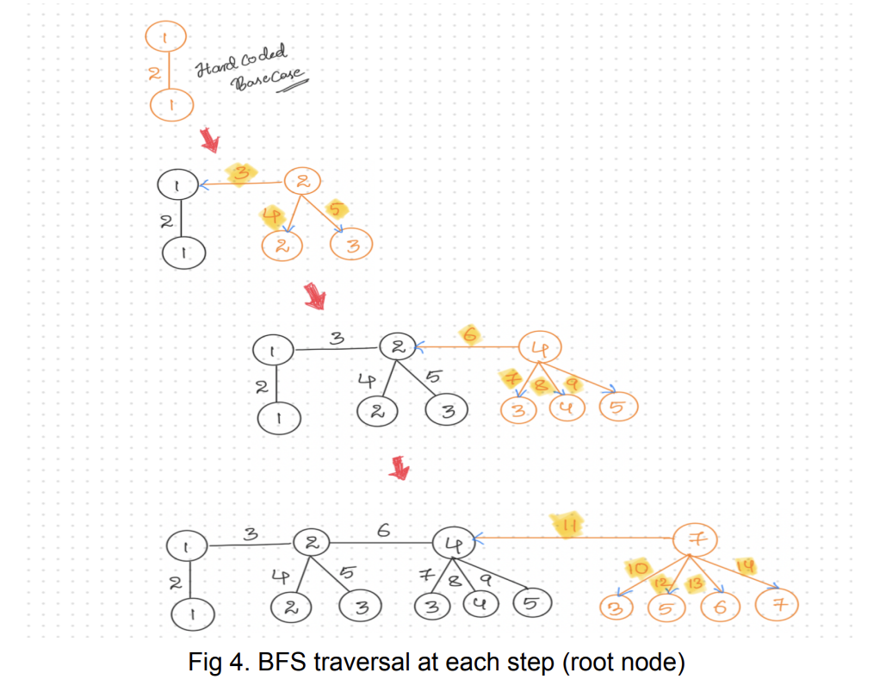
Traversing
The labelling algorithm employs Breadth-First Search (BFS) traversal. It systematically explores and labels the root node along with its child vertices before progressing to the next node, ensuring a comprehensive labelling process until all vertices are accurately labelled.

Slide 11
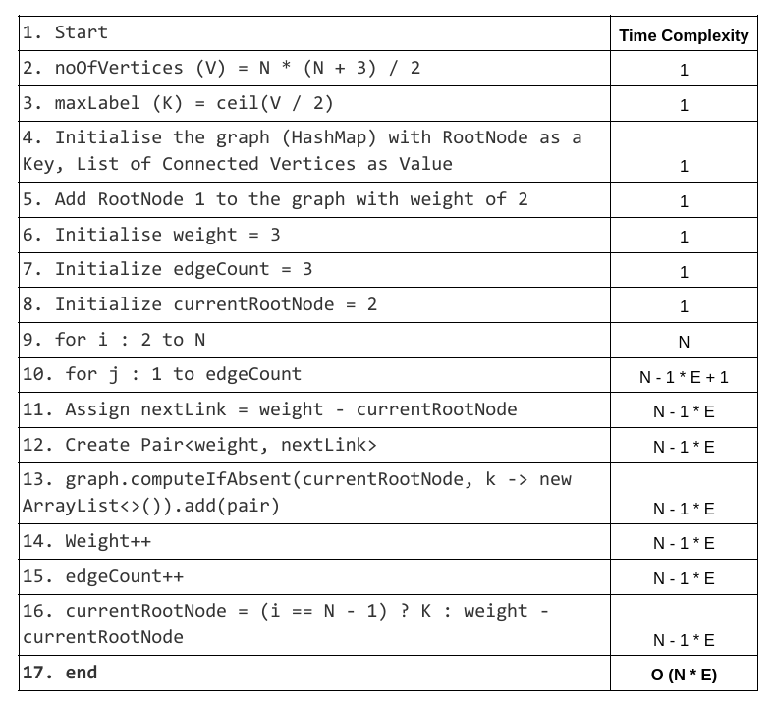
Time Complexity

Slide 12
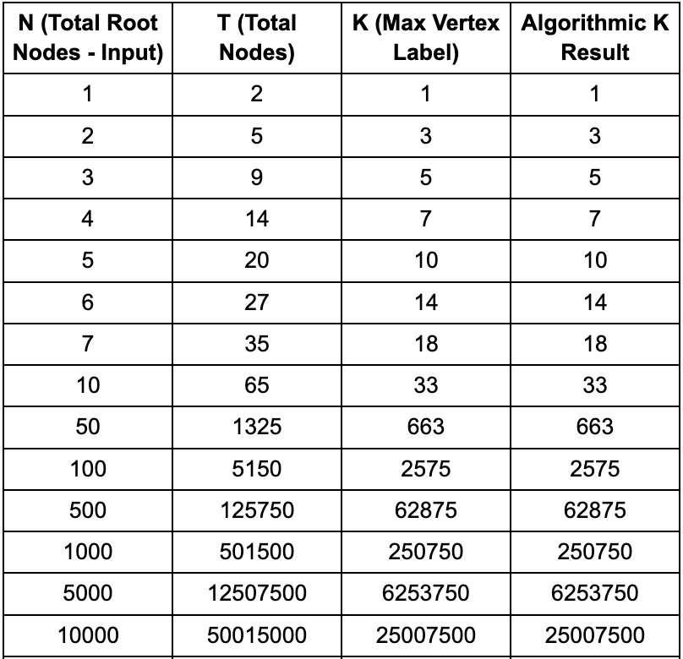
Comparison with Mathematical results

Slide 13
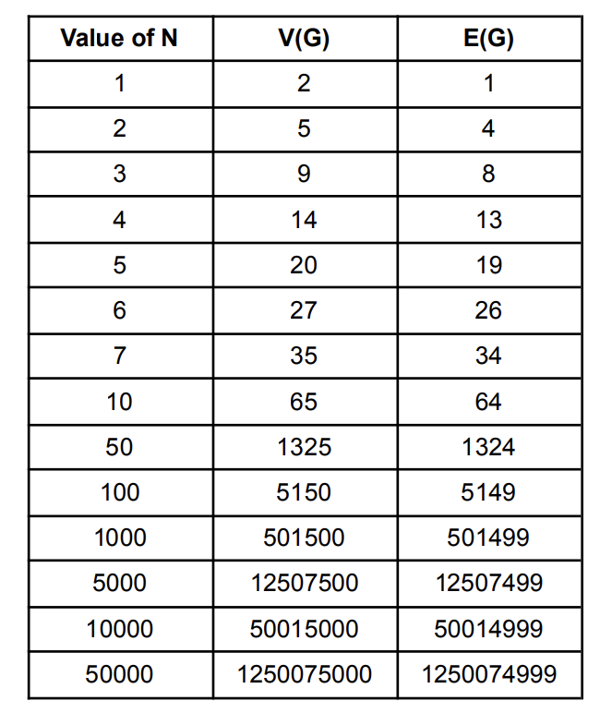
Set of Vertices and Edges

Slide 14

Hardware Scalability
Operating System: Mac OS
OS Chip: M1
RAM: 8 GB
Maximum “N” value we could reach with this algorithm considering above machine hardware specifications and Java Programming Language Internal Memory Constraints is 10500.

Slide 15
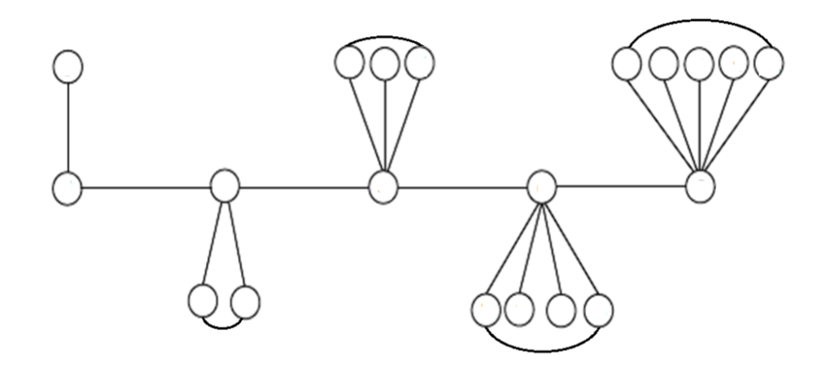
Non-Homogeneous Caterpillar with Cycles
This is the graph with cycles.
To label, weights are maintained unique as primary criteria.

Slide 16

Why K-Limit is violated?
We are violating the K-limit, because of existence of cycles in the graph.
Reason:
To get unique weights, vertices as part of cycles cannot take duplicate labels.
Hence, unique labels are maintained in cycles.
So, it is difficult to fit all the unique values within K.

Slide 17
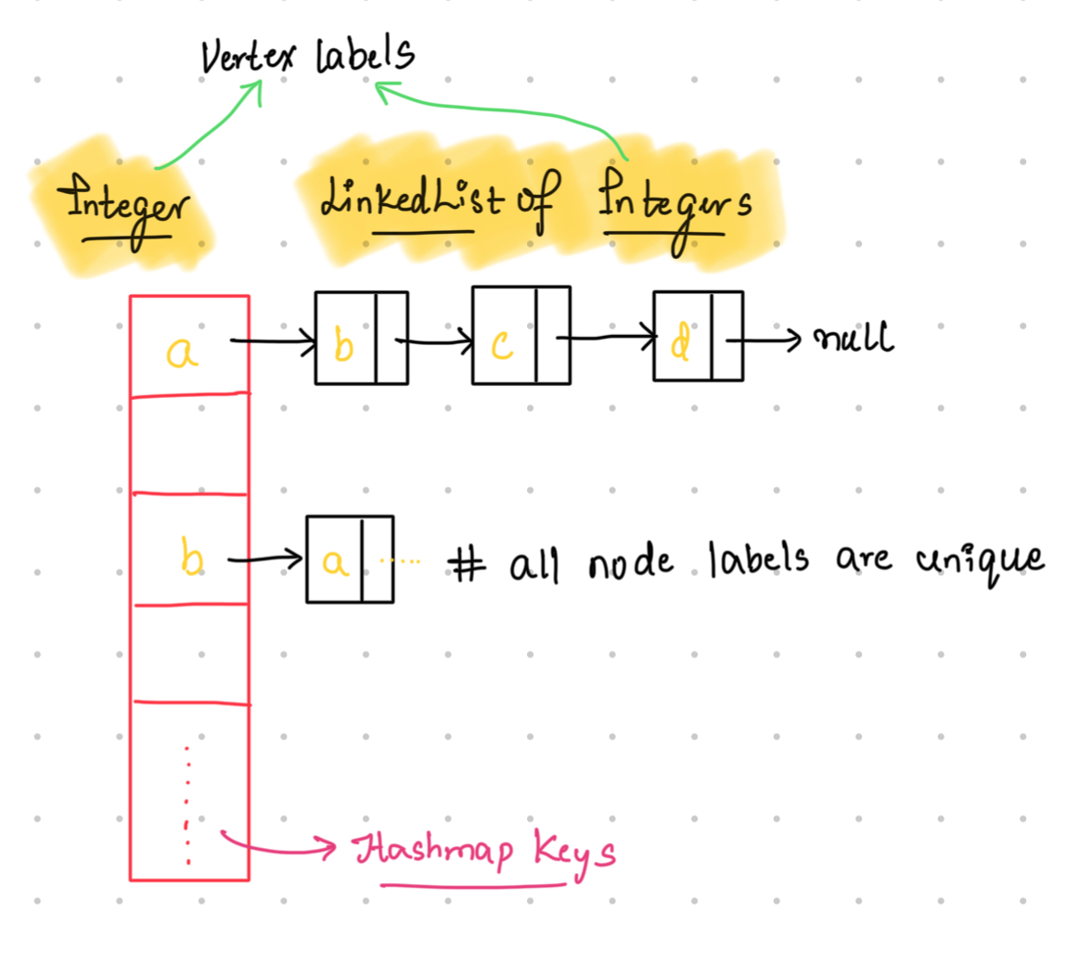
Representation of Graph in Data Structure
Key: Vertex Label (Integer)
Value: LinkedList of Vertex Labels
Advantages:
Space is efficiently used.
Efficient Label Retrieval.

Slide 18
Concept of Cyclic Algorithm
Objective: Labelling the Edge Irregular Non-homogeneous caterpillar with cycles using the concept of Vertex Labelling.
Base Values: Min Label is 1 and Min weight =3
Approach:
Initiated with initial nodes set to 1 and 2 and assigned a weight of 3 to its link.
The algorithm traverses through all the root nodes and its child nodes in an order, then fills the vertex labels and weights.

Slide 19
29
13
Labelling of Cyclic Graph using Proposed Approach
N = 7
74
42
2x+4
38
18
37
21
22
36
39
9
10
20
69
70
71
8
38
39
35
72
40
2
40
23
68
15
2x+2
16
17
2x+3
19
37
3
2x+1
34
67
73
x
41
4
10
19
30
43
58
1
3
7
12
18
25
33
2x +1
7
8
2x+2
x
51
56
4
5
Last Used Weight + 1
26
52
31
25
28
55
26
27
53
54
30
9
27
13
15
16
28
29
2x+3
14
29
57
Achieved Labelling for All Vertices Maintaining Unique edges !!!!

Slide 20
Algorithm
public void labelGraphWithLoops(int rootNodes, HashMap<Integer, LinkedList<Integer>> hashMap){ hashMap.put(1,new LinkedList<>(Arrays.asList(2))); hashMap.put(2,new LinkedList<>(Arrays.asList(1))); int weight=4; int edgeCount=2; int rootNode=1; int i=1, count=0;
while(i<rootNodes) { int j = 0; int prevRootNode=rootNode; rootNode = weight - prevRootNode; hashMap.put(rootNode, new LinkedList<Integer>()); hashMap.get(rootNode).add(prevRootNode); hashMap.get(prevRootNode).add(rootNode); weight = (2 * rootNode) + 1; int leftMostChild=weight-rootNode; hashMap.put(leftMostChild, new LinkedList<>());

Slide 21
Algorithm (Cont..)
while (j < edgeCount) { int child=weight - rootNode; hashMap.get(rootNode).add(child); if(!hashMap.containsKey(child)) hashMap.put(child,new LinkedList<>()); hashMap.get(child).add(rootNode); weight++; j++; } int rightMostChild=weight-rootNode-1; hashMap.get(leftMostChild).add(rightMostChild); hashMap.get(rightMostChild).add(leftMostChild); weight++; edgeCount++; i++; } }

Slide 22
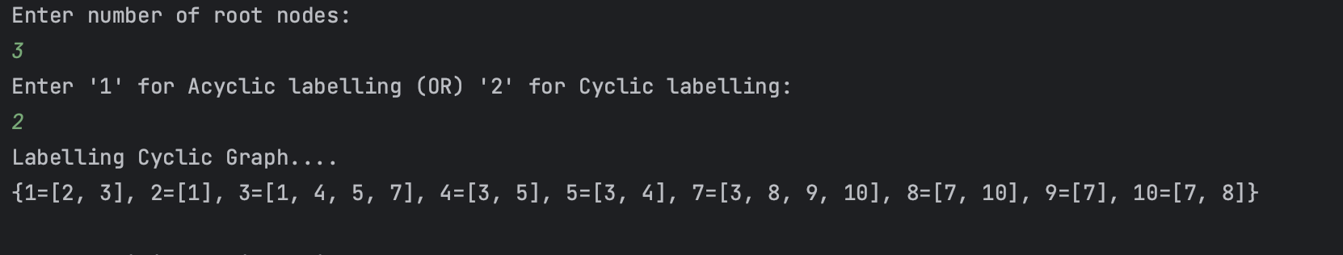
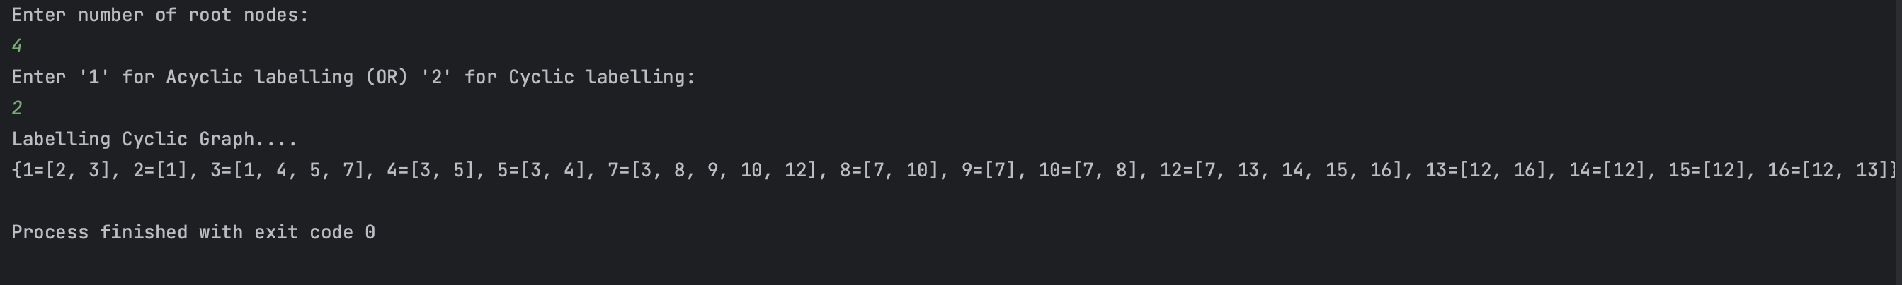
Demo Run

Slide 23
Future scope of the project
A Pair can be eliminated by considering only the label of the connected vertex, because we can anyways add both vertices when we require.
A List can be replaced with LinkedList which efficiently stores since it scatters the nodes across the memory blocks in a non-sequential manner.
Instead of considering Integers as nodes, we could use some objects with id and label which enhances the representation of the graph and interconnects them in a one of the best possible ways.

