Slide 1
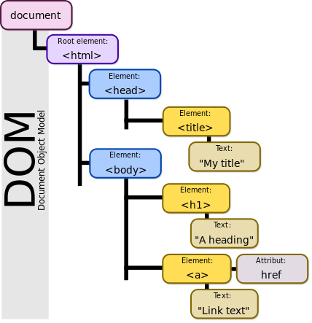
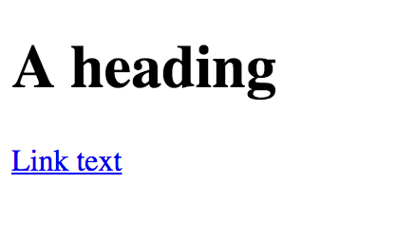
Document Object Model
<! DOCTYPE html>
<html>
<head>
<title> My Title </title>
</head>
<body>
<h1>A heading </h1>
<a href= “websiteLink”>Link text</a>
</body>

Slide 2
Document Object Model
We can see the DOM of any website.
This DOM will allow us to use Javascript to interact with the web page.
The DOM is enormous, most developers won’t use all the properties.
We will cover the common objects used, but be prepared for the unknown!

Slide 3
Document Object Model
Here are some important document attributes:
document.URL
document.body
document.head
document.links

Slide 4
Document Object Model
There are many methods for grabbing elements from the DOM:
document.getElementById()
document.getElementByClassName()
document.getElementsByTagName()
document.querySelector()
document.querySelectorAll()

Slide 5
Document Object Model
Once you have grabbed an element, you can interact with it!
myvariable.style.color (Many CSS options)
myvariable.textContent
myvariable.innerHTML
myvariable.getAttribute()
myvariable.setAttribute()

