Slide 1
Natural Language Processing
-Rahul Nandanwar

Slide 2
Natural Language Processing (NLP)
Natural Language Processing (NLP) is a field of Artificial Intelligence (AI) that makes human language intelligible to machines.
NLP combines the power of linguistics and computer science to study the rules and structure of language and create intelligent systems (run on machine learning and NLP algorithms) capable of understanding, analyzing, and extracting meaning from text and speech.

Slide 3
Why NLP?
There are billions of text data being generated every day.
In-apps messages (WhatsApp, WeChat, Telegram etc.), social media (Facebook, Instagram, Twitter, YouTube etc.), forums (Quora, Reddit etc.), blogs, news publishing platforms, google searches and many other channels.
Because of the large volumes of text data as well as the highly unstructured data source, we can no longer use the common approach to understand the text and this is where NLP comes in.
Human language is astoundingly complex and diverse. Not only are there hundreds of languages and dialects, but within each language is a unique set of grammar and syntax rules, terms and slang.

Slide 4
Advantages of NLP
Perform large-scale analysis - Natural Language Processing helps machines automatically understand and analyze huge amounts of unstructured text data, like social media comments, customer support tickets, online reviews, news reports, and more.
Automate processes in real-time - Natural language processing tools can help machines learn to sort and route information with little to no human interaction – quickly, efficiently, accurately, and around the clock.
Tailor NLP tools to your industry - Natural language processing algorithms can be tailored to your needs and criteria, like complex, industry-specific language – even sarcasm and misused words.

Slide 5
Application of NLP
Search Autocorrect and Autocomplete
Language Translator
Social Media Monitoring
Survey Analysis
Targeted Advertising
Hiring and Recruitment
Voice Assistants
Grammar Checkers
Email Filtering
Auto Reply
Automatic summarization

Slide 6
Common NLP Tasks & Techniques
Tokenization
Part-of-speech tagging
Dependency Parsing
Constituency Parsing
Lemmatization & Stemming
Stop word Removal
Word Sense Disambiguation
Named Entity Recognition (NER)
Text Classification
Sentiment analysis
Syntactic analysis
Semantic analysis

Slide 7
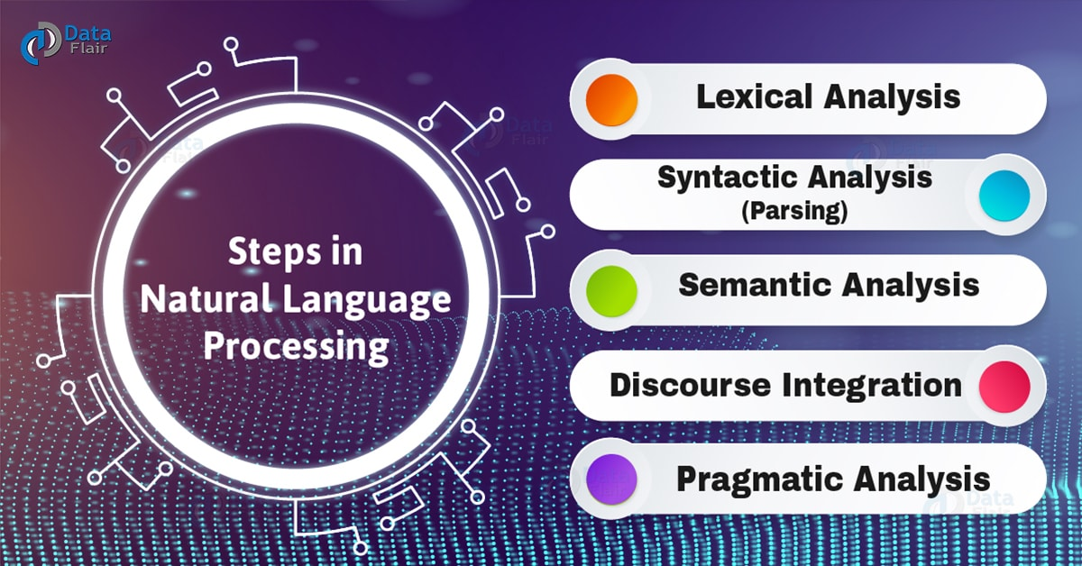
Information Extraction Using NLP Natural Language Processing works on multiple levels and most often, these different areas synergize well with each other.

Slide 8
Lexical analysis –
Morphological - The morphological level of linguistic processing deals with the study of word structures and word formation, focusing on the analysis of the individual components of words. The most important unit of morphology, defined as having the “minimal unit of meaning”, is referred to as the morpheme. Example – word “unhappiness”
Lexical analysis in NLP deals with the study at the level of words with respect to their lexical meaning and part-of-speech. This level of linguistic processing utilizes a language’s lexicon, which is a collection of individual lexemes.
A lexeme is a basic unit of lexical meaning; which is an abstract unit of morphological analysis that represents the set of forms or “senses” taken by a single morpheme.
“Duck”, for example, can take the form of a noun or a verb but its part-of-speech and lexical meaning can only be derived in context with other words used in the phrase/sentence.
This, in fact, is an early step towards a more sophisticated Information Retrieval system where precision is improved through part-of-speech tagging.

Slide 9
Syntactic Analysis - The part-of-speech tagging output of the lexical analysis can be used at the syntactic level of linguistic processing to group words into the phrase and clause brackets. Syntactic Analysis also referred to as “parsing”, allows the extraction of phrases which convey more meaning than just the individual words by themselves, such as in a noun phrase.
In Information Retrieval, parsing can be leveraged to improve indexing since phrases can be used as representations of documents which provide better information than just single-word indices. In the same way, phrases that are syntactically derived from the query offers better search keys to match with documents that are similarly parsed.

Slide 10
Semantic Analysis - The semantic level of linguistic processing deals with the determination of what a sentence really means by relating syntactic features and disambiguating words with multiple definitions to the given context. This level entails the appropriate interpretation of the meaning of sentences, rather than the analysis at the level of individual words or phrases.
In Information Retrieval, the query and document matching process can be performed on a conceptual level, as opposed to simple terms, thereby further increasing system precision.

Slide 11
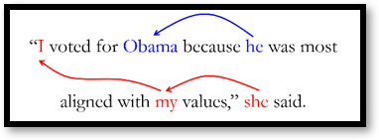
Discourse Integration - The discourse level of linguistic processing deals with the analysis of structure and meaning of text beyond a single sentence, making connections between words and sentences. At this level, Anaphora Resolution is also achieved by identifying the entity referenced by an anaphor (most commonly in the form of, but not limited to, a pronoun). An example is shown below.

Slide 12
Pragmatic - The pragmatic level of linguistic processing deals with the use of real-world knowledge and understanding of how this impacts the meaning of what is being communicated. By analyzing the contextual dimension of the documents and queries, a more detailed representation is derived.
In Information Retrieval, this level of Natural Language Processing primarily engages query processing and understanding by integrating the user’s history and goals as well as the context upon which the query is being made. Contexts may include time and location.

