Slide 1

Ecommerce Olist Store

Slide 2
About Olist
eCommerce enablement platform like Shopify
Data collection from its partner online storefronts
Trusted provider of eCommerce solutions
Notes:
Olist is a Brazilian startup that operates in the e-commerce segment through several marketplaces
On the one hand, olist concentrates sellers who want to advertise on marketplaces such as Amazon.
On the other hand, it concentrates the products of all sellers in a single store that is visible to the final consumer.

Slide 3
Project Aim
Building Metrics to gauge customer lifetime value (CLV)
Monthly product sales performance
Future sales predictions
Notes:
Customer lifetime value (CLV) is a measure of the total income a business can expect to bring in from a typical customer for as long as that person or account remains a client.

Slide 4
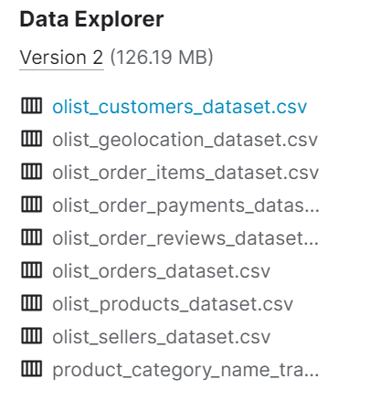

Data
Datasets: 11
Total Rows: 540,357
Total Features: 70

Slide 5
Data Cleaning & Preprocessing
Removed duplicate rows
Added sales column ( quantity * price )
Removed rows for categorical variables having null values
Joined and Merged relevant datasets to perform EDA and Machine Learning
Notes:
In order to create a reliable dataset, we need to clean data to remove errors & duplicate data
This improves the quality of the training data for analytics and enables accurate decision-making.

Slide 6
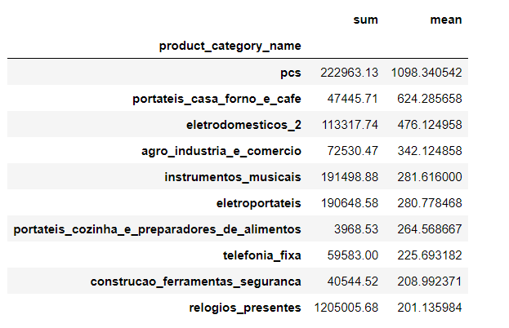
EDA
Merged order items and raw product files on the product id column.
We grouped by product category to see how many orders we have per product category

Slide 7
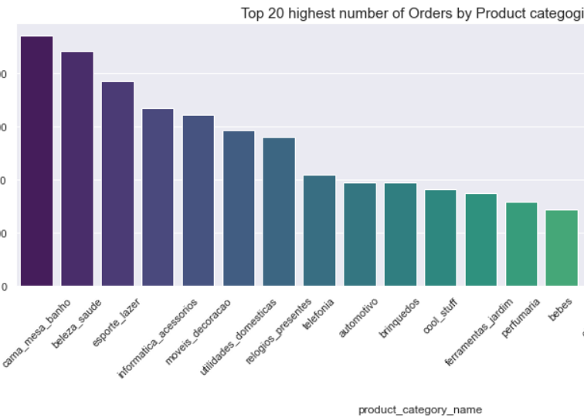
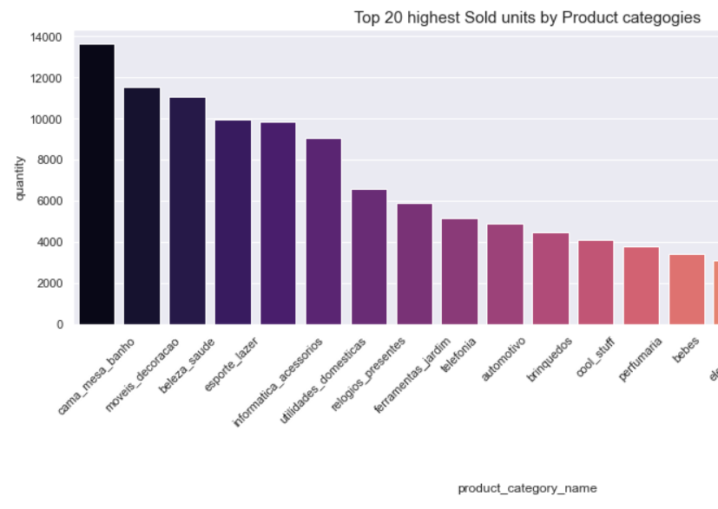
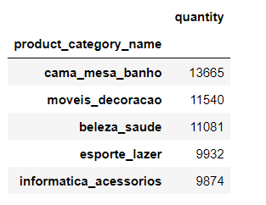
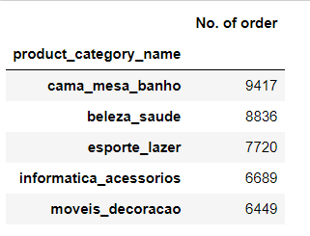
Product Category Performance
Notes:
Cama_mesa_banho: Bed tables and bath

Slide 8
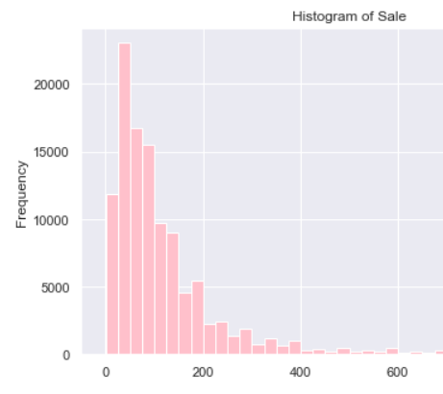
Product Repeat Sales
This visualization tells us what product categories are performing well
The product categories that we should focus on: casa_construcao', 'cool_stuff', 'eletronicos', 'beleza_saude', 'cama_mesa_banho'

Slide 9

Fulfillment
Next, we want to see whether the delivery period can affect the preference of the customers.
For this, we focused on two new columns:
'Actual Delivery time' (No of days it took for the order to be delivered)
'Estimated Delivery time' (No of days that were estimated for the order to be delivered)

Slide 10
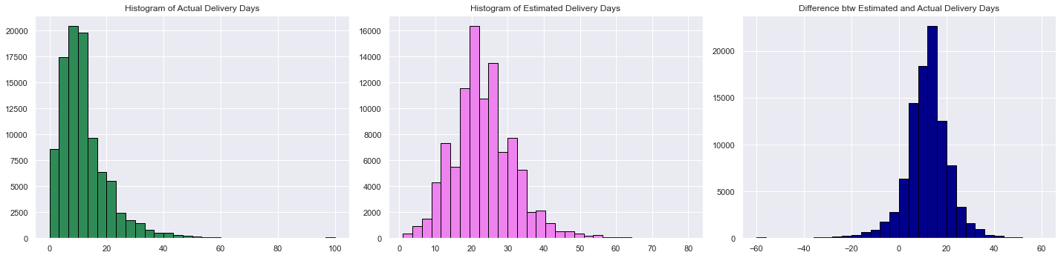
Logistics efficiency analysis

Slide 11
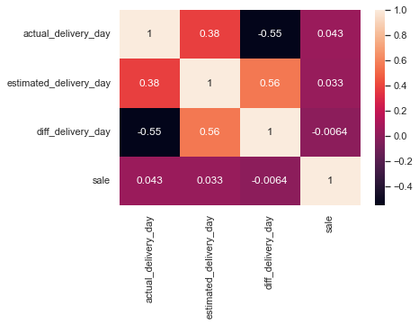
Delivery Date correlation to Sales Frequency
Delivery expectations vs actual arrival
Expected a strong correlation to frequency of sales
No strong pattern was observed
Required us to reach out for different options

Slide 12
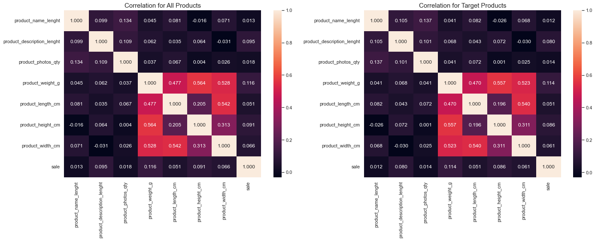

Slide 13
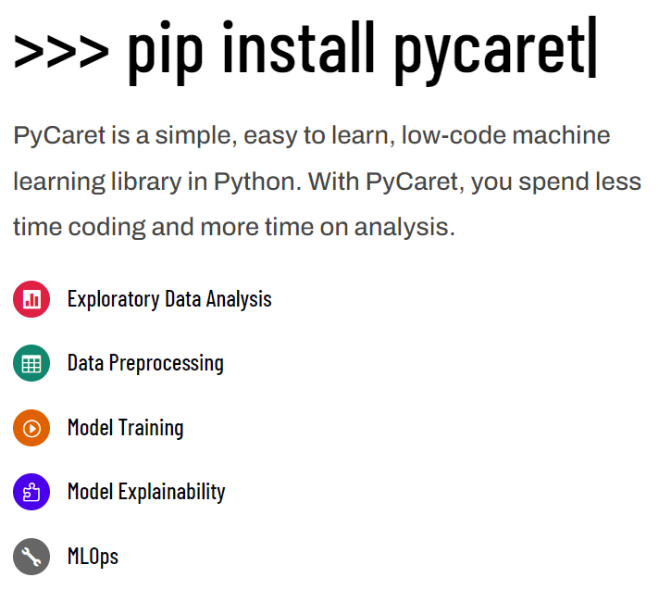
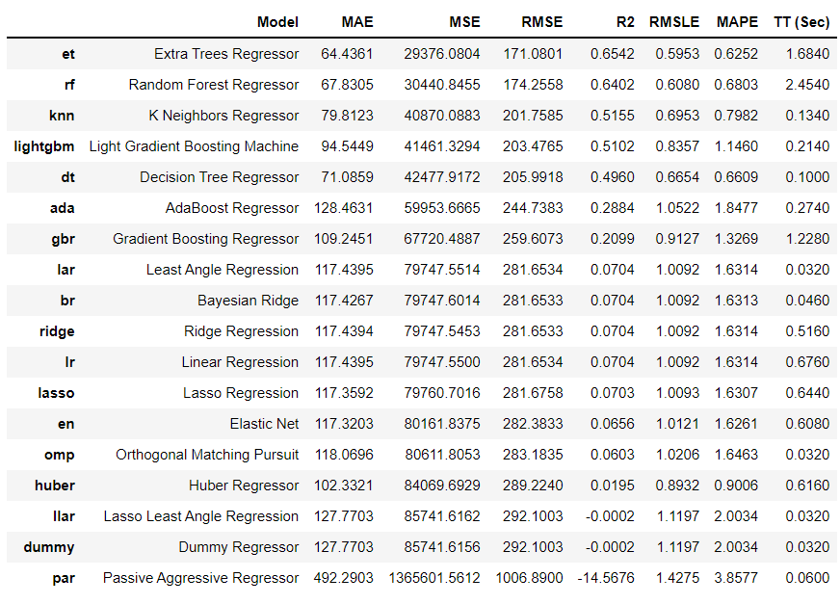
PyCaret

Slide 14
Customer Lifetime Value
In marketing, customer lifetime value (CLV or often CLTV), lifetime customer value (LCV) a prognostication of the net profit contributed to the whole future relationship with a customer Lifetime Value: Total Gross Revenue - Total Cost Since total purchases by each customer is not given, we take Revenue as the life time value of the customer
In order to get LTV, we have performed RFM Analysis on the dataset.
Frequency - Number of purchase made
Recency- Days from last purchase
Monetary- total amount purchase for by a customer

Slide 15
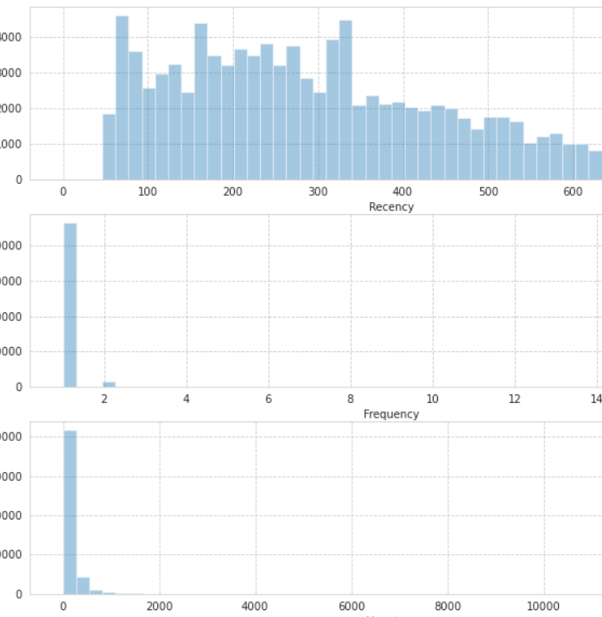
Distribution Plot

Slide 16
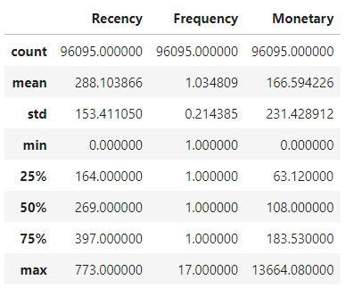
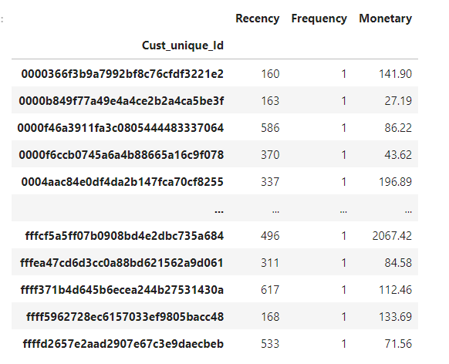
Recency plot implies that lot customer re-buy items between 100-300 days.
Frequency plot signifies that >95% of customers makes a single purchase while ordering
Monetary plot implies that usually, customer’s makes a purchase of 160

Slide 17
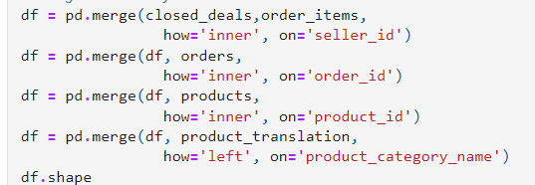
Sales Performance Overview What has performance been monthly? What are the best-selling categories?
Grouped Sales by month to observe monthly product category performance

Slide 18
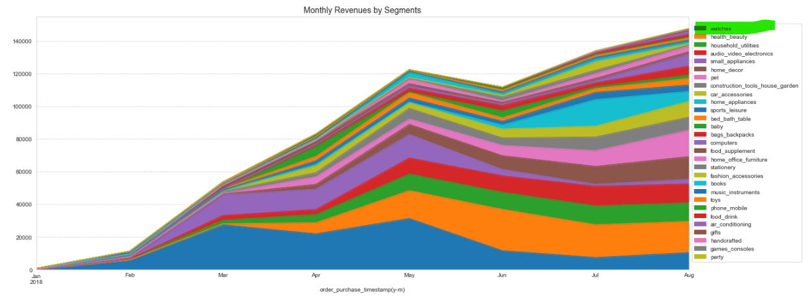
The graph shows that watches is the category with largest peak monthly revenue. Total revenues across 29 segments came in at 664,858. The biggest segment was 'watches', which generated 17.4% of total revenues (115,901), followed by health_beauty.

Slide 19
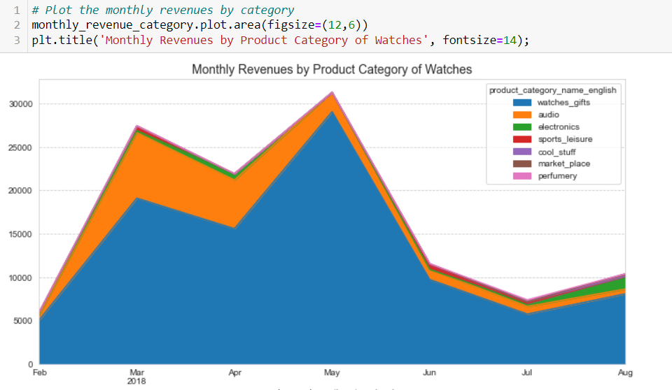
'watches_gifts' category generated most of total revenue of segment. 'watches_gifts' revenue soared in March and reached its peak in May. This category seems a seasonal item.

Slide 20
ARIMA
Auto-Regressive Integrated Moving Average
uses observations from previous steps as input to predict the next time step.
It fits a function to the provided data, eliminating seasonal factors.
MA- Moving average is a key factor in predicting trends in time series

Slide 21
AR - Autoregression is a time series model that uses observations from previous time steps as input to the regression equation to predict the value at the next time step. The “I” stands for integrated, which means it observes the difference between static data values and previous values. The goal is to achieve stationary data that is not subject to seasonality. MA- Moving average which is also called as rolling mean. Here we calculate the simple average in a particular time frame and dividing it with the total number of time frames taken.
Auto-Regressive Integrated Moving Average
uses observations from previous steps as input to predict the next time step.
It fits a function to the provided data, eliminating seasonal factors.
MA- Moving average is a key factor in predicting trends in time series

Slide 22
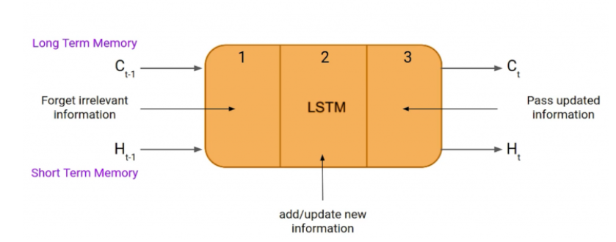
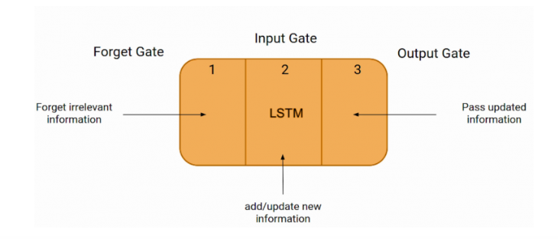
LSTM
LSTM (Long Short-Term Memory) is a Recurrent Neural Network (RNN) based architecture trained using Backpropagation through time.
H(t-1): Hidden state of the previous timestamp
H(t): Hidden state of the current timestamp. In addition to C(t-1) and C(t) : Represents LSTM cell state.
Forget Gate : Chooses whether info coming from the previous timestamp is to be remembered or is irrelevant.
Input Gate: The cell tries to learn new information from the input to this cell.
Output Gate: The cell passes the updated information from the current timestamp to the next timestamp.

Slide 23
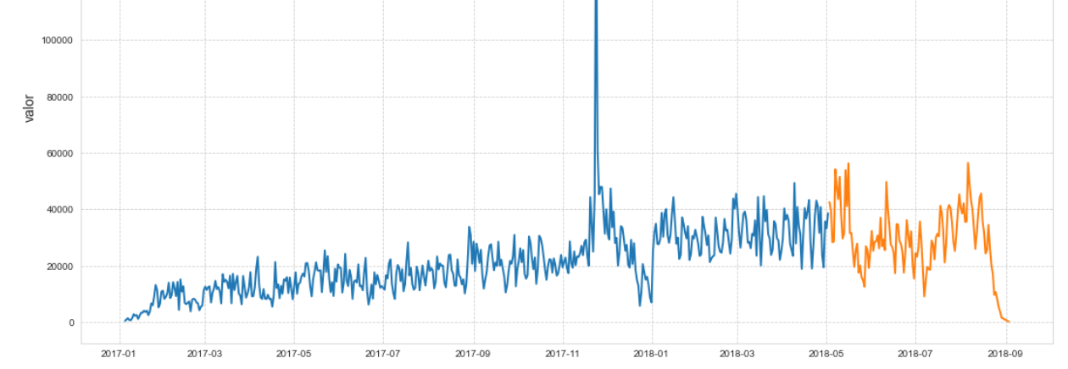
Train-Test Split for Time Series
Here we did the time series analysis on the amount of sales done by Olist.
Methodology:
- Divide the dataset into 2 sets training/test with 80% and 20% ratio
Arima Models / Use LSTM NN for future prediction. Predictions were made on the testing dataset

Slide 24
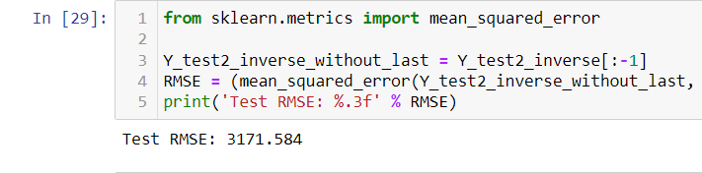
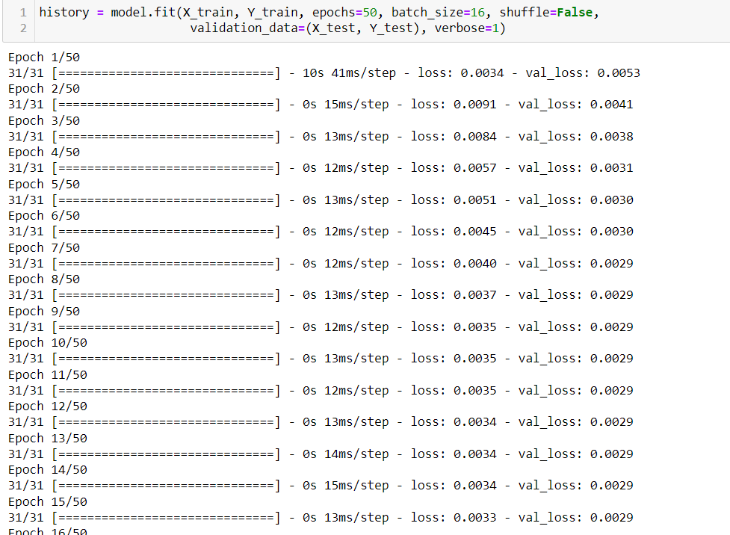
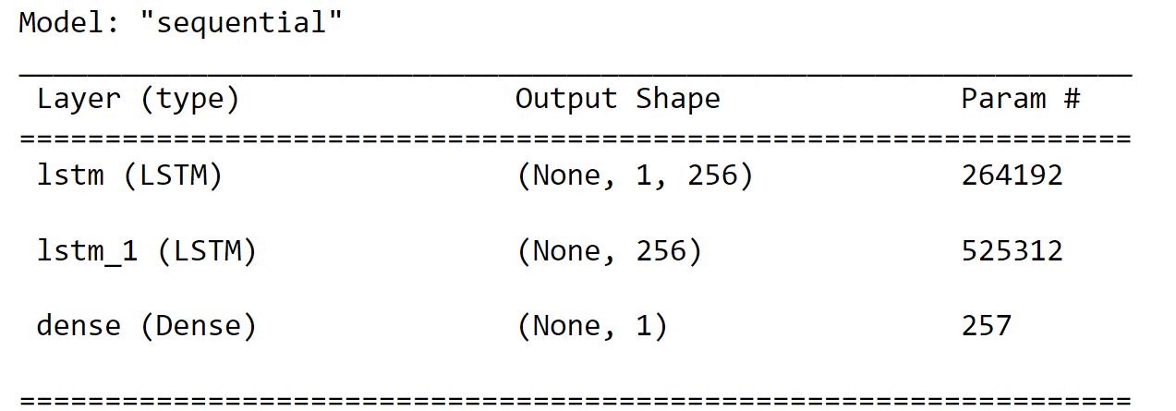
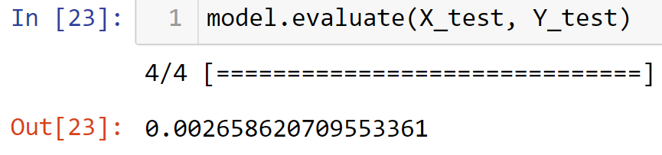
ARIMA Performance

Slide 25
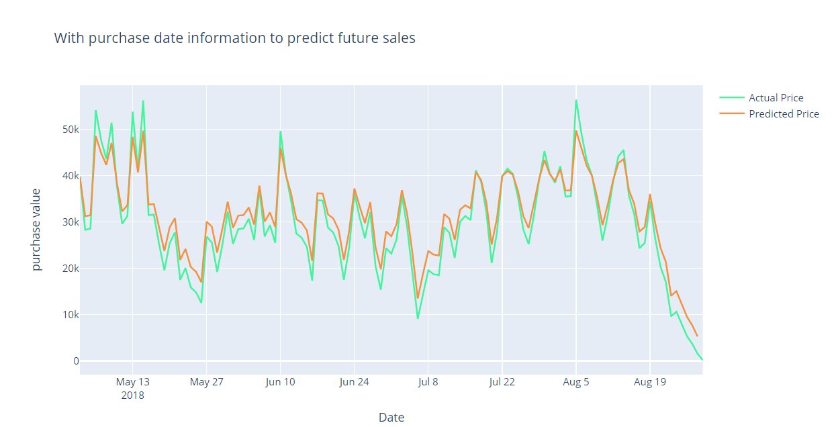
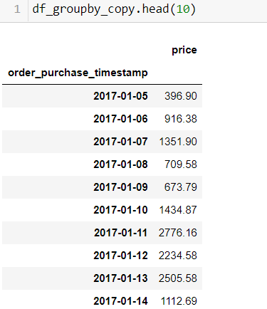

Slide 26
Conclusion
Low correlation of dataset features required a different approach
Grouped by Seller_ID and identified major sellers to find their customer lifetime value
Using ARIMA framework with an added LSTM layer to accurately forecast trends in Sales data. Loss observed was 0.0026
This model can be used to predict ecommerce sales trends in Brazil

Slide 27

Thank You

