Slide 1

COMPUTER NETWORK
Computer network is a connection between two or more computer for exchange data. Computer network Connection may be wired or wireless.
LAN (LOCAL AREA NETWORK)- computer network that interconnects computers within a limited area such as a residence, school, laboratory, or office building.
WAN (WIDE AREA NETWORK) A computer network that interconnects computers within large geographical area. Typically, a WAN consists of two or more local-area networks (LANs). Computers connected to a wide-area network are often connected through public networks, such as the telephone system. They can also be connected through leased lines or satellites. It is a wireless computer network.
MAN (MATROPOLITAN AREA NETWORL) It is a computer network larger than a local area network, covering an area of a few city blocks to the area of an entire city, possibly also including the surrounding areas.

Slide 2
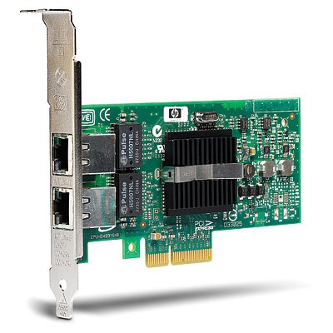
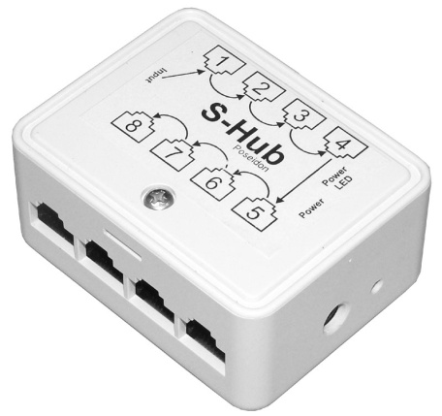
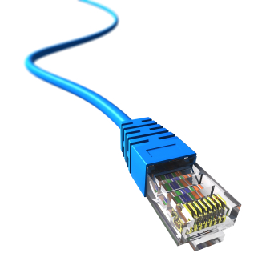
BASIC NETWORK DEVICES
NIC (Network Interface Card)- A network interface card is a computer hardware component designed to allow computers to communicate over a computer network. Example Ethernet port and Wi-Fi.
HUB- A network hub is a device that allows multiple computers to communicate with each other over a network. It has several Ethernet ports that are used to connect two or more network devices together. Each computer or device connected to the hub can communicate with any other device connected to one of the hub's Ethernet ports.
Networking cables - It is used to connect one network device to other network devices or to connect two or more computers to share printer, scanner etc. Different types of network cables like Coaxial cable, Optical fiber cable, Twisted Pair cables.

Slide 3
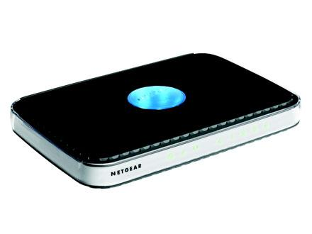
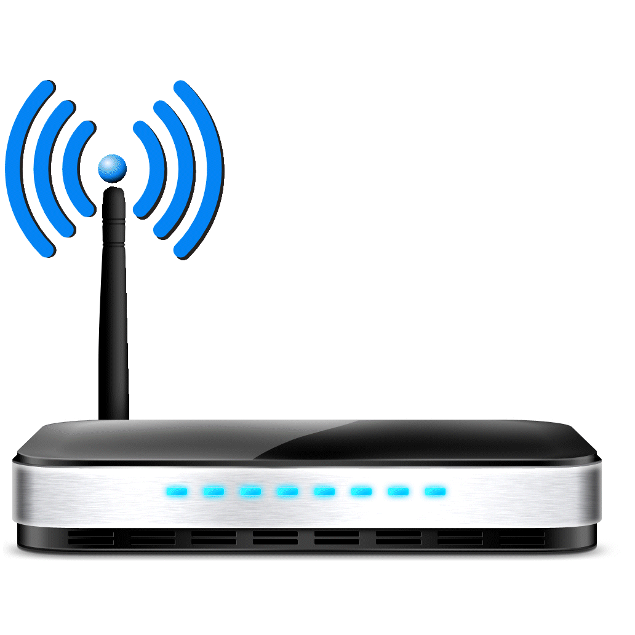
Router
A router is a computer whose software and hardware are customized to move data between computer networks. They are responsible for making sure traffic between computers gets where it needs to go. They do this by choosing the shortest path between the computers using a complicated system of rules called Routing Protocols.
Broadband Routers
Broadband routers can be used to connect computers
or to connect to the Internet.
Wireless Routers
Wireless routers create a wireless signal in your home or office. So, any PC within range of Wireless routers can connect it and use your Internet.

Slide 4
IP(INTERNET PROTOCOL)
An Internet Protocol address (IP address) is a numerical label assigned to each device (e.g., computer, printer) participating in a computer network that uses the Internet Protocol for communication. An IP address serves two principal functions: host or network interface identification and location addressing. Every computer has an unique IP address.
192.168.1.25
NETWORK ADDRESS
HOST ADDRESS

